Slide 1
CS 2104 – Prog. Lang. Concepts
Logic Programming - II
Dr. Abhik Roychoudhury
School of Computing

Slide 2
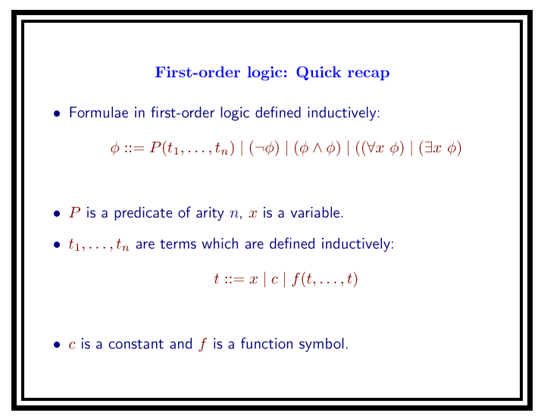

Slide 3
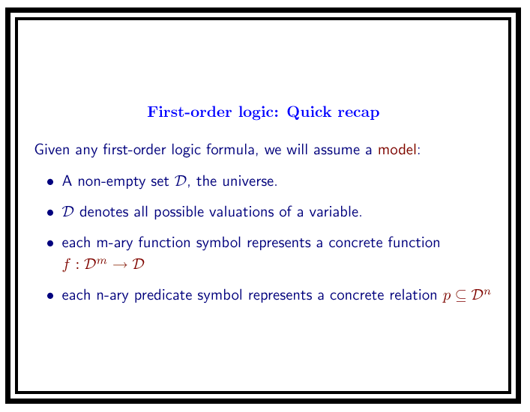

Slide 4
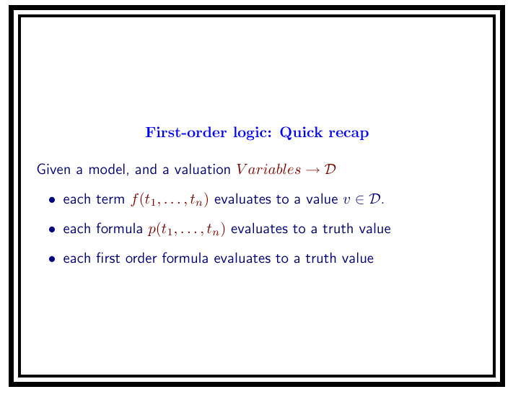

Slide 5
Facts
        link(fortran, algol60). link(c,cplusplus).
        link(algol60,cpl). link(algol60,simula67).
        link(cpl,bcpl). link(simula67,cplusplus).
        link(bcpl, c). link(simula67, smalltalk80).
“Facts”
fortran
algol60
simula67
cpl
bcpl
c
cplusplus
smalltalk80

Slide 6
Meaning of Rules and Facts
        path(L, L).
        path(L, M) :- link(L,X), path(X,M).
variable
Variables in the head of a rule or a fact are universally quantified.
path(L,L). For all L, path(L,L).
Hence, we have path(a,a), or path(you,you),
but we don’t know if we have path(you,me).

Slide 7
Rules or Clauses
The clause path(L,L).
Stands for the logical formula
∀L path(L, L)
The clause path(L,M) :- link(L,X), path(X, M).
Stands for the logical formula
∀L,M path(L, M) ⇐ ∃ X link(L,X) ∧ path(X, M)

Slide 8
Meaning of Rules and Facts
        path(L, L).
        path(L, M) :- link(L,X), path(X,M).
        link(fortran, algol60). link(c, cplusplus).
        link(algol60,cpl). link(algol60, simula67).
        link(cpl,bcpl). link(simula67, cplusplus).
        link(bcpl, c). link(simula67, smalltalk80).
New variables in the body of a rule are existentially quantified.
  path(L,M) :- link(L,X), path(X,M).
  For all L and M, path(L,M) if there exists X such that
  link(L,X) and path(X,M).
path(fortran,cpl) if link(fortran, algol60) and path(algol60,cpl).

Slide 9
The Meaning of Queries
Queries are existentially quantified logical formulae
subgoal
?- link(algo60,L), link(L,M).
Do there exist some values for L and M such that link(algo60,L)
and link(L,M) ?
A solution to a query is a binding of variables (in the query)
to values that makes the query true.
  When a solution exists, the query is said to be satisfiable.
Prolog answers no to a query if it fails to satisfy the query

Slide 10
Query Evaluation (last lecture)
Recall that Prolog computation proceeds by query evaluation.
This corresponds to generating bindings for variables in the query which allow the query to be deduced.
Truth/falsehood of the query is deduced from the program which stands for a set of universally quantified first order logic formulae.
Contrast this with the procedural manner in which we viewed query evaluation in the last lecture !

Slide 11
Query Evaluation
A query evaluation succeeds only when the truth can be
established from the rules and facts.
Otherwise, it is considered false.
        link(fortran, algol60). link(c, cplusplus).
        link(algol60,cpl). link(algol60, simula67).
        link(cpl,bcpl). link(simula67, cplusplus).
        link(bcpl, c). link(simula67, smalltalk80).
link(bcpl, c). Is true
link(bcpl,cplusplus) is false.

Slide 12
Example
        path(L, L).
        path(L, M) :- link(L,X), path(X,M).
path(cpl,cpl) is true, so is path(you,you).
path(algol60,smalltalk80) is true.
path(c,smalltalk) is not true, neither is path(you,me).

Slide 13
Negative Answers and Queries
Query answer : no ≡ “I can’t prove it”.
?- link(lisp,scheme).
no
?- not(link(lisp,scheme)).
yes
?- not(P).
  returns false if Prolog can deduce P (make P true).
  returns true if Prolog fails to deduce P.

Slide 14
Negation as Failure
Negation as Failure ≠ logical negation
  Logical negation : We can prove that it is false
  Negation as failure : We can’t prove that it is true

Slide 15
Example
        ?- link(L,N), link(M,N).
        L = fortran
        N = algol60
        M = fortran
        ?- link(L,N), link(M,N), not(L=M).
        L = c
        N = cplusplus
        M = simula67
Subgoal ordering can
affect the solution
        ?- not(L=M), link(L,N), link(M,N).
        no

Slide 16
Example
Negation can appear in program as well as query.
bachelor(X) :- male(X), not(married(X)).
male(bill). married(bill).
male(jim). married(mary).
?- bachelor(X)
X = jim
not(married(bill) fails.
not(married(jim)) succeeds. (Negation as failure)

Slide 17
Now…
Control in Prolog computation
  Ordering of goals
  Ordering of rules
  Search trees
Some programming practices
  Generate and test
  Cuts – A piece of hackery !

Slide 18
Control in Prolog
Start with a query as the
current goal;
while the current goal
is nonempty do {
choose the leftmost subgoal ;
if a rule applies to
the subgoal then {
select the 1st applicable rule ;
form a new current goal }
else { backtrack }
} ;
if the current goal is empty
then succeed
else fail.
append1([ ],Y,Y).
append1([X|Xs],Ys,[X|Zs]) :- append1(Xs,Ys,Zs).
prefix(X,Z) :- append1(X, _ ,Z).
suffix(Y,Z) :- append1(_ ,Y,Z).
X
Y
Z
?- prefix([a],[a,b,c]).
prefix([a],[a,b,c])
append1([a],_,[a,b,c])
append1([],Ys,[b,c]).
yes

Slide 19
Ordering of Subgoals
Start with a query as the
current goal;
while the current goal
is nonempty do {
choose the leftmost subgoal ;
if a rule applies to
the subgoal then {
select the 1st applicable rule ;
form a new current goal }
else { backtrack }
} ;
if the current goal is empty
then succeed
else fail.
append1([ ],Y,Y).
append1([X|Xs],Ys,[X|Zs]) :- append1(Xs,Ys,Zs).
prefix(X,Z) :- append1(X, _ ,Z).
suffix(Y,Z) :- append1(_ ,Y,Z).
X
Y
Z
?- prefix(X,[a,b,c]), suffix([e],X).
no
?- suffix([e],X), prefix(X,[a,b,c]).
<infinite computation>

Slide 20
Ordering of Rules
Start with a query as the
current goal;
while the current goal
is nonempty do {
choose the leftmost subgoal ;
if a rule applies to
the subgoal then {
select the 1st applicable rule ;
form a new current goal }
else { backtrack }
} ;
if the current goal is empty
then succeed
else fail.
append1([ ],Y,Y).
append1([X|Xs],Ys,[X|Zs]) :- append1(Xs,Ys,Zs).
app([X|Xs],Ys,[X|Zs]) :- app(Xs,Ys,Zs).
app([ ],Y,Y).
?- append1(X,[c],Z).
X = [ ], Z = [c] ;
X = [ _1 ], Z = [ _1,c] ;
X = [ _1,_2 ], Z = [ _1,_2,c ] ;
…..
?- app(X,[c],Z).
<infinite computation>

Slide 21
A Refined Description of Control
Start with a query as the current goal;
while the current goal is nonempty do {
let the current goal be G₁,..,G_{k}, k>0;
choose the leftmost subgoal G₁ ;
if a rule applies to G₁ then {
select the 1st applicable rule A :- B₁, .. , B_{j}. (j ≥ 1) ;
let σ be the most general unifier of G₁ and A ;
set the current goal to be B₁σ,..,B_{j} σ,G₂σ,..,G_{k}σ }
else { backtrack }
} ;
if the current goal is empty
then succeed
else fail.

Slide 22
Search in Prolog – Example:
Program:
append([], X, X).
append([X|Xs], Y,[X|Zs]) :- append(Xs,Y,Zs).
Query: A conjunction of subgoals
append(A, B, [a]), append(B, [a], A).

Slide 23
Prolog’s Search Trees
?- append(A,B,[a]),append(B,[a],A).
C2
{A->[a|Xs1],
Ys1->B,Zs1->[]}
C1
{A->[ ],B->[a],Y1->[a]}
?- append([a],[a],[ ]).
?- append(Xs1,B,[ ]), append( B,[a],[a|Xs1]).
C1
C2
C1
{Xs1->[],B->[ ]}
C2
Fail and Backtrack
?- append([ ],[a],[a]).
Fail and Backtrack
Fail and Backtrack
C1
C2
A=[a],B=[ ]
Fail and Backtrack
User requests Backtrack

Slide 24
Generate-and-Test Technique
        member(M,[M|_]).
        member(M,[ _|T]) :- member(M,T).
        overlap(X,Y) :- member(M,X), member(M,Y).
Generate a
value for M
in X
Test if it is
in Y
?- overlap([a,b],[b,c]).
member(a,[a,b]), member(a,[b,c])
member(b,[a,b]), member(b,[b,c])
yes
Generate : Generate possible solutions
Test : Verify the solutions

Slide 25
Cuts
A cut prunes an explored part of a Prolog search tree.
        a(1) :- b.
        a(2) :- e.
        b :- c.
        b :- d.
        d.
        e.
a(X)
!,
X=1
X=2
b
e
X=2
d
!,
c
X=1
?- a(X).
X = 1 ;
X = 2 ;
no
?- a(X).
X = 2 ;
no
c
Cut in a clause commits to the use of that clause.
Cut has the effect of making b fails if c fails.

Slide 26
        a(X) :-b(X).
        a(X) :-f(X).
        b(X) :-g(X), v(X).
        b(X) :-X = 4, v(X).
        g(1).
        g(2).
        g(3).
        v(1).
        v(X) :- f(X).
        f(5).
a(Z)
!,
b(Z)
f(Z)
g(Z), v(Z)
Z=4,v(4)
!,
f(5)
v(1)
!,
v(2)
v(3)
f(4)
Z = 5
backtrack
v(1)
f(1)
f(2)
f(3)
backtrack
backtrack
?- a(Z).
Z = 1 ;
Z = 5 ;
no
?- a(Z).
Z = 1 ;
Z = 5 ;
no
backtrack
Z = 1

Slide 27
Green Cuts, Red Cuts
Green Cut
  a cut the prunes part of a Prolog search tree that cannot possibly reach a solution
    used mainly for efficiency sake.
Red Cut
  a cut that alters the set of possible solutions reachable.
    Powerful tool, yet fatal and can be confusing
    Handle with care

Slide 28
Merging two lists
merge([X|Xs],[Y|Ys],[X|Zs]) :- X <Y, merge(Xs,[Y|Ys],Zs).
merge([X|Xs],[Y|Ys],[X,Y|Zs]) :- X = Y, merge(Xs,Ys,Zs).
merge([X|Xs],[Y|Ys],[Y|Zs]) :- X > Y, merge([X|Xs], Ys, Zs).
merge(X, [], X).
merge([], Y, Y).
First three clauses mutually exclusive
No need to try the others, if one of them succeeds.
This is made explicit by a green cut.

Slide 29
Example: Green cut
merge([X|Xs],[Y|Ys],[X|Zs]) :- X <Y, ! , merge(Xs,[Y|Ys],Zs).
merge([X|Xs],[Y|Ys],[X,Y|Zs]) :- X = Y, ! , merge(Xs,Ys,Zs).
merge([X|Xs],[Y|Ys],[Y|Zs]) :- X > Y, ! , merge([X|Xs], Ys, Zs).
merge(X, [], X) :- ! .
merge([], Y, Y).
Inserting these cuts does not change the answers to any merge query.

Slide 30
Example: Red Cut
member(X,[X|Xs]) :- ! .
member(X,[Y|Ys]) :- member(X, Ys).
member(1, [1,2,1,1,3]) is more efficient.
But member(X, [1,2,3]) produces only one answer
  X = 1

Slide 31
Summary
Prolog is a procedural language with:
  Assign once variables
  Nondeterminism
As a result of having assign once variables
  Assignment is symmetric
  Test and assignment represented by same operator.
  Unification combines the concepts of test, assignment and pattern matching.

Slide 32
Summary
As a result of having nondeterminism
  Control issues for the search
  Cuts (allows the programmer explcit control)
Meaning of Prolog program given by queries that can be evaluated to true.
Applications of Prolog (in next lecture)
  Database query language
  Grammar Processing

