Slide 1
CS 2104 Prog. Lang. Concepts
Lecture 3
Dr. Abhik Roychoudhury
School of Computing

Slide 2
Announcements
Textbook to be returned by Co-op next week to the publisher.
From the next homework, write your name and Matric number in the .txt or .doc file submitted.

Slide 3
Topics to be covered
Very Quick Recap of Axiomatic Semantics [ Discussed in last class and this week’s tutorial (in details) ]
2. Scalar and Composite Types. (Pointer, String, Enumerations etc.)
[ Chapter 4.1 – 4.3, 5.3 ]
3. Structured Types (Arrays, Records etc.)
[ Chapter 5.4,5.5 ]
Acknowledgements: (2) and (3) lecture notes prepared with help from Pratt/Zelkowitz lecture notes.

Slide 4
Hoare Triples (recap)
Of the form {Pre} C {Post}
Pre, post are assertions
C is a code fragment/program
Proving such a Hoare Triple requires proving
  If we start in a state in which Pre holds
  Then execution of C produces a state C in which
  Post holds,
  provided the program C terminates

Slide 5
Proving Hoare Triples
Proving correctness of a program amounts to setting appropriate
pre- and post-conditions and then proving the corresponding
Hoare Triple.
To prove a Hoare Triple, we will use certain rules, based on the
structure of the program under question.
These rules are stated in the same manner as operational
semantics rules.

Slide 6
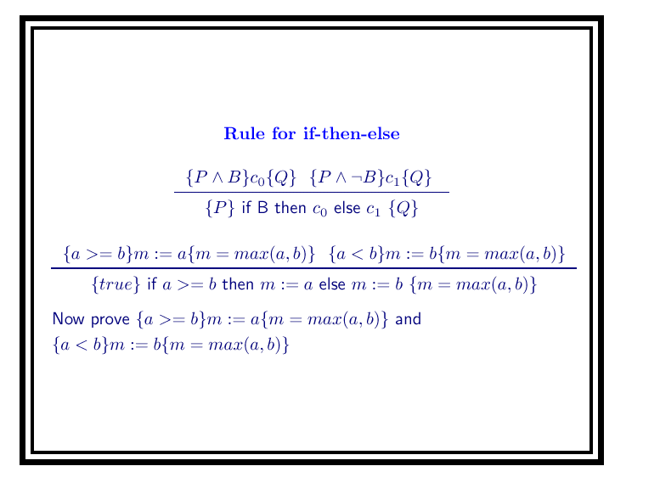

Slide 7
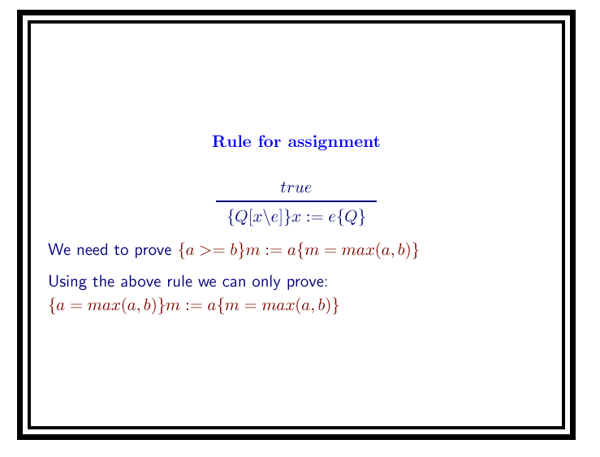

Slide 8
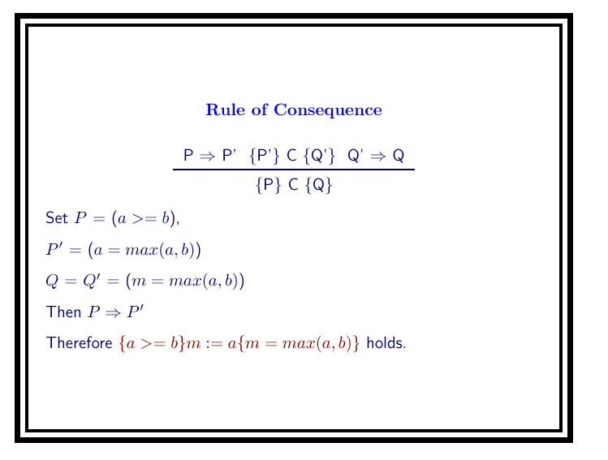

Slide 9
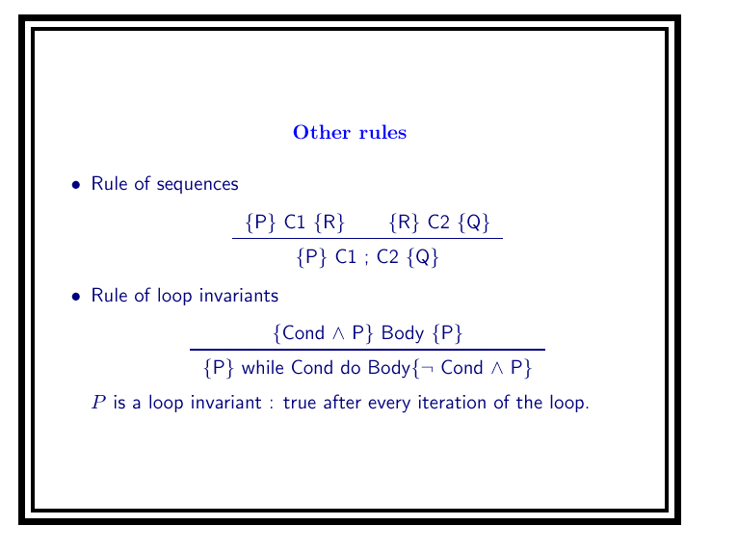

Slide 10
Data objects
Scalar data objects:
Numeric (Integers, Real)
Booleans
Characters
Enumerations
Composite objects:
String
Pointer
Structured objects:
Arrays
Records
Lists, Sets
Abstract data types:
Classes
Active Objects:
Tasks
Processes

Slide 11
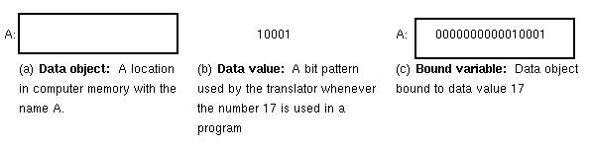
Binding of data objects
A compiler creates two classes of objects:
Memory locations
Numeric values
A variable is a binding of a name to a memory location:
Contents of the location may change

Slide 12
Data types
Each data object has a type:
Values: for objects of that type
Operations: for objects of that type
Implementation: (Storage representation) for objects of that type
Attributes: (e.g., name) for objects of that type
Signature: (of operation f): f: type x type → type

Slide 13
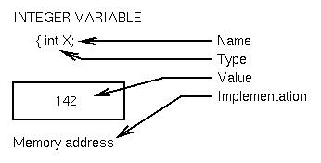
Data Types - Example

Slide 14
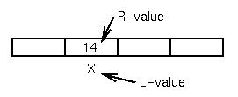
L-value and R-value
Location for an object is
its L-value. Contents of
that location is its
R-value.

Slide 15
L-value and R-value
Where did names L-value and R-value come from?
Consider executing: A = B + C;
1. Pick up contents of location B
2. Add contents of location C
3. Store result into address A.
For each named object, its position on the right-hand-side of the assignment operator (=) is a content-of access, and its position on the left-hand-side of the assignment operator is an address-of access.

Slide 16
Subtypes
A is a subtype of B if every value of A is a value of B.
Note: In C almost everything is a subtype of integer.
Conversion between types:
Given 2 variables A and B, when is A:=B legal?
Explicit: All conversion between different types must be specified
Implicit: Some conversions between different types implied by language definition

Slide 17
Coercion examples
Examples in Pascal:
var A: real;
B: integer;
A := B - Implicit, called a coercion - an automatic conversion from one type to another
A := B is called a widening since the type of A has more values than B.

Slide 18
Coercion examples
B := A (if it were allowed) would be called a narrowing since B has fewer values than A. Information could be lost in this case.
In most languages widening coercions are usually allowed;
narrowing coercions must be explicit:
B := round(A); Go to integer nearest A
B := trunc(A); Delete fractional part of A

Slide 19
Enumerations
typedef enum thing {a, b, c, d } NewType;
Implemented as small integers with values:
a = 0, b = 1, c = 2, d = 3
NewType X, Y, Z;
X = a
Why not simply write: X=0 instead of X=a?
Readability and Error detection

Slide 20
Enumerations
Example:
enum { fresh, soph, junior, senior} ClassLevel;
enum { old, new } BreadStatus;
BreadStatus = fresh; error can be detected

Slide 21
Composite data
Character Strings: Primitive object made up of more primitive character data.
Fixed length:
char A(10) - C
DCL B CHAR(10) - PL/I
var C packed array [1..10] of char - Pascal

Slide 22
Composite data
Variable length:
DCL D CHAR(20) VARYING - PL/I - 0 to 20 characters
E = “ABC” - SNOBOL4 - any size, dynamic
F = `ABCDEFG\0' - C - any size, programmer defined

Slide 23
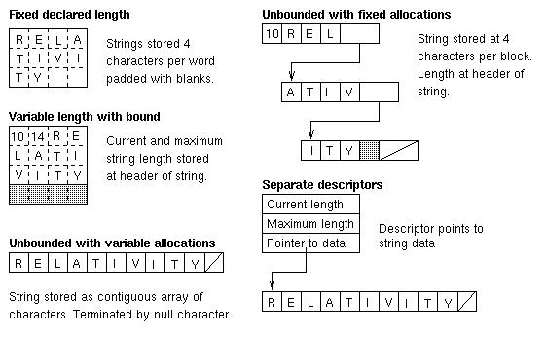
String implementations

Slide 24
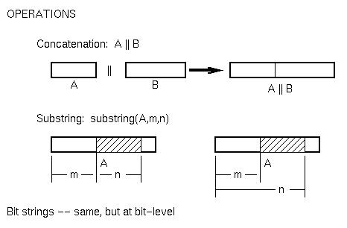
String operations
In C, arrays and character strings are the same.
Implementation:
L-value(A[I]) = L-value(A[0]) + I

Slide 25
Pointer data
Use of pointers to create arbitrary data structures
Each pointer can point to an object of another data structure
In general a very error prone construct and should be avoided

Slide 26
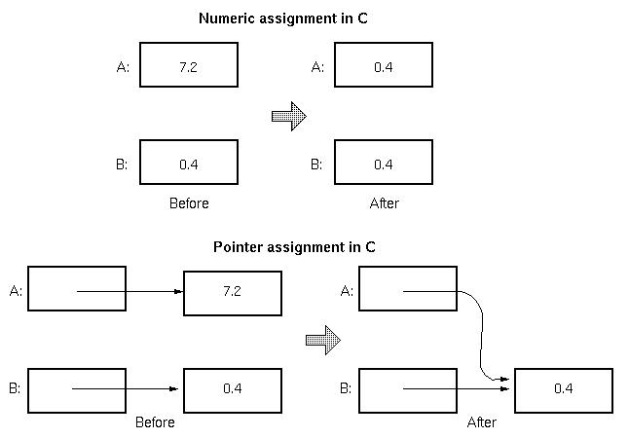
Pointer aliasing

Slide 27
Structured Types: Arrays
An array is an ordered sequence of identical objects.
The ordering is determined by a scalar data object (usually integer or enumeration data). This value is called the subscript or index, and written as A[I] for array A and subscript I.

Slide 28
Structured Types: Arrays
Multidimensional arrays have more than one subscript. A 2-dimensional array can be modeled as the boxes on a rectangular grid.
The L-value for array element A[I,J] is given by the accessing formula on the next slide

Slide 29
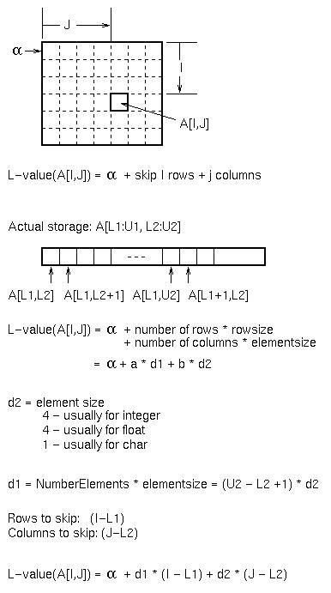

Slide 30

Array accessing (continued)
L-value(A[0,0]) = V0, a constant.
Call this constant the virtual origin (VO); It represents the address of the 0th element of the array.
L-value(A[I,J]) = VO +I*d1 + J*d2
To access an array element, use a dope vector

Slide 31
Array accessing summary
To create arrays:
1. Allocate total storage beginning at α:
(U2-L2+1)*(U1-L1+1)*eltsize
2. d2 = eltsize d1 = (U2-L2+1)*d2
4. To access A[I,J]:
Lvalue(A[I,J]) = VO + I*d1 + J*d2
This works for 1, 2 or more dimensions.
May not require runtime dope vector if all values known at compile time. (e.g., in Pascal, d1, d2, and VO can be computed by compiler.)
Next slide: Storage for 2-dimensional array.

Slide 32
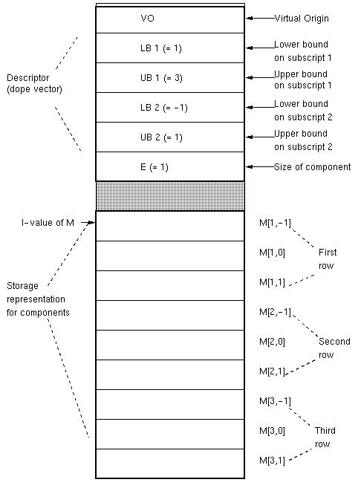

Slide 33
Associative arrays
Access information by name without having a predefined ordering or enumeration:
Example: Names and grades for students in a class:
NAME[I] = name of Ith student
GRADE[I] = Grade for Ith student
Associative array: Use Name as index:
CLASS[name] will be grade.
Problem: Do not know enumeration before obtaining data so dope vector method of accessing will not work.
Implemented in Perl and in SNOBOL4 (as a table)

Slide 34
Perl example
%ClassList = (“Michelle”, `A', “Doris”, `B', “Michael”, `D'); # % operator makes an associative array
$ClassList{‘Michelle’} has the value ‘A’
@y = %ClassList # Converts ClassList to an
# enum. array with index 0..5

Slide 35
Perl example
$I= 0 $y[$I] = Doris
$I= 1 $y[$I] = B
$I= 2 $y[$I] = Michael
$I= 3 $y[$I] = D
$I= 4 $y[$I] = Michelle
$I= 5 $y[$I] = A

Slide 36
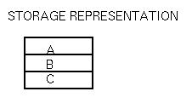
Structs in C
Representation: a sequence of objects:
record { A: object;
B: object;
C: object }

Slide 37
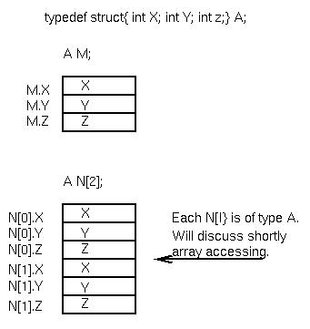
Structs in C

Slide 38

Union types
typedef union { int X;
float Y;
char Z[4];} B;
B P;
Similar to records, except all have overlapping (same) L-value.

Slide 39
Union types
But problems can occur. What happens below?
P.X = 142;
printf(“%O\n”, P.Z[3])
All 3 data objects have same L-value and occupy same storage. No enforcement of type checking.
⇒ Poor language design

Slide 40
Variant records
type PayType=(Salaried, Hourly);
var Employee:record
ID: integer;
Dept: array[1..3] of char;
Age: integer;
case PayClass: PayType of
Salaried:(MonthlyRate:real;
StartDate:integer);
Hourly:(HourRate:real;
Reg:integer;
Overtime:integer)
end

Slide 41
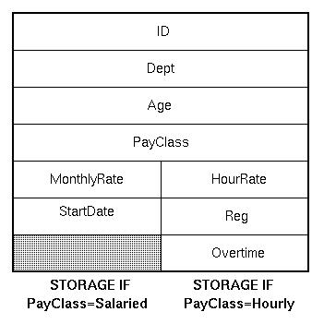
Variant records

Slide 42
Variant records (continued)
Tagged union type - Pascal variant records
type whichtype = (inttype, realtype, chartype);
type uniontype = record
case V: whichtype of
inttype: (X: integer);
realtype: (Y: real);
chartype: (Z: char4); string of length 4
end

Slide 43

Variant records (continued)
But can still subvert tagging:
var P: uniontype
P.V = inttype;
P.X = 142;
P.V = chartype;

