Slide 1
CS 2104 Prog. Lang. Concepts
Subprograms
Lecturer : Dr. Abhik Roychoudhury
School of Computing
Reading: Chapters 4.6, 5.1, 5.2

Slide 2
Topics covered
Activation Records
Scope : Static, Dynamic
Lifetime of variables
Parameter passing
  Value
  Reference
  Value-Result, Name etc.
Acknowledgements: Diagrams etc. adapted from Pratt/Zelkowitz lecture notes.

Slide 3
Implementation of subprogram storage
Each subprogram has a block of storage containing such information, called an activation record.
Consider the following C subprogram:
float FN( float X, int Y)
const initval=2;
#define finalval 10
float M(10); int N;
N = initval;
if(N<finalval){ ... }
return (20 * X + M(N)); }
Information about procedure FN is contained in its activation record.

Slide 4
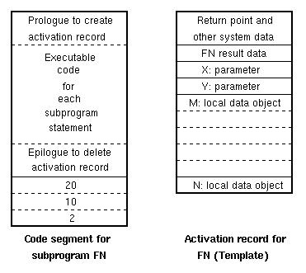
Activation records

Slide 5
Dynamic nature of activation records
Each invocation of FN causes a new activation record to be created.
Thus the static code generated by the compiler for FN will be associated with a new activation record, each time FN is called.
As we will see later, a stack structure is used for activation record storage.

Slide 6
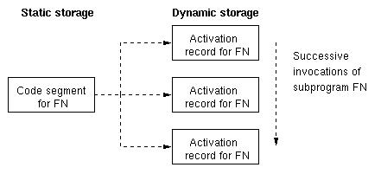
Dynamic nature of activation records

Slide 7
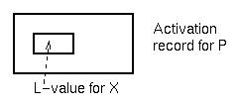
Subprogram control
Remember that data storage for subprograms is in an activation record.
var X: integer;
X is of type integer.
L-value of X is some specific offset in an
activation record.

Slide 8
Subprogram control
Goal is to look at locating activation record for P.
Given an expression: X = Y + Z
1. Locate activation record containing Y.
2. Get L-value of Y from fixed location in activation record.
3. Repeat process for Z and then X.

Slide 9
Scope rules
Scope rules: The scope of a variable are the set of statements where the variable may be accessed (i.e., named) in a program.
Static scope: Scope is dependent on the syntax of the program.
Dynamic scope: Scope is determined by the execution of the program.

Slide 10
Scope rules
Static nested scope: A variable is accessible in the procedure it is declared in, and all procedures internal to that procedure, except a new declaration of that variable name in an internal procedure will eliminate the new variable's scope from the scope of the outer variable.
A variable declared in a procedure is local in that procedure; otherwise it is global.

Slide 11
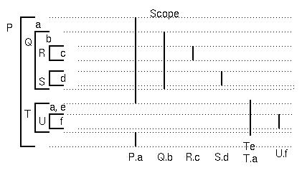
Review of scope rules
Q and T are declarations of procedures within P, so scope of names Q and T is same as scope of declaration a.
R and S are declarations of procedures in Q.
U is a declaration of a procedure in T.
Storage managed by adding activation records, when procedure invoked, on a stack.

Slide 12
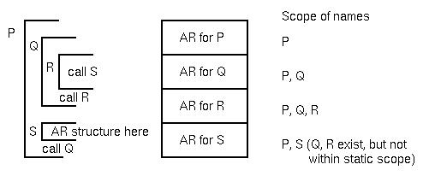
Activation record stack

Slide 13
Activation record stack
Problem is: How to manage this execution stack?
Two pointers perform this function:
1. Dynamic link pointer points to activation record that called (invoked) the new activation record. It is used for returning from the procedure to the calling procedure.
2. Static link pointer points to the activation record that is global to the current activation record (i.e., points to the activation record of the procedure containing the declaration of this procedure).

Slide 14
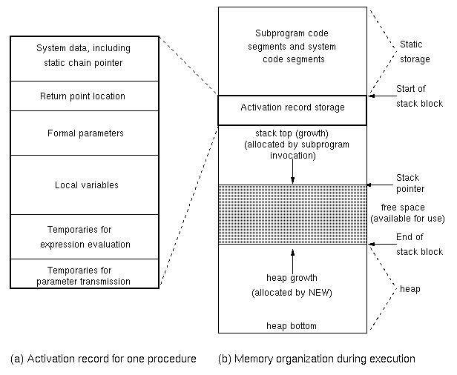
Activation record structure

Slide 15
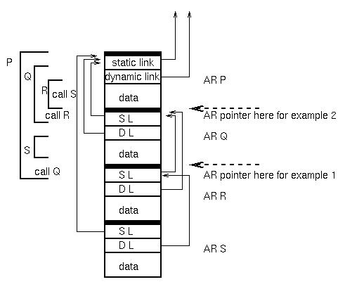
Example of act. record stack
Declarations
Var A in P
B in Q
C in R

Slide 16
Activation record example 1
Ex 1. In R: C := B+A; ⇒ C local, A,B global
For each variable, get pointer to proper activation record.
Assume AR is current act.record pointer (R).
1. B is one level back:
  Follow AR.SL to get AR containing B.
  Get R-value of B from fixed offset L-value
2. A is two levels back:
  Follow (AR.SL).SL to get activation record containing A.
  Add R-value of A from fixed offset L-value
3. C is local. AR points to correct act record.
  Store sum of B+A into L-value of C

Slide 17
Activation record example 2
Example 2. Execution in procedure Q: A := B
⇒ B is local, A global
Assume AR is current activation record pointer (Q)
1. B is now local. AR points to activation record
  Get R-value from local activation record

Slide 18
Activation record example 2
2. A is now one level back
AR.SL is activation record of P
  Store R-value of B into L-value of A
Compiler knows static structure, so it can generate the number of static link chains it has to access in order to access the correct activation record containing the data object. This is a compile time, not a runtime calculation.

Slide 19
Use of displays
Problem with static links:
Many links to follow if deeply nested. (But how common is that?)
Use of displays reduces access always to 2 instructions:
1. Access Display[I] = Act. Rec. pointer at level I
2. Get L-value of variable (fixed offset in act. rec.)

Slide 20
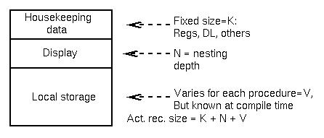
Use of displays
Activation record structure:
Static chain copied into display vector on subprogram entry.

Slide 21
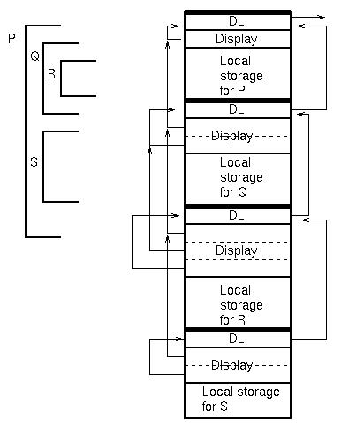
Display for previous example

Slide 22
Blocks
C, C++, Java allow any compound statement to have declarations and thus define a new scope.
If (list[I] < list[j]) {
int temp;
temp = list[I]; list[I] = list[j]; list[j] = temp;
}
Scopes created by blocks treated like those created by subprograms.

Slide 23
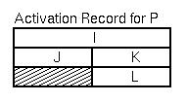
Blocks in C
Blocks in C are handled as union record types:
P()
{ int I;
{int J;
. . . }
{ int K; int L;
. . . }
. . . }
J and K cannot exist at the same time, so use the same space for them.

Slide 24
Lifetime
The lifetime of a variable is that period during program execution when the storage for the declared variable exists in some activation record (i.e., from the time the activation record for the declaring procedure is created until that activation record is destroyed).
The scope of a variable is the portion of the source program where the data item can be accessed (i.e., the name of the item is a legal reference at that point in the program).

Slide 25
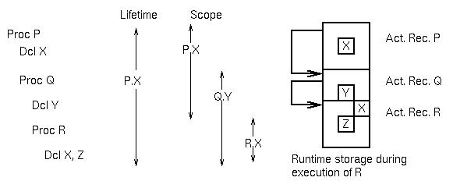
Lifetimes of variables
Lifetime of variable X is the period when the activation record for P exists.
Note that we can change the scope, but the not lifetime of a variable by nesting procedures:

Slide 26
Parameter passing
Parameter: A variable in a procedure that represents some other data from the procedure that invoked the given procedure.
Parameter transmission: How that information is passed to the procedure.
The parameter is also called the formal argument.The data from the invoking procedure is called the actual argument or sometimes just the argument.

Slide 27
Parameter passing
Usual syntax:
Actual arguments: call P(A, B+2, 27+3)
Parameters: Procedure P(X, Y, Z)
What is connection between the parameters and the arguments?
Call by name
Call by reference
Call by value
Call by value-result

Slide 28
Language dependent
Difference languages have different mechanisms:
ALGOL - name, value
Pascal - value, reference
C - value (BUT pointers give us reference
Constant tension between desire for efficiency and semantic correctness in defining parameter transmission.

Slide 29
Call by name
Substitute argument for parameter at each occurrence of parameter:
Invocation: P(A, B+2, 27+3)
Definition: procedure P(X,Y,Z)
{int I; I=7; X = I + (7/Y)*Z;}
Meaning: P(X,Y,Z) {int I; I=7; A=I+(7/(B+2))*(27+3);}

Slide 30
Call by name
This is a true macro expansion. Simple semantics, BUT:
1. Implementation. How to do it?
2. Aliases. What if statement of P were: I = A?
3. Expressions versus statements: If we had D=P(1,2,3) and a return(42) in P, what does semantics mean?
4. Error conditions: P(A+B, B+2, 27+3)

Slide 31
Impl. of call by name
A thunk is the code which computes the L-value and R-value of an argument.
For each argument, pass code address that computes both L-values and R-values of arguments.
P(A, B+2, 27+3) generates:
jump to subroutine P
address of thunk to return L-value(A)
address of thunk to return R-value(A)
address of thunk to return L-value(B+2)
address of thunk to return R-value(B+2)
address of thunk to return L-value(27+3)
address of thunk to return R-value(27+3)

Slide 32
Impl. of call by name
To assign to X, call thunk 1, To access X, call thunk 2
To assign to Y, call thunk 3, To access Y, call thunk 4
To assign to Z, call thunk 5, To access Z, call thunk 6
Issue: Assignment to (B+2): How?
Call by name is conceptually convenient, but inefficient.

Slide 33
Examples of Call by Name
1. P(x) {x = x + x;}
Seems simple enough …
Y = 2; P(Y); write(Y) ⇒
means Y = Y+Y
write(Y) ⇒ prints 4
2. int A[10];
for(I=0; I<10; I++) {A[I]=I;};
I=1; P(A[I]) ⇒ A[1] = A[1] + A[1]
⇒ A[1] set to 2

Slide 34
Examples of Call by Name
3. But: F {I = I + 1; return I;}
What is: P(A[F])?
P(A[F]) ⇒ A[F] = A[F]+A[F] ⇒ A[I++] = A[I++]+A[I++]
⇒ A[2] = A[3]+A[4]
4. Write a program to exchange values of X and Y: (swap(X,Y))
Usual way: swap(x,y) {t=x; x=y; y=t;}
Cannot do it with call by name. Cannot handle both of following: swap(I, A[I]) swap(A[I],I)
One of these must fail.

Slide 35
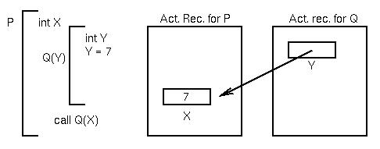
Call by reference
Pass the L-value of the argument for the parameter.
Invocation: P(A, B+2, 27+3)
whose R-value is the L-value of the argument.

Slide 36
Call by reference
Implementation:
Temp1 = B+2
Temp2 = 27+3
jump to
subroutine P
L-value of A
L-value of Temp1
L-value of Temp2
This is the most common parameter transmission mechanism. In the procedure activation record, parameter X is a local variable whose R-value is the L-value of the argument.

Slide 37
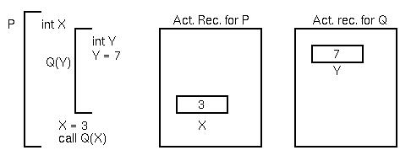
Call by value
Pass the R-value of the argument for the parameter.
Invocation: P(A, B+2, 27+3)

Slide 38
Call by value
Implementation:
Temp1 = B+2
Temp2 = 27+3
jump to
subroutine P
R-value of A
R-value of Temp1
R-value of Temp2
In procedure activation record, parameter X is a local variable whose R-value is the R-value of the argument.

Slide 39
Call by reference in C
C only has call by value,
BUT pointer variables allow for simulating call by reference:
P(i, j) ⇒ passes i and j by value.
P(&i, &j) ⇒ passes L-values of i and j.
P(*x, *y) {*x = *y + 1;} ⇒ arguments are addresses (pointers)

Slide 40
Call by value result
Call by value-result: Call by value, AND pass back the final value to argument upon return.
Similar to in-out parameters, discussed next.
Similar to call by reference, except for aliasing. (two variable names refering to the
Same memory location)
E.g. if a global variable is parameter passed by reference.

Slide 41
In-out semantics
Parameters in Ada are based upon use (semantics), not implementation:
in - argument value will be used in procedure.
out - parameter value will be used in calling program.
in out - both uses of arguments and parameters
P(X in integer;
Y out integer;
Z in out integer);
begin ... end;

Slide 42
In-out semantics
In Ada 83, language definition allowed some latitude in implementation ⇒ as long as implementation consistent, ok.
But this meant that the same program could give different answers from different standards conforming compilers
In Ada 95, more restricted: in integer is value, out integer is value-result, composite (e.g., arrays) is reference.

Slide 43
Example of parameter passing
Main
{A = 2; B = 5; C = 8; D = 9;
P(A, B, C, D); write(A, B, C, D);
P(U, V, W, X)
{V = U+A;
W = A+B;
A = A+1;
X = A+2;
write(U, V, W, X)}
Fill in table assume parameters are of the given type:

Slide 44
Example of parameter passing
A B C D U V W X print P print main
Call by name
Call by reference
Call by value
value-result
When do call by name and call by reference differ?
When L-value can change between parameter references. E.g., P(I, A[I])

