Slide 1
CS2104- ADT/Inheritance
Lecturer: Dr. Abhik Roychoudhury
School of Computing
Reading : Chapter 7.1, 7.2 of textbook

Slide 2
Topics covered
Abstract Data Types
Encapsulation
Inheritance
Virtual functions, Mixins etc.
Abstract classes, Interfaces etc.
Diagrams etc. adapted from Pratt/Zelkowitz lecture notes

Slide 3
Types
A type (data type) is a set of values that an object can have.
An abstract data type (ADT) is a:
data type
Set of functions (operations) that operates on data of that type
Each function is defined by its signature.
Can also specify operations formally (see section 4.2.5) (Algebraic data types): f(g(A,S)) = A

Slide 4
Example ADT
ADT student:
Operations:
SetName: name x student → student
GetName: student → name
SetCourse: course x student → student
GetCourse: student → course
GetCredits: student → integer

Slide 5
Example ADT
In this example, Name and Course are undefined ADTs. They are defined by some other abstraction.
Information hiding: We have no idea HOW a student object is stored, nor do we care. All we care about is the behavior of the data according to the defined functions.

Slide 6
Information hiding
Information hiding can be built into any language
C example:
typedef struct {i:int; ... } TypeA;
typedef struct { ... } TypeB;
P1 (TypeA X, other data) { ... } - P1:other data → TypeA
P2 (TypeB U, TypeA V) { ... } - P2:TypeA → TypeB

Slide 7
Information hiding
Problems with this structure:
No enforcement of information hiding. In P2 can write V.i to access component i of of TypeA object instead of calling P1.
Success depends upon conventions
But advantage is that it can be done in Pascal or C.
We will look at mechanisms later to enforce information hiding (Smalltalk, C++, Java, Ada). We will call this enforcement encapsulation.

Slide 8
Recap: subprogram storage
Before looking at ADTs in detail, we first need to recall the usual method for subprograms to create local objects.
Each subprogram has a block of storage containing such information, called an activation record.
Each invocation of a subprogram causes a new activation record to be created.
A stack structure is used for activation record storage.
Subprograms capture the notion of modularity in programming which is refined through ADT.

Slide 9
Encapsulated data types
Example: StudentRecord is type
Externally visible:
void SetName(StudentRecord, Name)
name GetName(StudentRecord)
Internal to module:
char Name[20];
float GPA;
char Address[50];
CourseType Schedule[10];

Slide 10
Packages in ADA
Usual Implementation in Ada:
package RationalNumber is
type rational is record -- User defined type
num, den: integer
end record;
procedure mult(x in rational; -- Abstract operation
y in rational; z out rational);
end package;

Slide 11
Packages in ADA
package body RationalNumber is -- Encapsulation
procedure mult(x in rational;
y in rational; z out rational)
begin
z.num := x.num * y.num;
z.den := x.den * y.den;
end;
end package;

Slide 12
Use of encapsulated data
Usual use of encapsulated RationalNumber:
Example: In main procedure do:
var A, B, C: rational;
A.num := 7; ⇐ Should be illegal
A.den := 1;
Mult(A, B, C);
No enforcement of encapsulation

Slide 13
Use of encapsulated data
Any procedure has access to components of type rational. Can manipulate A.num and A.den without using procedures in package RationalNumber.
Let's look at alternative model to enforce encapsulation.

Slide 14
Private types
package RationalNumber is
type rational is private; -- User defined type
procedure mult(x in rational; -- Abstract operation
y in rational; z out rational);
private
type rational is record -- User defined type
num, den: integer
end record;
end package;

Slide 15
Private types
package body RationalNumber is -- Same as before
procedure mult(x in rational;
y in rational; z out rational)
begin
z.num := x.num * y.num;
z.den := x.den * y.den;
end;
end package;

Slide 16
Private types add protection
var A: rational;
A.num := 7; -- Now illegal. Private blocks use of num and den outside of package RationalNumber.
What is role of private?
Any declarations in private part is not visible outside of package
What is difference in implementation of rational?
This solution encapsulates and hides implementation details of rational.

Slide 17
C++ RationalNumber example
C++ creates objects of a user defined class.
Data storage
Set of operations
Type rational can be specified in C++ as:
class rational{
public: void mult( rational x; rational y)
{ num = x.num * y.num;
den = x.den * y.den;}

Slide 18
C++ RationalNumber example
protected: int num; int den }
rational A, B, C;
A.mult(B,C) ⇐ invoke encapsulated function
A.num = B.num * C.num ⇐
Illegal. No access to num and den

Slide 19
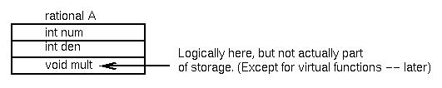
Storage for C++ classes
Visibility of objects:
public: globally known
private: locally known only
protected -- provides for inheritance

Slide 20
Inheritance
Inheritance provides for passing information from one data object to another automatically
It provides a form of data scope similar to syntactic scope.
Inheritance through
data in object
oriented languages
is explicit through
derived types.

Slide 21
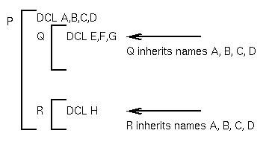
Inheritance
Static scope (above) -
Names are known implicitly
through nested procedure names

Slide 22
C++ derived classes
Consider C++ class rational discussed earlier:
class complex: rational {
public: void mult( complex x; complex y);
{ realpt.mult(x.realpt,y.realpt)-realpt.mult(x.imagpt,y.imagpt) ...
void initial(complex x) {x.realpt.num = 0;
x.realpt.den = 1 }

Slide 23
C++ derived classes
// complex inherits rational components.
private: rational realpt;
rational imagpt }
. . .
complex M, N, P;
M.mult(N,P)

Slide 24
Power of inheritance
class rational {
public: mult( ...) { ... }
protected: error( ...) { ... } ...
private: ... }
class complex:rational {
public: mult( ...) { ... }
private: ... }
complex X;

Slide 25
Power of inheritance
Function error is passed (inherited) to class complex, so X.error is a valid function call. Any derived class can invoke error and a legal function will be executed.
But what if we want error to print out the type of its argument? (i.e., want to know if error occurred in a rational or complex data?)

Slide 26
Power of inheritance (continued)
Inheritance is normally a static property:
Function error in class complex is known by compiler to be within class rational.
x.error ⇐ compiler knows where the error function is.
So how can rational::error know where it was invoked,
as either rational::error or complex::error?
One way - Use function argument: error('rational') or error('complex')
Alternative: Use of virtual functions

Slide 27
Virtual functions
Base class:
class rational {
error() { cout << name() << endl; }
string name() { return “Rational”;} ... }
Derived class:
class complex: rational {
string name() { return “Complex”;} ... }
But if error is called, Rational is always printed since the call rational::name is compiled into class rational for the call in the error function.

Slide 28
Virtual functions
But if name is defined as:
virtual string name() { return “Rational”;}
then name() is defined as a virtual function and the function name in the current object is invoked when name() is called in rational::error.

Slide 29
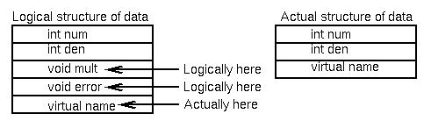
Implementing virtual functions
Virtual functions imply a runtime descriptor with a location of object
rational A;
complex B;
A.error() ⇐ error will call name() in rational
B.error() ⇐ error will call name() in complex

Slide 30
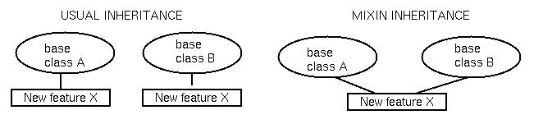
Mixin inheritance
Assume want to add feature X to both class A and B:
Usual way is to redefine both classes.

Slide 31
Mixin inheritance
Mixin inheritance: Have definition which is addition to base class (Not part of C++)
For example, the following is possible syntax:
featureX mixin {int valcounter} ⇐Add field to object
newclassA class A mod featureX;
newclassB class B mod featureX;
Can get similar effect with multiple inheritance:
class newclassA:A,featureX { ... }
class newclassB:B,featureX { ... }

Slide 32
Abstract classes
A class C might be abstract in Java.
No instance of C can be created.
But instances of subclasses of C can be created.
Useful to capture the commonality shared by a set of classes.
Expression
binary
Var.
Value

Slide 33
Abstract clases
abstract class Expression { … }
class Binary extends Expression {…}
class Variable extends Expression { … }
class Value extends Expression { … }
In an abstract class
  Some of the methods are defined inside the abstract class
  Rest of the methods defined via the subclasses

Slide 34
Class Interfaces
Typically, identifies a collection of methods to be implemented by various classes.
All methods are “abstract” : not defined in the interface.
Concrete methods are implemented in the classes implementing the interface.
All methods must be implemented in such class definitions.

Slide 35
Class Interfaces
Public abstract interface Enumeration {
// the method signatures appear here
public abstract boolean hasMoreElements();
public abstract object nextElement ();
}
Public class stringTok extends Object implements Enumeration{
// the method implementations appear here
public boolean hasMoreElements() {…}
public Object nextElement() {…}
}

Slide 36
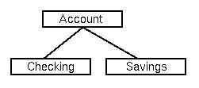
Inheritance principles
1. Specialization: Usual form of inheritance: Checking inherits properties of Account.
Opposite is generalization:
Account is more general than Checking.

Slide 37
Inheritance principles
2. Decomposition: Breaking an encapsulated object into parts.
A rational object is a num and a den.
Useful if inheritance of methods disallowed.

Slide 38
Inheritance principles
3. Instantiation: Creation of instances of an object:
rational A, B, C; ⇐ Represents 3 instantiations of object rational.

Slide 39
Inheritance principles
4. Individualization: Related to specialization.
Separate objects by function, not structure. A stack and a set can both be an array and and an index pointer, but functionality different.
Opposite is grouping.

