Slide 1
Embedded Systems and Software Validation – Performance Validation
Abhik Roychoudhury
National University of Singapore
http://www.comp.nus.edu.sg/~abhik/
Copyright 2009 by Abhik Roychoudhury

Slide 2
Timing in Embedded Systems
Task
Scheduling
CPU
Co-proc.
DSP
Communication scheduling
Task1
Task4
Task2
event stream
Communication network
Subsystem
A
Subsystem
B
Task5
Task3
I/O
Complex Processors
Cache, Pipeline
Complex Interaction
With environment
Many possible inputs
- Complex application programs
Difficult to analyze & debug!
Copyright (c) 2009, Abhik Roychoudhury

Slide 3


Example Set-up
system-level view of a video
encoder in a video phone
raw video
stream
MPEG-2 encoder
encoded
video stream
media processor + µ-architecture
network
on-chip
buffer
video decoding
and playout at the
receiver at a
specified frame-rate
video
capture
minimum
buffer size
required?
Need to look inside the different processing tasks, and analyze their timing!
Copyright 2009 by Abhik Roychoudhury

Slide 4
Time is abstracted!
Our programming languages do not mention time
  C, Java, C#, C++
Even an instruction takes variable time
  Hit/miss in instruction cache
  Hit/miss in data cache
  Pipeline stalls
    Data hazard
    Resource contention
  Branch prediction …
Need timing analysis of programs!
Copyright (c) 2009, Abhik Roychoudhury

Slide 5
Timing analysis of programs
  Estimating uninterrupted software execution time on a given hardware (processor).
  A building block for more complicated performance analysis.
    Communicating multi-processor execution.
  Helps estimate performance of a design point.
    Serves as a sub-routine for Design Space Exploration.
Copyright (c) 2009, Abhik Roychoudhury

Slide 6
Timing analysis of programs
Schedulability analysis of Hard Real-time systems.
  Such analysis assumes knowledge of WCET of each task being scheduled.
    WCET stands for Worst-case Execution Time
  Rate Monotonic scheduling with tasks T₁,…,T_{n}
    Computation times C₁,…,C_{n}
    Period = deadline D₁,…,D_{n}
    Here C₁,…,C_{n} are the WCET (not average execution times of the programs)
Copyright (c) 2009, Abhik Roychoudhury

Slide 7
Organization
Software timing analysis
  WCET analysis
System level analysis
  Schedulability analysis
Design issues to improve timing predictability
  Scratchpad memories
Copyright (c) 2009, Abhik Roychoudhury

Slide 8
WCET
Worst Case Execution Time (WCET) of a program for a given hardware platform.
  Sequential Terminating Programs.
  Gets input, computes, produces output.
Many inputs are possible.
  Leads to different execution times.
WCET : An upper bound on the execution time for all possible inputs.
Copyright (c) 2009, Abhik Roychoudhury

Slide 9
Why need analysis?
To find WCET of a program, execute it for all possible inputs.
  WCET by measurement.
  Exponentially many possible inputs in terms of input size.
    Insertion sort program
  Similar problems will be encountered for WCET Analysis via platform simulation.
Need access to platforms/simulators also!
  Go for static analysis.
Copyright (c) 2009, Abhik Roychoudhury

Slide 10
WCET by measurement?
What about single path programs such as matrix multiplication ?
  Execution path is independent of input data.
  Still execution time can be variable.
    Latency of floating point operation (e.g., multiplication) depends on the input data.
  Not possible to try it on all possible platforms and then choose one.
    Often trying to decide the platform as well.
Copyright (c) 2009, Abhik Roychoudhury

Slide 11
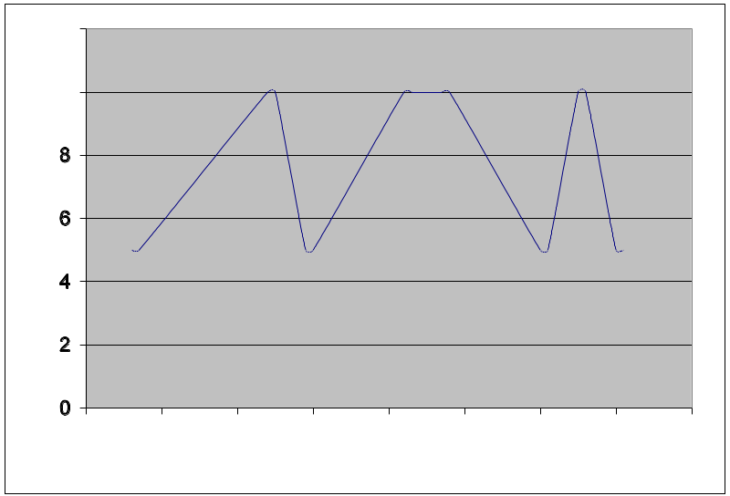
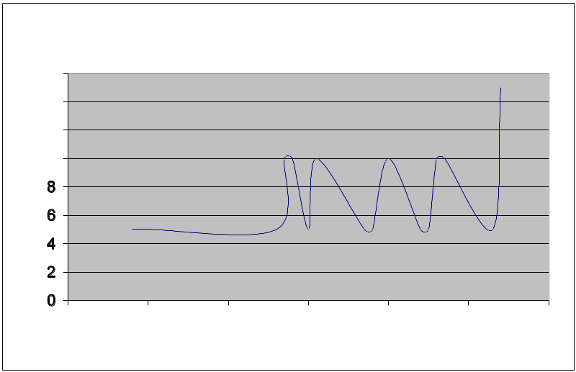
Why Platform-aware Analysis?
Distribution of execution times across inputs in a quicksort program on a simple and complex processor
Copyright (c) 2009, Abhik Roychoudhury

Slide 12
WCET Analysis
Employ static analysis to compute an upper bound on actual WCET (Estimated WCET)
Run program on selected inputs get a lower bound on actual WCET (Observed WCET)
Estimated WCET ≥ Actual WCET ≥ Observed WCET
Estimated
Actual
Observed
Copyright (c) 2009, Abhik Roychoudhury

Slide 13
BCET and WCET
Over-estimation
Observed
BCET
Observed
WCET
Estimated
WCET
Distribution of Execution Time
Actual
WCET
Actual
BCET
Actual
Estimated
BCET
Observed
Execution Time
Copyright (c) 2009, Abhik Roychoudhury

Slide 14
WCET Analysis
Program path analysis
  All paths in control flow graph are not feasible.
Micro-architectural modeling
  Dynamically variable instruction execution time.
    Cache, Pipeline, Branch Prediction
    Out-of-order Pipelines
Estimated
Actual
Observed
Copyright (c) 2009, Abhik Roychoudhury

Slide 15
Clarification: Control flow graph
x = 1; y = 0; z = 0;
while (x < 10){
if (x > 5)
y = y + x;
else z = z + x;
x = x + 1;
}
printf(….);
x =1; y = 0; z = 0;
x < 10
Y
N
x > 5
Y
N
y = y +x
z = z + x
printf(…)
x = x +1
Nodes of the graph, basic blocks, are maximal code fragments executed without control transfer. The edges denote control transfer.
Copyright 2009 by Abhik Roychoudhury

Slide 16
Exercise: CFG
procedure Check_data()
{ int i = 0, morecheck = 1, wrongone = -1, datasize = 10;
L: while (morecheck)
LB: {
if (data[i] < 0)
A: { wrongone = i; morecheck = 0; }
else
B: if (++i >= datasize) morecheck = 0;
}
if (wrongone >= 0)
C: { handle_exception(wrongone); return 0; }
C’: else return i;
}
Copyright 2009 by Abhik Roychoudhury

Slide 17
Exercise on CFG
Construct the CFG of the procedure given in the previous slide.
How to construct an inter-procedural CFG for a program with many procedures?
main(){ f1(){ f2(){
… … …
f1(); f2(); f2();
f2(); … …
… } }
}
Copyright 2009 by Abhik Roychoudhury

Slide 18
Why all paths may not be feasible?
if (x > 0{
y = 1;
else
y = 2;
}
if (x > 1){
z = 10;
else
z = 20;
}
…
x >0
Y
N
y = 1
y = 2
x >1
Y
N
z = 10
z = 20
…
Copyright 2009 by Abhik Roychoudhury

Slide 19
Restrictions of analysis – (1)
Static analysis need not be on source program.
  We can perform static analysis on assembly code of a given program.
  The analysis is only for time taken, and not for the memory locations / values accessed.
  No restriction on program data structures used for WCET analysis.
  What about control flow ?
Copyright (c) 2009, Abhik Roychoudhury

Slide 20
Restrictions of analysis – (2)
Restrictions on control flow
  1. No unbounded loops
    Common sense.
      Otherwise how to guarantee time?
  2. No unbounded recursion
    Similar issue.
  3. No dynamic function calls
    Need to statically know the functions called, and the possible call sites of these functions.
Copyright (c) 2009, Abhik Roychoudhury

Slide 21
Organization of WCET Analysis
What is Timing Analysis ?
An Early solution -- Timing Schema.
Modeling Program Flows.
  Primarily Control flow.
Modeling timing effects of Micro-architecture.
  Cache, pipeline.
Copyright (c) 2009, Abhik Roychoudhury

Slide 22
Timing Schema
One of the first works on WCET analysis.
Basically, perform control flow analysis to find the “longest” program path.
The notion of “longest” is weighted
  Take into account the cost of executing individual program elements.
  Timing schema is a simple way of composing these costs.
Does not work on Control Flow Graphs
  Works on Abstract Syntax Tree
Copyright (c) 2009, Abhik Roychoudhury

Slide 23
Example
sum = 0;
for (i=0; i< 10; i++){
if (i % 2 == 0)
sum += i;
if (sum < 0)
break;
}
return sum;
SEQUENCE
sum = 0;
i = 0
FOR
return sum
i < 10
SEQUENCE
i++
IF
IF
i%2==0
sum<0
sum+=i
break
Copyright (c) 2009, Abhik Roychoudhury

Slide 24
AST and CFG
Hierarchy
  AST shows the different scopes at different levels
  CFG has no hierarchy.
Loops
  AST is tree, free from cycles
  Any loop in the program is a cycle in the CFG.
Copyright 2009 by Abhik Roychoudhury

Slide 25
AST and CFG
sum =0; i =0;
SEQUENCE
i < 10
sum = 0; i = 0
FOR
return sum
Y
N
i %2==0
Y
N
i < 10
SEQUENCE
i++
sum+=i
IF
IF
sum<0
Y
N
break
i%2==0
sum<0
sum+=i
break
i++
return sum
Copyright 2009 by Abhik Roychoudhury

Slide 26
Timing schema – (works on AST)
Time(S1;S2) = Time(S1) + Time(S2)
Time(if B {S1} else {S2})
  = Time (B) + max( Time(S1), Time(S2) )
Time( while B {S1} )
  = (n+1) * Time(B) + n * Time(S1)
  n is the loop bound.
Time( for(Init; B; Incr.){ S } )
  = Time(Init) + (n+1)*Time(B) + n*Time(S) + n*Time(Incr.)
Time( if (B) { S} ) = Time(B) + Time(S)
Copyright (c) 2009, Abhik Roychoudhury

Slide 27
Timing schema
SEQUENCE
Time(for-loop)
= Time(i= 0) +
11 * Time(i < 10) +
10 * 4 + 10 * Time(i++)
= 1 + 11 + 10*4 + 10*1
= 62 time units
sum = 0; i = 0
FOR
return sum
4
i < 10
SEQUENCE
i++
Assumption:
Each assignment/condition takes 1 time unit
(not realistic in practice).
IF
IF
(1 + 1 ) = 2
(1 + 1 ) = 2
i%2==0
sum<0
sum+=i
break
Copyright (c) 2009, Abhik Roychoudhury

Slide 28
Problems with Timing Schema
Language Level:
  Just a control flow analysis.
  Insensitive to knowledge of infeasible paths.
Compiler level:
  How to integrate effect of compiler opt?
    Easy to handle – schema on optimized code.
Architecture level:
  Instructions take constant time – Not true.
  Cache hits, pipelining and other performance enhancing features.
Copyright (c) 2009, Abhik Roychoudhury

Slide 29
The issue with Infeasible Paths
T = T5 + T6
SEQ
T6
T5 = (n+1)*T4 + n*T3
i = 0
WHILE
What if T1 > T2 and
S1 is executed only in the first loop iteration?
T3 = T0 + max(T1,T2)
T4
B
IF
T1
T2
T0
B1
S1
S2
Copyright (c) 2009, Abhik Roychoudhury

Slide 30
Infeasible paths
Infeasible sequence of statements in general
if (J== 0) {
K = 1
} else {
K = 10
}
if (K < 5){
J++;
} else {
J--;
}
Cannot be executed together
Such infeasible paths should not be a witness to our WCET estimate.
Copyright (c) 2009, Abhik Roychoudhury

Slide 31
Infeasible Path handling in Timing Schema
if (J== 0) {
K = 1
} else {
K = 10; …
}
if (K < 5){
J++;…
} else {
J--;
}
SEQUENCE
ITE
ITE
J== 0
K=1
K=10;
…
K <5
J++
J--
How will timing schema work on this example?
Copyright 2009 by Abhik Roychoudhury

Slide 32
Working of timing schema
Time(first-if-statement)
= 1 + max(1,5) = 6
Time(second-if-statement)
= 1 + max(5,1) = 6
Estimated worst case
time = 6 + 6 = 12
Actual worst-case time
= 2 +6 = 8
Why?
Where is the overestimate from?
SEQUENCE
ITE
ITE
1
5
1
1
1
5
J== 0
K=1
K=10;
…
K <5
J++; …
J--;
Copyright 2009 by Abhik Roychoudhury

Slide 33
Control flow graph (CFG)
J == 0 ??
Y
N
K = 1
K = 10
K < 5 ??
Y
N
J --
J++
Copyright (c) 2009, Abhik Roychoudhury

Slide 34
Infeasible path in CFG
J == 0 ??
Y
N
K = 1
K = 10
K < 5 ??
Y
N
J --
J++
Copyright (c) 2009, Abhik Roychoudhury

Slide 35
Modeling of control flow
Path-based
  Enumerate paths and find longest path
    Expensive !
    Need to remove longest path if it is infeasible.
Tree-based
  Bottom-up pass of Syntax Tree
    Timing Schema
  Difficult to integrate infeasible path info
Integer Linear Programming
  Can take into account certain infeasible path information if available.
  Efficient solvers available e.g. CPLEX
    Forms the back-end of most state-of-the-art timing analyzers.
Copyright (c) 2009, Abhik Roychoudhury

Slide 36
Integer Linear Programming
ILP: Integer Linear Programming
  Variables and linear constraints on them.
  Cost function (linear) to optimize.
f = 3x + 5y + z
0 <= x, y, z <= 100
x + y + z = 200
x + 2y <= 160
________________________________________________
Optimal: f = 520; x = 40; y = 60; z = 100
Non-Optimal: f = 480; x = 80; y = 30; z = 90
Copyright 2009 by Abhik Roychoudhury

Slide 37
ILP Modeling
e1
e2
x = e1 + e2
= e3 + e4
Basic Blk
x
e3
e4
We are dealing with aggregated execution counts of nodes/edges of CFG.
Copyright (c) 2009, Abhik Roychoudhury

Slide 38
1
sum = 0; i = 0
2
i < 10
sum = 0;
for (i=0; i< 10; i++){
if (i % 2 == 0)
sum += i;
if (sum < 0)
break;
}
return sum;
yes
no
3
i % 2 == 0
yes
no
4
sum += i
5
sum<0
no
yes
6
8
i++
break
7
return sum
Copyright (c) 2009, Abhik Roychoudhury

Slide 39
Maximize
Time =
c₁N₁ +c₂N₂ +c₃N₃ +c₄N₄+ c₅N₅ + c₆N₆ + c₇N₇ + c₈N₈
1 = N₁ = E_{1,2}
E_{6,2} + E_{1,2} = N₂ = E_{2,3} + E_{2,7}
E_{2,3} = N₃ = E_{3,4} + E_{3,5}
E_{3,4} = N₄ = E_{4,5}
E_{3,5} + E_{4,5} = N₅ = E_{5,6} + E_{5,8}
E_{5,6} = N₆ = E_{6,7}
E_{5,8} = N₈ = E_{8,7}
E_{8,7} + E_{2,7} = N₇ = 1
E_{6,2} ≤ 10
1
sum = 0; i = 0
2
i < 10
yes
no
3
i % 2 == 0
yes
no
4
sum += i
5
sum<0
no
yes
6
8
i++
break
7
return sum
Copyright (c) 2009, Abhik Roychoudhury

Slide 40
Infeasible path
1
sum = 0; i = 0
2
i < 10
The break statement is executed at most once.
  N₈ ≤ 1
yes
no
3
i % 2 == 0
yes
no
4
sum += i
5
sum<0
no
yes
6
8
i++
break
7
return sum
Copyright (c) 2009, Abhik Roychoudhury

Slide 41
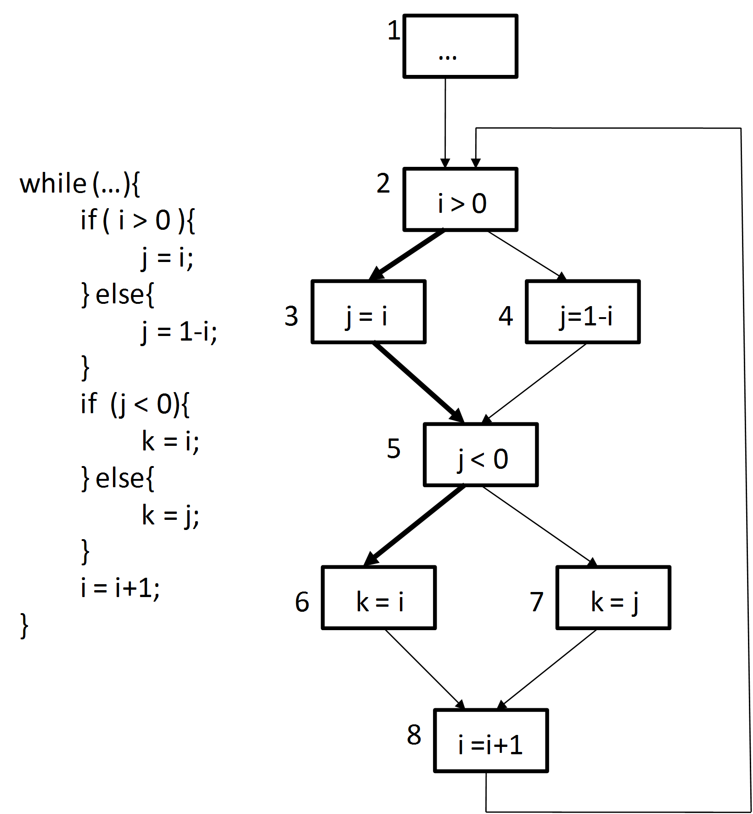
Blocks 3 and 6 are
never executed in
same loop iteration
N₃ +N₆ ≤ loopbound
Edges (2,3) and (5,6) are not executed together.
E_{2,3} = E_{5,7}
Copyright (c) 2009, Abhik Roychoudhury

Slide 42
How to express this inf. path constraint?
J == 0 ??
Y
N
K = 1
K = 10
K < 5 ??
Y
N
J --
J++
Copyright 2009 by Abhik Roychoudhury

Slide 43
Exercise: What are the infeasible paths?
procedure Check_data()
{ int i = 0, morecheck = 1, wrongone = -1, datasize = 10;
while (morecheck)
{
if (data[i] < 0)
{ wrongone = i; morecheck = 0; }
else
if (++i >= datasize) morecheck = 0;
}
if (wrongone >= 0)
{ handle_exception(wrongone); return 0; }
else return i;
}
Copyright 2009 by Abhik Roychoudhury

Slide 44
Organization
What is Timing Analysis ?
An Early solution – Timing schema
Modeling Program Flows.
  Primarily Control flow.
Modeling timing effects of Micro-architecture.
  Cache, pipeline.
Copyright (c) 2009, Abhik Roychoudhury

Slide 45
The two phases
WCET analysis involves
  Program path analysis – ILP
  Micro-architectural modeling.
How do the two analyses interact?
  Time = c1*N1 + c2*N2 +c3*N3 + …
  c1,c2, … : exec time of basic blocks 1,2, …
  N1,N2, … : exec count of basic blocks 1,2, …
  c1, c2, … are estimated by µ-arch. modeling
  N1,N2, … are fixed by control flow analysis via Integer Linear Programming (ILP).
Copyright (c) 2009, Abhik Roychoudhury

Slide 46
Instruction Cache Modeling
One concrete hardware data structure.
With no hardware modeling, all instructions should be taken as misses.
Instead we can categorize some instructions as “always hit”
  Coarse modeling.
  For certain instructions, even the “worst case” may not be a miss !
Copyright (c) 2009, Abhik Roychoudhury

Slide 47
Categorization
… of instructions
  AH (always hit)
  AM (always miss)
  PS (Persistent: second and all further executions are guaranteed to produce a hit)
    Effect of cold misses
  NC (not AH, AM, PS)
Copyright (c) 2009, Abhik Roychoudhury

Slide 48
Cache - basics
Redundant storage to reduce memory access time.
Many memory blocks map to a single cache line
F: Memory Block → Cache lines
  Given a memory block m, F(m) returns the set of cache lines it can map to.
  If F(m) is always a singleton set, then we have a direct mapped cache.
  If |F(m)| is n, we have n-way set associative cache.
  If F(m) = Set of all cache lines, then we have a fully associative cache (any memory block can map to any cache line).
Copyright (c) 2009, Abhik Roychoudhury

Slide 49
Cache - basics
Fully associative with LRU policy.
Cache lines = L₁, L₂, …, L_{n}
  L₁ is the youngest line
  L_{n} is the oldest line
  Do not refer to physical cache lines
Memory blocks = S₁, …,S_{m}
  Any block S_{i} can map to any cache line L_{j} during program execution
Copyright (c) 2009, Abhik Roychoudhury

Slide 50
Concrete cache update
s
s
youngest
z
z
y
x
y
t
x
oldest
s is not in cache
Removed from cache
Copyright (c) 2009, Abhik Roychoudhury

Slide 51
Concrete cache update
s
z
s
youngest
z
s
x
x
t
t
oldest
s is in cache
Copyright (c) 2009, Abhik Roychoudhury

Slide 52
Abstract cache state
In the concrete cache state c, if a block is in cache line x, its age is x
  Cache line 1 is youngest.
In the abstract cache state c’, each line x contains a set of memory blocks
  B ∈ c’( L_{x} ) at a program point p means …
  When control reaches p, B may (must) be in cache with min (max) age = x
  Direction of approximation in abstraction.
Copyright (c) 2009, Abhik Roychoudhury

Slide 53
May analysis
{a}
{c}
youngest
{c,f}
{e}
{}
{a}
{d}
{d}
oldest
In cache in some path.
If so, take min. age
{a,c}
{e,f}
{}
{d}
Copyright (c) 2009, Abhik Roychoudhury

Slide 54
Must analysis
{a}
{c}
youngest
{e}
{}
{c,f}
{a}
{d}
{d}
oldest
In cache in both paths
If yes, take max age.
{}
{}
{a,c}
{d}
Copyright (c) 2009, Abhik Roychoudhury

Slide 55
Persistence analysis
{c}
youngest
{e}
{e,f}
{b}
{c}
{a}
{d}
{d}
oldest
{a}
{b}
{}
{e,f}
In cache in any path
If yes, take max age.
{c}
{d}
{a,b}
Copyright (c) 2009, Abhik Roychoudhury

Slide 56
How to use such analyses?
Let I be an instruction at control loc. CL
Let M be the memory block containing I.
  Consider cache state at CL obtained via “must analysis”.
    If M is in some cache line within this abstract cache state, then I is Always Hit.
  For cache state at CL obtained via “may analysis”
    If M is not in any cache line within this abstract cache state, then I is Always Miss.
  For abstract cache state at CL obtained from persistence analysis
    If M is not in the evicted line, then I is Persistent.
Copyright (c) 2009, Abhik Roychoudhury

Slide 57
Use of may-must analyses
Let hit_time = t1, miss_time = t2
Number of accesses of I == #I (ILP variable)
  I is AH
    #I * t1 = contribution of I to WCET
  I is AM
    #I * t2 = contribution of I to WCET
  I is PS
    (#I -1)*t1 + t2 = contribution of I to WCET
Formulation is still linear, solve via ILP.
Copyright (c) 2009, Abhik Roychoudhury

Slide 58
Improving precision
If we can bound the number of misses of instr. I (via constraints)
  No need to reduce exec. Time of I to constant
  Contribution of I to WCET
    #miss(I)*t2 + (#I – #miss(I))*t1
  Need constraints to bound #miss(I)
  How to develop such constraints ?
    ILP, Expensive !!
    See cache conflict graph approach in textbook
      Pages 147 – 149.
Copyright (c) 2009, Abhik Roychoudhury

Slide 59
Micro-arch. modeling so far
Modeling timing effects of I-cache
  Abstract Interpretation to categorize instr
  ILP based modeling is more expensive.
I-cache does not have timing anomalies
  Can assume all accesses are misses.
  Very pessimistic, but estimate still safe !
For certain processors, even this is not true !
  Adding worst-case of each instruction may produce an estimate lower than the global worst-case !
Copyright (c) 2009, Abhik Roychoudhury

Slide 60
Pipelined execution
Divide the execution of an instruction into stages
Instruction I+1 can proceed before I completes
Increased throughput, lower overall execution time
IF
SIMPLIFIED VIEW !!
0
1
2
3
4
I
ID
I+1
I
EX
I+2
I+1
I
WB
I+3
I+2
I+1
I
CM
I+4
I+3
I+2
I+1
I
Copyright (c) 2009, Abhik Roychoudhury

Slide 61
Out-of-order pipeline
Mem => I-buffer (inorder)
IBUF => ROB (in-order)
ROB => FU (out-of-order), (Instr still in ROB)
FU => ROB (out-of-order) (forward data)
Update register file, free ROB entry (in-order)
IF
I+1
I
IBUF
tail
head
ID
I-1
I-4
GPR
EX
ROB
I-2
I-3
FPR
WB
ALU
CM
MULT
FPU
Copyright (c) 2009, Abhik Roychoudhury

Slide 62
O-o-o execution (1)
Partial order of dependences
# Ready Instruction
Cycle
A 0 mult r3 r1 r2
B 1 add r3 r3 8
C 2 and r3 r3 0xff
D 3 addu r5 r4 8
E 4 mult r5 r5 r6
A
D
B
C
E
0
1
2
3
4
5
6
7
8
9
10
A
E
Instruction sequence
MULTU
D
B
C
MULTU 1 ~ 4 cycles
ALU 1 cycle
ALU
Latencies
Instruction A executes 4 cycles
Copyright (c) 2009, Abhik Roychoudhury

Slide 63
O-o-O execution (2)
# Ready Instruction
Cycle
A 0 mult r3 r1 r2
B 1 add r3 r3 8
C 2 and r3 r3 0xff
D 3 addu r5 r4 8
E 4 mult r5 r5 r6
0
1
2
3
4
5
6
7
8
9
10
MULTU
A
E
B
C
D
ALU
Instruction A executes 3 cycles
Instruction sequence
A
D
MULTU 1 ~ 4 cycles
ALU 1 cycle
B
C
E
Latencies
Copyright (c) 2009, Abhik Roychoudhury

Slide 64
Difficulty in modeling
# Ready Instruction
Cycle
A 0 mult r3 r1 r2
B 1 add r3 r3 8
C 2 and r3 r3 0xff
D 3 addu r5 r4 8
E 4 mult r5 r5 r6
0
1
2
3
4
5
6
7
8
9
10
MULTU
A
E
B
C
D
ALU
Instruction A executes 3 cycles
0
1
2
3
4
5
6
7
8
9
10
A
E
Instruction sequence
MULTU
D
B
C
MULTU 1 ~ 4 cycles
ALU 1 cycle
ALU
Latencies
Instruction A executes 4 cycles
Copyright (c) 2009, Abhik Roychoudhury

Slide 65
Timing Anomaly
Overall WCET of an instruction sequence cannot be obtained from WCET of each instruction
Need to consider all possible execution times of each instruction to safely estimate WCET !
  Expensive enumeration
Very different from cache modeling
  Worst-case cache behavior of an instruction sequence can be safely estimated by considering all cache accesses as misses
Copyright (c) 2009, Abhik Roychoudhury

Slide 66
Summing up …
WCET Analysis
  Program flow modeling (typically by ILP)
    Combine reasoning about timing of program fragments.
    Exploiting Infeasible path information.
    Difficult to use model checking for this purpose.
  Micro-architectural modeling (customized analysis)
    Exec. time of each instruction is not constant.
    Worst-case not found by adding up worst-cases of code fragments – non compositional.
      Efficient analysis developed to overcome this (not discussed).
Copyright (c) 2009, Abhik Roychoudhury

Slide 67
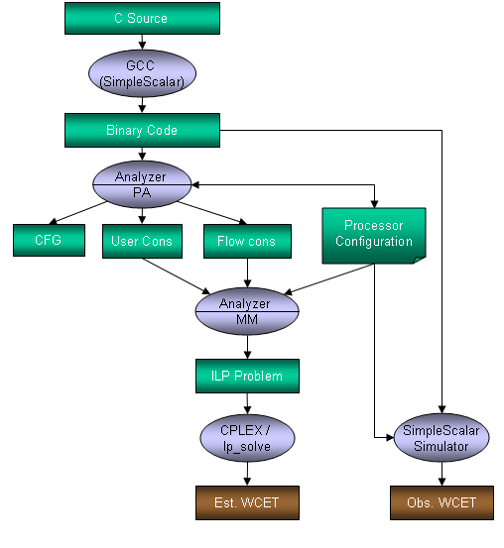
Chronos Tool for WCET analysis
Copyright (c) 2009, Abhik Roychoudhury

Slide 68
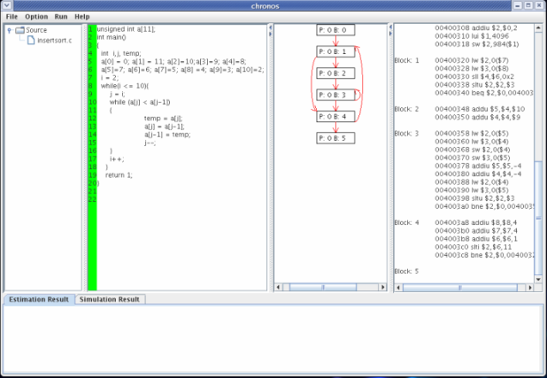
Chronos – views of program
Copyright (c) 2009, Abhik Roychoudhury

Slide 69
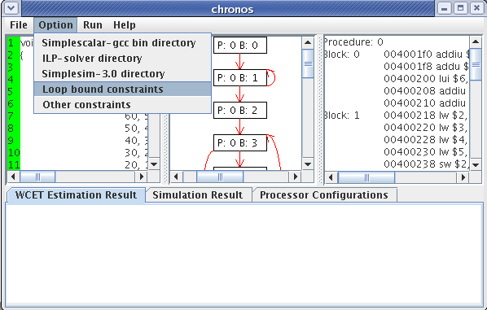
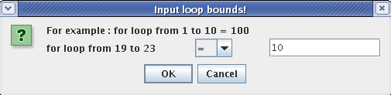
Set loop bounds
Constraints specified by user at source code level.
These are automatically translated to node counts of assembly level control flow graph.
Copyright (c) 2009, Abhik Roychoudhury

Slide 70
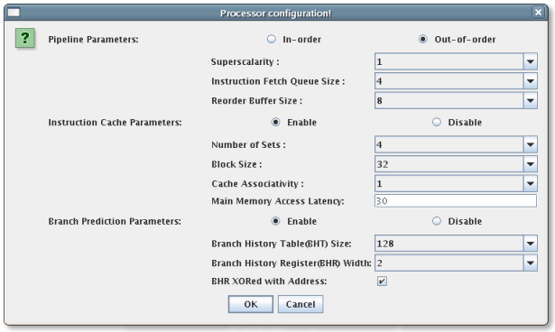
Flexible micro-arch modeling
Copyright (c) 2009, Abhik Roychoudhury

Slide 71
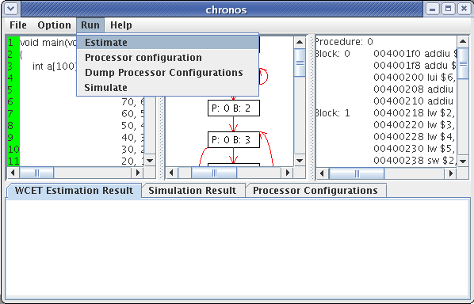
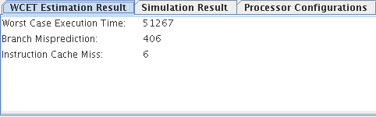
WCET Estimation
Copyright (c) 2009, Abhik Roychoudhury

Slide 72
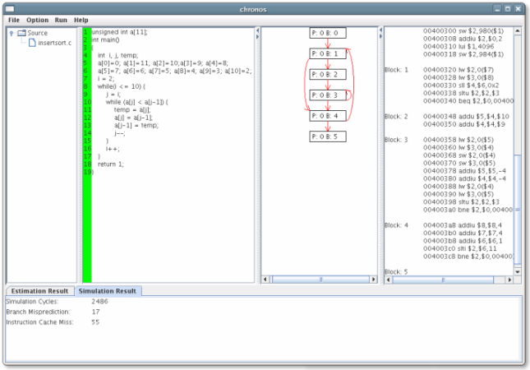
Simulation vs Estimation
Simulation produces
Observed WCET.
Estimation produces
Estimated WCET
Observed WCET ≤ Actual WCET ≤ Estimated WCET
Copyright (c) 2009, Abhik Roychoudhury

Slide 73
Organization
Software timing analysis
  WCET analysis
System level analysis
  Schedulability analysis
Design issues to improve timing predictability
  Scratchpad memories
Copyright (c) 2009, Abhik Roychoudhury

Slide 74
Why study scheduling?
Increase CPU utilization or other metrics
For real-time systems requiring hard guarantees
  Study in advance whether all tasks can be scheduled without missing any deadlines.
  Need computation time of each task
    Typically given as a worst-case bound, called the Worst-case Execution Time (WCET)
    How to derive these bounds ? –
      We studied this just now (WCET analysis !)
Copyright (c) 2009, Abhik Roychoudhury

Slide 75
Periodic tasks
A task is a program!
Activated on a regular basis between fixed interval
  scan the airspace every 3 sec
P = (s, c, p, d)
  s = start time or arrival time
  c = worst case execution time (WCET)
  p = period or cycle time
  d = deadline
  c <= d <= p
Copyright (c) 2009, Abhik Roychoudhury

Slide 76
Task Execution
Terminate
Scheduling
activation
dis-
patch
Execution
….
pre-emption
Dispatching from the ready queue will be based on the scheduling policy which takes into account task priority.
Copyright (c) 2009, Abhik Roychoudhury

Slide 77
Priority driven scheduling
Each process has a priority.
CPU goes to highest-priority process that is ready.
Priorities determine scheduling policy:
  fixed priority;
  time-varying priorities.
Rules:
  each process has a fixed priority (1 highest);
  highest-priority ready process gets CPU
  process continues until done (non pre-emptive) OR
  Process can be pre-empted by a later arriving higher priority process.
Copyright (c) 2009, Abhik Roychoudhury

Slide 78
Example (premptive)
  P1: priority 1, execution time 10
  P2: priority 2, execution time 30
  P3: priority 3, execution time 20
P3 ready t=18
P2 ready t=0
P1 ready t=15
P2
P1
P2
P3
0
10
20
30
40
50
60
time
Copyright (c) 2009, Abhik Roychoudhury

Slide 79
Rate-monotonic scheduling
RMS (Liu and Layland 1973)
  widely-used, analyzable scheduling policy.
Analysis is known as Rate Monotonic Analysis
RMS is an optimal fixed priority assignment method
  If there exists a schedule that meets all the deadlines with fixed priority, then RMS will produce a feasible schedule.
Fixed-priority, pre-emptive scheduling.
Copyright (c) 2009, Abhik Roychoudhury

Slide 80
Assumptions in RMS
All process run on single CPU.
Zero context switch time.
No data dependencies between processes.
Process execution time is constant.
Deadline is at end of period (p = d)
Highest-priority ready process runs.
Copyright (c) 2009, Abhik Roychoudhury

Slide 81
Priority assignment in RMS.
Optimal (fixed) priority assignment:
  shortest-period process gets highest priority;
  priority inversely proportional to period;
  break ties arbitrarily.
Intuition: Processes requiring frequent attention (smaller period) should receive higher priority
Copyright (c) 2009, Abhik Roychoudhury

Slide 82
RMS Example
P1: s=0, c=2, p=d=5
P2: s=1, c=1, p=d=4
P3: s=2, c=2, p=d=20
0
5
10
15
20
P1
1
5
9
13
17
21
P2
2
22
P3
Copyright (c) 2009, Abhik Roychoudhury

Slide 83
Rate monotonic analysis
Response time: time required to finish process.
Critical instant: scheduling state that gives worst response time.
Critical instant occurs when all higher-priority processes are ready to execute.
Worst case response time
  Solved by iterative computation
  w_{i} = c_{i} + ∑_{j<i} c_{j} *⎡w_{i}/p_{j}⎤
Copyright (c) 2009, Abhik Roychoudhury

Slide 84
Critical Instant
interfering processes
P1
P1
P1
P1
P1
P2
P2
P2
P3
P3
critical
instant
P4
Copyright (c) 2009, Abhik Roychoudhury

Slide 85
Informal argument about optimality
P1 = (c1, p1, d1) with p1 = d1
P2 = (c2, p2, d2) with p2 = d2
p1 < p2
Suppose P1 and P2 can be scheduled with non-RM priority assignment, i.e., P2 has highest priority
At critical instant, with non-RM priorities
  c1 + c2 <= p1; [1]
With RM priority
  ⎣p2/p1⎦*c1 + c2 <= p2; [2]
If [1] is satisfied, then [2] is also satisfied
Copyright (c) 2009, Abhik Roychoudhury

Slide 86
RMS optimality
P2
P2 period
P1 period
P1
P1
P1
P1
P2 period
P1 period
P2
P1
P1
Copyright (c) 2009, Abhik Roychoudhury

Slide 87
RMS CPU utilization
Utilization for n processes is
  U = Σ _{i} c_{i} / p_{i}
U<=1 is a necessary condition for feasibility regardless of scheduling policy
Scheduling with fixed priorities is feasible if
U <= n (2 ^{1/n} – 1)
The bound is sufficient but not necessary
As number of tasks approaches infinity, maximum utilization approaches 69%.
  RMS cannot use 100% of CPU, even with zero context switch overhead.
  Must keep idle cycles available to handle worst-case scenario.
Copyright (c) 2009, Abhik Roychoudhury

Slide 88
Earliest-Deadline-First
EDF: dynamic priority scheduling scheme.
Process closest to its deadline has highest priority.
Requires recalculating processes at every timer interrupt.
EDF can use 100% of CPU.
Implementation
  On each timer interrupt:
    compute time to deadline;
    choose process closest to deadline.
  Generally considered too expensive to use in practice.
Copyright (c) 2009, Abhik Roychoudhury

Slide 89
EDF Example
P1 = (2, 4, 4) P2 = (5, 10, 10)
P1 period
P1
P1
P1
P1
P1
P2 period
P2
P2
P2
P2
0 2 4 6 8 10 12 14 16 18 20
time
Copyright (c) 2009, Abhik Roychoudhury

Slide 90
EDF Properties
EDF is optimal
  If a feasible schedule exists using dynamic priorities, then EDF will produce a feasible schedule
EDF can always produce a feasible schedule if U ≤ 1
Scheduling with dynamic priority is feasible if and only if U ≤ 1
Copyright (c) 2009, Abhik Roychoudhury

Slide 91
Fixing scheduling problems …
… in practice.
What if your set of processes is not schedulable?
  Change deadlines in requirements.
  Reduce execution times of processes.
  Get a faster CPU.
Copyright (c) 2009, Abhik Roychoudhury

