Slide 1
Embedded Systems and Software Validation – Software Validation
Abhik Roychoudhury
National University of Singapore
http://www.comp.nus.edu.sg/~abhik/
Copyright 2009 by Abhik Roychoudhury

Slide 2
Software construction
From a design model
  In safety-critical domains – automotive, avionics.
  D0 178C – software in airborne systems.
Or, hand-constructed
  Usual practice – audio, video and other domains.
  UML models only for guidance.
Copyright (c) 2009, Abhik Roychoudhury

Slide 3
Model-driven engineering
User
Requirements (English)
Desirable
Properties
Manual step
Manual step
Alternate models?
Sequence Diag.
Design Model (State Diagrams?)
Static checking
tools
Semi-automated
Tests
Testing
Code
Dynamic
checking tools
Validation output
Copyright (c) 2009, Abhik Roychoudhury

Slide 4
No model may be available.
Programmer
coverage
Static
Analyzer
Test Suite
Code
Properties
abstract
testing
Dynamic
Checker
Model
Static
Checker
Validation output
Copyright (c) 2009, Abhik Roychoudhury

Slide 5
Organization
Dynamic checking of programs
  Dynamic slicing
  Hierarchical slicing
  Fault Localization
  Directed testing
Static checking of programs
  Predicate abstraction
  Abstraction refinement
Copyright (c) 2009, Abhik Roychoudhury

Slide 6
What is dynamic checking?
Check program executions, not source code.
How to generate program executions?
  Testing (coverage based)
  Testing (specification based)
How to check program executions
  Data and control dependencies (slicing)
  By comparing against other program executions (fault localization).
Copyright (c) 2009, Abhik Roychoudhury

Slide 7
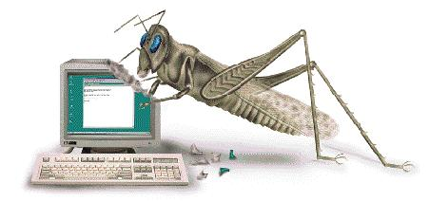
SW Debugging: Social aspects
Software-controlled devices are ubiquitous ---
automotive control, avionics control and consumer electronics
Many of these software are safety-critical
⇒ should be validated extensively.
Copyright (c) 2009, Abhik Roychoudhury

Slide 8
SW Debugging: Economics
How often do bugs appear ?
How many of them are critical?
How much money does a company gain by using sophisticated debugging tools?
Could it be avoided simply by sparing one more programmer?
Copyright (c) 2009, Abhik Roychoudhury

Slide 9
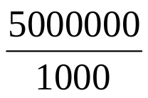
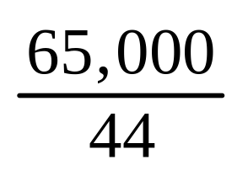
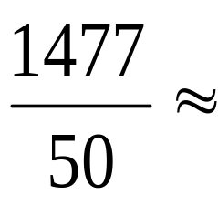
SW Debugging: Economics
SW project with 5 million LOC (note: Windows Vista is 50 million LOC !!)
  Assume linear scaling up of errors
    Actually could be more errors --- we make more mistakes as the SW grows long and arduous.
  1 hr to fix each major error
    Actually much more
  $40K salary per year
= 65,000 bugs
13 *
weeks = 1477 weeks =
30 years = $1.2 M
Copyright (c) 2009, Abhik Roychoudhury

Slide 10
SW Debugging: tools
“Even today, debugging remains very much of an art. Much of the computer science community has largely ignored the debugging problem….. over 50 percent of the problems resulted from the time and space chasm between symptom and root cause or inadequate debugging tools.” (Hailpern & Santhanam, IBM Sys Jnl, 41(1), 2002)
-> Need methods and tools to trace back to the root cause of bug from the manifested error
-> What about the current tools?
Copyright (c) 2009, Abhik Roychoudhury

Slide 11
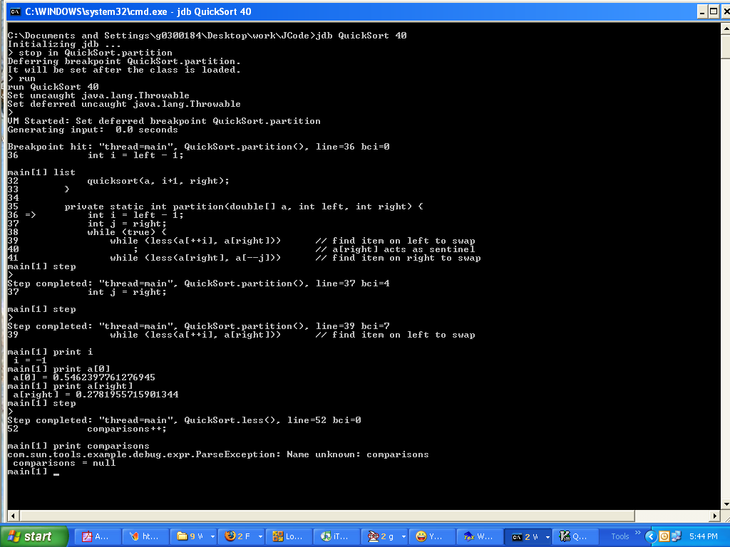
jdb on windows XP
Copyright (c) 2009, Abhik Roychoudhury

Slide 12
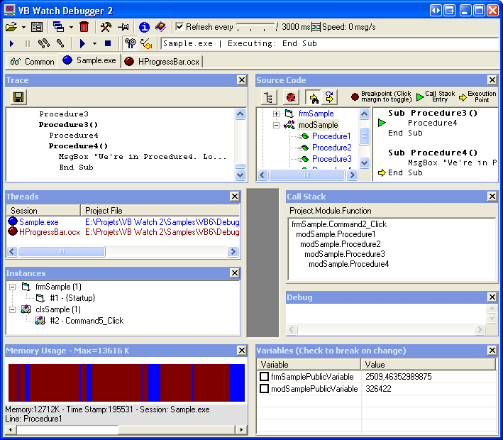
VB watch debugger
Copyright (c) 2009, Abhik Roychoudhury

Slide 13
So, what did we see?
Command line tool for Java
  User can set breakpoints, and
  Replay an execution, and
  Watch it at the breakpoints.
Lack of GUI is not the issue here.
  Can easily collect and visualize more program info.
Lack of automation is the problem!
  Need automated trace analysis.
Copyright (c) 2009, Abhik Roychoudhury

Slide 14
Dynamic Slicing for Debugging
Input
Instrument
Program
Exec. Trace
Debugging
Output
Dynamic Slice =
Bug Report
criterion
OK
Unexpected, debug it
Copyright (c) 2009, Abhik Roychoudhury

Slide 15
Dynamic Slice
Set slicing criterion
  (Variable v at first instance of line 70)
  The value of variable v at first instance of line 70 is unexpected.
Dynamic slice
  Closure of
    Data dependencies &
    Control dependencies
  from the slicing criterion.
Copyright (c) 2009, Abhik Roychoudhury

Slide 16
Dynamic data dependencies
V := 1;
…
U := V
An edge from a variable usage to the latest definition of the variable.
→ Do we consider this data dependence edge ?
→ Remember that the slicing is for an input, so the addresses are resolved
→ We thus define data dependences corresponding to memory locations rather than variable names.
A[i] := 1;
…
U := A[j]
Copyright (c) 2009, Abhik Roychoudhury

Slide 17
Static Control dependencies
Post-dominated: I,J – nodes in Control Flow Graph
I is post-dominated by J iff all paths from I to EXIT pass through J
I
I
NO
YES
J
J
EXIT
EXIT
Copyright (c) 2009, Abhik Roychoudhury

Slide 18
Static control dependencies
I not post-dom by J
U, V post-dom by J
Control dependence
I -> J
I
U
V
J
EXIT
Copyright (c) 2009, Abhik Roychoudhury

Slide 19
Dynamic control dependencies
X is dynamically control dependent on Y if
  Y occurs before X in the execution trace
  X’s stmt. is statically control dependent on Y’s stmt.
  No statement Z between Y and X is such that X’s stmt. is statically control dependent on Z’s stmt.
Captures the intuition:
  What is the nearest conditional branch statement that allows X to be executed, in the execution trace under consideration.
Copyright (c) 2009, Abhik Roychoudhury

Slide 20
Dynamic Slice
1. void setRunningVersion(boolean runningVersion)
2. if( runningVersion ) {
3. savedValue = value;
}
else{
4. savedValue = "";
}
5 this.runningVersion = runningVersion;
6. System.out.println(savedValue);
}
Slicing Criterion
Copyright (c) 2009, Abhik Roychoudhury

Slide 21











Jslice: a dynamic slicing tool
GUI (a Eclipse plug-in)
Execute the program
Select
Bug Report
Kaffe JVM
Instrument
Compact Bytecode Trace
Criterion = (Inp, Var, Line#)
Reverse Translate
Dynamic Slicing
(Stack simulation)
Class Files
Set of bytecodes
http://jslice.sourceforge.net
Copyright (c) 2009, Abhik Roychoudhury

Slide 22
Issues for such a slicing tool
Online trace compression – beyond conventional string compression.
  Full trace is never stored.
Program dependence analysis on compressed trace – no decompression.
Analysis at low-level (byte-code) to support third-party software.
  Managing stack architecture.
Copyright (c) 2009, Abhik Roychoudhury

Slide 23
Organization
Dynamic checking of programs
  Dynamic slicing
  Hierarchical slicing
  Fault Localization
  Directed testing
Static checking of programs
  Predicate abstraction
  Abstraction refinement
Copyright (c) 2009, Abhik Roychoudhury

Slide 24
Problem with dynamic slicing
Huge overheads
  Backwards slicing requires trace storage.
  Jslice tool for Java
    Online trace compression & traversal
    http://jslice.sourceforge.net
Dynamic Slice is still too large …
  … for human comprehension
  Now
Copyright (c) 2009, Abhik Roychoudhury

Slide 25
An example
public static void main(String[] args) {
…….
2. init( db );
3 operate( db );
output ( db )
return;
}
SPECJVM DB program
init( .. db) {
db= ..
….
}
operate (… db ) {
db =..
…
}
output (db) {
……
print(db...);
}
Copyright (c) 2009, Abhik Roychoudhury

Slide 26
Divide trace into phases
public static void main(String[] args) {
…….
2. init( db );
3 operate( db );
output ( db );
return; }
main()
init()
operate()
output()
db
db
db
Copyright (c) 2009, Abhik Roychoudhury

Slide 27
Report inter-phase dependencies
main()
init()
operate()
output()
db
db
db
Intra-phase control and data dependencies are suppressed.
Inter-phase dep. form input-output relationships.
Copyright (c) 2009, Abhik Roychoudhury

Slide 28
Programmer zooms into …
… one phase by inspecting the phase outputs
-> (may/may not involve re-executing program)
main()
init()
operate()
output()
db
db
db
Re-exec phase 1 and observe db
read_db()
insert()
exit()
current_record
entries[2]
Copyright (c) 2009, Abhik Roychoudhury

Slide 29
Parallel Dependence Chains
main()
y
f1()
f2()
f3()
x1
x2
x3
x1 = f1();
x2 = f2();
x3 = f3();
y = x1 + x2 + x3;
print y --- Criterion
…
y
Copyright (c) 2009, Abhik Roychoudhury

Slide 30
Hierarchical dynamic slicing
Compute “phases” of an exec. trace
  Control structure boundaries
Augment dynamic slicing algorithm
  Mark inter-phase dependencies
  Compute only reachable nodes from selected inter-phase dependency.
Programmer intervention
  Select the first suspicious inter-phase dep.
  Comprehension guides computation.
Copyright (c) 2009, Abhik Roychoudhury

Slide 31
In action …
main()
init()
operate()
output()
Copyright (c) 2009, Abhik Roychoudhury

Slide 32
Organization
Dynamic checking of programs
  Dynamic slicing
  Hierarchical slicing
  Fault Localization
  Directed testing
Static checking of programs
  Predicate abstraction
  Abstraction refinement
Copyright (c) 2009, Abhik Roychoudhury

Slide 33
More on debugging
Dynamic slicing analyzes the problematic execution trace.
  Problematic: output is unexpected
  OK: output is as expected.
Alternatively:
  We could compare a given problematic trace with an OK trace to localize the source of error.
Copyright (c) 2009, Abhik Roychoudhury

Slide 34
Fault Localization: overview
Failing Run
Successful Run
Compare Execution
Difference
As bug report
Developer
Copyright (c) 2009, Abhik Roychoudhury

Slide 35
Comparing executions
1 . m=...
2. if (m >= 0) {
3. ...
4. lastm = m;
5. }
6. …..
should be
if ((m >= 0) && (lastm!=m))
Copyright (c) 2009, Abhik Roychoudhury

Slide 36
Comparing executions
1 . m=...
2. if (m >= 0) {
3. ...
4. lastm = m;
5. }
6. …..
1 . m=...
2. if (m >= 0) {
3. ...
4. lastm = m;
5. }
6. …..
Failing run
Successful run
Copyright (c) 2009, Abhik Roychoudhury

Slide 37
Fault localization
Successful Run Pool
Testing
Change Failing Input
Generate
Choose
Failing Run
Successful Run
Difference Metric
Compare Execution
Difference
As bug report
Copyright (c) 2009, Abhik Roychoudhury

Slide 38
Example program
1. if (a)
2. i = i + 1;
3. if (b)
4. j = j + 1;
5. if (c)
6. if (d)
7. k = k + 1;
8. else
9. k = k + 2;
10. printf(“%d”, k);
Program
Copyright (c) 2009, Abhik Roychoudhury

Slide 39
Comparing executions
1. if (a)
2. i = i + 1;
3. if (b)
4. j = j + 1;
5. if (c)
6. if (d)
7. k = k + 1;
8. else
9. k = k + 2;
10. printf(“%d”, k);
1. if (a)
2. i = i + 1;
3. if (b)
4. j = j + 1;
5. if (c)
6. if (d)
7. k = k + 1;
8. else
9. k = k + 2;
10. printf(“%d”, k);
Execution run π
Execution run π1
Copyright (c) 2009, Abhik Roychoudhury

Slide 40
Set of statements
S = Set of statements executed in π
  {1,3,5,6,7,10}
S1 = Set of statements executed in π1
  {1,3,4,5,6,9,10}
If π is faulty and π1 is OK
  Bug report = S – S1 = {4,7}
Choice of the execution run to compare with is very important.
Copyright (c) 2009, Abhik Roychoudhury

Slide 41
Another difference metric
Failing Run
Successful Runs
Number of Branches
Location of Branches
π
π1, π2
diff_1
diff_2
Compare
Copyright (c) 2009, Abhik Roychoudhury

Slide 42
Difference b/w traces shown
1. if (a)
2. i = i + 1;
3. if (b)
4. j = j + 1;
5. if (c)
6. if (d)
7. k = k + 1;
8. else
9. k = k + 2;
10. printf(“%d”, k);
1. if (a)
2. i = i + 1;
3. if (b)
4. j = j + 1;
5. if (c)
6. if (d)
7. k = k + 1;
8. else
9. k = k + 2;
10. printf(“%d”, k);
Copyright (c) 2009, Abhik Roychoudhury

Slide 43
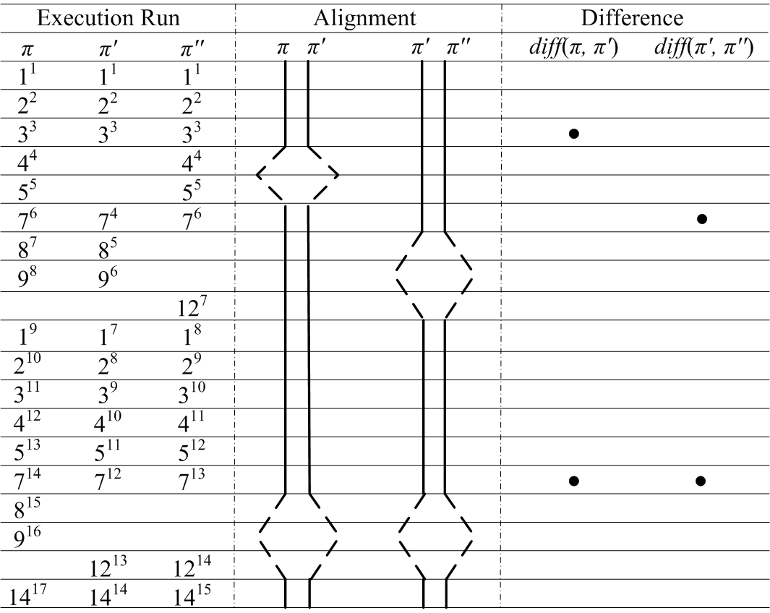
Trace alignment and differences
Copyright (c) 2009, Abhik Roychoudhury

Slide 44
Comparison of differences
Failing run
Successful runs
?
π
π₁
π₂
diff’
diff
Copyright 2009 by Abhik Roychoudhury

Slide 45
Comparison of differences
<
<
diff’
diff’
diff
diff
Copyright 2009 by Abhik Roychoudhury

Slide 46
Organization
Dynamic checking of programs
  Dynamic slicing
  Hierarchical slicing
  Fault Localization
  Directed testing
Static checking of programs
  Predicate abstraction
  Abstraction refinement
Copyright (c) 2009, Abhik Roychoudhury

Slide 47
Common terminology
Test case
  A test input (or its execution trace)
Test suite
  Set of test cases
Test purpose
  A formal specification to guide testing
    e.g. a regular expression which the test case should satisfy
Coverage criterion
  A guide to exhaustively cover program structure.
    e.g. Statement coverage, Cond. coverage, Path coverage.
Copyright (c) 2009, Abhik Roychoudhury

Slide 48
Statement coverage
Make the branch condition true
⟨X = 2, Y = 1, Z = 2, W = 1⟩
Y = Y +1
X == Y ∧ Z > W
true
false
X = X -1
Copyright (c) 2009, Abhik Roychoudhury

Slide 49
Edge coverage
Make the branch condition true/false
⟨X = 2, Y = 1, Z = 2, W = 1⟩
⟨X = 2, Y = 1, Z = 2, W = 2⟩
Y = Y +1
X == Y ∧ Z > W
true
false
X = X -1
Copyright (c) 2009, Abhik Roychoudhury

Slide 50
Condition coverage
For each executable condition c
  Check whether it can be both true or false
    c could be unsatisfiable or valid in all pgm. executions
  For all such conditions c, c should be true in at least one test in the test suite, and c should be false in at least one test in the test suite.
Copyright (c) 2009, Abhik Roychoudhury

Slide 51
Condition coverage
⟨X = 2, Y = 1, Z = 2, W = 1⟩
⟨X = 2, Y = 1, Z = 2, W = 2⟩
X == Y is true in both the test cases
Y = Y +1
X == Y ∧ Z > W
true
false
X = X -1
Copyright (c) 2009, Abhik Roychoudhury

Slide 52
Condition coverage
⟨X = 2, Y = 1, Z = 2, W = 1⟩
⟨X = 2, Y = 1, Z = 2, W = 2⟩
⟨X = 3, Y = 4, Z = 7, W = 5⟩
Y = Y +1
X == Y ∧ Z > W
true
false
X = X -1
Copyright (c) 2009, Abhik Roychoudhury

Slide 53
Path coverage
Cover all paths in the program
  Unboundedly many, unless loops can be bounded.
  Lot of infeasible paths i.e. paths which do not form execution trace for any input.
    Infeasible path detection will help test-suite construction.
A technique to help exercise new paths with new tests
  Attempts to achieve path coverage
  Basic idea: concrete and symbolic execution at the same time.
Copyright (c) 2009, Abhik Roychoudhury

Slide 54
Directed testing
Start with a random input I.
Execute program P with I
  Suppose I executes path p in program P.
  While executing p, collect a symbolic formula f which captures the set of all inputs which execute path p in program P.
    Path conditions!
Minimally change f, to produce a formula f1
  Solve f1 to get a new input I1 which executes a path p1 different from path p.
Copyright (c) 2009, Abhik Roychoudhury

Slide 55
Example program
if (Climb)
  separation = Up;
else
  separation = Up + 100; Start with random input
if (separation > 150) (Climb == 0, Up == 457)
  upward = 1;
else
  upward = 0;
if (upward >0)
  printf(“Upward”);
else
  printf(“Downward);
Copyright (c) 2009, Abhik Roychoudhury

Slide 56
Example program
if (Climb)
  separation = Up;
else Climb == 0 ∧
  separation = Up + 100;
if (separation > 150) (Up + 100 > 150) ∧
  upward = 1;
else
  upward = 0;
if (upward >0) upward > 0
  printf(“Upward”);
else
  printf(“Downward);
Copyright (c) 2009, Abhik Roychoudhury

Slide 57
Generating new tests
The path condition calculated
  Climb ==0 ∧ Up + 100 > 150 ∧ upward > 0
Minimally modify the condition
  Climb ==0 ∧ Up + 100 > 150 ∧ ¬(upward > 0)
Corresponding to the path …
Copyright (c) 2009, Abhik Roychoudhury

Slide 58
Infeasible path!!
if (Climb)
  separation = Up;
else Climb == 0 ∧
  separation = Up + 100;
if (separation > 150) (Up + 100 > 150) ∧
  upward = 1;
else
  upward = 0;
if (upward >0)
  printf(“Upward”);
else ¬ upward > 0
  printf(“Downward);
Copyright (c) 2009, Abhik Roychoudhury

Slide 59
Generating new tests
The path condition calculated
  Climb ==0 ∧ Up + 100 > 150 ∧ upward > 0
Minimally modify the condition
  Climb ==0 ∧ Up + 100 > 150 ∧ ¬(upward > 0)
  Corresponding to infeasible path!
Modify a bit more
  Climb == 0 ∧ ¬ (Up + 100 > 150)
  Corresponding to the path …
Copyright (c) 2009, Abhik Roychoudhury

Slide 60
Feasible path
if (Climb)
  separation = Up;
else Climb == 0 ∧
  separation = Up + 100;
if (separation > 150) ¬ (Up + 100 > 150)
  upward = 1;
else
  upward = 0;
if (upward >0)
  printf(“Upward”);
else
  printf(“Downward);
Copyright (c) 2009, Abhik Roychoudhury

Slide 61
Generating new tests
The path condition calculated
  Climb ==0 ∧ Up + 100 > 150 ∧ upward > 0
Minimally modify the condition
  Climb ==0 ∧ Up + 100 > 150 ∧ ¬(upward > 0)
  Corresponding to infeasible path!
Modify a bit more
  Climb == 0 ∧ ¬ (Up + 100 > 150)
  Solve to get another test input
    Climb == 0, Up == 0
Continue in this fashion.
Copyright (c) 2009, Abhik Roychoudhury

Slide 62
Summary
Software testing
  The most common way of validating software!
  What do you do for your programming assignments ☺
  Systematic testing of software is essential.
Software debugging
  What happens when a test fails?
  How to locate the root-cause of the failure?
  How many hrs/days you spent debugging your assignments ☺
  Automated debugging methods can greatly help.
Copyright 2009 by Abhik Roychoudhury

