Slide 1
Experience in using Model Checking – A real-life study
Abhik Roychoudhury
CS 4271

Slide 2
A real-life application
Verifying the AMBA Advanced High-performance (AHB) bus protocol in ARM processors.
Cannot discuss all the details, but it gives a feel of:
  the practical usage of model checking
  Simplifications involved in modeling
    The original AMBA AHB document runs to 60 pages, see
    http://www.comp.nus.edu.sg/~abhik/CS4271/AMBA_SPEC.pdf
    Look at chapter 3 (AMBA AHB)
  How subtle errors can creep into real designs !!

Slide 3
Bus-based SoC design
ARM Processor
On-chip RAM
B R I D G E
Timer
Mem. Interf.
AHB
APB
DMA bus master
Keypad

Slide 4
Bus Protocols
Popularity of bus-based SoC designs necessitate the verification of bus protocols.
Different from testing/validating the cores.
SoC Bus Protocols often involve advanced features for high speed data transfer, leading to corner cases
  Pipelining
  Wait Cycles
  Split Transfers
Case study: AMBA AHB protocol from ARM.

Slide 5
Bus architecture
Several masters and slaves are connected to AHB.
An arbiter decides which master will transfer data.
Data is transferred from a master to a slave in bursts.
Any burst involves read/write of a sequence of addresses.
The slave to service a burst is chosen depending on the addresses (decided by a decoder).
AHB is connected to APB via a bus bridge.
Let us study the transfer features of AHB protocol

Slide 6
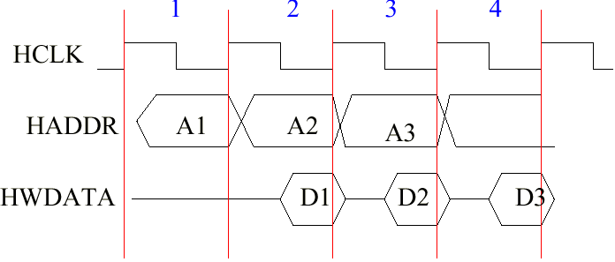
Pipelining within a burst
Address and data of consecutive transfers are transmitted in same clock cycle,

Slide 7
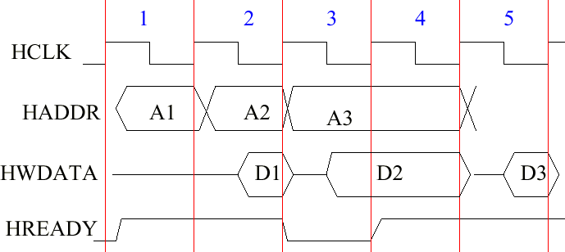
Wait cycles
Slave may not be ready to service request.
Inserts Wait cycle(s) by de-asserting HREADY

Slide 8
Split response
If the slave thinks it may take too long to service a request
  Insert too many wait cycles, or better …
  Suspend the request (via SPLIT response)
    Arbiter informed via bus
    Corresponding master is suspended
    Other masters can access the bus
    Later slave informs arbiter that it is ready.

Slide 9
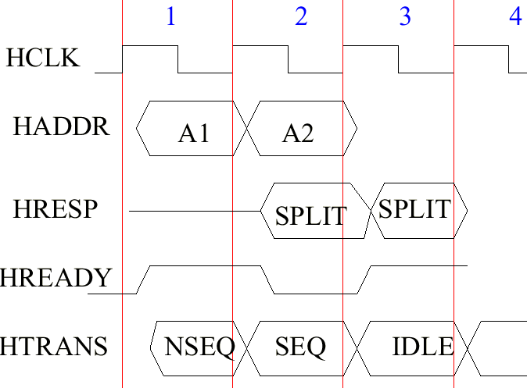
Transfer Cancellation

Slide 10
Split response
Cycle i
  Master M drives address A on bus
Cycle i+1
  Slave S thinks it can take too long to service A, issues SPLIT response
  Arbiter snoops on SPLIT response, records current master.
  Issued in (i+1, i+2) to kill already initiated transfers
Cycle i+2
  Arbiter disables bus access to current master. Others can now access the bus.

Slide 11
Mechanism of split
Slave issues split to master m.
Arbiter records that m has been split
  Even if m requests bus access during this period, it is not even considered by the arbitration algorithm
Slave informs arbiter later that it can now service m.
Arbiter now enables potential access
  m may still not get bus access immediately.

Slide 12
Model Checking
Developed a formal specification of the protocol.
Various kinds of components
  > 1 Masters
  Slave(s)
  Arbiter
Bus interface of each component modeled as a finite state machine.
Protocol = Synchronous composition of these FSMs
Model check temporal properties (e.g. non-starvation) using Cadence SMV tool.

Slide 13
Checking for no-starvation
Property in Temporal Logic LTL
  G ( HBUSREQ_{m} ⇒ F HGRANT_{m} )
  HBUSREQ_{m} : Master m requests bus access
  HGRANT_{m} : Master m granted access by arbiter
Do not consider starvation introduced by incorrect implementation of the cores, e.g.
  The arbiter is unfair.
  A slave is not guaranteed to service every split transfer eventually.

Slide 14
Checking for no-starvation
Check for starvation introduced by corner cases of the protocol
However, do not fix any implementation of the cores
  Do not code up a fair arbiter.
  Do not code up a slave which is guaranteed to eventually service split responses.
Use assertions to denote these features
  using fair, slave_live prove no_starve;
  assume fair, slave_live;
Restrict model checking to executions satisfying these assertions (possible in Cadence SMV).

Slide 15
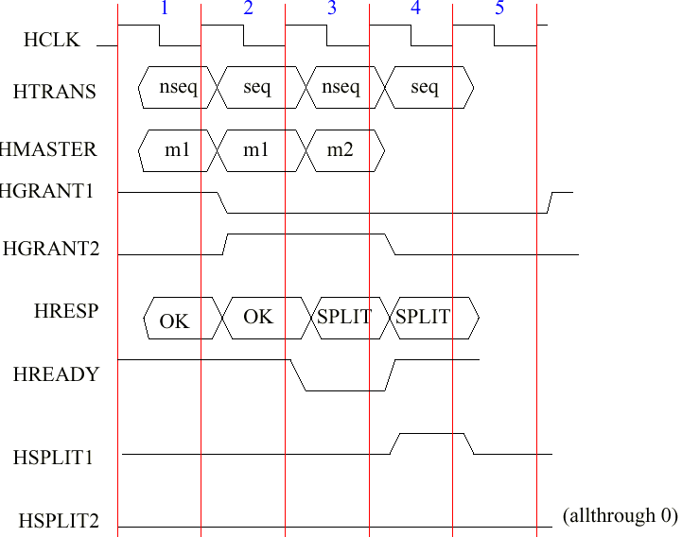
Counter-example

Slide 16
Explanation of counterexample
Cycle 1: Master m1 transmits, slave gives OK response later.
Cycle 2: Master m1 transmits again, slave’s SPLIT response in cycle 3.
Master m1 is done.
Cycle 3: Master m2 starts to transmit, slave’s SPLIT response reaches.
Slave records that m1 has been split.
Arbiter snoops on bus, records current master m2 and
marks m2 as split.
Cycle 4 onwards:
Arbiter waits for slave to inform that m2 can resume
participation in bus contention.
But slave never informs so since it does not have any
record of m2 being split.
Master m2 is starved from bus access forever.

Slide 17
Conclusion
Case study in model checking of a bus protocol with non-trivial data transfer features
Interaction of these features (Pipelining + Splits) leads to a corner case starvation scenario.
  Essentially an incompleteness in the spec.
Source of starvation was suspected via human understanding of the protocol.

Slide 18
Conclusion
Model checking effort was taken up to:
  verify our suspicion.
  Find a detailed counter-example trace.
References
  A relevant paper
    http://www.comp.nus.edu.sg/~abhik/pdf/date03.pdf

