Slide 1
CS4272 Hardware-Software Co-design
Assignment 1
Guo Liang
School of Computing
National University of Singapore

Slide 2
Assignment 1
Use Rhapsody to model a shuttle system
  Due by: 20 Sep 2007
  Individual work
The helping hand
  IVLE discuss forum
  Lab session: (COM1-01-14)
    Tuesday 1400-1800
    Wednesday 1500-1800
  guol@comp.nus.edu.sg

Slide 3
Rhapsody
“visual design environment to create requirements and model embedded software”
  Analysis, design, implementation, and testing
Allows
  Create UML model - class diagrams, object diagrams and statecharts
  Generate executable code for the model (Java, C, or C++)
  Animate, execute and test the UML model

Slide 4
Rhapsody
Basic usage
  Create classes / objects
  Create Statechart for classes
  Set up model configuration
  Generate code
  Compile and run / animate

Slide 5
Rhapsody
Available at COM1-01-14
Embedded Systems Teaching Lab 1
Tutorials
  Help → List of Books → Rhapsody in J tutorial
Demo

Slide 6
Reminder - Procedure
Create classes, attributes, methods, and their associations and multiplicities
Create statecharts for classes
Create objects, their initializations and their links
Edit “DefaultConfig”
Run and debug

Slide 7
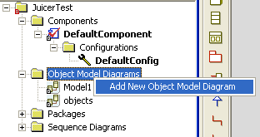
Reminder - Add Object Diagram

Slide 8
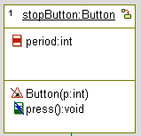
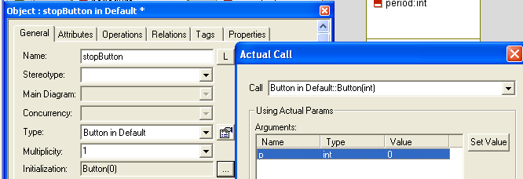
Reminder - Create Object
Object name
<instance name>:<class name>
Initialization

Slide 9
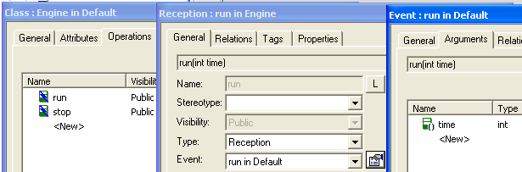
Create Event Argument

Slide 10
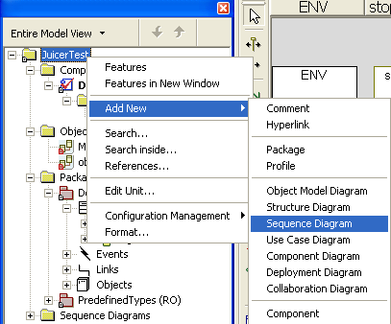
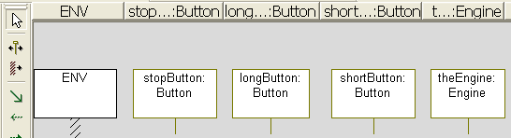
Create Sequence Diagram
Role name
All objects to be shown

Slide 11
Shuttle System
A railway system
  Shuttles running on it to transport passengers
Order-based system
  Passenger places an order
  Shuttles bid for the order
  Successful shuttle move passengers from start station to destination.
A management system (MS) controls orders.

Slide 12
Shuttle System
4 stations connected in a ring
1
2
0
3

Slide 13
Protocol – Order Assignment
ENV
Management System
Shuttle 1
Shuttle 2
order
order
order
offer
offer
assign

Slide 14
Protocol – Shuttle Movement
ENV
Shuttle
Track
depart
check
not free
If track is occupied by another shuttle
free
If no shuttle on the track
occupy
arrive
release

Slide 15
Order Assignment
shuttles
s1
Shuttle:
Capacity
Unit fare
Initial station
Management
System
neworder
neworder
Env
s2
neworder
Order:
Start station
Destination
# of passengers
neworder
s3

Slide 16
Order Assignment (Cont.)
shuttles
When to Offer:
No assignment;
Order size <= capacity
s1
Management
System
offer(10)
s2
offer(20)
refuse
s3
May use the same event “offer” for both cases, e.g refuse = offer(9999)

Slide 17
Order Assignment (Cont.)
shuttles
s1
MS assigns order to shuttle s1, since it made the lowest offer of 10 dollars.
No event sent to s2 and s3.
Management
System
assign
s2
s3

Slide 18
Process Order
After s1 (at station 1) got assignment (1→2, 5 passengers):
1. It loads since it is already at start station 1.
@station 1
s1
load

Slide 19
Process Order (Cont.)
2. It checks the availability of track, then move onto track if available.
@station 1
Track
Request to move
depart
s1
Env
@track1
Track
occupied
Track
free
s1
s1
Move to track

Slide 20
Process Order (Cont.)
3. It arrives destination, then unloads.
@track 1
Track
release
arrive
s1
Env
@station 2
s1
unload

Slide 21
Good Luck!

