Slide 1
Bytecode Level Dynamic Analysis for Software Debugging
Wang Tao
CS Dept., NUS

Slide 2
Outline
Introduction
Dynamic Slicing
Test based Fault Localization
Summary
Notes:
Software become complex→ always have errors → not because the programmers are careless, but because of human’s limitation to manage complexity

Slide 3
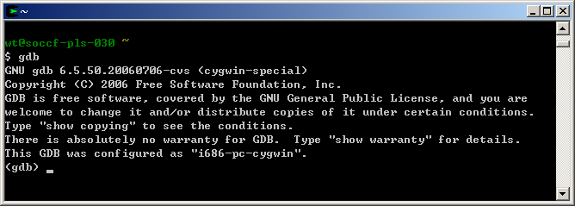
Introduction
Software Debugging
  Time consuming
Traditional Source-Level Debugger
Notes:
Software Debugging is a time consuming and boring process.
We spend the same amount of time in debugging and development.
➔ traditional source –level debugger such as GDB

Slide 4
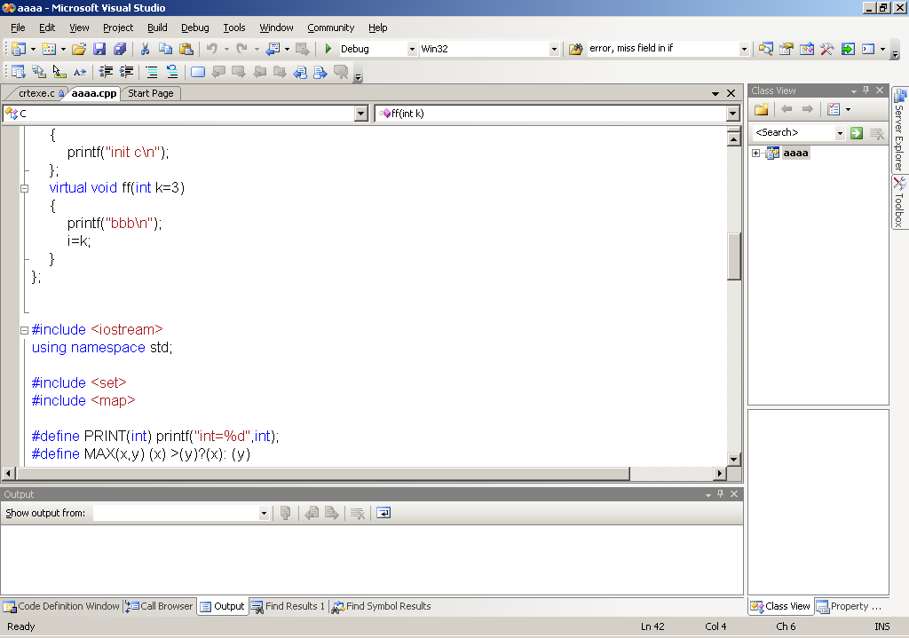
Introduction
Debuggers have been Improved
Not Enough !
the core problem in debugging is automation
Notes:
Debugging tools have been improved.
Good GUI,
Conditional breakpoint,
=➔ the improvement is only on the usability of tools, friendly interact with developer
==> Not enough
==> debugging is done manually
➔ Need tools support to increase the degree of automation

Slide 5

Automate Software Debugging
Hypothesize the cause of the error
Try to confirm it
Automatic step
Identify suspicious statements
Manual step
Use specification?
Notes:
As we can see, when a human is debugging the program, he will often be involved in two activities.
…
Can we automate the two steps?
The first step can.
The second cannot, not specification, developer does not like to write

Slide 6
Dynamic vs Static Analysis
 | Static Analysis | Dynamic Analysis
All possible inputs
One or a few inputs
Inputs
Property → Program fragment
Execution →Property
Process
Accuracy
Conservative
Accurate
Notes:
Dynamic analysis vs static analysis
Dynamic analysis ➔ execution runs
Static analysis ➔ source code
Dynamic analysis is more suitable for debugging
Because of the following three reasons

Slide 7
Bytecode Level vs Source Level
Java Libraries
  source code is not available
Stable
  source code level, frequently changed
  bytecode level, stable
Easy Instrumentation
Can be applied to other intermediate representation
  Microsoft Intermediate Language (MSIL)
Notes:
Why analyze at the level of bytecode
Library
source code ➔ java language specification, changes since 1.5,
bytecode ➔ JVM specification, not changed
The tools can be directly used
3. Easy to modify a JVM to collect the information about the execution
4. ….

Slide 8
Outline
Introduction
Dynamic Slicing
Testing based Fault Localization
Summary
Notes:
Dynamic analysis is most commonly used for debugging
Dynamic Slicing is a well known one

Slide 9
Dynamic Slicing
1. void setRunningVersion(boolean runningVersion){
2. if( runningVersion ) {
3. savedValue = value;
}
else{
4. savedValue = "";
}
5 this.runningVersion = runningVersion;
6. if ( savedValue == null )
……
}
a bug from JMeter
should be
savedValue = NULL;
Notes:
an example

Slide 10
Dynamic Slicing
1. void setRunningVersion(boolean runningVersion){
2. if( runningVersion ) {
3. savedValue = value;
}
else{
4. savedValue = "";
}
5 this.runningVersion = runningVersion;
6. System.out.println(savedValue);
}
a bug from JMeter
should be
savedValue = NULL;
Notes:
an example

Slide 11
Dynamic Slicing
1. void setRunningVersion(boolean runningVersion){
2. if( runningVersion ) {
3. savedValue = value;
}
else{
4. savedValue = "";
}
5 this.runningVersion = runningVersion;
6. System.out.println(savedValue);
}
runningVersion = false
null
?
Notes:
an example

Slide 12
Dynamic Slice
1. void setRunningVersion(boolean runningVersion)
2. if( runningVersion ) {
3. savedValue = value;
}
else{
4. savedValue = "";
}
5 this.runningVersion = runningVersion;
6. System.out.println(savedValue);
}
Slicing Criterion
Notes:
an example
also explain the dynamic slicing algorithm

Slide 13
JSlice
Dynamic Slicing tool for Java programs
  The first one
Open source
  http://jslice.sourceforge.net
Have been downloaded by more than 30 research groups
appear in TOPLAS
Notes:
In this thesis, we have developed JSlice.
As far as we know, JSlice is the first Dynamic Slicing tool for Java programs.
Open source available at ..,
Used by research community
30 groups to study dynamic slicing techniques
And also for some lectures

Slide 14
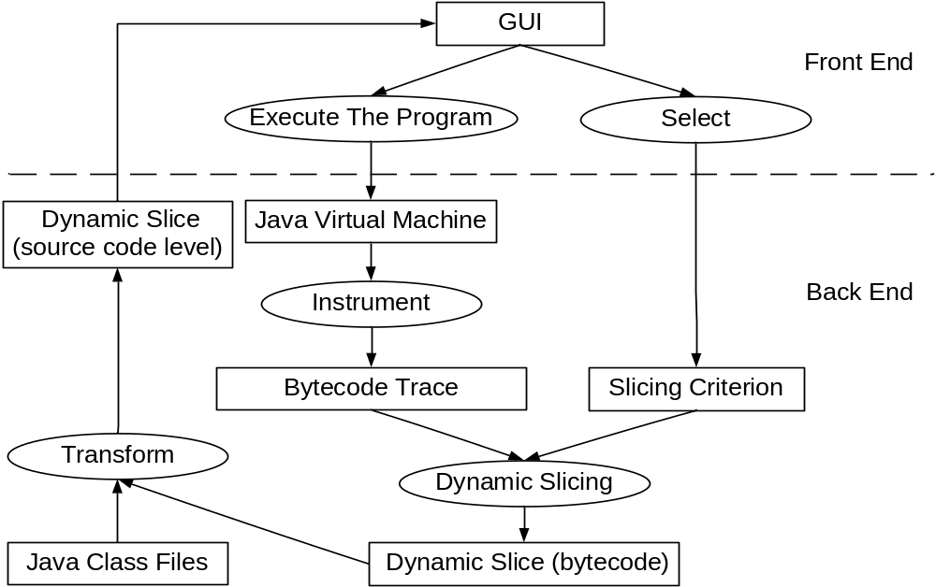
Infrastructure for Dynamic Slicing
appear in TOPLAS
Notes:
Infrastructure of JSlice.
This can also be used as the Infrastructure of any dynamic slicing tool for Java.
Front End, the gui, to execute the program on the JVM.
The back end instruments the JVM to get the bytecode trace.
Front End→ the slicing criterion
Then perform slicing → the result at the level of bytecode → transform to source code level → the result is then illustrated on the GUI
To make the dynamic slicing tool realistic to debug real programs, we have done research on the following three problems

Slide 15
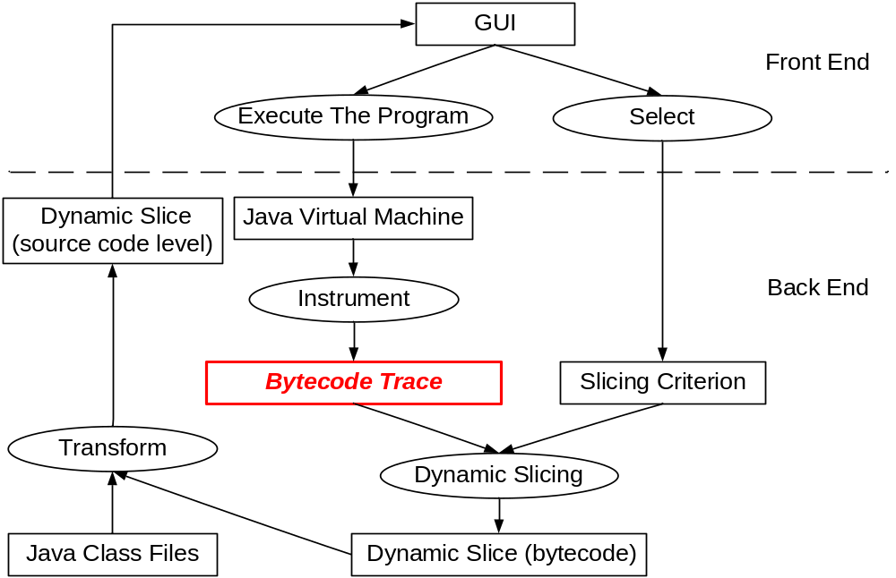
Improve the Trace Representation
appear in ICSE’04
Notes:
The first is the trace representation
Important, the foundation of the slicing algorithm,
However, the trace can be huge and cannot fit into the main memory
Compact trace representation
→ dynamic slicing without decompression

Slide 16
Compact Bytecode Trace
Execution Trace (for a program)
Trace Table (per method)
Operand Traces
(per bytecode)
  Control Flow
  Data Flow
  Others not traced !!
……
appear in ICSE’04
Notes:
The overall trace representation

Slide 17
Example: Trace Table
0: bipush 10
2: newarray int
4: astore_1
5: iconst_0
6: istore_2
7: iload_2
8: bipush 10
10: if_icmpge 23
13: aload_1
14: iload_2
15: iload_2
16: iastore
17: iinc 2, 1
20: goto 7
23: return
Foo(){
int a[], i;
a= new int[10];
for (i=0; i<10; i++)
a[i]= i;
}
bytecode | Operand trace
7
16
6, 20, ……, 20
(addr, addr, ….., addr),
(1, 2, ..., 9)
appear in ICSE’04
Notes:
Example:
A java program → bytecode sequence →
Only two bytecodes need traced
Operand trace
→ compress these operand traces

Slide 18
Compare SEQUITUR and RLESe
Input:
aaaaaaaaaaaaaaaa
S
C C
S
a:16
C
B
B
B
A
A
A
a a
SEQUITUR
RLESe
appear in ICSE’04
Notes:
We improve the existing SEQUITUR algorithm to compress the operand traces
An example shows the improvement

Slide 19
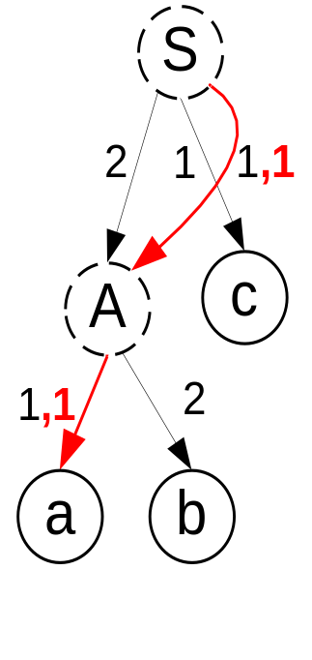
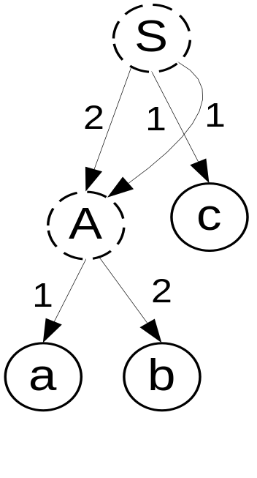
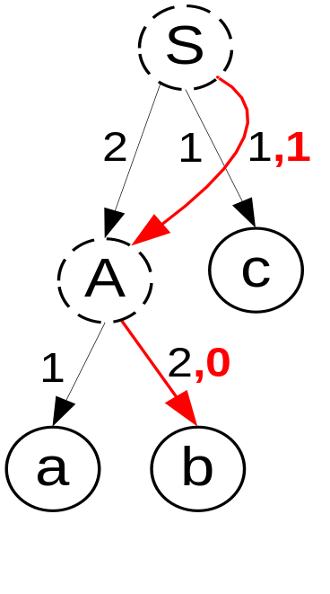
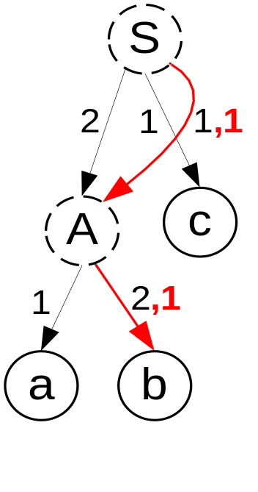

Traverse the Compressed Trace
a
b
b
Example: abbabbc
S ---> A:2, c:1, A:1
A -> a:1, b:2
appear in ICSE’04
Notes:
slicing without decompression
An example,
Represent as a DAG
The difficult is to record the unvisited path
Use the root to leaf path. The red lines:
=== experiment results: compression ratio, 10-100, slow down 2-10 times

Slide 20
Backward Dynamic Slicing Algorithm
dynamicSlicing ( ){
β = the last bytecode instance in the trace H;
while(βis defined ){
check if βis the slicing criterion;
check dynamic control dependence w.r.t. β;
update theγset;
check dynamic data dependence w.r.t. β;
update the δset;
stack simulation for bytecode;
β= the bytecode instance before β in the trace H;
}
}
appear in TOPLAS

Slide 21
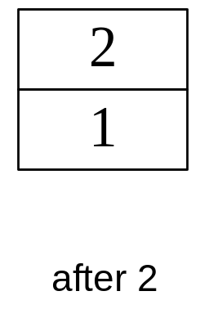
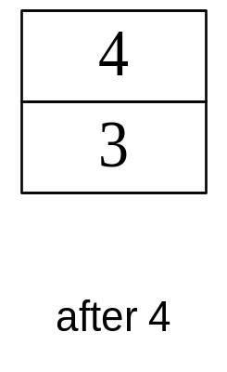
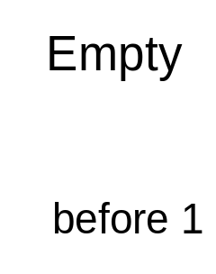
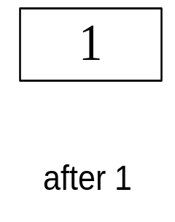
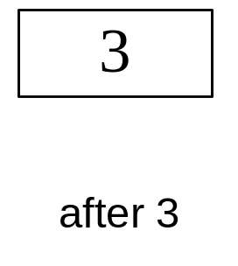

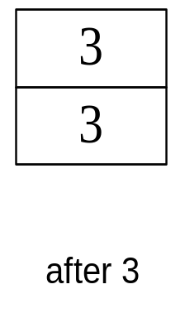
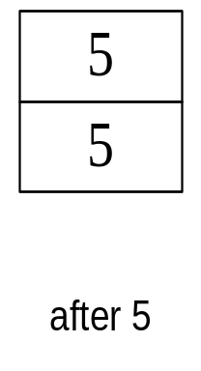
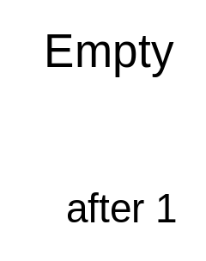
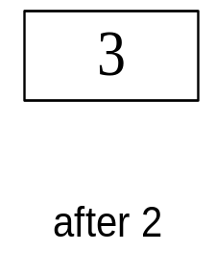
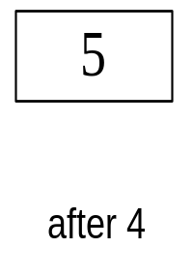
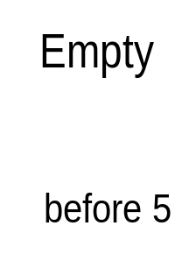
Stack Simulation
if (j%2==1)
1: iload_1
2: iconst_2
3: irem
4: iconst_1
5: if_icmpne
Execution
Slicing
appear in TOPLAS

Slide 22
Handle Exceptions
public void f1(){
BufferedReader in = null;
try{
in = new
BufferedReader(
new FileReader("foo.in"));
……..
}catch (Exception e) {
System.out.println(“file error ”+e);
}
}
FileReader( …){
…..
throw FileNotFoundException;
}
Non local transfer
Standard IO operation in Java
appear in TOPLAS
Notes:
exception,
the non-local transfer
need to trace the class name, method name, signature …

Slide 23
Handle Reflection
Java Method A
Reflection Method
native
Java Method B
appear in TOPLAS
Notes:
Reflection methods are implemented as native methods
cannot trace
they do not contribute to the computation, can be ignored

Slide 24
Handle Reflection
Java Method A
Reflection Method
Java Method B
appear in TOPLAS
Notes:
in the trace, we record that method A calls method B, instead of the reflection API

Slide 25
Trace Multi-threaded Java Programs
Thread A
Object O
Thread B
0
0
0
Lamport Clocks
1
1
2
2
3
4
3
4
appear in TOPLAS

Slide 26
Experiment
Subject Programs
  6 subjects from the Java Grande Forum benchmark suite
  3 subjects SPECjvm 98 benchmark suite
  1 Java utility program JLex
Tracing Overheads

Slide 27
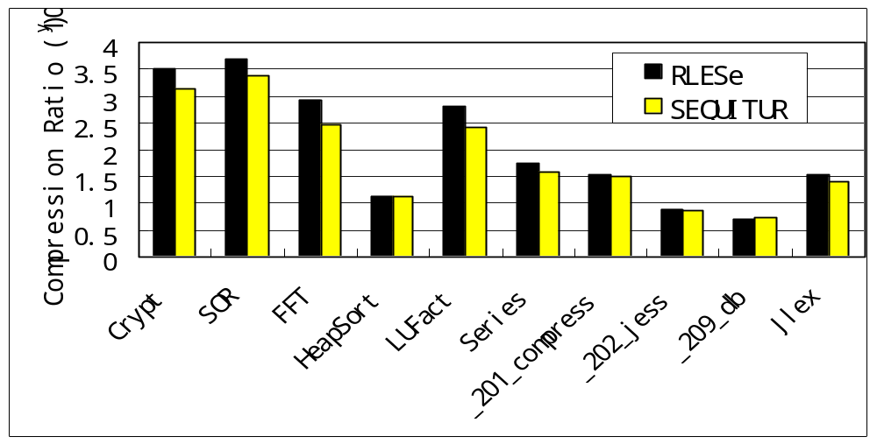
Compression Ratio

Slide 28
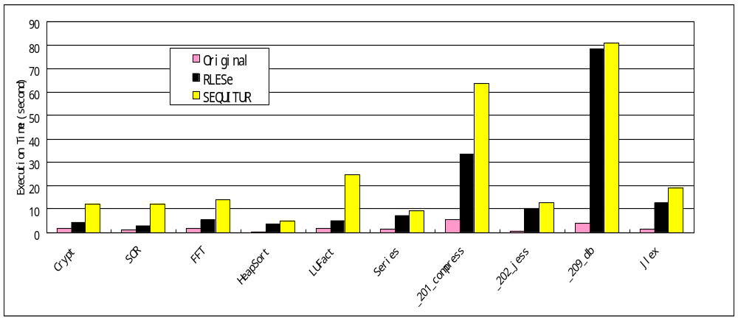
Time Overhead

Slide 29
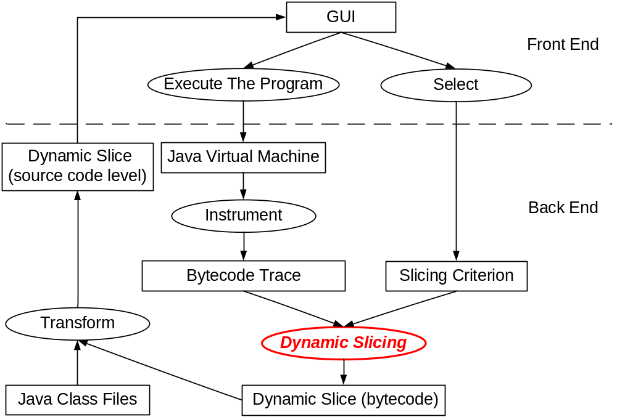
Improve the Slicing Algorithm
appear in TOPLAS
Notes:
The slicing algorithm is the core of the infrastructure
The slicing: get part of the program which is relevant to the error, so that the developer can focus on…
This requires the slice should always contain the error.
However, ….

Slide 30
Execution Omission Errors
1. ch = reader.read();
2. buf.append(ch);
3. if (ch == ‘ ‘ ) {
4. while (ch != ';') {
5. ch = reader.read();
6. buf.append(ch);
7. }
8 }
9 return buf;
a bug from NanoXML
should be ch == ‘&’
reader= “&abc;”
buf =“&“
appear in TOPLAS
Notes:
An example

Slide 31
Potential Dependence
1. ch = reader.read();
2. buf.append(ch);
3. if (ch == ‘ ‘ ) {
4. while (ch != ';') {
5. ch = reader.read();
6. buf.append(ch);
7. }
8 }
9 return buf;
Execution Omission
appear in TOPLAS
Notes:
Dynamic slicing only consider dynamic control/data dependencies
So only 1,2,9 in slice, but 3 is not
Let us look into details of the program
→ Line 3 is wrong-- > execution omission → potential effect → potential dependence

Slide 32
Relevant Slicing
1. ch = reader.read();
2. buf.append(ch);
3. if (ch == ‘ ‘ ) {
4. while (ch != ';') {
5. ch = reader.read();
6. buf.append(ch);
7. }
8 }
9 return buf;
appear in TOPLAS
Notes:
Relevant slicing,
Consider not only dynamic data/control dependence, but also potential dependence
Is always bigger the dynamic slice
➔ experiment results: a little bigger than dynamic slicing, with little time overheads

Slide 33
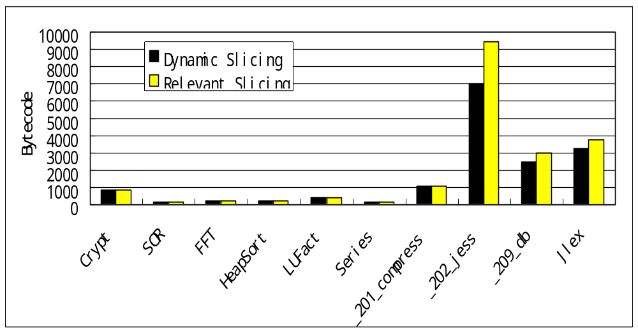
Slice Sizes

Slide 34
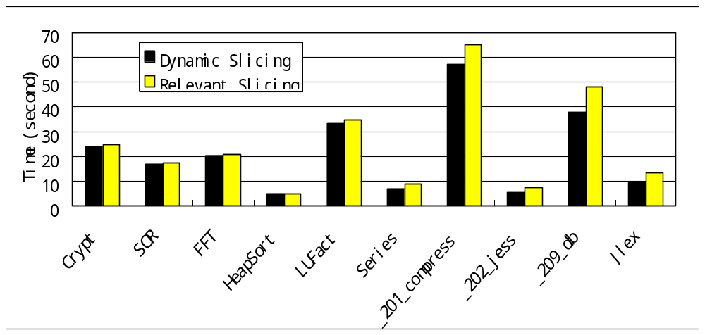
Time for Slicing

Slide 35
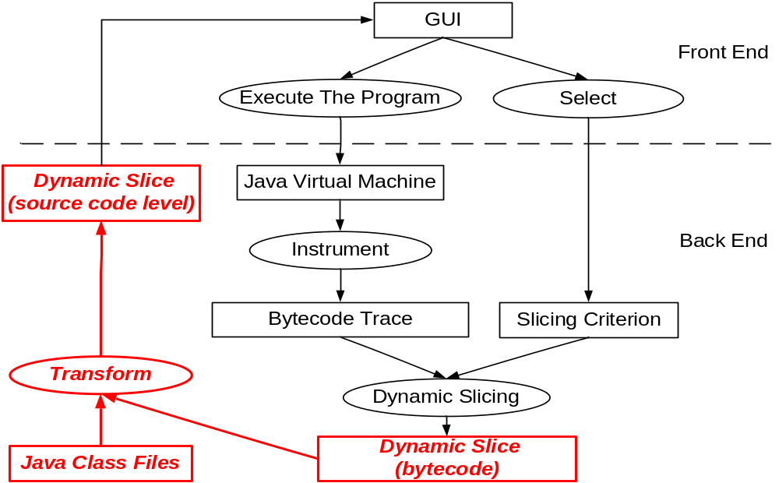
Improve the Representation of Result
appear in ISSTA’07
Notes:
overall, traditional dynamic slicing can be seen as two big step.
one is the slicing computation, another is the slice representation.
the slice is reported to the programmer directly, as a flat set of statement or statement instances
➔ still big, 10% of a 10,000 lines program is 1,000 lines

Slide 36
Hierarchical Dynamic Slicing
public static void main(String[] args) {
…….
2. init( db );
3 operate( db );
output ( db )
return;
}
the JVM DB program
init( .. db) {
db= ..
….
}
operate (… db ) {
db =..
…
}
output (db) {
……
print(db...);
}
appear in ISSTA’07
Notes:
an example,
if y at line 6 is the criterion, then the whole program included in the slice.

Slide 37
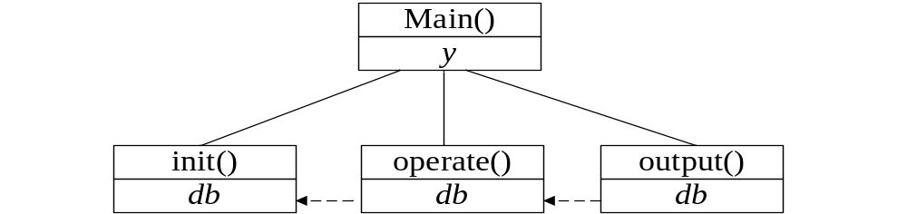
Example
public static void main(String[] args) {
…….
2. init( db );
3 operate( db );
output ( db )
return;
}
appear in ISSTA’07
Notes:
explore the trace in a hierarchical fashion
programs have phases
➔divide phases at loop or method boundaries
➔ report inter-phase dependences, to checking input-output pair

Slide 38
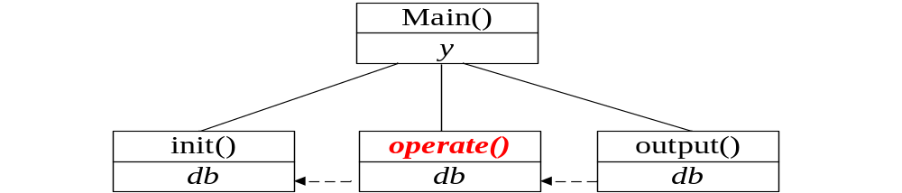
Example (cont)
init( .. db) {
….
}
operate (… db ) {
…
}
output (db) {
……
print(db...);
}
…….
…….
…….
appear in ISSTA’07
Notes:
developer check these inter- phase dependencies to find the first phase whose behavior is incorrect
say f2() in this example.
then we can ignore detail dependences in all other phases, and only focus on the selected phase
➔ the phase is then further divided into sub-phases, and we compute dependencies across these sub-phases and so on

Slide 39
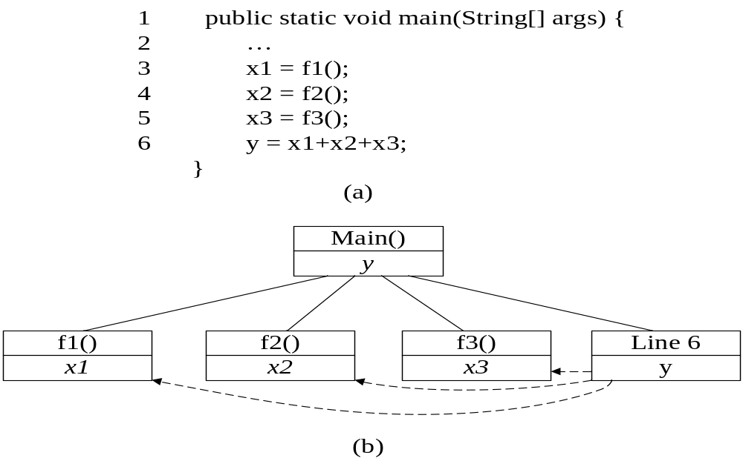
Parallel Dependence Chains
appear in ISSTA’07
Notes:
In the previous example, we show the hierarchical exploration along a long dependence chain
the idea can also be applied to explore parallel dependence chains.
an example
experiment results: our approach can significantly reduce the number
of statement instances which the programmer needs to examine for debugging.

Slide 40
Experiment
Subject Programs
  from Software artifact Infrastructure Repository (SIR)
  NanoXML: a XML parser
  JTopas: a Java library for parsing text
  JMeter: a performance testing tool

Slide 41
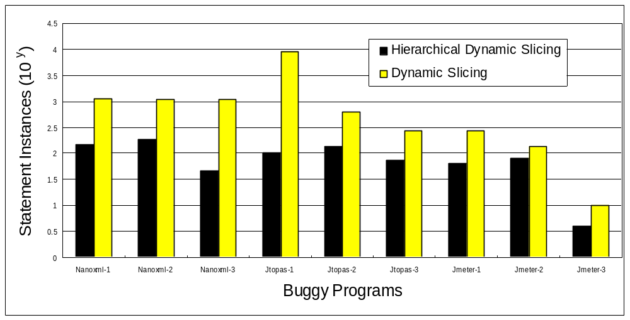
Statement Instances to Examine

Slide 42
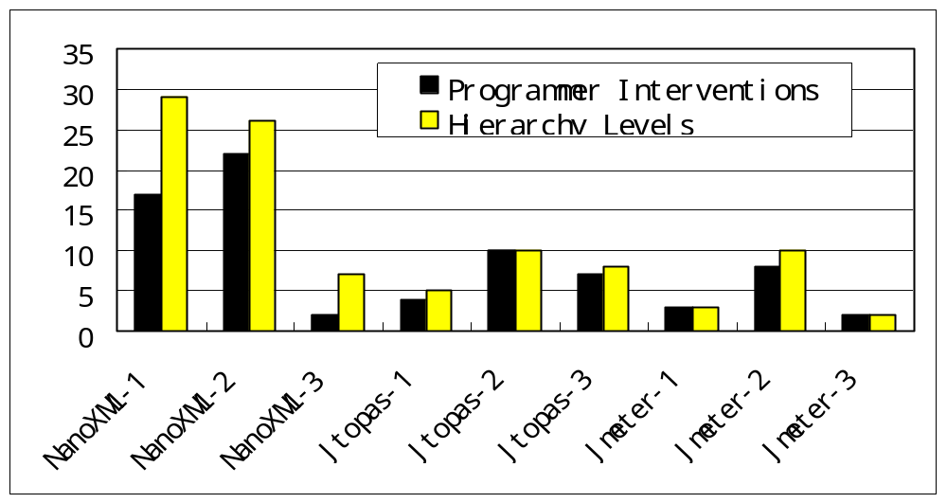
Human Interventions

Slide 43
Outline
Introduction
Dynamic Slicing
Test based Fault Localization
Summary
Notes:
slicing can reduce the role of programmers, by automatically computing the essential dependence chains to the error, and guiding the developer to explore these dependence chains.
this is one way to improve the debugging, by simply automating what developers do.
It is also limited to certain kinds of errors. For example, left hand of assignment is wrongly….
Can we do things better, by employing the computation power of modern computer systems to perform sophisticated analysis?

Slide 44
Test based Fault Localization
Failing Run
Successful Run
Compare Execution
Difference
As bug report
Developer

Slide 45
Debugging by Comparing Executions
1 . m=...
2. if (m >= 0) {
3. ...
4. lastm = m;
5. }
6. …..
a bug in Replace program
should be
if ((m >= 0) && (lastm!=m))
appear in CC’06

Slide 46
Debugging by Comparing Executions
1 . m=...
2. if (m >= 0) {
3. ...
4. lastm = m;
5. }
6. …..
1 . m=...
2. if (m >= 0) {
3. ...
4. lastm = m;
5. }
6. …..
Failing run,
Successful run,
appear in CC’06

Slide 47
Infrastructure of Test Based Fault Localization
Successful Run Pool
Testing
Change Failing Input
Generate
Choose
Failing Run
Successful Run
Difference Metric
Compare Execution
Difference
As bug report
appear in ASE’05 &CC’06

Slide 48
Difference Metric
1. if (a)
2. i = i + 1;
3. if (b)
4. j = j + 1;
5. if (c)
6. if (d)
7. k = k + 1;
8. else
9. k = k + 2;
10. printf(“%d”, k);
Program
appear in CC’06

Slide 49
Difference Metric
1. if (a)
2. i = i + 1;
3. if (b)
4. j = j + 1;
5. if (c)
6. if (d)
7. k = k + 1;
8. else
9. k = k + 2;
10. printf(“%d”, k);
1. if (a)
2. i = i + 1;
3. if (b)
4. j = j + 1;
5. if (c)
6. if (d)
7. k = k + 1;
8. else
9. k = k + 2;
10. printf(“%d”, k);
Execution run π
Execution run π1
appear in CC’06
Notes:
➔ to measure the similarity between execution runs, we have proposed a difference metric
==> control flow based, efficiently
consider branch with similar context
the example
why consider these branches

Slide 50
Compare Difference Metric
Failing Run
Successful Runs
Number of Branches
Location of Branches
π
π1, π2
diff_1
diff_2
Compare
appear in CC’06
Notes:
compare difference metric

Slide 51
Location of Branches
1. int main(int argc, char **argv)
2. if (argc < 3 ){
3. printf(“parameter error\n”);
4. return 0;
5. }
6. ….
7. if ( m == -1)
8. ….
9. }
TCAS program
check the input
Favor branches near to the observable error
appear in CC’06

Slide 52
Automatic Generation
1. if (a)
2. i = i + 1;
3. if (b)
4. j = j + 1;
5. if (c)
6. if (d)
7. k = k + 1;
8. else
9. k = k + 2;
10. printf(“%d”, k);
1. if (a)
2. i = i + 1;
3. if (b)
4. j = j + 1;
5. if (c)
6. if (d)
7. k = k + 1;
8. else
9. k = k + 2;
10. printf(“%d”, k);
Execution run π
appear in ASE’05
Notes:
Automatic path Generation
the order, last, ➔ last and the second last ==➔
feasible path check
successful run check
unfortunately, performance is bad, (a) feasible path check (b) number of branches

Slide 53
Automatic Generation
1. if (a)
2. i = i + 1;
3. if (b)
4. j = j + 1;
5. if (c)
6. if (d)
7. k = k + 1;
8. else
9. k = k + 2;
10. printf(“%d”, k);
1. if (a)
2. i = i + 1;
3. if (b)
4. j = j + 1;
5. if (c)
6. if (d)
7. k = k + 1;
8. else
9. k = k + 2;
10. printf(“%d”, k);
Execution run π
appear in ASE’05
Notes:
Automatic path Generation
the order, last, ➔ last and the second last ==➔
feasible path check
successful run check
unfortunately, performance is bad, (a) feasible path check (b) number of branches

Slide 54
Evaluation Framework
statement in bug report

Slide 55
Evaluation Framework
statement in bug report

Slide 56
Evaluation Framework
statement in bug report

Slide 57
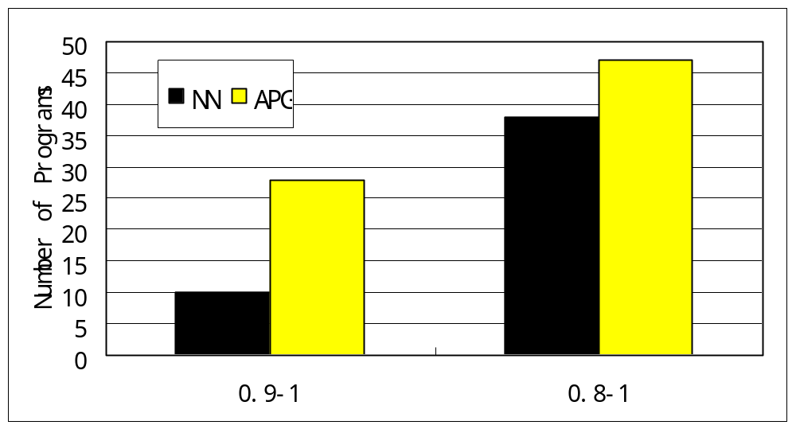
Overall Quality of Bug Report

Slide 58
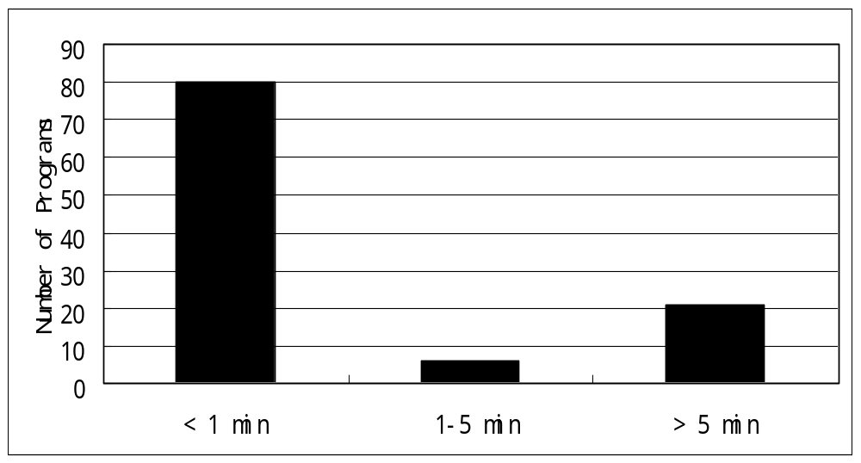
Time Overhead

Slide 59
Choose a Successful Run
1. int main(int argc, char **argv)
2. if (argc < 3 ){
3. printf(“parameter error\n”);
4. return 0;
5. }
6. ….
7. if ( m == -1)
8. ….
9. }
TCAS program
appear in CC’06

Slide 60
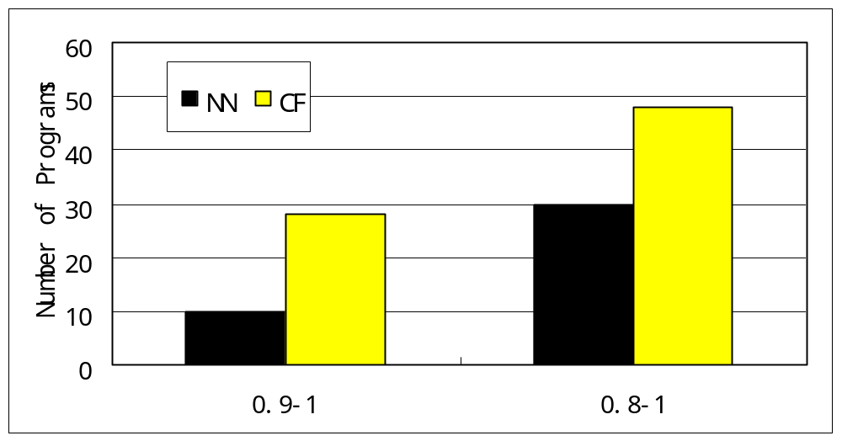
Overall Quality of Bug Report

Slide 61
Summary
Dynamic Slicing
  Trace Representation
  Extend Dynamic Slicing to Relevant Slicing
  Hierarchical Dynamic Slicing
Test based Fault Localization
  Difference Metric
  Automatically Generate a Successful Execution
  Choose a Successful Execution
Notes:
In this lecture, I will introduce some algorithms which can analyze the program and help us debug.

Slide 62
Future Work
Application of the Compact Trace
Application of Hierarchical Exploration
Applying program debugging methods to modeling languages

