Slide 1
Hierarchical Dynamic Slicing
Tao Wang Abhik Roychoudhury
National University of Singapore

Slide 2
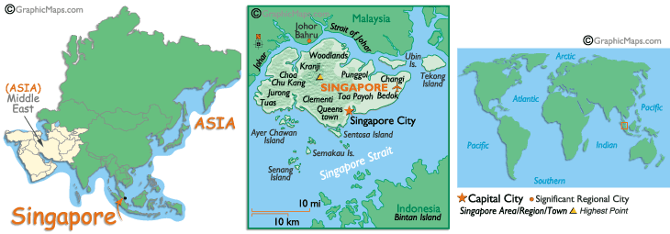
Preamble

Slide 3
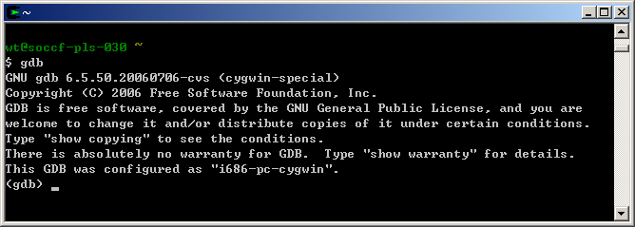
Software Debugging
Time consuming
Traditional Source-Level Debugger
  The key problem is automation
Notes:
Software Debugging is a time consuming and boring process.
We spend the same amount of time in debugging and development.
➔ traditional source –level debugger such as GDB

Slide 4
Slicing for Debugging
Slicing criterion
  (Input, Variable, Line#)
(Dynamic) Slice
  A fragment of the program which directly or indirectly affect the behavior of the slicing criterion
  Compute closure of control/data dep.
  Treat the slice as bug-report.

Slide 5
Why Dynamic?
Naturally corresponds to debugging via testing.
  Test program against test-cases.
  Find “offending” test-cases
    Output “unexpected”.
  Compute dynamic slice to debug the behavior in the offending test cases.

Slide 6
Dynamic Slicing
1. void setRunningVersion(boolean runningVersion){
2. if( runningVersion ) {
3. savedValue = value;
}
else{
4. savedValue = "";
}
5 this.runningVersion = runningVersion;
6. System.out.println(savedValue);
}
runningVersion = false
null
?
Notes:
an example

Slide 7
Dynamic Slice
1. void setRunningVersion(boolean runningVersion)
2. if( runningVersion ) {
3. savedValue = value;
}
else{
4. savedValue = "";
}
5 this.runningVersion = runningVersion;
6. System.out.println(savedValue);
}
Slicing Criterion
Notes:
an example
also explain the dynamic slicing algorithm

Slide 8
So … ?
Huge overheads
  Backwards slicing requires trace storage.
  Past work – Jslice tool for Java
    Online trace compression & traversal
    http://jslice.sourceforge.net
Dynamic Slice is still too large …
  … for human comprehension
  In this paper

Slide 9
An example
public static void main(String[] args) {
…….
2. init( db );
3 operate( db );
output ( db )
return;
}
SPECJVM DB program
init( .. db) {
db= ..
….
}
operate (… db ) {
db =..
…
}
output (db) {
……
print(db...);
}

Slide 10
Divide exec. into “phases”
public static void main(String[] args) {
…….
2. init( db );
3 operate( db );
output ( db );
return; }
main()
init()
operate()
output()
db
db
db

Slide 11
Report inter-phase dep.
main()
init()
operate()
output()
db
db
db
Intra-phase control and data dependencies are suppressed.
Inter-phase dep. form input-output relationships.

Slide 12
Programmer helps zoom into
… one phase by inspecting the phase outputs
-> (may/may not involve re-executing program)
main()
init()
operate()
output()
db
db
db
Re-exec phase 1 and observe db
read_db()
insert()
exit()
current_record
entries[2]

Slide 13
Parallel dependence chains
main()
y
f1()
f2()
f3()
x1
x2
x3
x1 = f1();
x2 = f2();
x3 = f3();
y = x1 + x2 + x3;
print y --- Criterion
…
y

Slide 14
Programmer intervention …
… may not be needed, for example
main()
func2()
func3()
func1()
All dependencies inside this phase, zoom into this one

Slide 15
Key issues
Compute “phases” of an exec. trace
  Diff. from phase detection in PL community
Augment dynamic slicing algorithm
  Mark inter-phase dependencies
  Compute only reachable nodes from selected inter-phase dependency.
Programmer intervention
  Select the first suspicious inter-phase dep.
  Comprehension guides computation.

Slide 16
Phase detection
Divide an exec. trace at boundaries of
  Loops
  Method calls
  Loop iterations
  …
    and recursively again at these control structure boundaries.

Slide 17
Differs from work in PL
Phase detection to guide program opt.
  Divide a phase into fixed-length intervals.
  Compute metric (e.g. Basic block vectors) for each interval.
  Cluster adjacent intervals with similar metric.
No notion of control flow context.

Slide 18
Programmer intervention
main()
init()
operate()
output()

Slide 19
Beyond Visualization
main()
init()
operate()
output()

Slide 20
Subject Programs
Subject Pgm. | Description | Size
NanoXML | XML parser for Java | 7646 LOC 24 classes
JTopas | Java library for parsing text | 5400 LOC 50 classes
Apache JMeter | Performance testing tool | 43400 LOC 389 classes
SIR subjects --- for each used 3 buggy versions with seeded faults.

Slide 21
Slicing Infrastructure - JSlice
Dynamic Slicing tool for Java programs
  The first one
Open source, bytecode level slicing tool
  http://jslice.sourceforge.net
  Distributed with the Kaffe VM
50+ registered users.
  released 8 months ago
  Adopted for teaching in few universities
Notes:
In this thesis, we have developed JSlice.
As far as we know, JSlice is the first Dynamic Slicing tool for Java programs.
Open source available at ..,
Used by research community
30 groups to study dynamic slicing techniques
And also for some lectures

Slide 22
Slicing Infrastructure JSlice
GUI (a Eclipse plug-in)
Execute the program
Select
Slice
Kaffe JVM
Instrument
Compact Bytecode Trace
Criterion = (Inp, Var, Line#)
Reverse Translate
Dynamic Slicing
(Stack simulation)
Class Files
Set of bytecodes

Slide 23
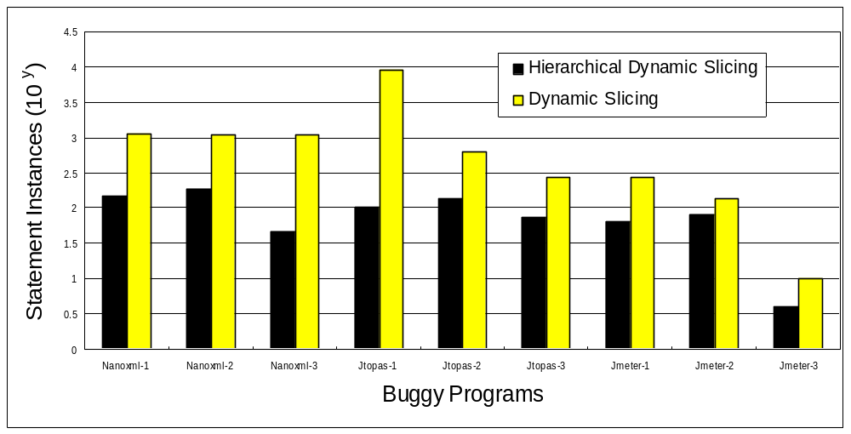
Statement Inst. Examined (Log scale)

Slide 24
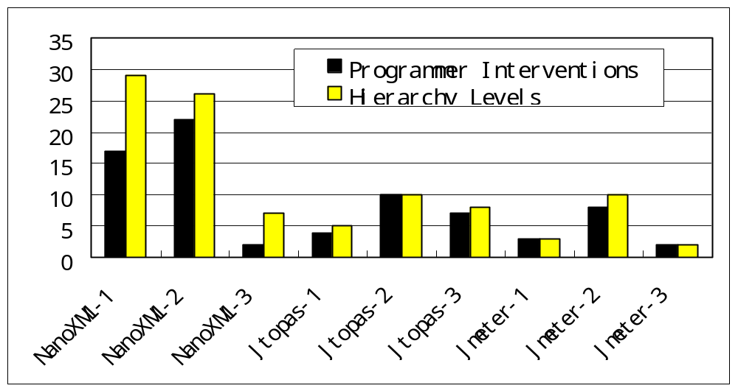
Human Interventions

Slide 25
Fault Localization
Failing Run
Successful Run
Compare Executions
= Bug report?
(hierarchically construct and explore)
Difference
Slicing?

Slide 26
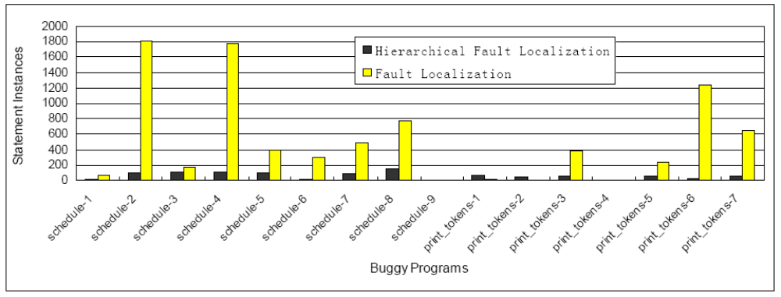
Experiments

Slide 27
Summary
Hierarchically Explore Bug-report
  Dynamic vs. Static
    Thin Slicing – explore static slices
  On-line vs. post-mortem
    DDgraph – explore dynamic dependence graph hierarchically.
  Inter-phase vs. intra-phase
    Work on parallel pgm. debugging – present intra-phase dependencies

Slide 28
Summary
Hierarchically construct and explore the dynamic slice for understanding.
  Comprehension/computation interleaved.
  Structures programmer feedback
    Only examine inter-phase dependencies
    Not just view a programmer chosen phase.
  Detailed expt. on SIR benchmarks
Efficacy on human subjects
  To be distributed in next release of Jslice.
  http://jslice.sourceforge.net/

