Slide 1

Testing and Analysis of Device Drivers
Supervisor: Abhik Roychoudhury
Author: Pham Van Thuan

Slide 2
Agenda
Problem statement
Literature review
Open research problems
RQ-1. Subsystem aware test case generation
RQ-2. Testing device protocol violation bugs
Preliminary work

Slide 3
Problem statement
Device driver bugs are the main cause of OS crashes (85% crashes of Windows XP, 53% out of 1000 defects in Linux kernel 2.6.9).
How to find these bugs and/or prevent their negative effects.
Software model checking
Testing and analysis
Isolating and tolerating
Modifying current driver architectures
Static analysis + code transformation
Dynamic symbolic execution based testing
Notes:
- Stack guard: runtime checking

Slide 4
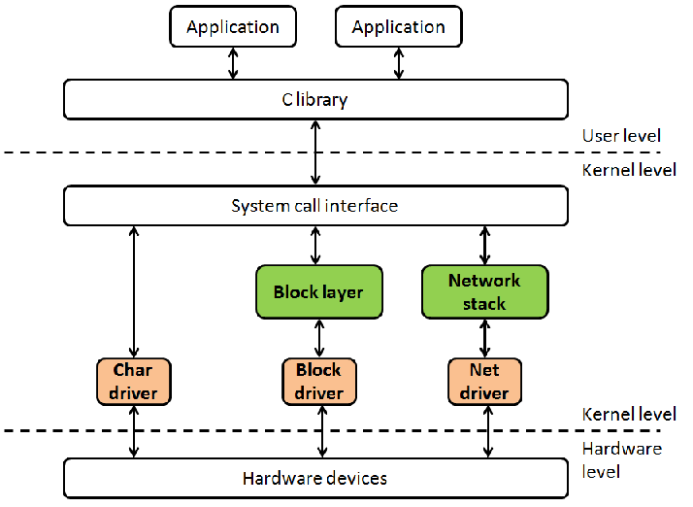
Linux device driver architecture
Linux device driver architecture

Slide 5
Classification of common device driver bugs
Incorrect use of kernel-internal APIs
Incorrect implementation of the device’s protocol
Concurrency related bug
Memory access violation
Resource leak

Slide 6
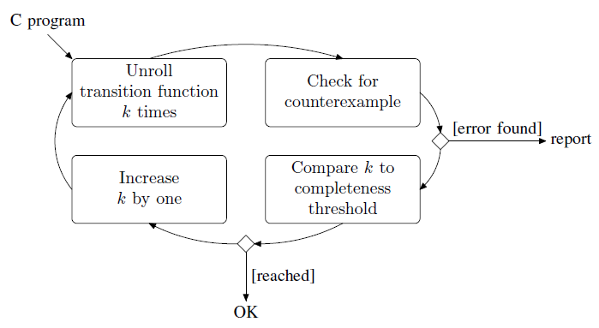
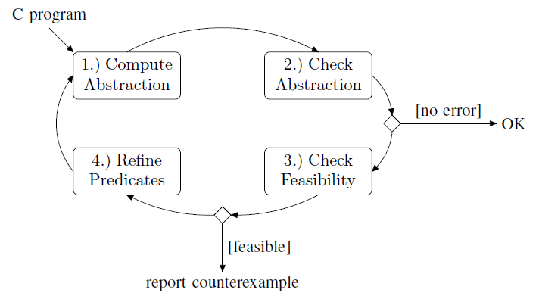
Program analysis and Software model checking
Static analysis
Composite static analysis
Configurable Software Verification
Abstract interpretation
Predicate abstraction + CEGAR
Lazy abstraction
CPAChecker
Software model checking
SLAM, SATABS
BLAST
CBMC
CEGAR
Bounded model checking
CBMC

Slide 7
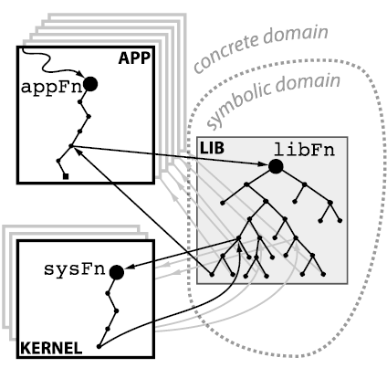
Symbolic Execution
Dynamic symbolic/concolic execution
(DSE)
Compositional DSE
POPL’2007
DSE + Selective symbolic execution
DART, KLEE, MAYHEM
ASPLOS’2011
DSE + State merging
PLDI’2012
L1
DSE + Interpolation
L2
FSE’2013
L3
L4
L4
Static symbolic execution (SSE)
DSE + SSE
L5
L6
L6
Calysto (ICSE’2008)
ISCE’2014
L7
L8

Slide 8
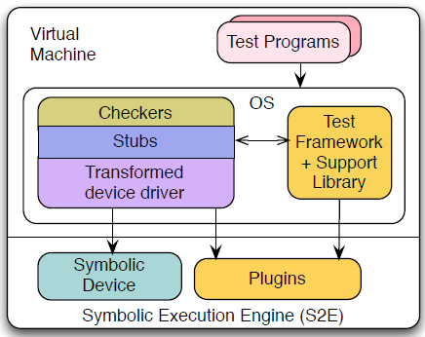
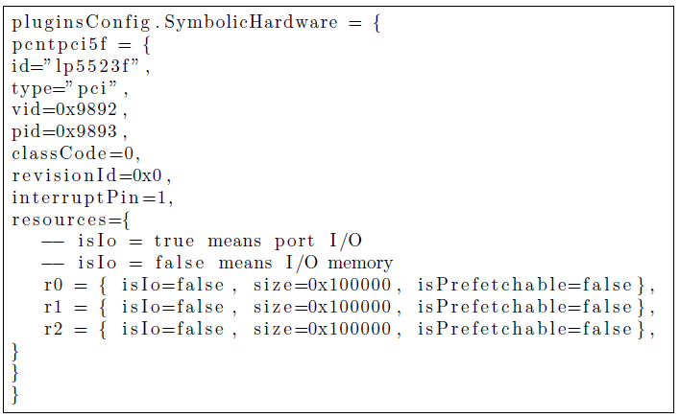
SymDrive: Testing drivers without devices
Static analyzer + code transformation
Test framework
Symbolic device

Slide 9
Open research problems
Scalability problem
Reachability problem
Test oracle – Assertion generation
Driver/Device interface violation testing

Slide 10
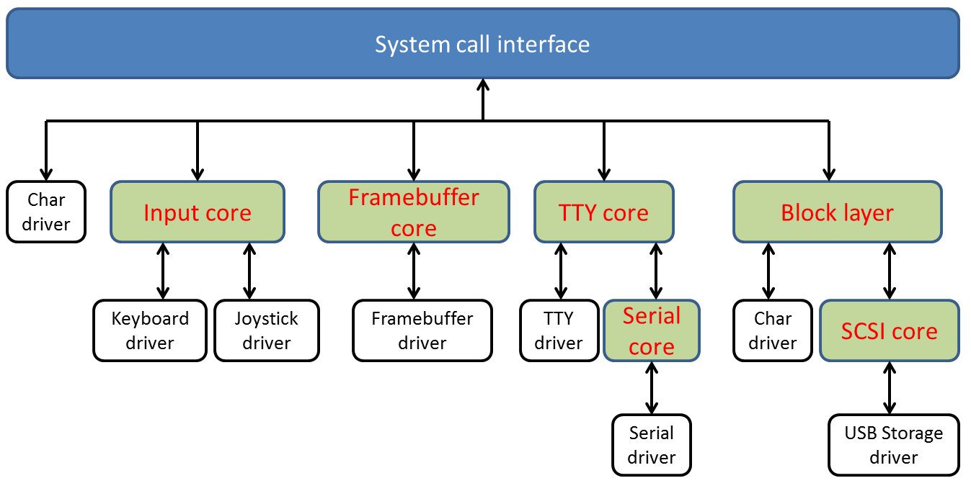
RQ-1. Subsystem aware test case generation
Example of Linux driver subsystems

Slide 11
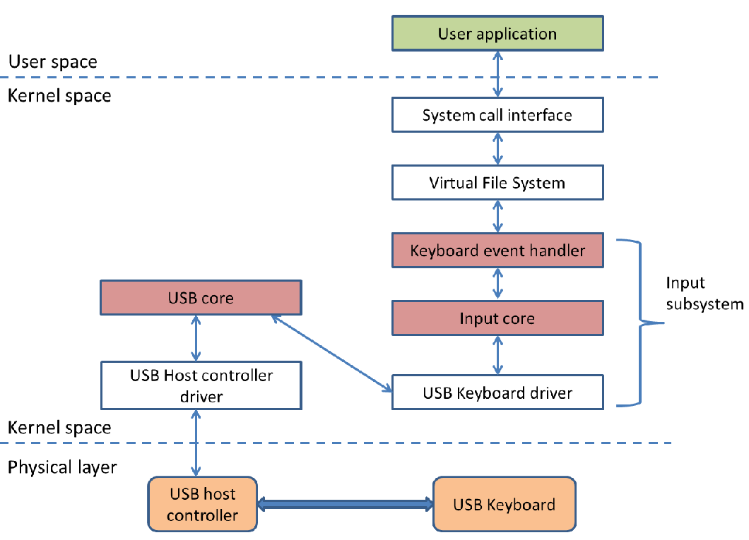
Subsystem aware test case generation
Hierarchical view of a USB keyboard device driver

Slide 12
RQ-1.1. Assertion generation
Use static analyzer to detect potential buggy locations
Use code transformation technique to insert calls to run-time checkers.
Design checkers for the interface between the kernel and device drivers (Checker can be used for testing several device drivers)

Slide 13
RQ-1.2. Test program generation
Libc, system calls invocations
Open(…)
Read(…)
Write(…)
…
Close(…)
Test program
C library
System call interface + Virtual File System
Generic interfaces:
File_operations, block_device_operations, net_device_ops
Driver subsystem core
Subsystem specific functions
Device Driver
Driver entry points

Slide 14
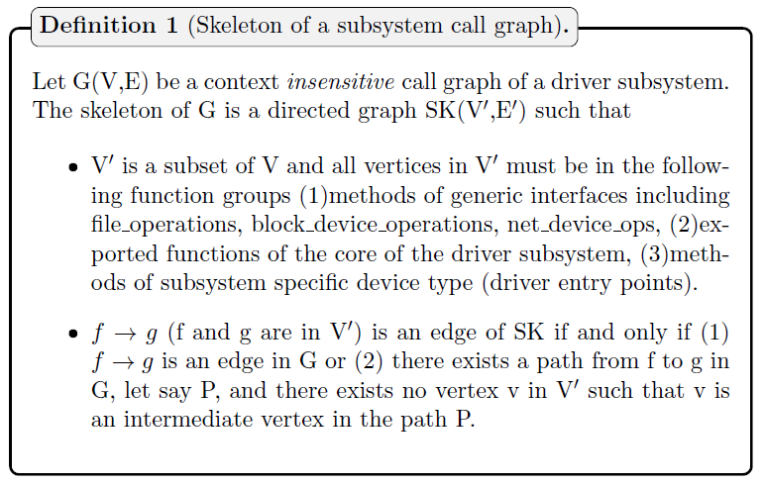
Skeleton of a driver subsystem call graph
Build the skeleton for each driver subsystem.
Generate test program(s) based on the paths in the skeleton of the driver subsystem under test

Slide 15
RQ-1.3. Driver entry points and assertions reachability
Test program
Test program
C library
C library
System call
VFS
System call
VFS
Driver
core
Driver
core
Entry points
Device
Driver
Device
Driver
Assertion
Driver entry points reachability
Assertions reachability

Slide 16
RQ-2. Testing device protocol violation bugs
A device driver may violate the protocol of the corresponding hardware device (packet format, sequence of packet transfer, time …)
A Hardware device may run in unexpected states due to bugs in the device driver.
Device driver
Bus controller +
Bus driver
Virtual hardware device

Slide 17
RQ-2.1. Virtual symbolic device modeling
Symbolic input/output interfaces
Internal working blocks to emulate real hardware device(s)
Virtual Symbolic Device
S2E
Symbolic Device
QEMU
Virtual hardware device

Slide 18
RQ-2.2. Assertion & Annotation generation
Assertion
Assert valid register settings
Assert a correct working state
Assert a correct packet format (received from device driver)
Annotation
Add constraints for the format of packets to be sent to a device driver
informal technical documents (datasheets)
?
Assertion, annotation

Slide 19
Preliminary work
Control Flow Graph (CFG)
Use profiling information to resolve indirect calls, indirect jumps.
Control Dependency Graph (CDG)
CDG works with CFG and the skeleton of the subsystem call graph to guide path exploration and prune uninteresting paths.

Slide 20
Preliminary work
Test program
Search algorithm replays a path to reach a predefined location (a driver entry point is an example).
Integrate Z3 constraint solver into S2E framework for checking un-sat core, solving string constraints (Z3-str) … (not supported by STP, the default solver of S2E)
C library
System call
VFS
Driver
core
Device
Driver
Assertion

Slide 21
Q&A

