Slide 1

Agentic Geo-Spatial Intelligence
Predictive Maritime Logistics & AI Orchestration
• The Problem: Global supply chains operate on reactive, legacy systems. Ships sail blindly into severe weather, resulting in massive fuel waste, multi-million dollar delays, and environmental damage.
• The Solution: An autonomous, AI-driven routing engine that predicts delay risks in real-time and orchestrates dynamic detours, saving fuel and mitigating catastrophe.

Slide 2
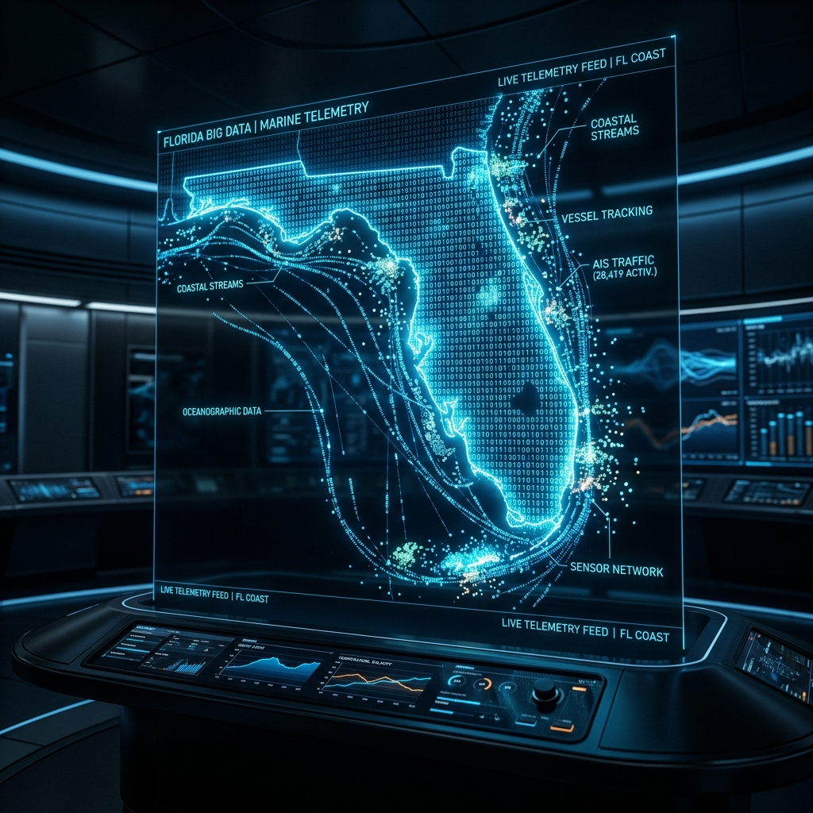
The Ground-Truth Dataset
U.S. Government NOAA MarineCadastre
• Processed a massive 1-Gigabyte historical dataset of true vessel telemetry.
• Focus Area: Gulf of Mexico, August 28, 2023 (Hurricane Idalia formation).
• Scale: Analyzed the trajectories of 30,000 real commercial vessels.
• Keywords: Big Data Pipeline, AIS Telemetry, Spatio-Temporal Filtering, Haversine Geolocation.

Slide 3

AI Architecture & Engineering
Decoupled Microservices & XGBoost ML
• The Engine: A localized XGBoost Decision Tree trained to predict the precise probability of a logistical delay.
• Feature Engineering: Engineered complex spatial features like Distance-to-Storm and a mathematically decoupled Congestion Index.
• Data Science Integrity: Identified and mitigated a severe feature-leakage (multicollinearity) anomaly during training, ensuring robust predictions.
• Explainable AI (XAI): Built-in SHAP approximations allow human operators to trust the machine's routing decisions.

Slide 4

The Revolution: Future Roadmap
From Point-in-Time to Deep Learning Sequences
• LSTM Neural Networks: Transitioning from static XGBoost trees to Deep Learning sequences to forecast ship trajectories 24-48 hours into the future.
• Global Uber H3 Hexbins: Scaling the architecture to optimize 50,000+ global vessels simultaneously via spatial hexagonal clustering.
• Multi-Variate Weather: Ingesting complex GRIB weather vectors (wind currents, wave heights) for ultra-realistic risk prediction.
• Keywords: Deep Learning, Time-Series Forecasting, Global Fleet Orchestration.

