Slide 1
Idea :- Advanced Navigation System For Blind. Theme :- Healthcare.

Slide 2
PROBLEM STATEMENT :-
Object detection and navigation is the major problem for blind people and also for old aged people whose eye blindness increases with age. According to WHO, there are 39 million people are blind and 246 million people have low vision. These people face many problems to perform their daily task, to cross the road etc .

Slide 3
Implementation :-
Detailed road map of our project :-
we will create a device in which camera is connected to RPI which takes a photo by just press a button.
A photo is received by the raspberry-pi in which we used a concept of LSTM(long-short-term-memory-cell) of deep-learning which gives us a caption of a photo by a pre-trained model in a few seconds.
We also make text-to-speech converter which convert the text message into a voice message in a second.
Thus on hearing the loud message through bluetooth earphone, people with visual disability will come to know what is present in front of them.

Slide 4
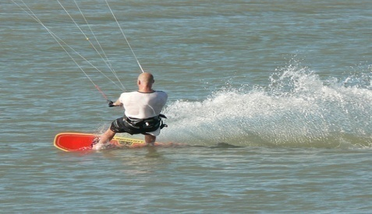
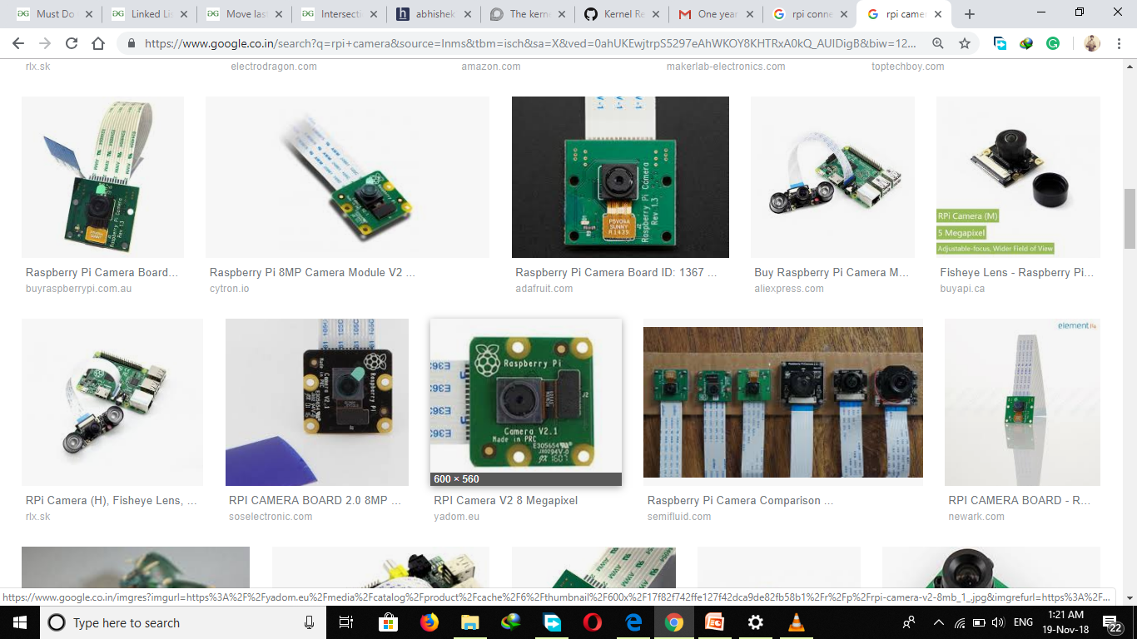
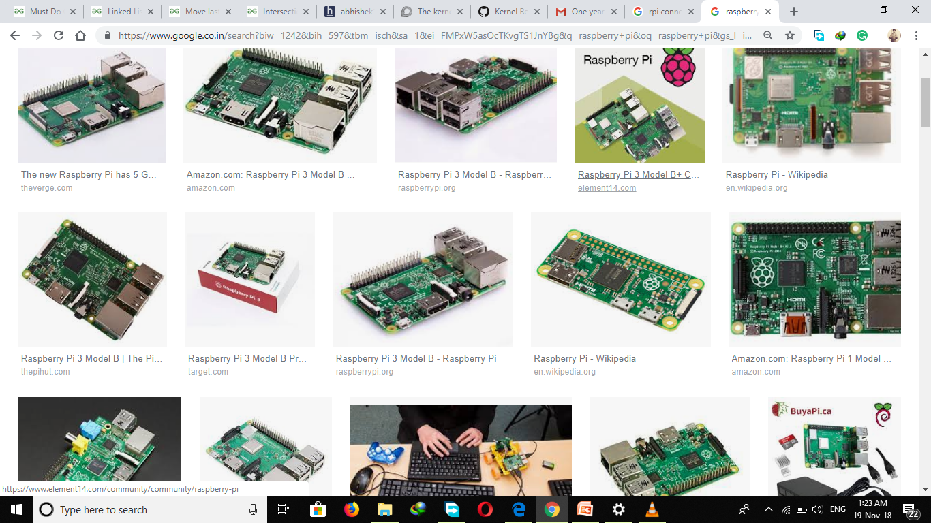

BLOCK DIAGRAM :-
Image
Camera
Raspberry-Pi-3B+
White shirt Man surfing on water
Caption Audio
Caption of Image
Deep Learning Model
Bluetooth Earphone

Slide 5

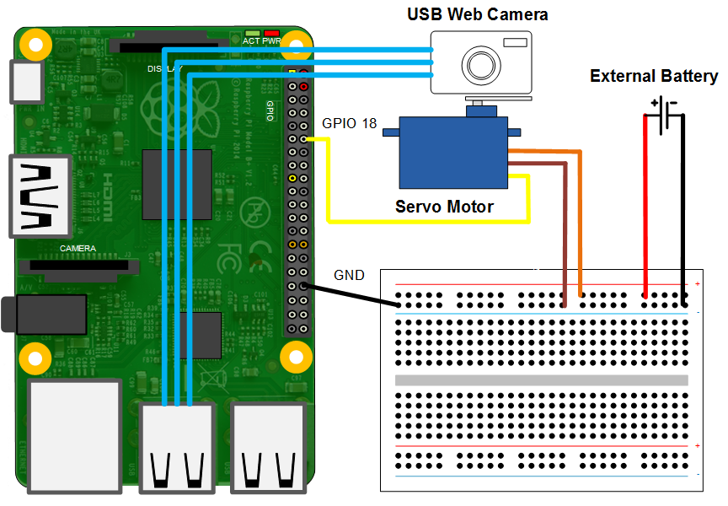
CIRCUIT DIAGRAM :-
RPI inbuilt wifi & bluetooth

Slide 6


