Slide 1
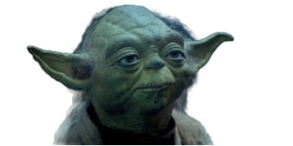


Recycle If You Will
By Merry, Rissa, Ali,
Yuheng and Abhi
Notes:
Yoda image is copyright of Lucas Disney Entertainment

Slide 2
The WHAT
The challenge of recycling lies in the waste segregation at source
Without waste segregation, recycling is difficult if not impossible
As majority of recyclable waste is generated at consumer level, recycling at its core is still a community effort
Key Objective: Foster recycling behavior in residential communities

Slide 3

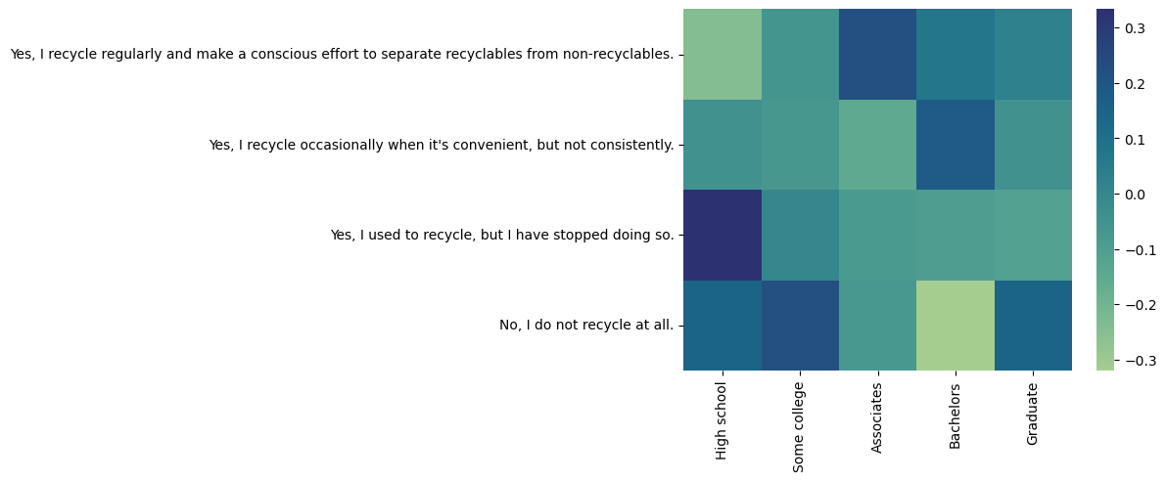
Initial Assumptions Debunked
Higher Education = More Recycling

Slide 4
Initial Assumptions Debunked
Higher Education = More Recycling
≠

Slide 5

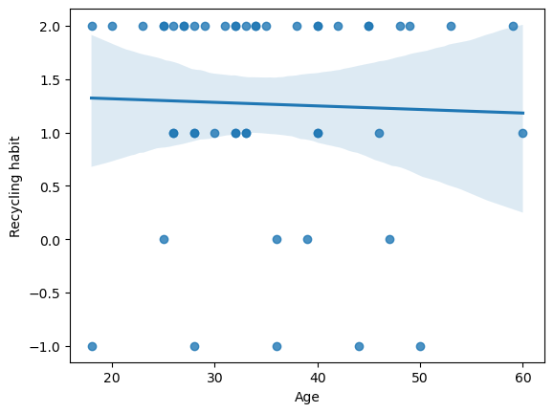
Initial Assumptions Debunked
Advanced Age = Less Recycling

Slide 6
Initial Assumptions Debunked
Advanced Age = Less Recycling
≠

Slide 7


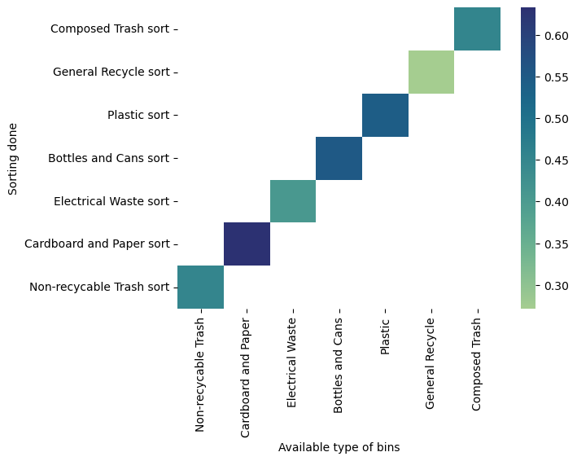
Initial Assumptions Debunked
More Resources = More Recycling

Slide 8
Initial Assumptions Debunked
More Resources = More Recycling
≠

Slide 9

Drawing Insights
Sentiments and actions influenced by community
“...in my new building, you are expected to break down all of your cardboard and put that into one bin, and then put plastic and cans into a different bin. Everyone who lives in the building really sticks to these rules, so if I were to just dump my recycling into the wrong bin I feel like there would be a picture of me put up in the lobby or something because I didn’t recycle properly.”
Jay, who lives in Brooklyn with his family, is proud of Brooklyn's community-centric approach to recycling and often takes part in local awareness campaigns.
Notes:
Based on our interview and survey data, one observation we were able to make is that people’s behavior towards recycling is influenced by their community or living environment. Here are some quotes and paraphrasing from 3 interviews where we see this trend. One quote that I really love is from my friend Julia, who said that “...in my new building, you are expected to break down all of your cardboard and put that into one bin, and then put plastic and cans into a different bin. Everyone who lives in the building really sticks to these rules, so if I were to just dump my recycling into the wrong bin I feel like there would be a picture of me put up in the lobby or something because I didn’t recycle properly.” What Julia says really shows how her communities expectations, whether implicit or explicit, almost “shame” her into recycling.

Slide 10
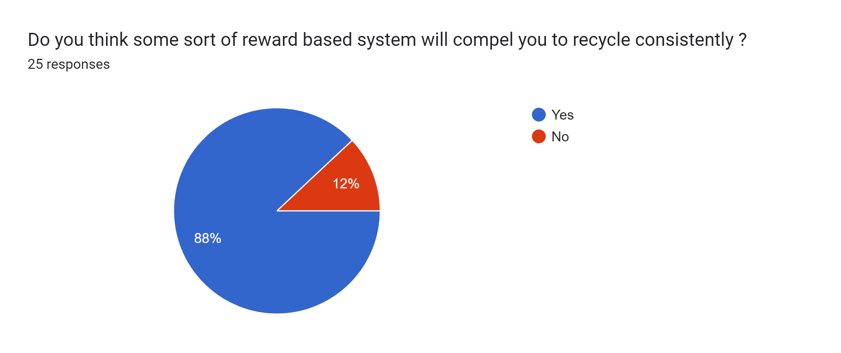
Drawing Insights
Sentiments and actions influenced by community
“...in my new building, you are expected to break down all of your cardboard and put that into one bin, and then put plastic and cans into a different bin. Everyone who lives in the building really sticks to these rules, so if I were to just dump my recycling into the wrong bin I feel like there would be a picture of me put up in the lobby or something because I didn’t recycle properly.”
Jay, who lives in Brooklyn with his family, is proud of Brooklyn's community-centric approach to recycling and often takes part in local awareness campaigns.
Marionna, a sophomore at CC residing at Carleton Arms, expressed reservations about the overall impact of her recycling efforts, citing concerns about incorrect sorting by others within her living environment.
Notes:
Based on our interview and survey data, one observation we were able to make is that people’s behavior towards recycling is influenced by their community or living environment. Here are some quotes and paraphrasing from 3 interviews where we see this trend. One quote that I really love is from my friend Julia, who said that “...in my new building, you are expected to break down all of your cardboard and put that into one bin, and then put plastic and cans into a different bin. Everyone who lives in the building really sticks to these rules, so if I were to just dump my recycling into the wrong bin I feel like there would be a picture of me put up in the lobby or something because I didn’t recycle properly.” What Julia says really shows how her communities expectations, whether implicit or explicit, almost “shame” her into recycling.

Slide 11



Drawing Insights
Concern about recycling habits of others
“...in my new building, you are expected to break down all of your cardboard and put that into one bin, and then put plastic and cans into a different bin. Everyone who lives in the building really sticks to these rules, so if I were to just dump my recycling into the wrong bin I feel like there would be a picture of me put up in the lobby or something because I didn’t recycle properly.”
Jay, who lives in Brooklyn with his family, is proud of Brooklyn's community-centric approach to recycling and often takes part in local awareness campaigns.
Marionna, a sophomore at CC residing at Carleton Arms, expressed reservations about the overall impact of her recycling efforts, citing concerns about incorrect sorting by others within her living environment.
Notes:
Going off of this theme, it also seemed as though many had concerns about the recycling habits of others, particularly their neighbors. This makes sense, as especially in such a concentrated place as New York, where many live in apartments and share a trash disposal area, it is really easy to witness or infer your neighbors recycling behavior based on the state of the trash disposal room. “If nobody else is recycling, why should I?”

Slide 12

Drawing Insights
Incentive drives positive behavior
Marionna, a sophomore at CC residing at Carleton Arms, expressed reservations about the overall impact of her recycling efforts, citing concerns about incorrect sorting by others within her living environment.
“...in my new building, you are expected to break down all of your cardboard and put that into one bin, and then put plastic and cans into a different bin. Everyone who lives in the building really sticks to these rules, so if I were to just dump my recycling into the wrong bin I feel like there would be a picture of me put up in the lobby or something because I didn’t recycle properly.”
Jay, who lives in Brooklyn with his family, is proud of Brooklyn's community-centric approach to recycling and often takes part in local awareness campaigns.
Notes:
We also saw that implementing rewards would likely compel people to recycle more.

Slide 13
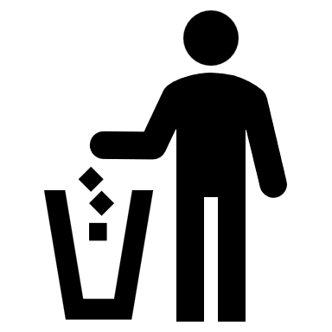
Drawing Insights
Availability => Usage, only when convenient
Marionna, a sophomore at CC residing at Carleton Arms, expressed reservations about the overall impact of her recycling efforts, citing concerns about incorrect sorting by others within her living environment.

Slide 14
The WHY
The four horsemen of people’s poor recycling habits:
Incentives – Little to None
Resources – Limited or Inconvenient
Information – Inadequate or Confusing
Complacency – Little too much

Slide 15
Reframing
A system which promotes recycling by:
Being convenient enough to fit in daily routines
Yet structured enough to not be cheated with
Providing personal stats within context of community trends
Distributing tangible incentives

Slide 16
Idea & Inspiration
Idea: Community based Reward system for proper disposal of recyclable materials
Inspiration:
Financial rewards for recycling in countries like Germany
Accounting for people’s concern about recycling behavior of their neighbors
Tests:
Different kinds of reward system
Different reward distribution strategies
Note: Both the ideas were tested using interactive group exercise and live feedback was captured

Slide 17


The HOW
Trash is generated by an individual
Notes:
Idea 1: Reward based system for proper disposal of recyclable materials
Prototype 1: Testing different types of reward systems. Participants were asked to choose a
preferred reward system, either Immediate - Cuts on utility bills, taxes etc. or Long term -
Federal credits for lower loan rates, mortgage relief etc.
Prototype 2: Testing relative reward redistribution. Participants were given rewards
commensurate with their amount recycled directly or could opt in a relative system, where based
on their performance relative to the community, the rewards were redistributed.
Learnings:
● People prefer immediate rewards over long term rewards, which is purely instinctive and
includes no calculated decision making
● People do not want their rewards to be influenced by patterns of the community. Ideally
competitive nature should foster better individual behavior, but seemingly is not observed
in the testing.
● If people do choose relative rewards, they do not agree with “recycled amount” as a
proper metric.

Slide 18

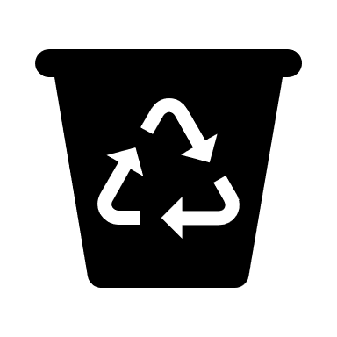


The HOW
Trash is generated by an individual

Slide 19



The HOW
Trash is segregated in recyclable and throwaway

Slide 20


The HOW
Recyclables are taken to apartment disposal area on designated days

Slide 21

The HOW
Waste is checked before disposal

Slide 22
The HOW
Waste is then weighted

Slide 23



The HOW
The amount recycled is logged for the individual

Slide 24
The HOW
The recycling logs are used to generate statistics

Slide 25

The HOW
The individual contribution in the community is calculated using the statistics

Slide 26

The HOW
Adjustments to utility bills are made according to individual contribution and report is presented with stats of your apartment

Slide 27
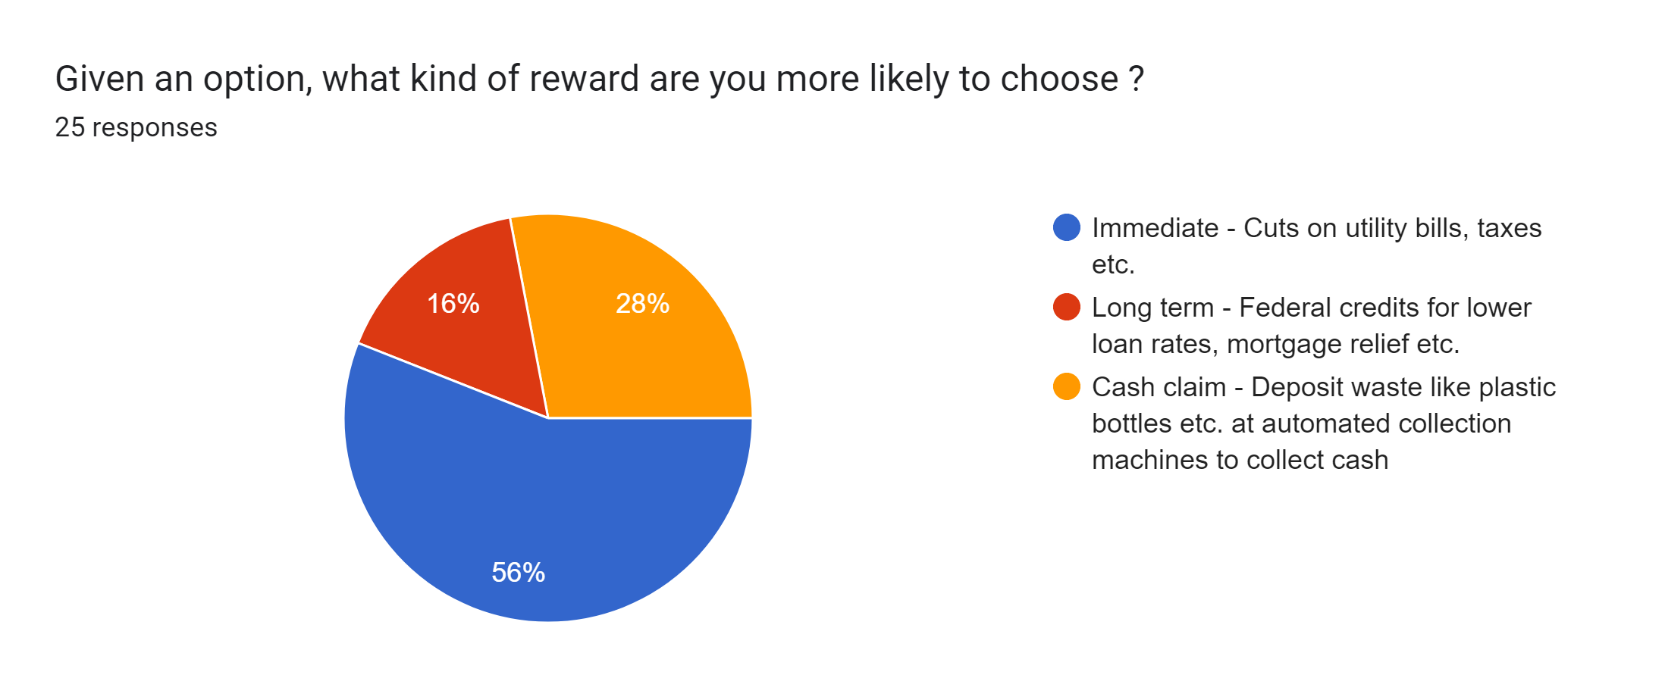
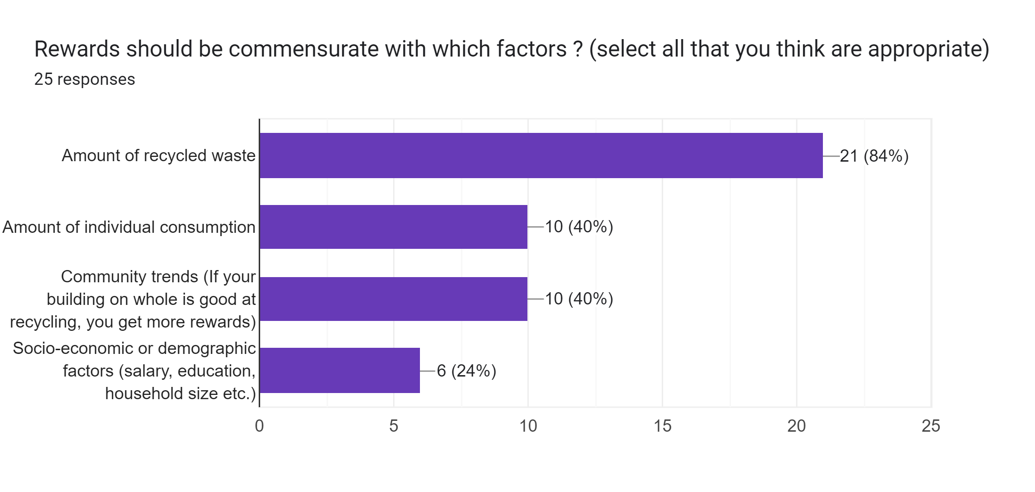
Insights from Prototype Testing
People prefer rewards which are immediate without considering value

Slide 28
Insights from Prototype Testing
People prefer rewards which are immediate without considering value

Slide 29
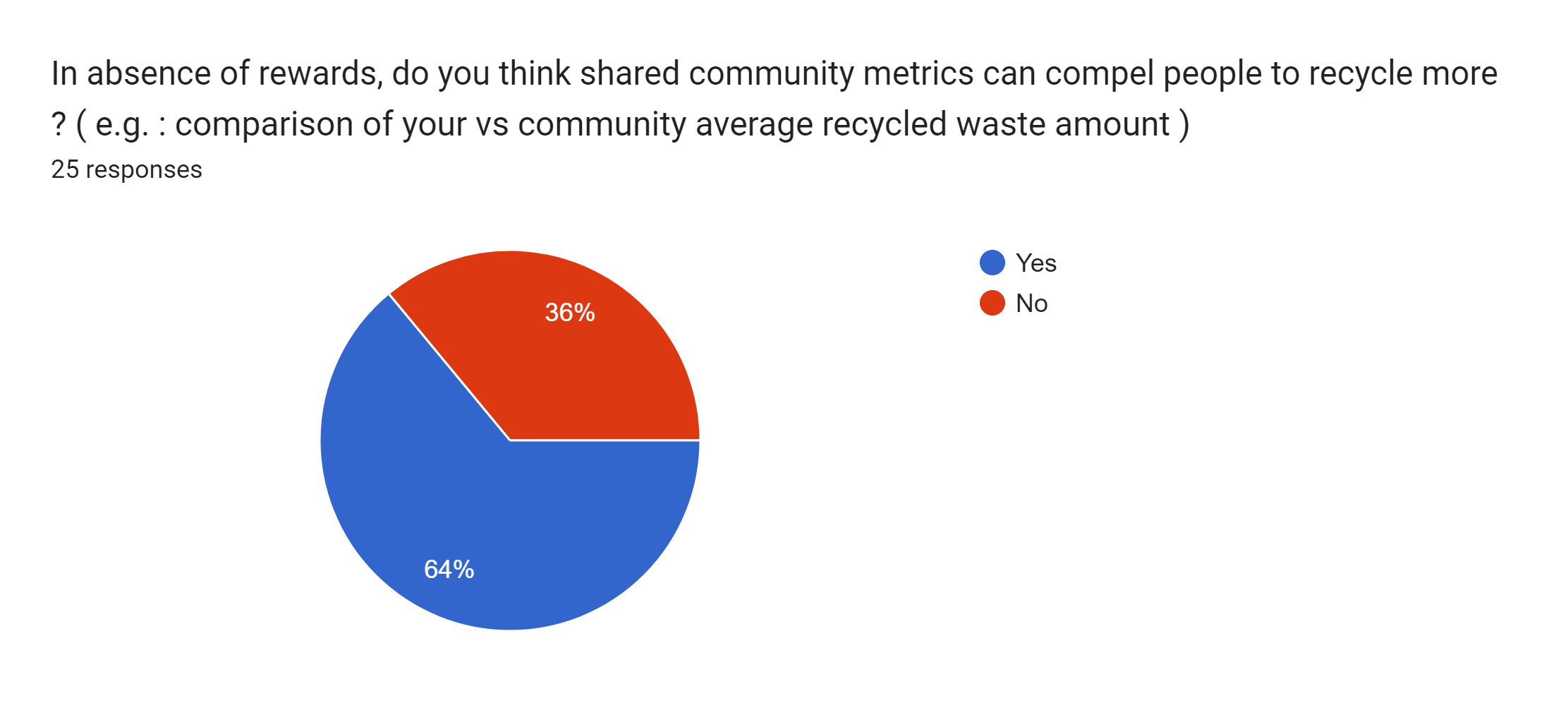
Insights from Prototype Testing
Socio-economic/demographic factors were least favored for reward commensuration

Slide 30
Insights from Prototype Testing
Hesitation in community-based rewards due to fear of loss of rewards or embarrassment in community

Slide 31

Some User Concerns
The amount of recycled waste isn’t necessarily a good metric
Reduction in
headcount
Waste generated
Waste recycled
Temporary
absence

Slide 32
Some User Concerns
The amount of recycled waste isn’t necessarily a good metric
Reduction in
headcount
Waste generated
Waste recycled
Temporary
absence

Slide 33
Some User Concerns
How can you account for changes in user behavior or environment ?
Reduction in
headcount
Waste generated
Waste recycled
Temporary
absence

Slide 34
Closing Thoughts
% of recycled amount out of your consumption is a better metric
Adoption of such system by the populace, and the entities involved (apartment management, utility providers etc.)
Long term viability of financial rewards is questionable, so we want to test if just the community sentiments are sufficient

Slide 35


The HOW (Idea 2)
Manufacturers add information on waste generated per product
Notes:
Idea 2: Punishment based system factoring in the waste generation aspect
Prototype 1: Testing 2 things. 1) Do people even read packaging and if so, does it impact their
purchase decision concerning their environmental impact? 2) Will people agree to a mandatory
program about logging waste generation of an individual at the source (purchase time).
Prototype 2: Testing penalty system based on waste generation metric of an individual.
Learnings:
● Printing environmental impact on packaging is more or less irrelevant, as people tend
not to make their purchase decisions based on those factors.
● Mandatory waste generation log for individuals does not seem to sit well with people.
● People do not want to get penalized for their purchases. Even if they agree to it as a part
of a new tax regime, just the amount of waste generated is not a good metric if all of it
just ends in landfill.

Slide 36



The HOW
People are given ID which can log the generated waste

Slide 37

The HOW

Slide 38
The HOW
For every purchase, you also get the estimated waste generated on your part

Slide 39
The HOW
This estimated waste is logged to your ID

Slide 40

The HOW – Our Prototype
Adjustments to utility bills are made according to individual contribution and report is presented with stats of your apartment

