Slide 1
Fetal Brain Segmentation
Abhi Lad

Slide 2
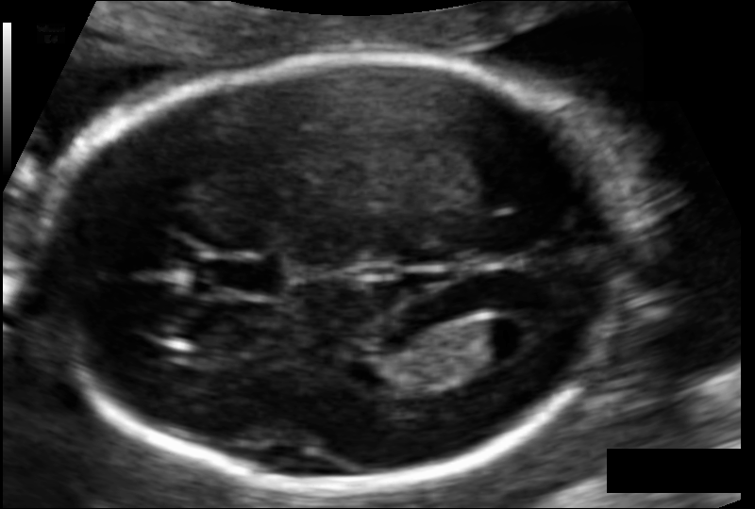

The Task
Given an ultrasound image containing brain region of a fetus, our model should output a segmentation map which labels every pixel in the ultrasound image to 6 classes as annotated by an expert.
Since the model we will be using is a deep learning based model, we can approach this segmentation task as an image-to-image translation task.
Model
Input
Output

Slide 3
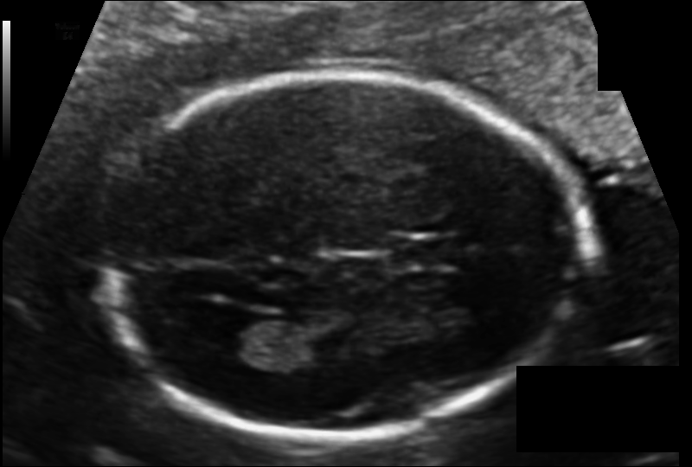
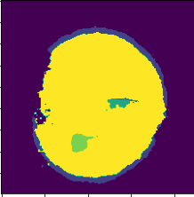
Challenges
Here are some of the challenges to be considered while addressing the task.
Small training set.
Less samples corresponding to anomalies in the dataset.
Whether to predict segmented region if input is not clearly visible.
Should we predict this ?

Slide 4
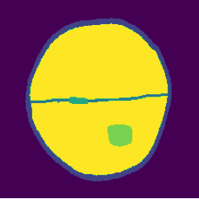
Data
Input Data: We have ultrasound images which are feed as 3 channel images to our model
Output Data: We have 1 channel segmentation map, with 6 classes represented as integers 0-5.
0
1
3
2
5
4
We resize our images to 224*224 as part of preprocessing
We use different colourmap in order to better identify the segments

Slide 5
Basic Approach
We will use a basic implementation of UNet architecture for our task.
Model Information
Input: 3 channel 224*224 ultrasound images
Model Output: 6 channel 224*224 probability maps
Final Output: 1 channel 224*224 segmentation map

Slide 6
Basic Approach
Architecture: UNet
Downsampling layers: Pretrained MobileNetv2 (non trainable)
Upsampling layers: Deconvolutional layers (trainable)
Loss: SparseCategoricalCrossentropy (since output classes are in int format)

Slide 7
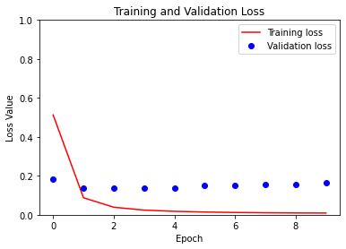
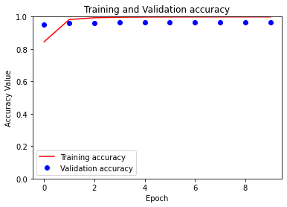
Results
As it can be seen in the performance plots given below, the validation loss and accuracy saturates only after 3 epochs. This is due to small sample size.

Slide 8
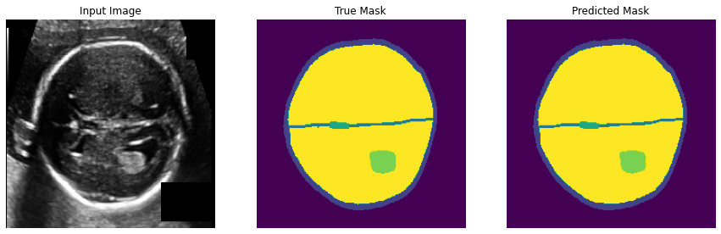
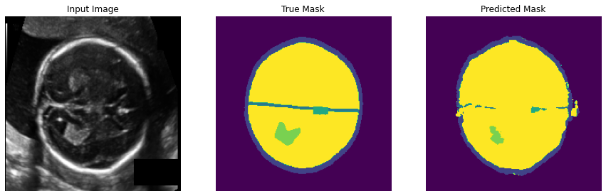
Results
The model performs well in scenarios where there is good enough contrast variation between segments
Lower visibility of even a single segment affects the prediction of every other segment.

Slide 9
Improving the Basic Approach
Addressing Class Imbalance
Every segmentation map consists of classes 0 (Background) and 5 (BRAIN_PARENCHYMA) covering almost 90 % values.
This leads to class imbalance problem, where our actual segments of interest (3 & 4) which are crucial in detecting abnormalities are encountered less while training and thus the probability output does not represent actual likelihood of these segments.
We can use adjust class weights with their approximate inverse frequency.

Slide 10
Further Approaches
Domain Knowledge
Relative importance of segmented regions : We can incorporate domain knowledge while training the model.
CSP and CHOROID_PLEXUS are more important in detecting abnormalities than other segments. So we can train the model by incorporating class importance and giving higher priority to these segments.

Slide 11
Further Approaches
Data Augmentation
Multiple Exposure Inputs: We can increase training samples by adjusting the exposure of the ultrasound images. This will also help in cases where the model cannot predict segments due to less contrast difference between segments.
Adding Occlusion: We can improve predictive performance by introducing occlusion in the input data. This way the model learns to predict segment even if segments in input data are not clearly visible.

