Slide 1
StoryBoard: An AI-Assisted Marketplace for Writers
Cloud Computing and Big Data
COMS6998 006
Abhi Lad (al4363)
Preethi Chandirasekeran (pc3019)
Hamid Alaie (sa3724)

Slide 2
Motivation
Writers have the opportunity to publish their stories for free and with ease on the internet. However, a lack of visual media such as illustrations and language barriers creates various problems such as
Problem Statement
After analyzing the existing literature, we aim to create a writer’s space where authors can upload their stories and generate art and translation to complement their written work. The following challenges are faced while tackling this problem
Working with multimodal data
Lacking flair and not generating much interest among readers
Reduced marketing potential and audience reach
Having to read through generally boring summary
Help writers with generating relevant content
Finding the right balance between assistance and infringement

Slide 3




Introduction
Key Objectives
Creating a marketplace where users can either purchase stories or upload stories to sell
Developing a Text-to-Image synthesis interface which can generate Cover-art for the story
Automating the trivial tasks like writing summary, creating immersive reading experience and keeping track of reads

Slide 4
Introduction
Secondary Objectives
01
Providing automatic language translation of the stories uploaded by user
02
Automatic audiobook generation of the stories
03
Provide story outline assistance to improve writer throughput
04
Provide spotify-style user wrapped to show reading stats and achievements

Slide 5
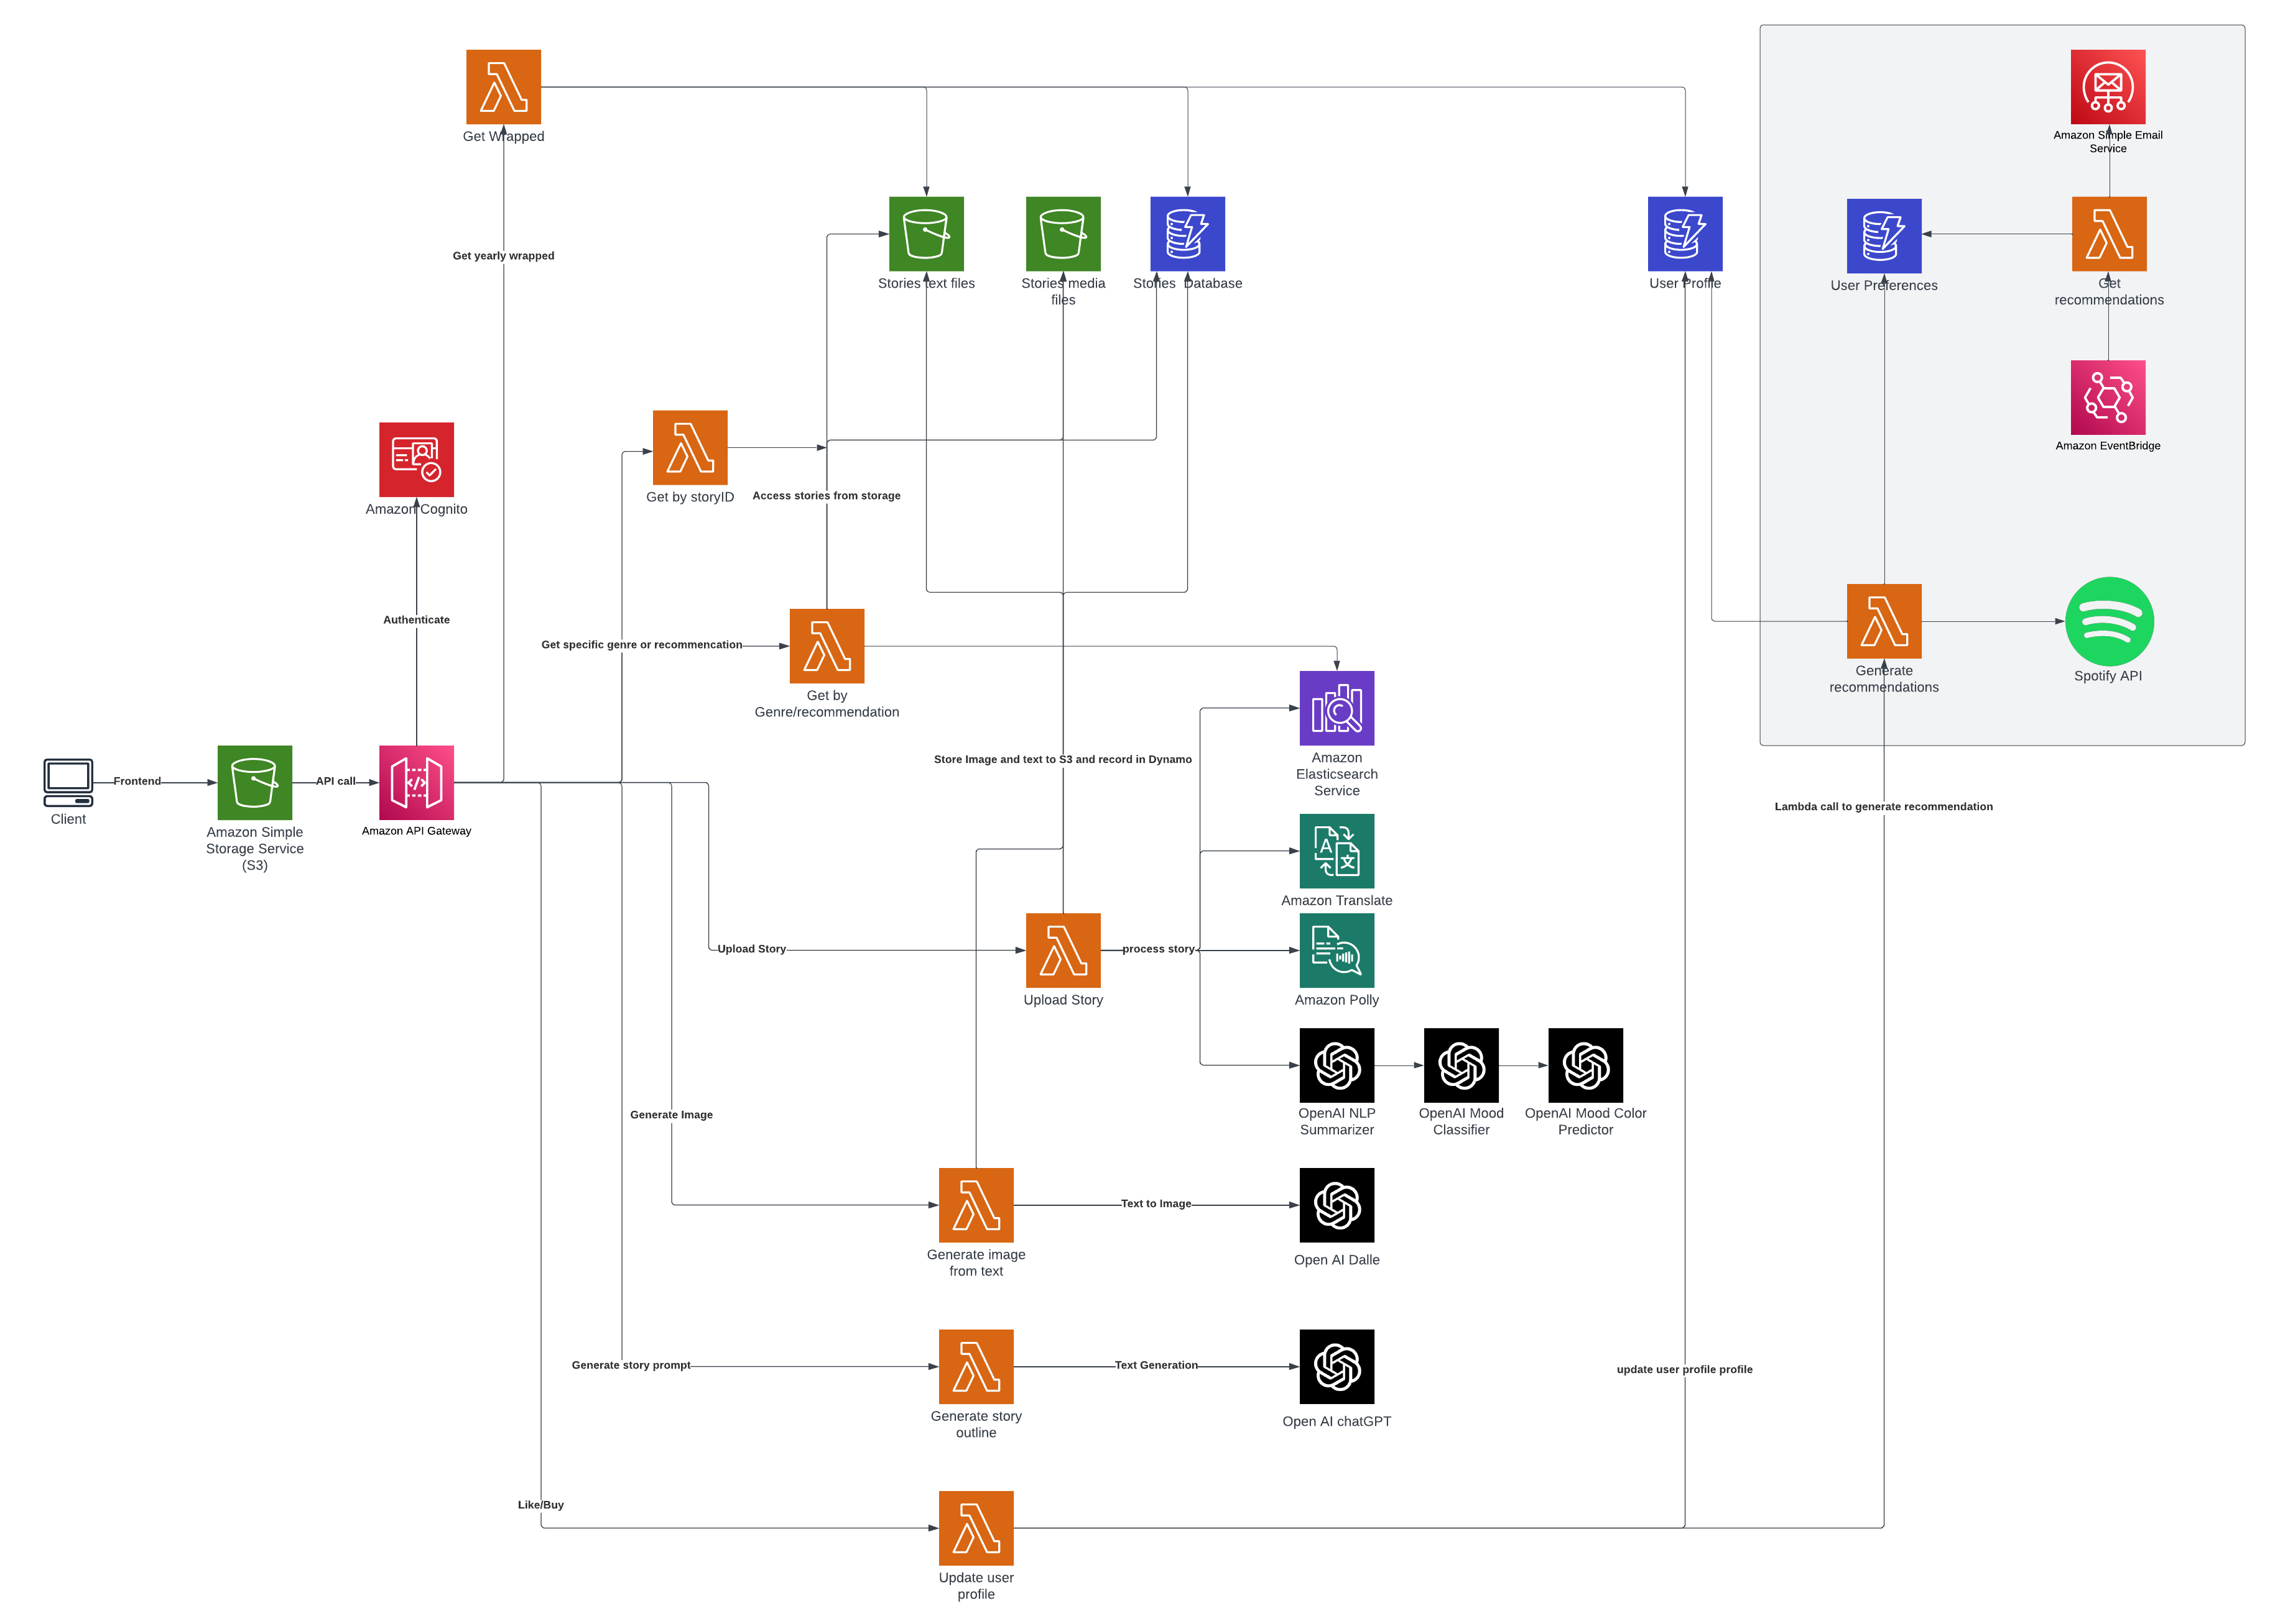
System Architecture

Slide 6
THANK YOU

