Slide 1
Version Control using Git & GitHub
Techversant Infotech
December 2025
Abhilash Antony

Slide 2




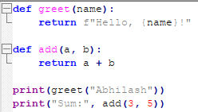
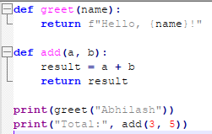
Techversant Infotech
VERSION CONTROL
VCS is useful for
  Keep track of changes in files
  Reverting to safe/stable previous version
  Who did What and When
  Makes collaboration easier
Diffing: Shows the exact differences between two files or code versions.
file1.py
file2.py
$ diff -u file1.py file2.py

Slide 3
Projected results

