Slide 1

Distributed DL Framework Acceleration for Large Generative Models
Abhilash Majumder
Deep Learning and Supercompute Engineer ,Intel

Slide 2
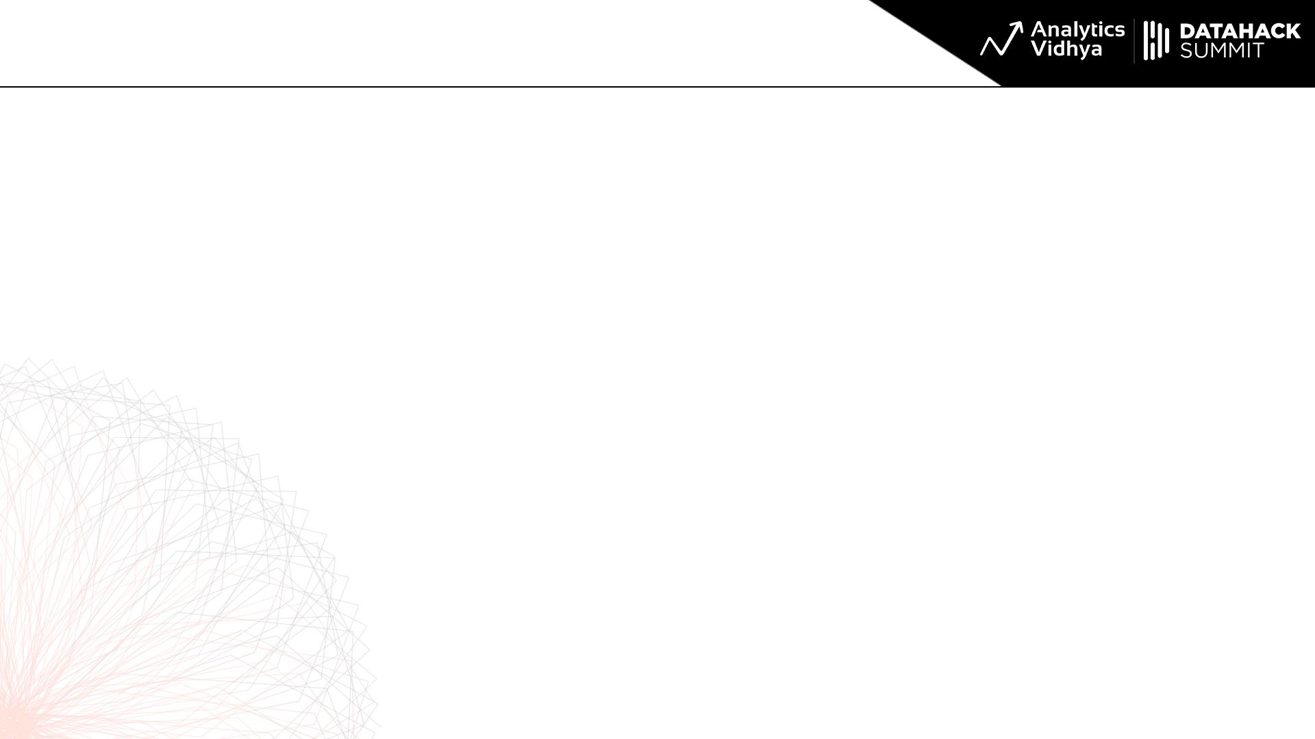
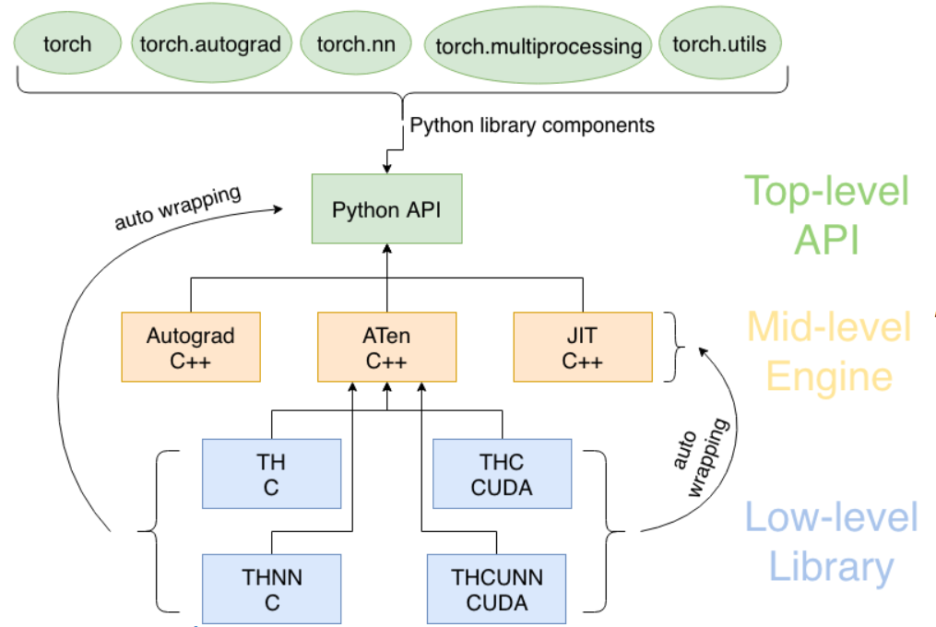
Deep Learning Frameworks

Slide 3
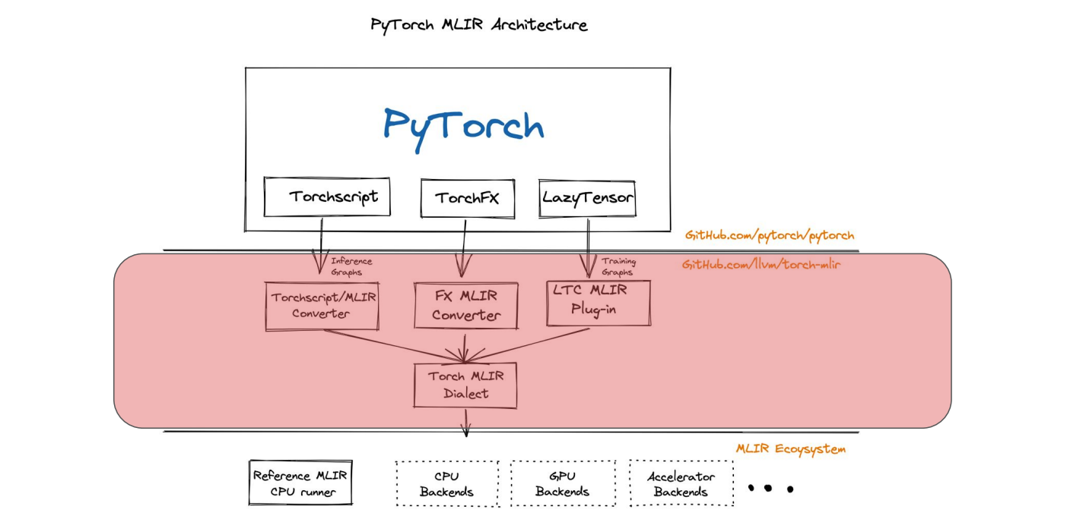
Deep Learning Frameworks
DL Frameworks (Pytorch,TF) are a set of compiler instructions which enable faster compute for repetitive GEMM manipulations
The basic architecture consists of a graph compiler backend, native apis and a frontend python linkage for the developer.
Since most of the optimizations related to graphs occur at compiler level tweaking internal IR code generated by Frameworks becomes difficult.
Optimizations generally arise from fused mappings in compiled graphs (eager mode) so as to reduce the number of GEMM calls to the device and avoid overhead of collective calls.

Slide 4
Deep Learning Frameworks
Pytorch (DL FW) has induced several abstractions for optimizing graph kernels which falls under 3 broad steps: - Graph Capture or Acquisition : Contains the torchscript/jit/IR graph representation of models. This includes IR /Torchscript frontend
- Graph Lowering : Refers to mapping graph calls to device specific subset of primitive IRs . This includes Aten/Prim IR
- Graph Compilation: Compile the primitive IR to device specific C++/GPU/XPU code for the graph and optimize. This includes Inductor/Codegen.

Slide 5
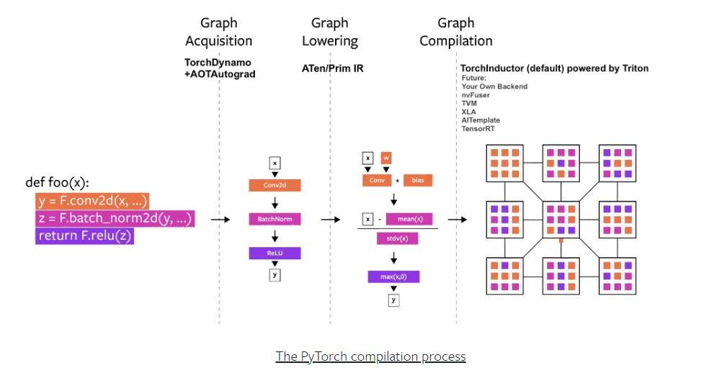
Deep Learning Frameworks

Slide 6
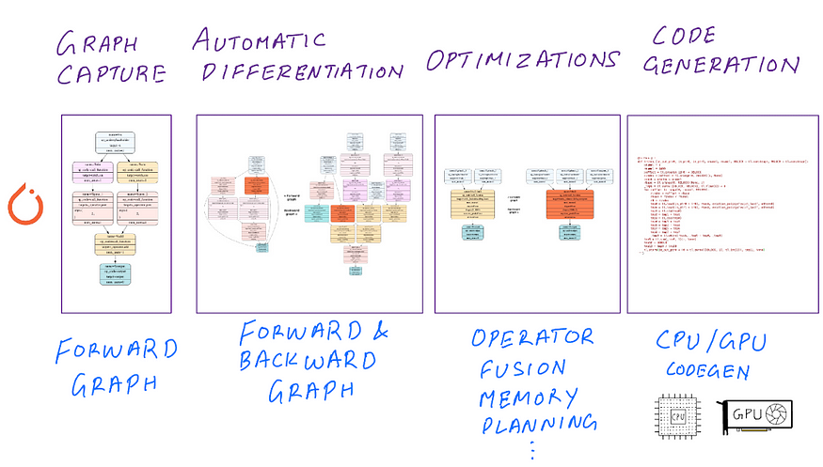
Deep Learning Frameworks - PT

Slide 7
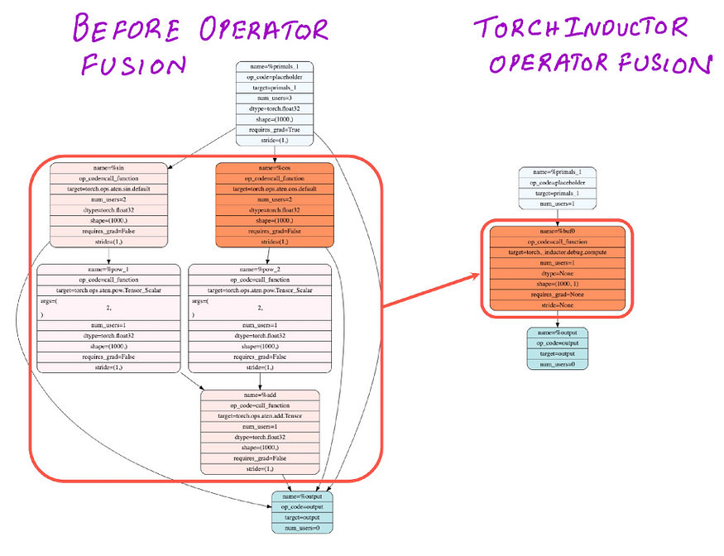
Deep Learning Frameworks - PT
Pytorch (DL FW) optimizes compiled DL code through inductor and generates FX IR.
These FX passes contain several optimizations including numerous matmul fusions, freezing subgraph sections (fx freeze passes)
For the IR graph generated, torch inductor has a capability to view AOT( ahead of time) runtime dependency on each graph nodes (operator)
Inductor then generates a simplified fused IR by merging certain operators and layers (such as badmm+relu/gelu ,fused attention)
Inductor , which is triggered during ‘torch.compile’ can then use pythonic triton compiler code for low level PTX code which can be induced to OpenMP for parallel threads and runtimes for separate devices.

Slide 8
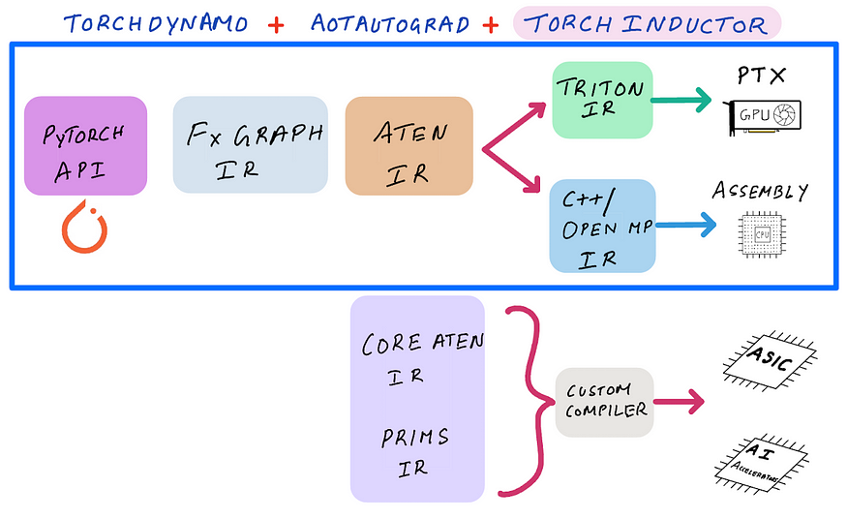
Deep Learning Frameworks - PT

Slide 9
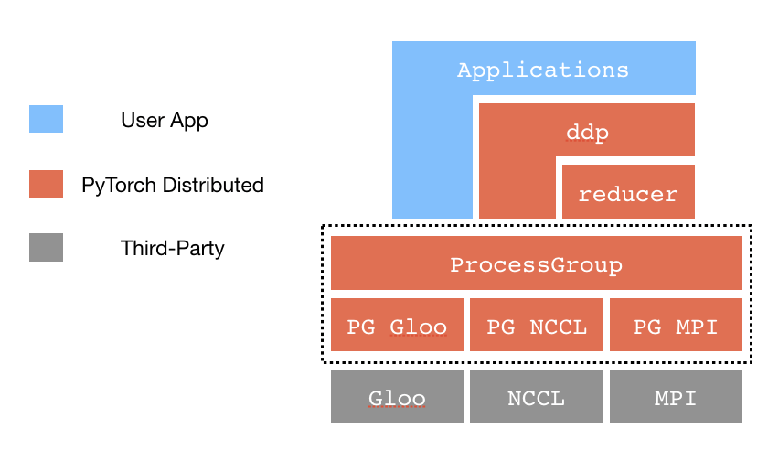
Distributed DL- PT

Slide 10
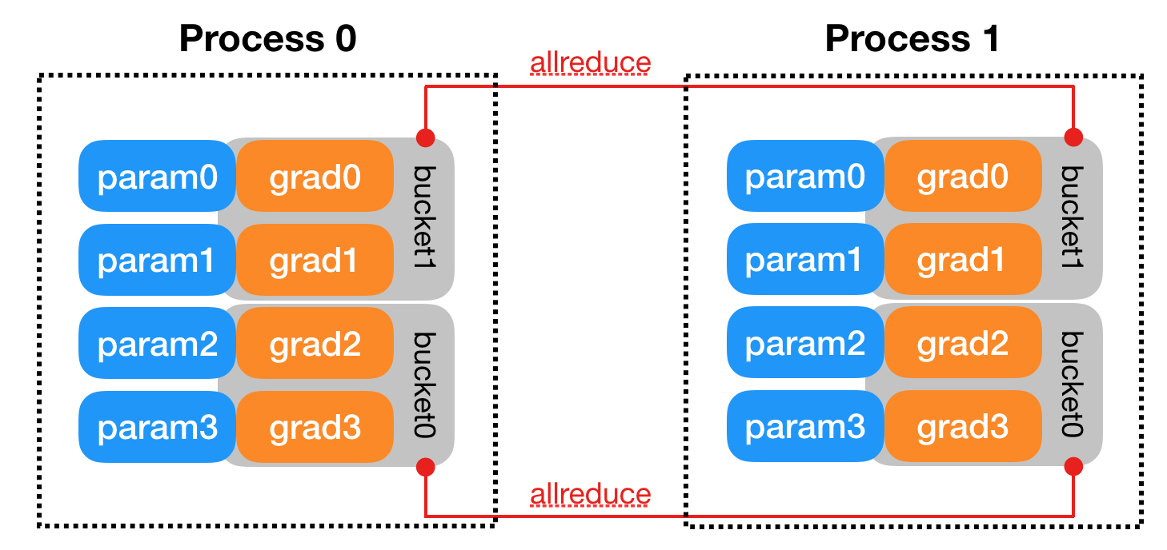
Data Parallelism
In data parallel training, the dataset is split into several shards, each shard is allocated to a device. This is equivalent to parallelize the training process along the batch dimension.
Each device will hold a full copy of the model replica and trains on the dataset shard allocated. After back-propagation, the gradients of the model will be all-reduced so that the model parameters on different devices can stay synchronized.

Slide 11
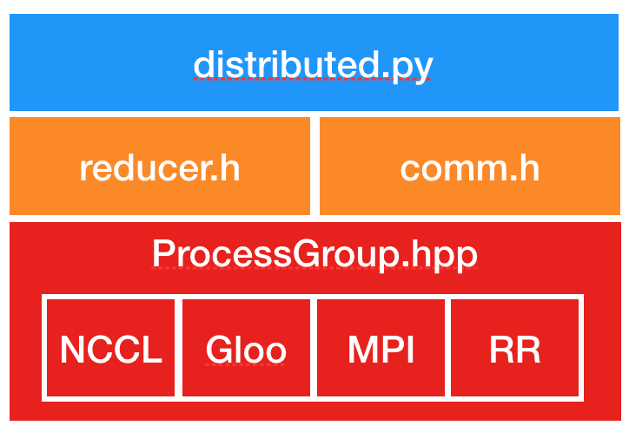
Data Parallelism
In pytorch, DDP has 3 stages: - distributed bcast: performs intra process param sync when one DDP process works on multiple devices and broadcasts the model params from root rank (generally rank 0).
- coalesced bcast: invoked to broadcast model states during initialization and synchronize model before the forward pass
- reduce : gradient synchronization during backward pass. This uses the autograd graph to determine weak linkages and prepare the ddp graph for backward

Slide 12
Tensor Parallelism
Model Parallelism involves sharding model blocks (not separate tensor lists) across devices in a uniform manner.
For generic model parallel, horizontal partitioning of the model is preferred – this involves shifting modules (torch.nn.modulelist) to specific devices.
These modules can be FFNs , Attention kernels or fancy embedding layers (such as Rotary positional embedding in GPT Neo variants)
Vertical partitioning is preferred when splitting across gradient checkpoints . This implies that gradient collection across ranks requires additional collective operations for correctness (loss values etc).

Slide 13
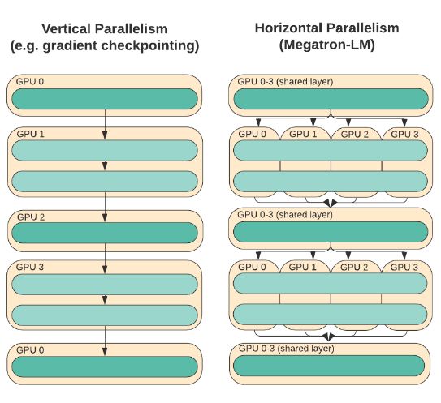
Model Parallelism

Slide 14
Tensor Parallelism
Tensor Parallelism implies splitting a tensor (or list or tensors) in uniform (n) chunks across a specific dimension where each device holds 1/n of the whole tensor .
This should not affect the outcome of the computation graph through IR
When performing operations (general reduction) more such collective calls are needed to gather the results of (1/n) part of the tensors to a root (destination) rank for correctness.
This offers significant tiling and partitioning capabilities of extreme scale models like Bloom/GPT XL and even for smaller models such as GPT-J and Llama families.
To induce tensor parallelism, we use torch distributed to initiate separate process groups with the task of partitioning selected tensors into buckets across gpu/xpu/tpu devices . Then this process group is used to perform any collective operations on those partitions (such as all gather, all reduce etc).

Slide 15
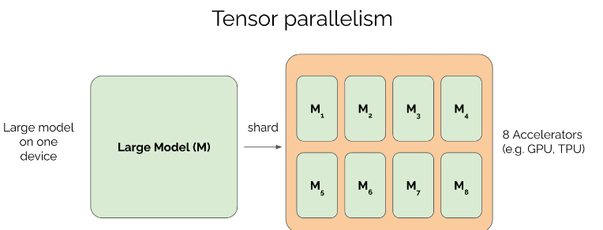
Tensor Parallelism

Slide 16
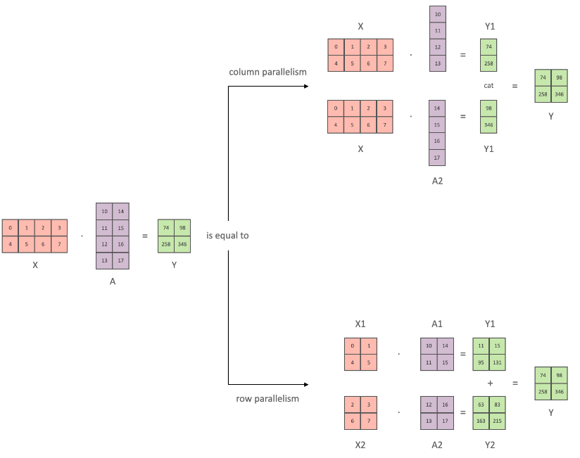
Model Parallelism – FW support
While creating TP /MP groups , it is inherent to create a dedicated process group and then use the process group for synchronization across different DP /MP instances.
For popular FWs like Transformers, Megatron –LM, creating shards can either be done in a row wise or columnar manner . This requires explicit declaration to device ids to pytorch so that the IR calls get translated to low level device specific IR without much errors. Partitioning the model across blocks is not random, and should be done only when the gradient checkpoint (or the optimizer) is able to load/perform backward correctly.

Slide 17
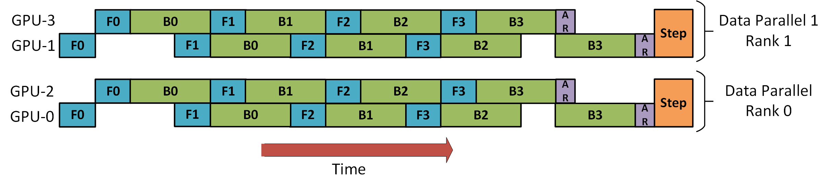
Pipeline Parallelism
The core idea of pipeline parallelism is that the model is split by layer into several chunks, each chunk is given to a device.
During the forward pass, each device passes the intermediate activation to the next stage.
During the backward pass, each device passes the gradient of the input tensor back to the previous pipeline stage.
The resultant increase in throughput per training step iteration is due to this interleaved 1F1B mode of pipeline parallelism.
Pipeline Parallelism in Deepspeed FW uses 1F1B in a way that the training data is split into batches to be trained parallely. Once a pp stage completes a forward on a micro-batch, the activation memory is communicated to the next stage. The gradient w.r.t the activation is communicated backwards through the pipeline.

Slide 18
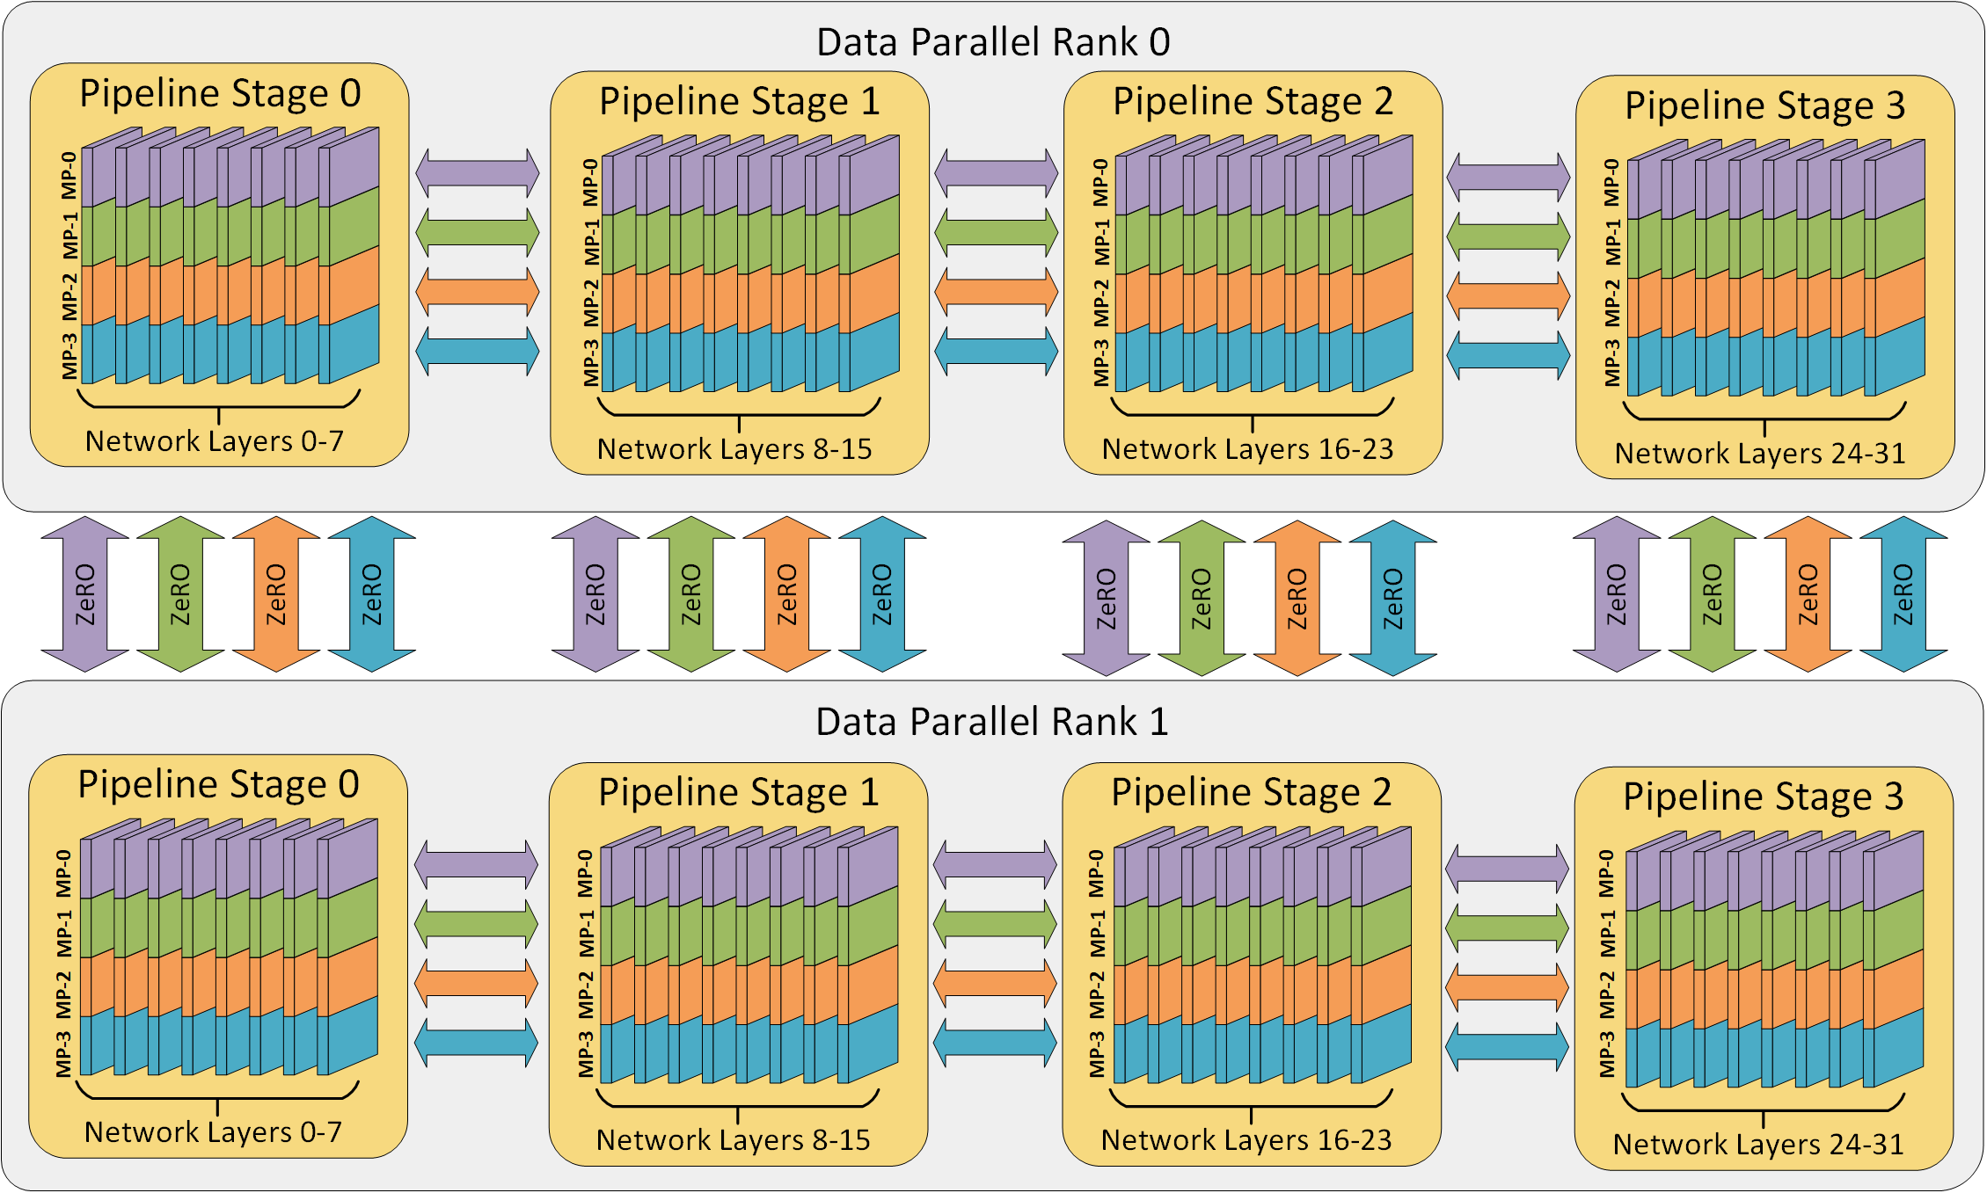
Pipeline Parallelism

Slide 19
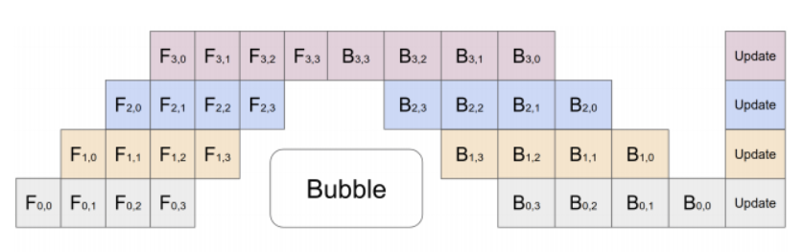
Pipeline Parallelism – Bubbles
The previous figure depicts GPUs 0 and 2 are out of phase for forward and backward calls . Once the calls complete, an all-reduce across the data parallel ranks are performed.
There are bubbles owing to scheduling of the pipeline stages , arising from insufficient devices for the pipeline to progress further.
For custom pipeline parallelism, the requirement is for an allreduce collective across DP ranks at the end of a “forced” optimizer.step . Hence there is no practical need of applying additional tensor parallelism since most of the compute will be governed by the availability of the gpus in the system and the pipeline stages.

Slide 20
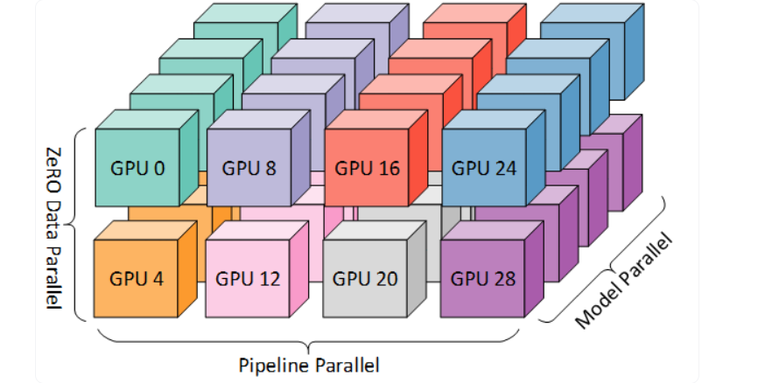
3D Parallelism

Slide 21
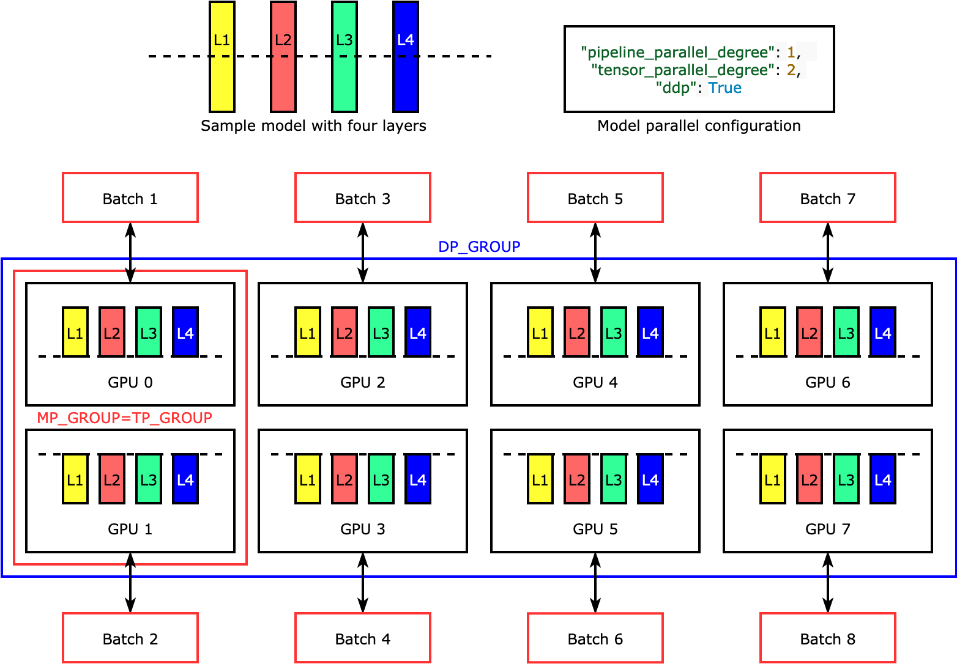
3D Parallelism – Horizontal Sharding

Slide 22
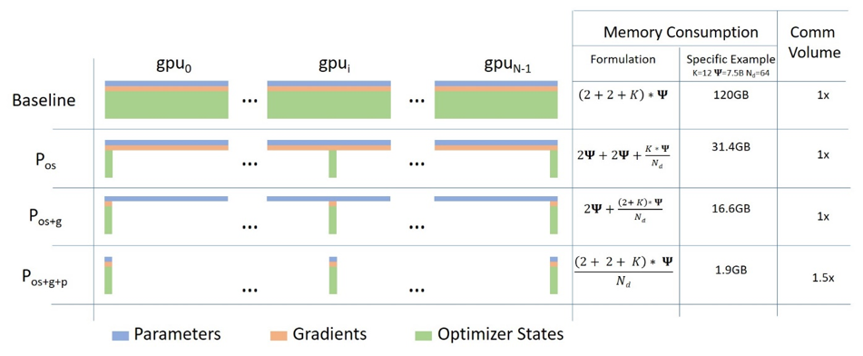
Deepspeed Optimization FW

Slide 23
DeepSpeed FW - Zero
ZeRO leverages the aggregate computation and memory resources of data parallelism to reduce the memory and compute requirements of each device (GPU) used for model training. ZeRO reduces the memory consumption of each GPU by partitioning the various model training states (weights, gradients, and optimizer states) across the available devices (GPUs and CPUs) in the distributed training hardware. Concretely, ZeRO is being implemented as incremental stages of optimizations, where optimizations in earlier stages are available in the later stages.
Stage 1: The optimizer states (e.g., for Adam optimizer, 32-bit weights, and the first, and second moment estimates) are partitioned across the processes, so that each process updates only its partition.
Stage 2: The reduced 32-bit gradients for updating the model weights are also partitioned such that each process retains only the gradients corresponding to its portion of the optimizer states.
Stage 3: The 16-bit model parameters are partitioned across the processes. ZeRO-3 will automatically collect and partition them during the forward and backward passes.
Zero Offload: Zero Offload (Zero infinity engine) involves offloading parameters and optimizer states either through nvme /cpus links to load and train large models which are difficult to split into GPUs (even after tensor slicing/model parallel).
Zero ++: Involves quantization of the model, all to all (p2p) collective operations for better bandwidth utilization .

Slide 24
Triton
Triton is a deep learning compiler created specifically to abstract IR code and optimize kernels which would otherwise be difficult to optimiz in cuda.
Triton uses 3 important modules: - Triton C : Clang for transcompilation for DNNs (oneAPI, PlaidML etc). These transcompilations allow device specific DNN kernels to get triggered at runtime .
- Triton IR : An LLVM-based Intermediate Representation (IR) that provides an environment suitable for tile-level program analysis, transformation and optimization
- Triton JIT : A Just-In-Time (JIT) compiler and code generation backend for compiling Triton-IR programs into efficient LLVM bitcode
Pytorch optimizes most of codegen (device specific generated code) using triton compiler. There are several advantages , such as fusing activation kernels (fused softmax) , instance parallelism and progressive attention mechanisms (flash attention). These building blocks are fundamental in optimizing and benchmarking trillion parameter models such as Megatron –GPT /GPT4 etc.

Slide 25
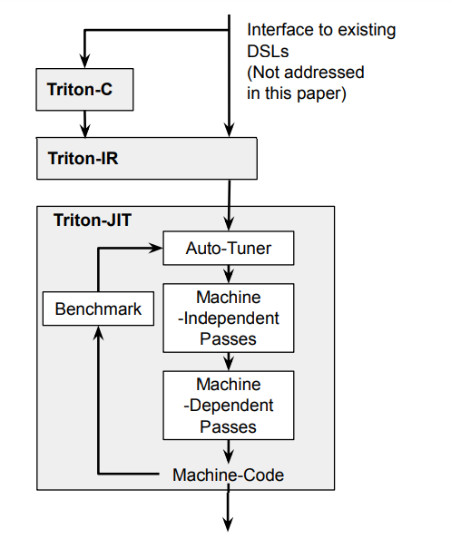
Triton Backend

Slide 26
Model Optimization Methods
- Model Parallelism across separate horizontal blocks
- Policy based Model And Tensor Slicing across process groups
- 3D Parallelism ,Custom scheduling in pipelines
- Zero Optimization
- Collective call optimization and sequencing more compute and less collective calls (larger batching)
- Intermediate kernel injections for inference , auto Tensor Parallelism (DeepSpeed)
- Custom cublas kernels for flash attention, sequence parallelism ,automated gradient checkpointing
- Activation Fusion ,Compiler optimizations (IR)
-Optimized Collective algorithms for resource sharing (SHM ,badwidth etc)

Slide 27
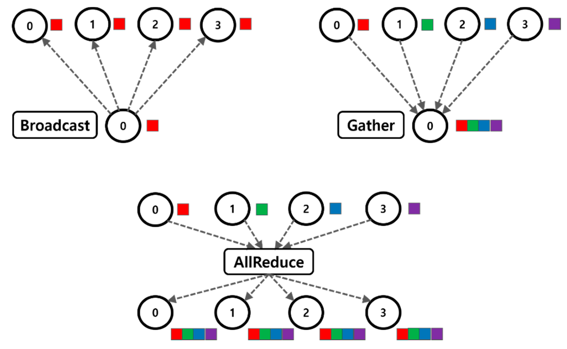
Distributed Collectives - Scaling
Broadcast operation copies a buffer on root rank to all other ranks
The AllReduce operation is performing reductions on data, for example, sum and max, across devices and writing the result in the receive buffers of every rank.
In All Gather each of the processors aggregates values from every processor into a combined output buffer which is indexed by rank order.

Slide 28
Collective Call Optimization
-Generally most common algorithms (allreduce, all gather) are implemented as point-to-poinr (P2P) communications which allow for better duplex bandwidth utilization across ranks.
In a IB connect (Infiniband) there are generally 2 transfer semantics – RDMA (Memory semantic) and Send/Recv(channel semantic)
For duplex communications, RDMA carries messages and the destination node information (with size) where as the nominal channel Send/Recv protocol carries only the source node information. This implies that RDMA does not require additional CPU cycles for transferring the data . (Data can be parameters, weights, optimizer states, gradients).
A lot of the transfer of data across models/modules rely on the underlying fabric .The fabric is connected to I/O nodes through Target Channel Adapters in IB, thereby controlling the flow of data across the fabric.
Topo based collective algorithms perform the best owing to their stable utilization of cpu/gpu/tpu resources and bandwidth.

Slide 29
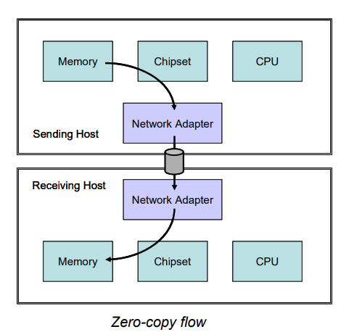
Collective Calls – RDMA 0 Copy Flow

Slide 30

!

