Slide 1

FFM: Flood Forecasting Model using Federated Learning
CVR COLLEGE OF ENGINEERING (An UGC Autonomous Institute, Accredited by NAAC with ‘A’ Grade) Department of CSE B. Tech CSE-J III Year II Semester
Industrial Oriented Mini Project
PROJECT SUPERVISOR:
Dr T. Rama Rao
Presented By:-
B. Abhilash (23B81A05KY)
G. Pavani Reddy (23B81A05LZ)
V. Sai Raghava (23B81A05MG)

Slide 2
Abstract :
India experiences severe monsoon floods causing major damage. Traditional centralized prediction systems face privacy issues, bandwidth limits, and lack collaborative learning. FedFlood addresses this using Federated Learning with a Feed-Forward Neural Network across 18 stations, where only model weights are shared and combined using FedAvg. Built with Python, TensorFlow/Keras, Streamlit, and Plotly, it includes monitoring and prediction dashboards. Trained on 50,000 records, it achieves 96.2% accuracy, showing strong potential for privacy-preserving flood forecasting.

Slide 3
Introduction
Problem Statement:
Increasing flood disasters demand effective prediction and mitigation systems.
Flood risk is rising due to climate change, urbanization, and hydrological extremes.
Accurate flood prediction is challenging because of complex environmental factors.
Traditional methods have limited accuracy, requiring advanced techniques.
Machine Learning improves prediction but raises data privacy and security issues.
This project proposes a Flood Forecasting Model using Federated Learning for secure and efficient decentralized prediction.

Slide 4
Literature Review and Objectives
Traditional flood prediction methods (Statistical, Regression, ARIMA) have limited accuracy and adaptability.
Machine Learning models improved prediction but require large centralized datasets, causing privacy, security, and communication issues.
Recent research shows Federated Learning enables decentralized model training without sharing raw data, improving privacy and efficiency.
This project aims to design a robust Flood Forecasting Model (FFM) using advanced Machine Learning techniques.
Implement Federated Learning to keep data secure, decentralized, and privacy-preserving.
Enable local data processing and model training without centralized data sharing.
Enable local data processing and model training without centralized data sharing.
Help authorities take proactive actions for flood preparedness, mitigation, and recovery.

Slide 5
Existing Systems
Traditional flood prediction systems use centralized data processing, where large environmental datasets are sent to a central server.
These systems rely on statistical and conventional machine learning models for flood forecasting.
Centralized approaches create data privacy and security risks due to raw data sharing.
Large data transfer causes high communication cost and network latency, affecting real-time prediction.
System performance depends heavily on data availability and network reliability.
Limited ability to provide accurate and timely early flood warnings.

Slide 6
Functional Requirements
Collect environmental data such as rainfall, water level, snow melting, and flow routing from local stations.
Train local machine learning models at multiple client nodes using Federated Learning.
Aggregate local model updates at the central server to build a global prediction model.
Predict flood risk and expected water level with 5-day early warning.
Generate flood alerts and notifications for disaster management authorities.
Continuously update and improve the model using new environmental data.

Slide 7
Non-Functional Requirements
Security: Raw data must remain local, only model parameters are shared.
Performance: System should provide timely and accurate flood prediction.
Scalability: Support multiple client stations and large environmental datasets.
Reliability: System should work consistently under different environmental conditions.
Efficiency: Reduce communication cost and network latency compared to centralized systems.
Usability: Simple and easy-to-understand interface for monitoring and alerts.

Slide 8
Software Requirements
Development Environment: Anaconda
Programming Language: Python
Platform: Jupyter Notebook
Libraries: NumPy, Pandas, Scikit-learn, Matplotlib
Frontend (Interface): Streamlit
Hardware Requirements
Operating System: Windows / Linux
Processor: Intel i5 or above
RAM: Minimum 8 GB
Storage: Minimum 25 GB free space
Network: Internet connection (for federated model communication)

Slide 9
Proposed Methodology
Use Federated Learning to build a privacy-preserving Flood Forecasting Model.
Collect environmental data (rainfall, water level, snow melting, flow routing) at local stations.
Train local FFNN models at each client using local data.
Share only model parameters, not raw data, with the central server.
Central server aggregates models using Federated Averaging (FedFlood) to create a global model.
Global model predicts flood risk and expected water level and provides 5-day early warning alerts.

Slide 10
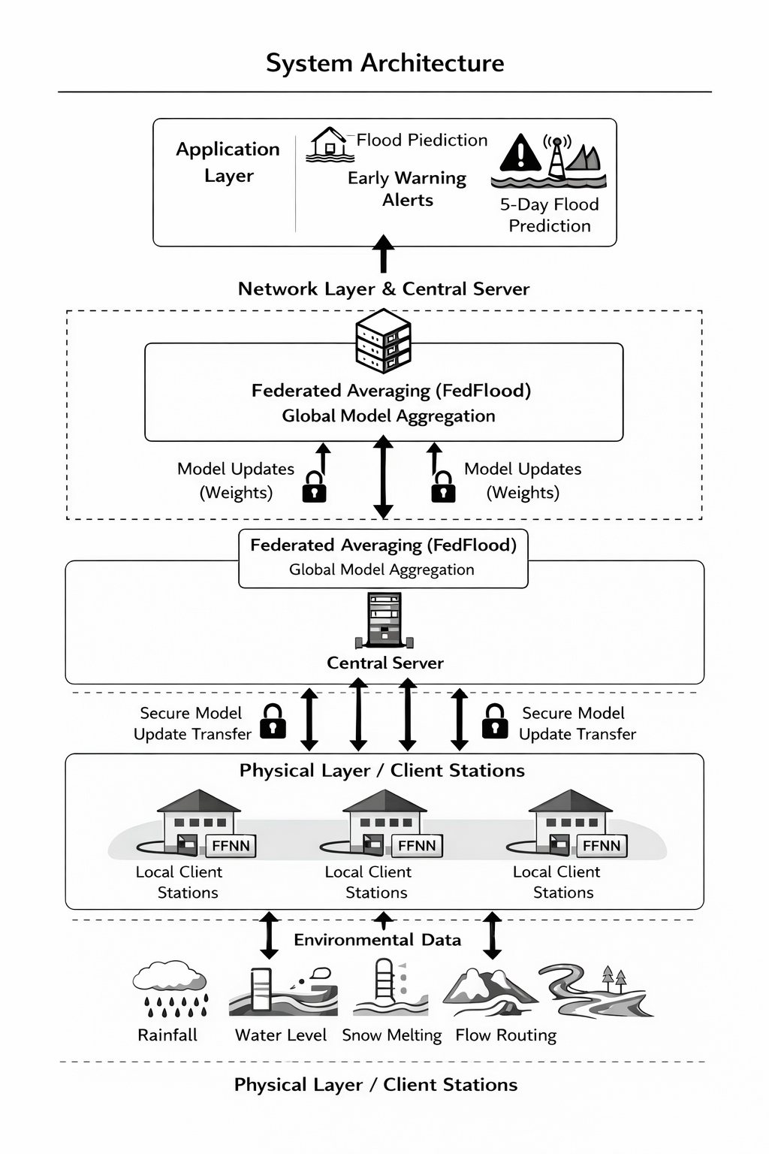
System Architecture

Slide 11
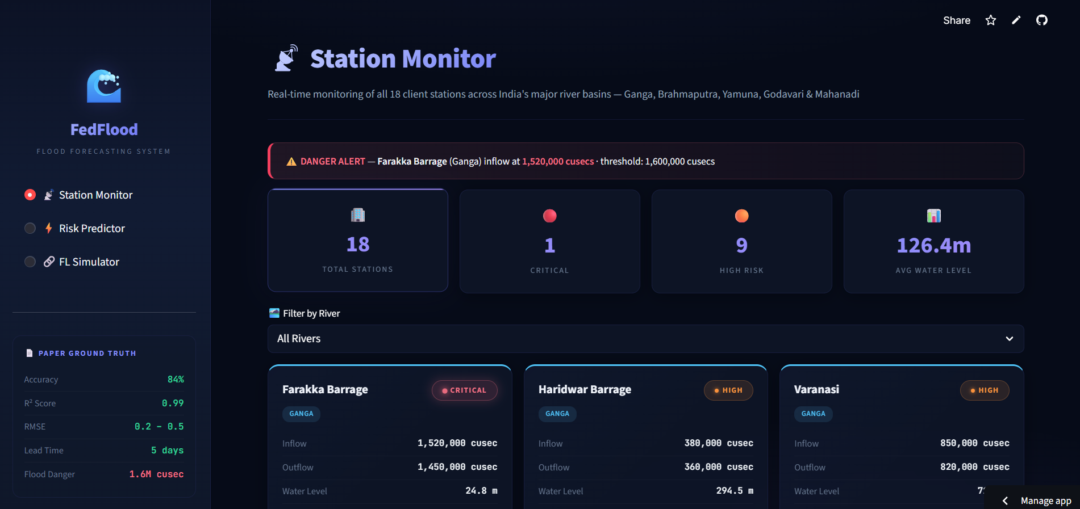

Slide 12
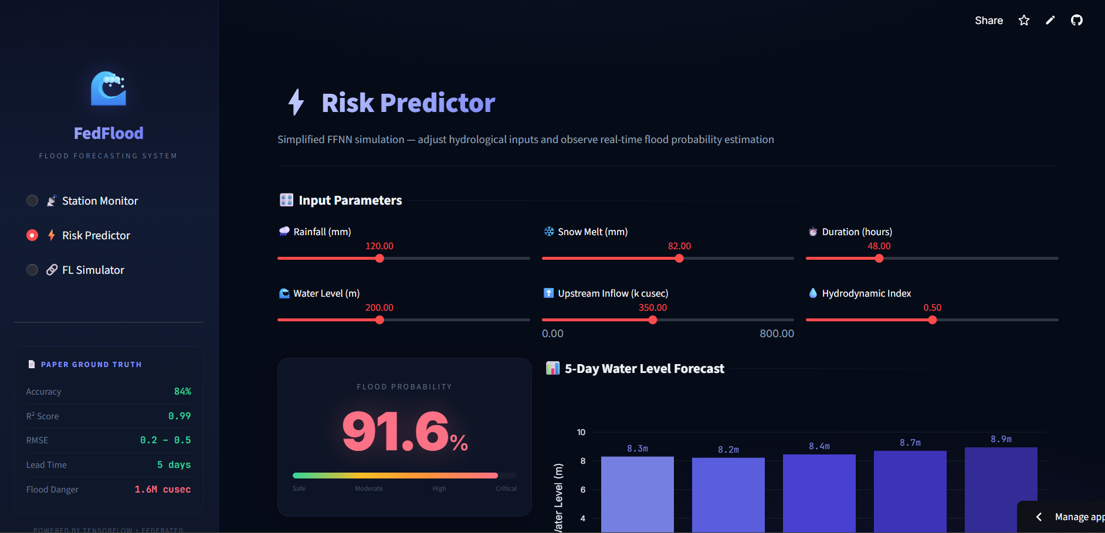

Slide 13
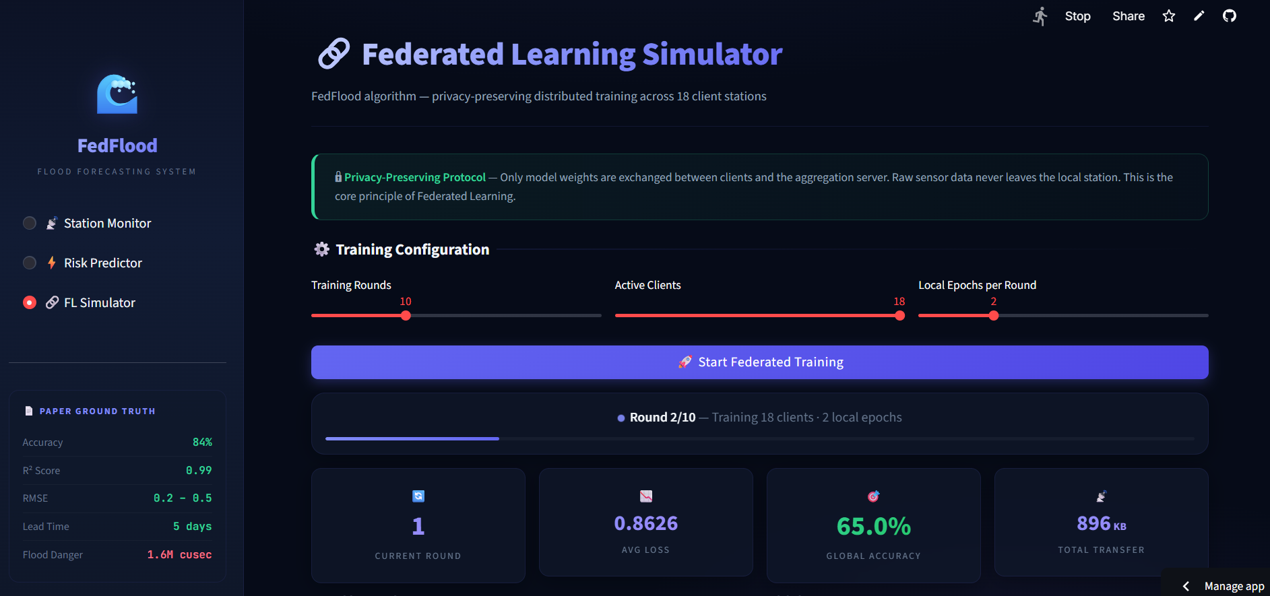

Slide 14
References
M. S. Farooq et al., “FFM: Flood Forecasting Model Using Federated Learning,” IEEE Access, vol. 11, 2023.
S. Sankaranarayanan et al., “Flood Prediction Based on Weather Parameters Using Deep Learning,” Journal of Water and Climate Change, 2020.

Slide 15
Future Course of Action
Extend the system to cover more rivers and geographical regions for wider flood prediction.
Integrate real-time IoT sensor data for continuous monitoring and faster prediction.
Enhance the system to provide mobile and web-based alert notifications for public safety.
Deploy the system in real-world environments for large-scale disaster management.

Slide 16
THANK YOU

