Slide 1
STEGANOGRAPHY USING MATLAB
Purackal Riba Sebastian-53
Patel Abhilasha Paresh-54
Varadkar Pratibha Mangaldas-55
Wankhede Raj Bhanudas-56
Guide: Mr. Amit Kukreja

Slide 2
INTRODUCTION
What is steganography?
Its importance?
Types of steganography?

Slide 3
APPLICATIONS
Confidential communication and secret data storing
Protection of data alteration
Access control system for digital content distribution
Media Database systems

Slide 4
LITERATURE SURVEY
Algorithms Studied:
Dynamic Steganography
LSB using a Secret Key
Randomization Algorithm
Edge Adaptive algorithm
Filtering Algorithm

Slide 5
IMAGE PARAMETERS
MSE
PSNR
AAD
SNR
Notes:
Low or high??consequences??

Slide 6
COMPARISON OF DIFFERENT ALGORITHMS
Algorithms | Images | PSNR
Dynamic Steganography | Leeena | 50.93
LSB using a secret key | Leena Baboon | 53.62 53.76
Randomization Algorithm | Baboon | 56.05
Edge Adaptive Algorithm | Leena | 68.38
Filtering algorithm | Leena Baboon | 74.38 74.53
Notes:
Size of the image u should know!!!!

Slide 7
ANALYSIS AND DESIGN
Why filtering algorithm?
Efficient
Indirect Method of embedding data
Difficult detection of hidden data

Slide 8
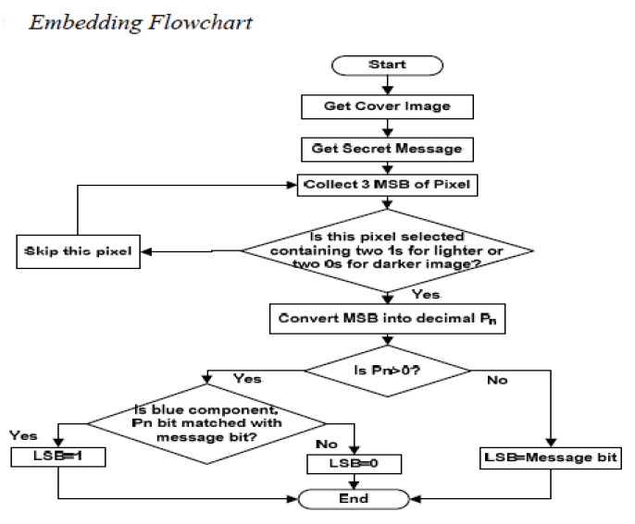
8

Slide 9
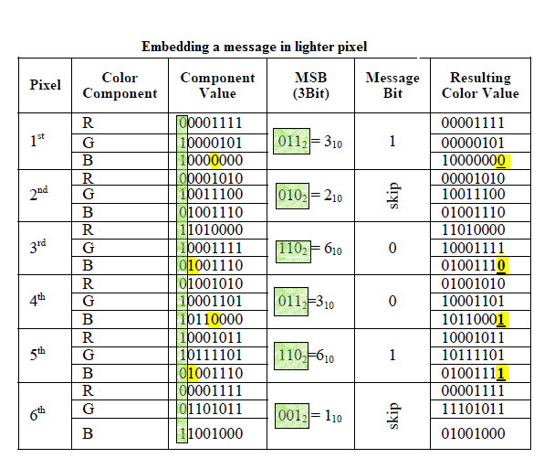
9

Slide 10
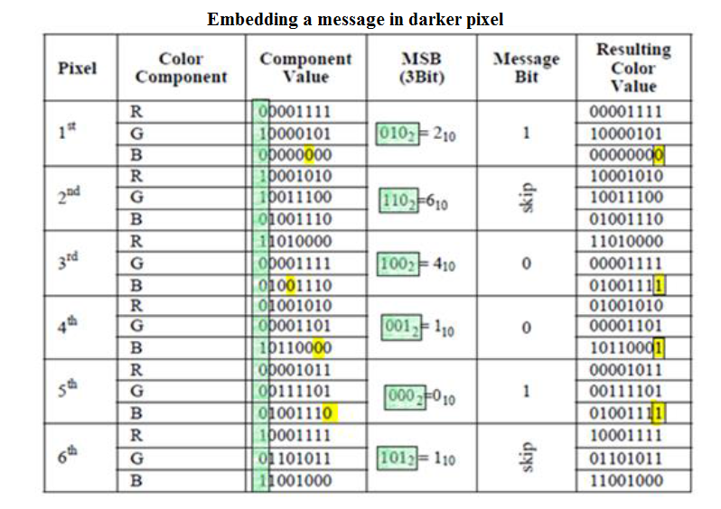

Slide 11
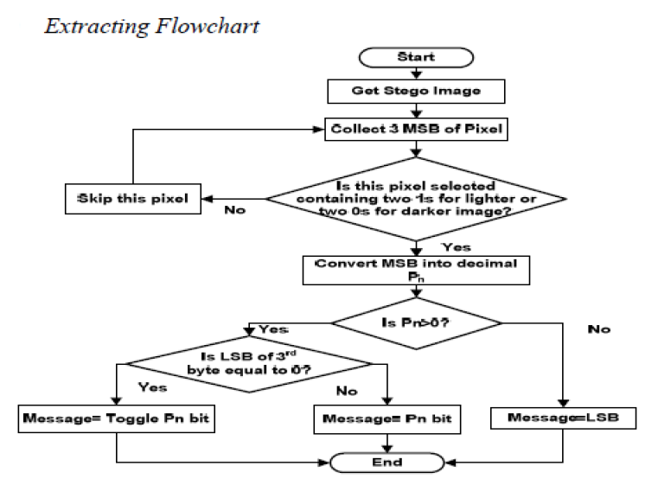
11

Slide 12
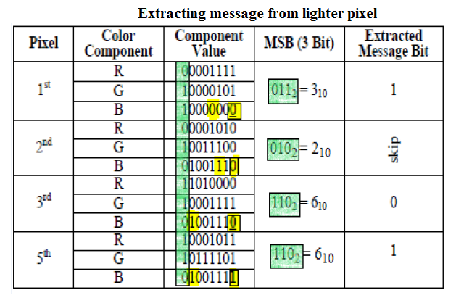
12

Slide 13
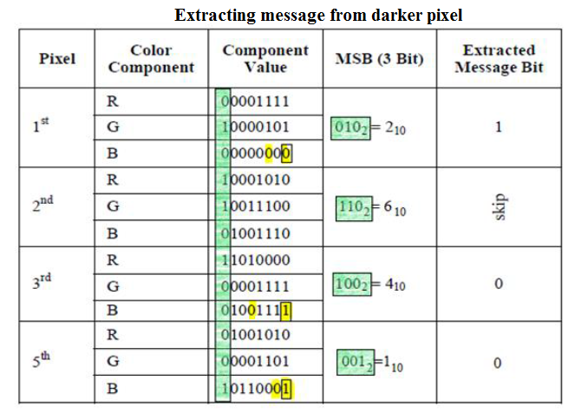

Slide 14
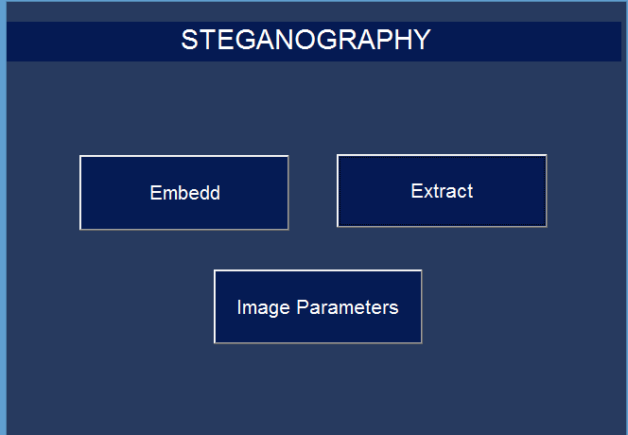
IMPLEMENTATION
Graphical User Interface
14

Slide 15
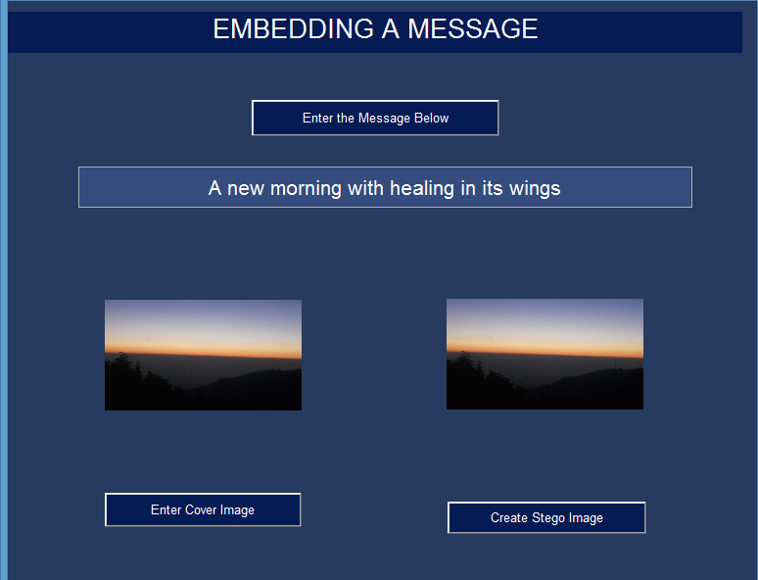

Slide 16
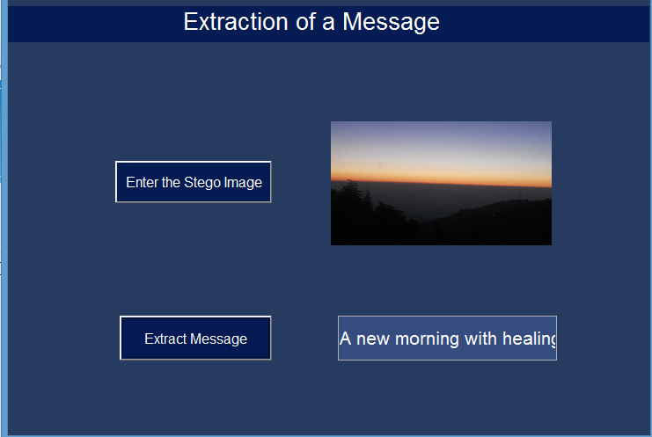

Slide 17
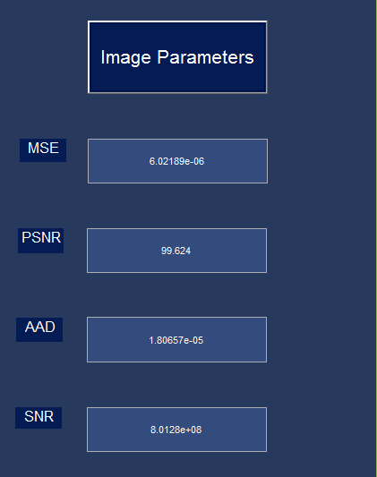

Slide 18
RESULTS AND ANALYSIS
Parameters to Judge a Steganographic Technique:
Image quality after embedding data
Imperceptibility
Succeptance to histogram attacks
Capacity

Slide 19
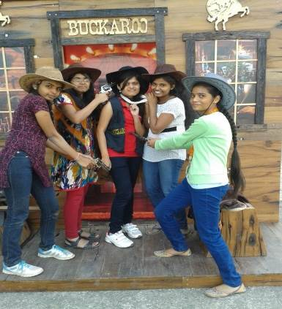
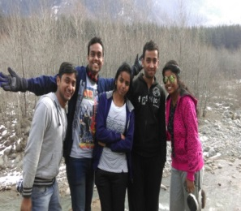
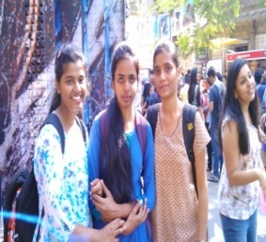
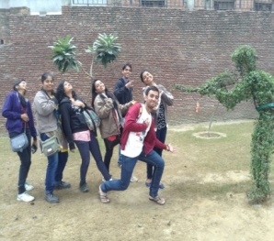
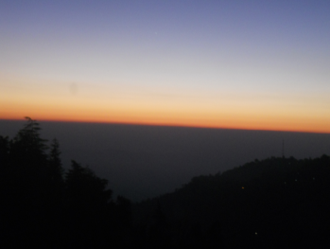

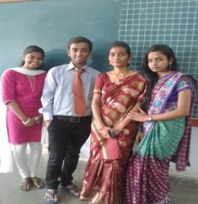

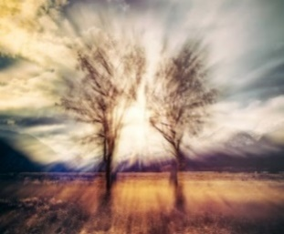
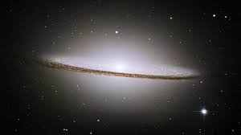
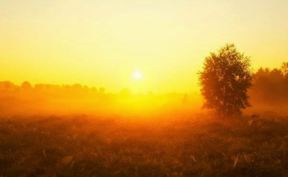
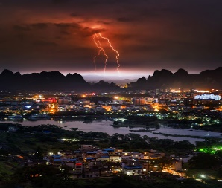
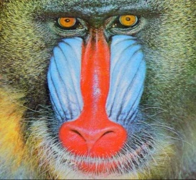
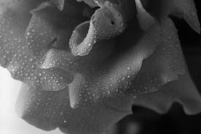
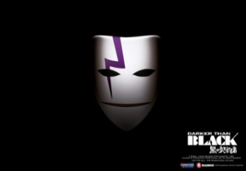
From (top-left)- cowboys,
ivfun,kalaghoda,shoot,horizon,newop,sareedy,sgtr,thetwotrees,index,pleasantsun,spirestorm,baboon,index1,darker2

Slide 20
IMAGE PARAMETERS
IMAGE | MSE | PSNR | AAD | SNR
Sareeday.jpg | 33.1828 e-05 | 82.2122 | 99.5483 e-05 | 1.84382 e+06
Cowboys.jpg | 33.2913 e-05 | 82.1981 | 99.8739 e-05 | 1.51978 e+06
Lighter2.jpg | 71.2889 e-05 | 78.8911 | 213.867 e-05 | 1.39290 e+06
Kalaghoda.jpg | 77.1605 e-05 | 78.5474 | 231.481 e-05 | 1.40853 e+06
Darker2.jpg | 84.8639 e-05 | 78.1341 | 254.592 e-05 | 1.33142 e+06
Shoot.jpg | 129.718 e-05 | 76.2914 | 389.154 e-05 | 5.54041 e+06
IVfun.jpg | 256.471 e-05 | 73.331 | 769.413 e-05 | 2.45100 e+06
Newop.jpg | 326.172 e-05 | 72.2869 | 978.516 e-05 | 6.15199 e+06
Baboon.jpg | 608.953 e-05 | 69.5755 | 1826.86 e-05 | 0.90452 e+06
Pleasentsun.jpg | 654.306 e-05 | 69.2636 | 1962.92 e-05 | 0.56828 e+06
Thetwotrees.jpg | 590.565 e-05 | 69.7087 | 1771.69 e-05 | 1.08848 e+06
Spirestorm.jpg | 760.921 e-05 | 68.608 | 2282.76 e-05 | 0.13575 e+06
Sgtr.png | 1371.7 e-05 | 66.0488 | 4115.09 e-05 | 1.19999 e+06
Index.jpg | 3163.36 e-05 | 62.4199 | 9490.08 e-05 | 0.06539 e+06
Index1.jpg | 3170.72 e-05 | 62.4098 | 9512.17 e-05 | 0.09510 e+06

Slide 21


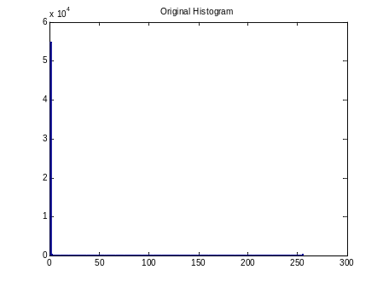
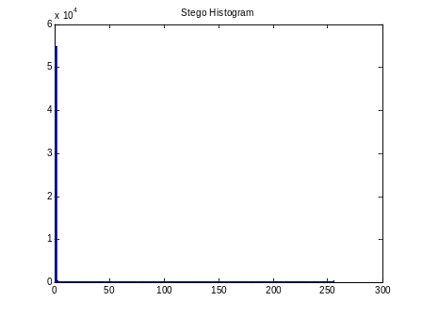
HISTOGRAM
COVER IMAGE STEGO IMAGE
COVER IMAGE HISTOGRAM
STEGO IMAGE HISTOGRAM

Slide 22
CAPACITY ANALYSIS
IMAGE | LIGHTER/ DARKER | CAPACITY(no. of characters) | SIZE(m*n) | % capacity
Sareeday.jpg | LIGHTER | 314326.25 | 1920*2560=4915200 | 51.15
Cowboys.jpg | LIGHTER | 314587 | 2560*1920=4915200 | 51.20
Lighter2.jpg | LIGHTER | 232920 | 2000*1125=2250000 | 82.81
Kalaghoda.jpg | LIGHTER | 164750 | 1920*1080=2073600 | 63.56
Darker2.jpg | DARKER | 206650 | 1680*1050=1764000 | 93.71
Shoot.jpg | LIGHTER | 102500.875 | 1280*956=1223680 | 67.01
Europp.jpg | DARKER | 120810 | 1000*1000=1000000 | 96.64
IVfun.jpg | LIGHTER | 47689 | 1056*592=625152 | 61.02
Newop.jpg | LIGHTER | 056512 | 960*480=460800 | 98.11
Baboon.jpg | LIGHTER | 017693 | 512*512=262144 | 53.99
Pleasentsun.jpg | LIGHTER | 22375.5 | 600*400=240000 | 74.58
Thetwotrees.jpg | LIGHTER | 24996.125 | 688*391=269008 | 74.33
Spirestorm.jpg | DARKER | 23661.875 | 386*541=208826 | 90.64
Sgtr.png | LIGHTER | 013009 | 427*280=119560 | 87.04
Index.jpg | DARKER | 5396.3 | 300*168=50400 | 85.65
Index1.jpg | DARKER | 5410.6 | 275*183=50325 | 86.01

Slide 23
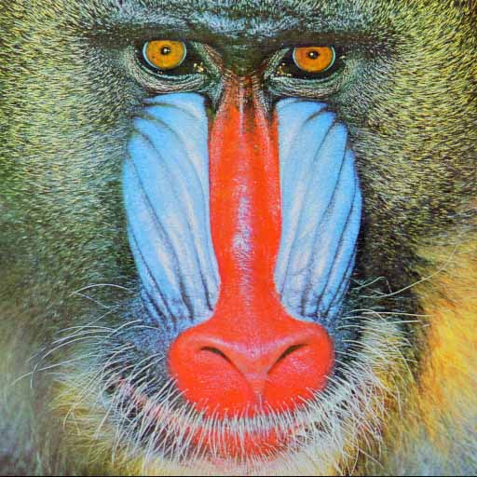
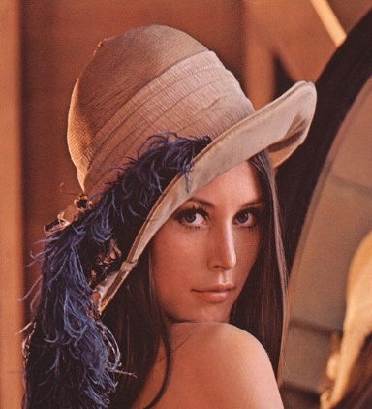
COMPARISON OF STUDIED AND IMPLEMENTED ALGORITHM
Baboon.jpg
Leena.jpg
Images | Theoretical value (PSNR) | Experimental values (PSNR)
Leena.jpg | 74.392286 | 85.1395
Baboon.jpg | 75.530119 | 86.4428

Slide 24
CONCLUSION
The implemented algorithm focuses more on the security of the message embedded.
This technique is highly efficient as the message is not directly embedded but the status bit is embedded.
The system gives high PSNR, SNR values signifying a good quality of the stego image and low MSE and AAD value suggesting that there is no addition of any visual artifacts.

Slide 25
REFERENCES
[1]T.Morkel,J.H.P.Eloff,and M.S.Olivier, “An overview of image steganography”New knowledge today conference,Sandton,pp.1-11,2005
[2]C.Kurak and J.McHugh A Cautionary, “Note on Image Downgrading”,Proc.IEEE 8th Annual Computer Security Applications Conference,San Antonio,USA,pp.153-155,1992
[3]E.Cole,Hiding in plain sight:Steganography and the Art of Covert communication,Indianapolis:Wiles publishing,2003.

Slide 26
[4]Abbas Cheddad,Joan Condell,Kevin Curran and Paul McKevitt, “Digital image Steganography:Survey and analysis of current methods,” signal processions.vol 90,pp.727-752,2010
[5]E.Franz and A.Schneidewind, “Adaptive Steganography based on dithering”,workshop on multimedia and security,pp.56-62,2004

