Slide 1

ONLINE GROCERY SHOPPING CART
Submitted by,
A S Sreenivasan
Abhilasha Choudhary
Alka Badhan
Aman Chauhan
Anjana Jose

Slide 2


Introduction
Online shopping is a form of electronic commerce.
An essential part of a retailer’s online store that streamlines the online shopping experience.
Software allows website visitors to select, reserve, and purchase a product or service from an e-commerce interface.
Presents real world shopping experience.
It is a fundamental part of the online shopping experience.
It is what facilitates everything in between the customer finding a product they like and completing their purchase.
So implementing excellent shopping cart software is crucial for your e-commerce business.

Slide 3
Technologies Used
Front-end:
HTML
CSS
Angular-8
Back-end:
Spring Boot-2.3.3
Spring Data JPA
Spring Web
Java 1.8
Database:
Oracle 11g
Server:
Tomcat-8.5

Slide 4
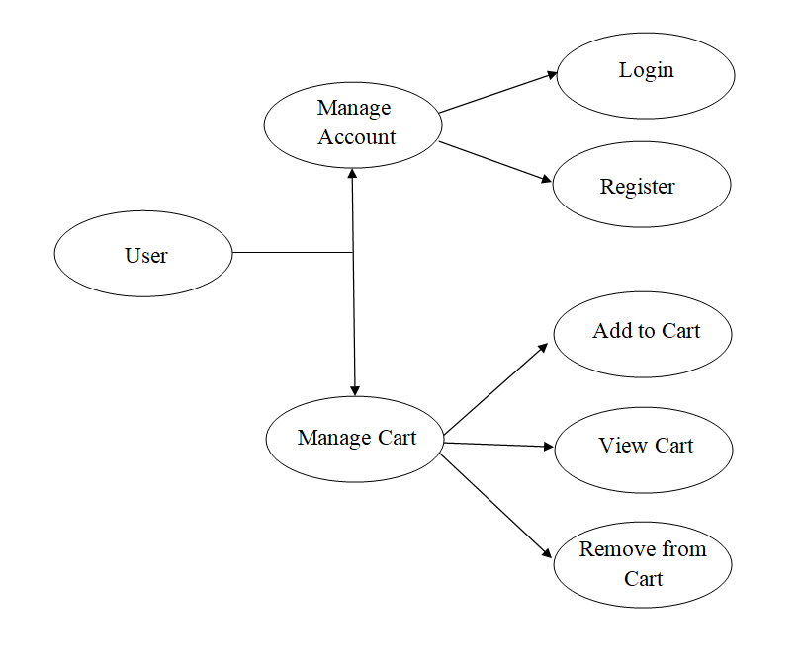
Flow Diagram

Slide 5
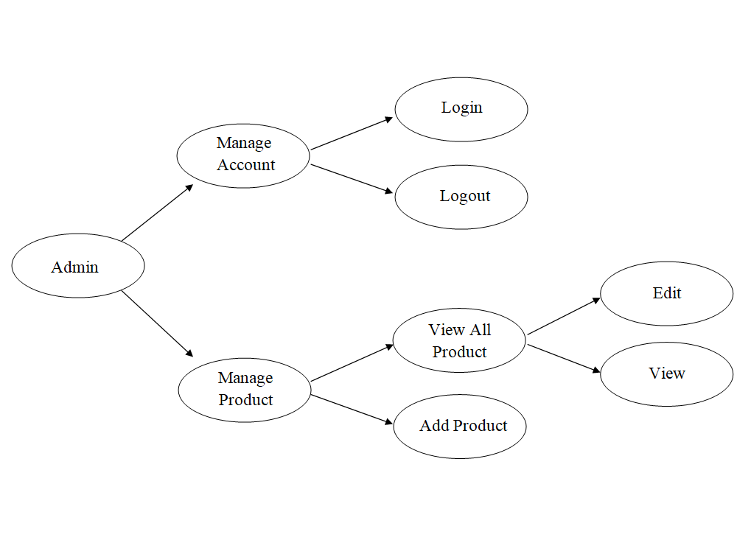

Slide 6
Architecture Diagram
User Registration
Add to Cart
Search
Presentation Layer
(UI Components)
Home page
Login
View Cart
Output
Configuration
Controller
Application Layer
(Web-Server Classes)
Entity/Model class
Rest
Controller
Service
Repository classes
Data Access Layer
Oracle 11g Database

Slide 7
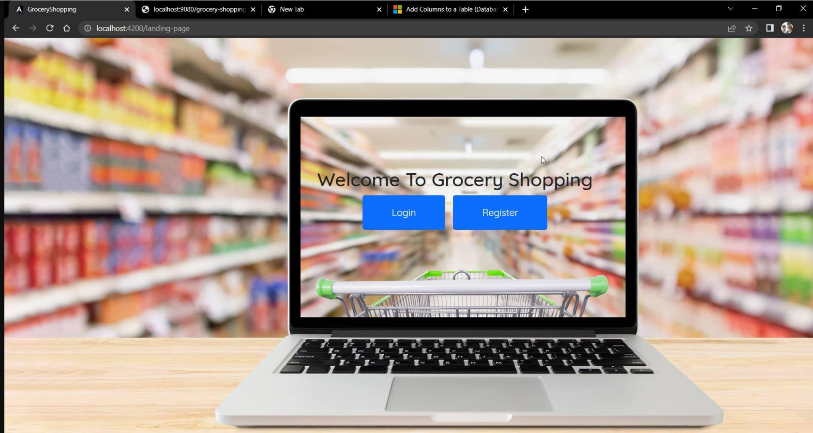
Login Page

Slide 8
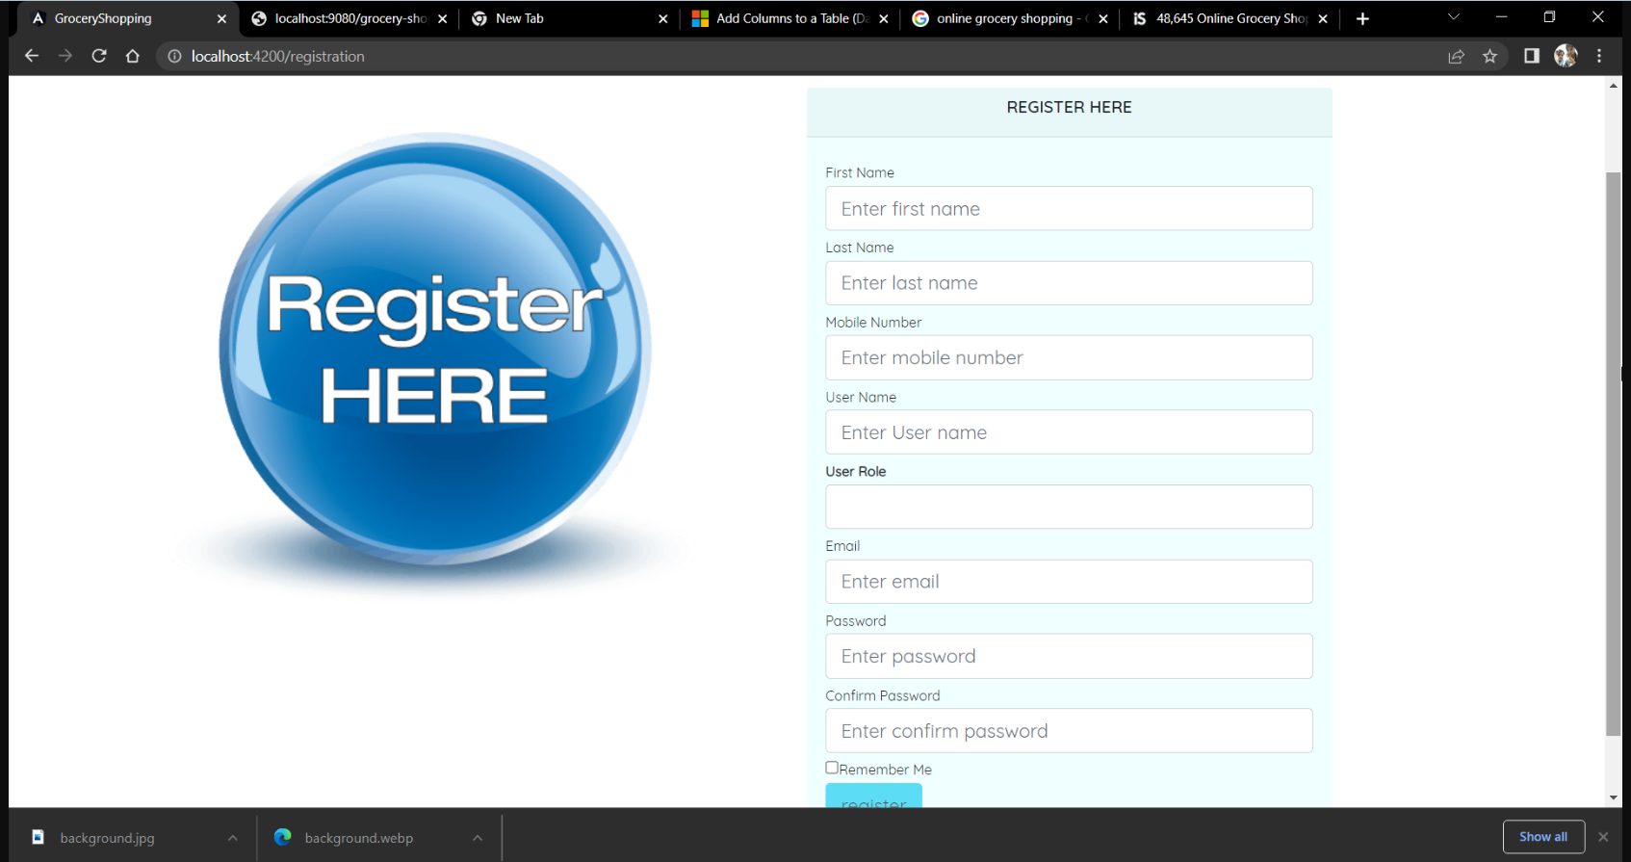
Registration Page

Slide 9
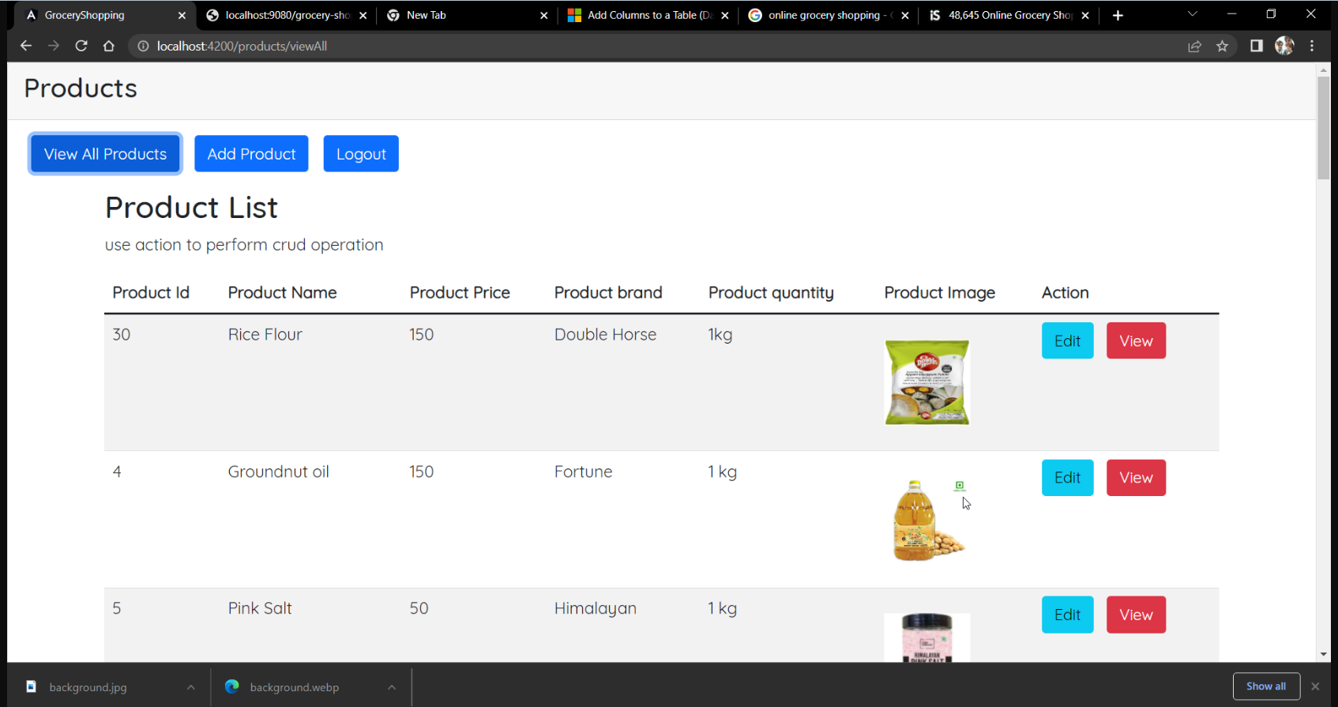
Admin Page

Slide 10
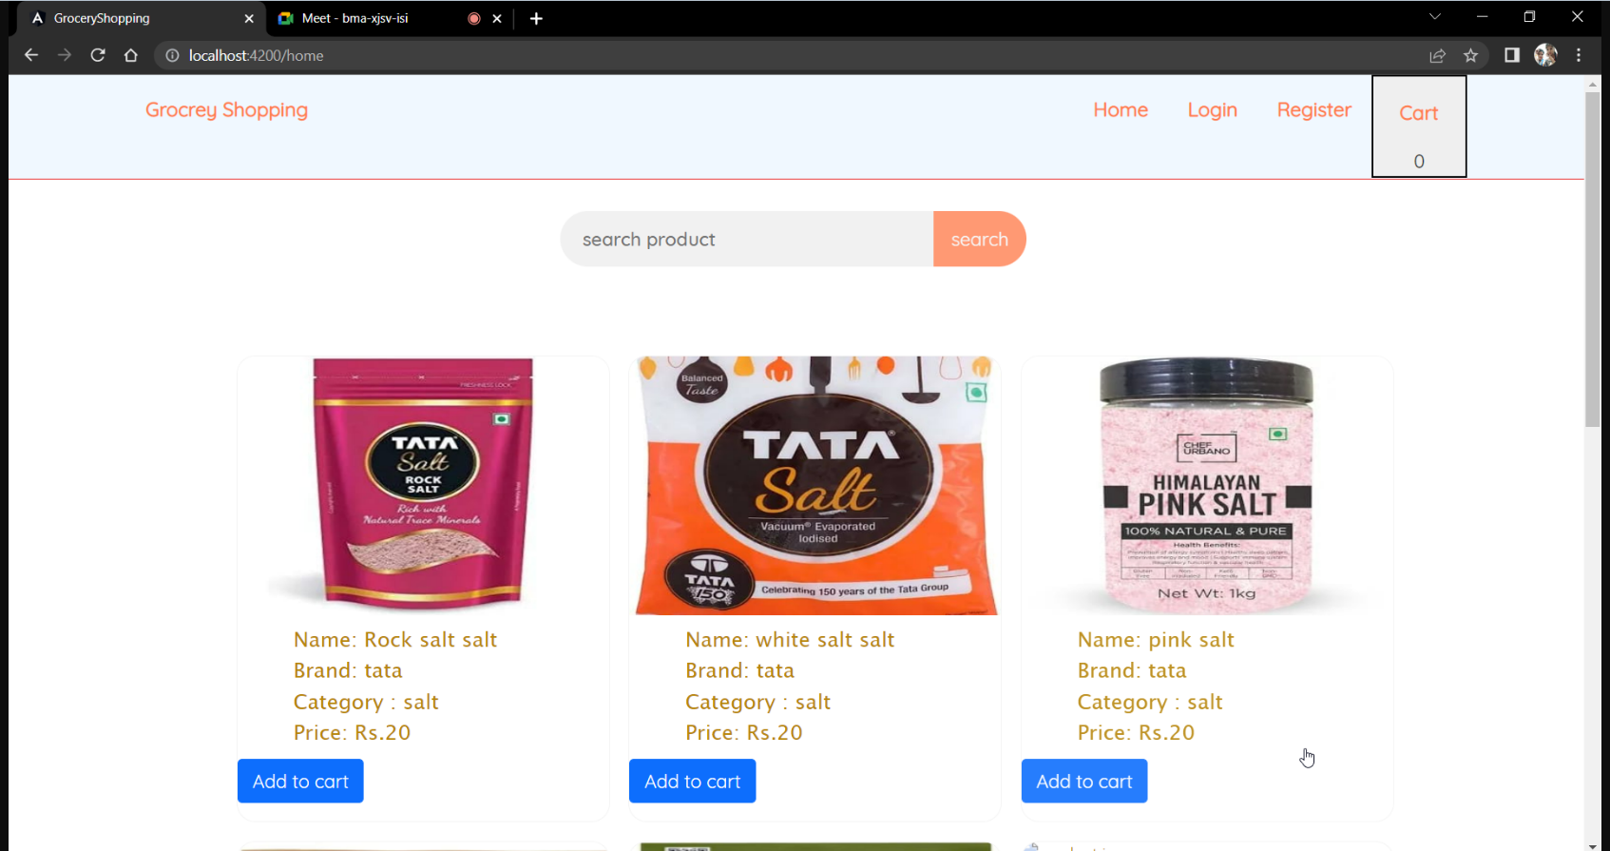
Home Page

Slide 11
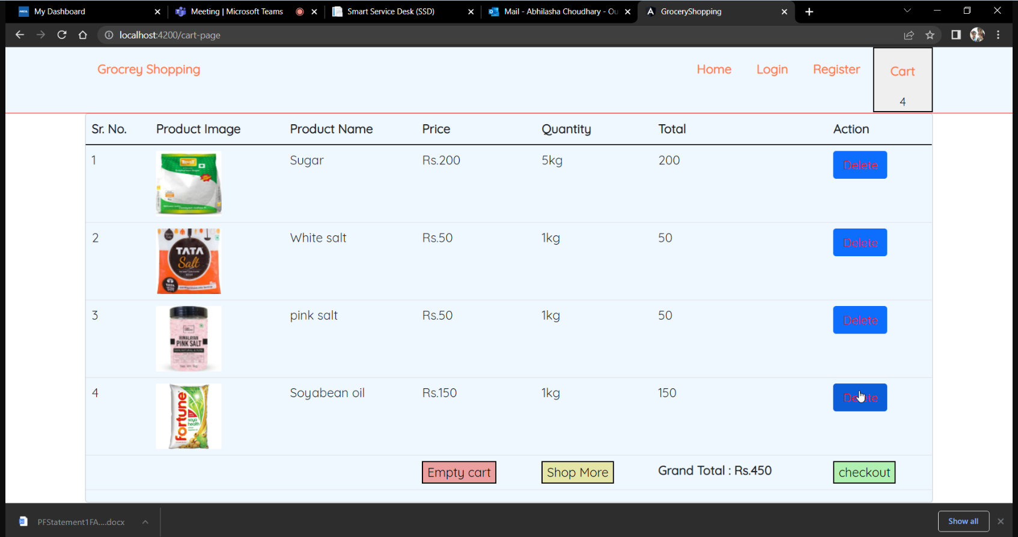
Cart Page

Slide 12
Conclusion
Using this system we can place order without going to rack and picking the required item.
Using this the user can choose the required item from the list and add to cart.
Search options are also available for the user for the easy selection of the item from the list.
This system help the user to save time.

Slide 13
Thank You

