Slide 1
S&P500/NASDAQ Stock Prediction
Stephen McGee Abhilash Menon

Slide 2
Project Focus
Original Goal:
“Genetic Deep Neural Networks Using Different Activation Functions for Financial Data Mining”
Dr. Zhang (author) contacted
Refined Goal:
Predict stock market index outcome for the next day after training the neural net on historical data (30 days)
Final Goal of project
Include more predictors to boost up accuracy.
Predict discrete binary values to determine whether or not tomorrow’s close would be higher than the current day.

Slide 3
S&P 500 & NASDAQ
S&P
“Index of 500 companies seen as the leading indicator of U.S. equities”¹
Focus mostly on “large cap universe”
Industry-spanning:
Genomics, Gaming, Soft Drinks, Hypermarkets
NASDAQ
“...benchmark index [of more than 3000] U.S. tech stocks”
includes Google, Apple, Microsoft, Amazon, etc.
1 - “Standard & Poor’s 500 Index” http://www.investopedia.com/terms/s/sp500.asp

Slide 4
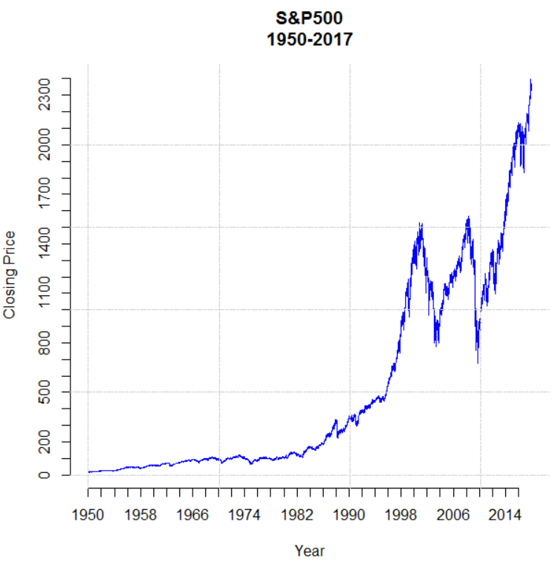
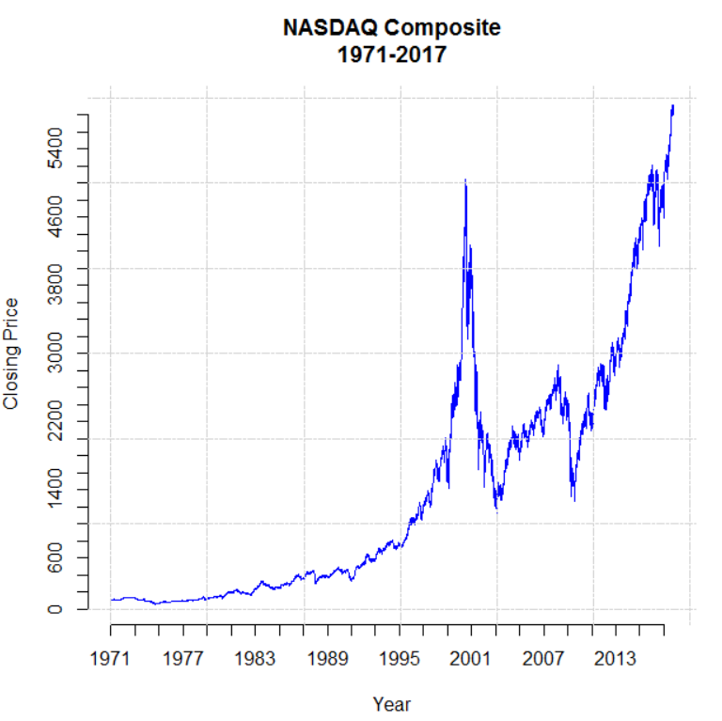
Market Trend

Slide 5
Preliminary Data Retrieval
Market Data:
S&P 500/NASDAQ market quotes from 2013-2017 ²
Volatility Index (VIX)
Adj. US Dollar Index (DX-Y.NYB)
Oil Prices [GCSI Crude Oil TR ETN (OIL)]
Corn Futures (ETRS Comm. Sec. Ltd ETFS CORN)
Calculated Data:
SMA (5, 30, & 200-Days)
MACD
Average True Range
Close-to-Close Profit
Notes:
•VIX- popular measure of the implied volatility of S&P 500 index options calculated by the CBOE (Chicago Board Options Exchange)
•Futures are financial contracts obligating the buyer to purchase an asset or the seller to sell an asset, such as a physical commodity or financial instrument at a predetermined future data and price

Slide 6
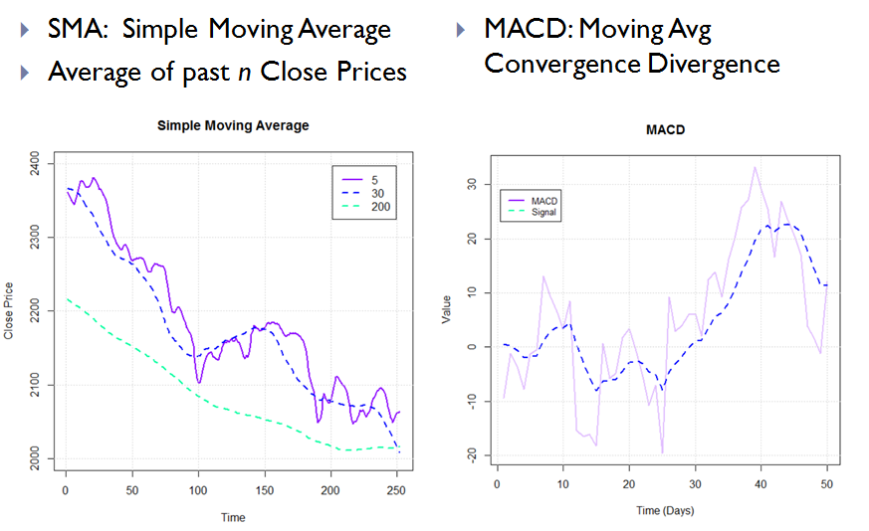
SMA & MACD

Slide 7
Data Preprocessing
Normalization:
Each attribute z-score normalized
Simplifies computation
Standardizes cross-database information
Optimal for Neural Network Model
Missing Data
Not common
Present in corn futures & Oil but very isolated
Average of surrounding days

Slide 8
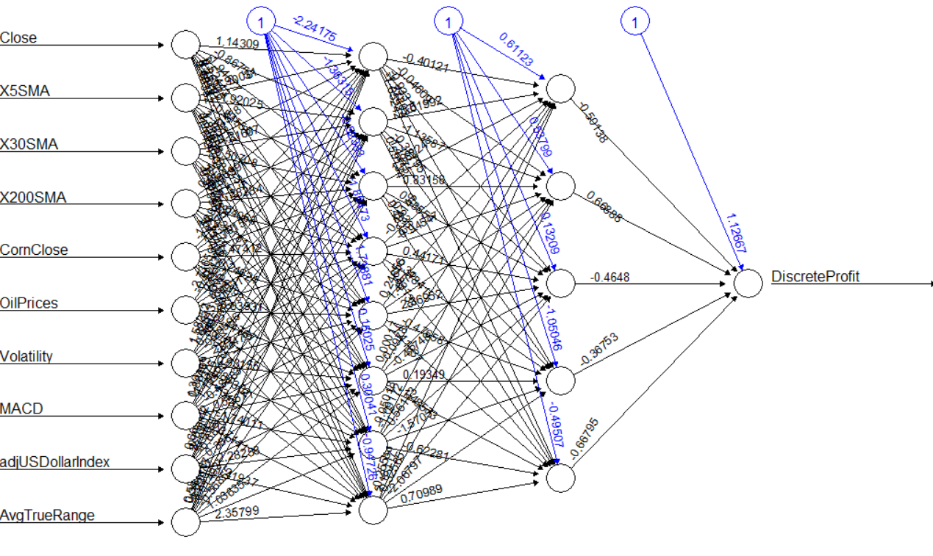
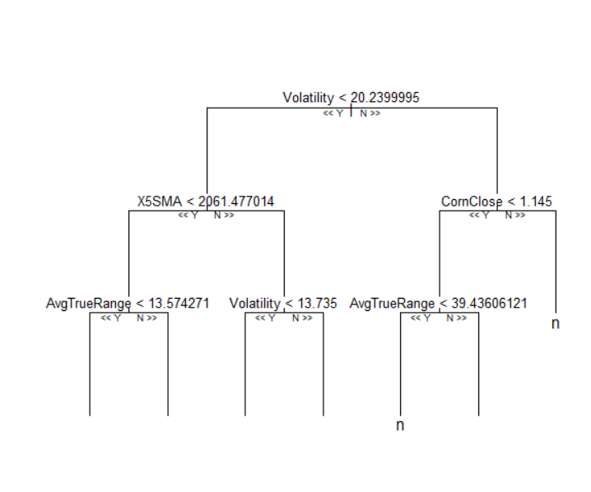
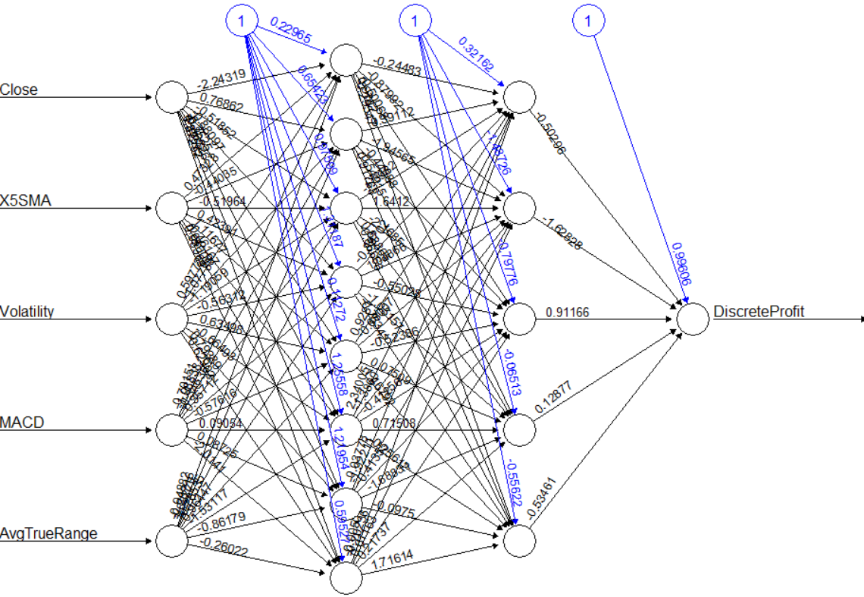
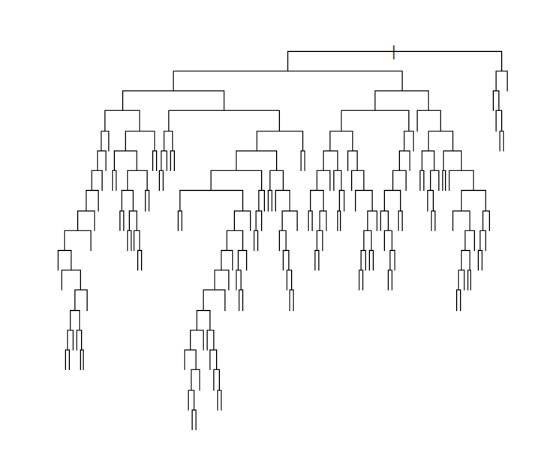
R Implementation
Utilizes RandomForest & neuralNet packages
2 approaches:
All Attributes
Top 5 Most Informative Attributes
Random Forest:
3000 trees
Used for attribute selection
Volatility, AvgTrueRange, MACD, X5SMA,Close
Classification accuracy: ~72%
Neural Net:
2 hidden layers (8,5)
backpropagation; sigmoid activation functions
Prediction accuracy: ~60-70%

Slide 9
Mean Decrease Accuracy
Attribute | MeanDecreaseAccuracy
High | 29.87
Low | 26.89
Volume | 14.12
Close | 52.29
Open | 78.63
X5SMA | 41.18
X30SMA | 27.47
X200SMA | 16.87
CornClose | 11.73
OilPrices | 24.31
Volatility | 70.38
MACD | -0.49
AdjUSDollarIndex | 16.80
AvgTrueRange | 20.08

Slide 10
Keras Implementation/Evaluation
Keras is a high-level neural networks library, written in python and capable of running on top of TensorFlow.
Environment setup: numpy, scikit-learn, virtualenvwrapper, virtualenv.
We have been able to achieve accuracies up to 85% after we split up the data into a 30 day sliding window.
The training method we used was backpropagation.
The network design we have implemented is 14-28-1.
We plan on employing cross-validation and trying out different configurations for the network topologies.

Slide 11
Keras Implementation/Evaluation (cont.)
The activation function used for all layers except the output layer was relu (rectified linear unit).
The output layer used a sigmoid activation function.
The optimizer function used is “adam” as its performance is better than “gradient descent”.
Ref:http://stats.stackexchange.com/questions/184448/difference-between-gradientdescentoptimizer-and-adamoptimizer-tensorflow
Notes:
A lot of literature led us to believe that adam is a better optimizer for backpropagation than gradient descent
http://stats.stackexchange.com/questions/184448/difference-between-gradientdescentoptimizer-and-adamoptimizer-tensorflow

Slide 12
Finalizing Project
Compare predicted profit vs actual profit
Stock Simulator (aka “Paper Trading”)
Compare Neural Net Output with Linear Regression
Probit/Logit Regression

