Slide 1
Racial Bias in the Stop and Frisk Program
Final Project IDS-575
Abhilash Nagaraja
Ronald Pukadyil
Ipseeta Deka

Slide 2

Motivation
Stop and frisk has long been a controversial policy in New York city
A violation of privacy or a necessary measure against wrongdoers?
Recent controversies in police brutality in the US has forced a lot of hatred towards police departments
We aim to engage in extensive Data Analysis to investigate whether racial discrimination is evident for arrests in stop and frisk program

Slide 3
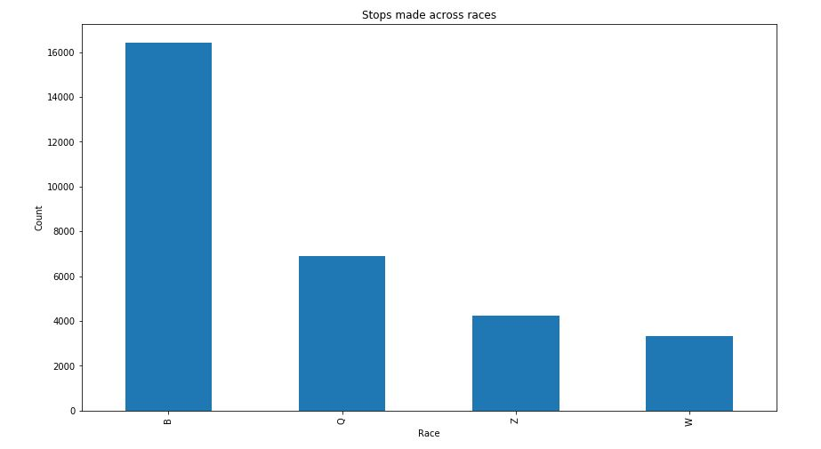
Data Exploration
NYPD stop and frisk data for the years 2015-16
The data consists of 35,000 instances of stops made with more than 100 features indicating various factors assessed by the police during the event of stop and frisk
More than 80% of the features are binary Y/N values
Crime related features: crime suspected, weapons carried by suspect, time & locality of the stop, whether the suspect was frisked, was physical force used by officer, etc.
Suspect Description: Race, Age, Sex, Height, Weight, Build, Hair color, etc.
Target feature: Suspect arrested (Y/N)
Data Source: https://www1.nyc.gov/site/nypd/stats/reports-analysis/stopfrisk.page
Black
White-Hispanic
Other
White

Slide 4
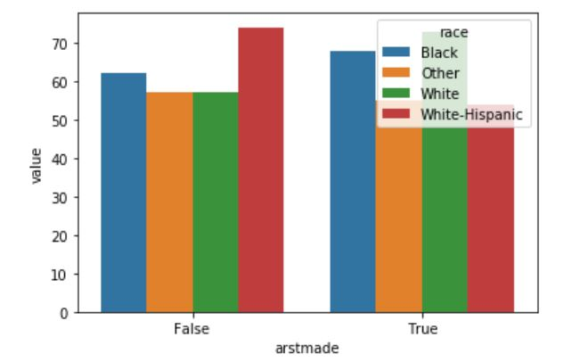
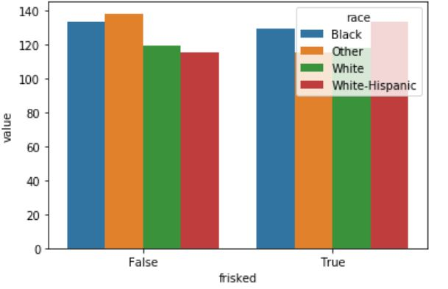
Data Exploration
Approximately 53% of stopped individuals were Blacks
Close to 70% were frisked
Only 18% of them were arrested

Slide 5
Feature Selection
Eliminating redundant features
A two-sided t-test for comparing means of samples of numerical features w.r.t the target variable
Chi-square test on categorical features w.r.t target variable
Eliminated a few variables based on intuition and results of statistical tests
Reduced feature size by 30%
Key Features
weapons
searched
contraband
frisked
hidden_obj
sumissue
arstoffn

Slide 6
Model Goals
Primary goal: Predict arrest made given the features
Secondary goal: Determine if race is a significant contributor in making an arrest
Designing a classifier with minimal number of False positives on test data

Slide 7
Model Implementation
Base classifier:
k-NN classifier –Base classifier with approximately 70% accuracy
Logistic Regression:
A Logistic regression model with MLE
L1, L2 regularization on Logistic Regression with cross validation
Further tuned with varied probability threshold values
A Bernoulli Naïve-Bayes model:
Implemented on a set of Bernoulli distribution of features

Slide 8
Model Results comparison
Parameters | K-NN model with CV | Logistic Regression with regularization | Log Reg with tuned threshold |  | Bernoulli Naïve-Bayes Model
Parameters | K=20 | L2, learn rate=0.01 | 0.5 | 0.6 | Laplace=0,
Accuracy | 80.20 | 89 | 89.96 | 89.51 | 86.50
Precision | 51.76 | 77 | 78 | 85.10 | 64.30
Recall | 2.39 | 58 | 62.13 | 55.80 | 72.20
AUC | 0.60 | 0.78 | 0.79 | 0.79 | 0.73

Slide 9
Conclusion
Detecting Racial Bias
Statistical test, Inferences from the Logistic Regression classifier show ’Race’ not be a significant contributor to arrest made.
Raises the question why stop more blacks even when their likelihood of arrest is less?
Prediction of arrest
Logistic Regression classifier designed with regularization performs best predictions with a Precision of 85% on the test data
Key factors in arrest
Crime related features
Weapons
Contraband
Hidden objects
Investigation related
Searched
Summon issued
Physical force by officer

