Slide 1
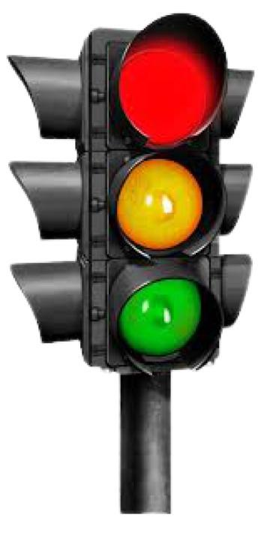
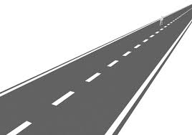
Automatic Traffic System

Slide 2
Problem statement
Traffic system which will change the signals according to the traffic at the instance, instead of round robin schedules.
Application-like software which can be uploaded with traffic images and outputs the timer according to the image data.

Slide 3
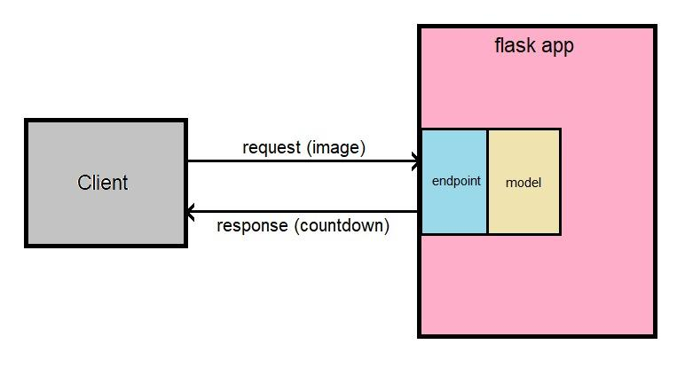
Implementation
We will provide the images to a Flask application. The image processing is done at the backend and timer is sent as response depending upon the limit of vehicles and other information gathered from the image processing.

Slide 4



Technical side
library of programming
functions Mainly aimed at real-time computer vision.
Algorithm that use neural networks to provide real-time object detection
Interpreted high-level general-purpose programming language

Slide 5
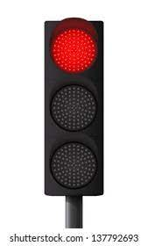
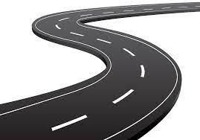
THANK YOU

