Slide 1
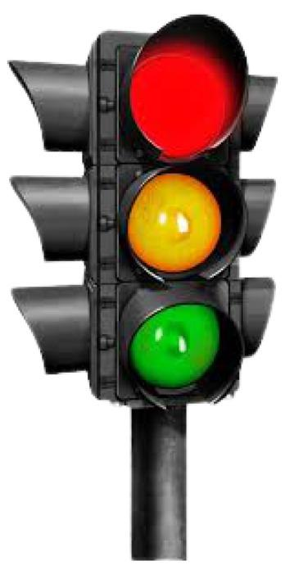

Automatic Traffic System

Slide 2
Problem statement
Traffic system which will change the signals according to the traffic at the instance, instead of round robin schedules.
Application-like software which can be uploaded with traffic images and outputs the timer according to the image data.

Slide 3
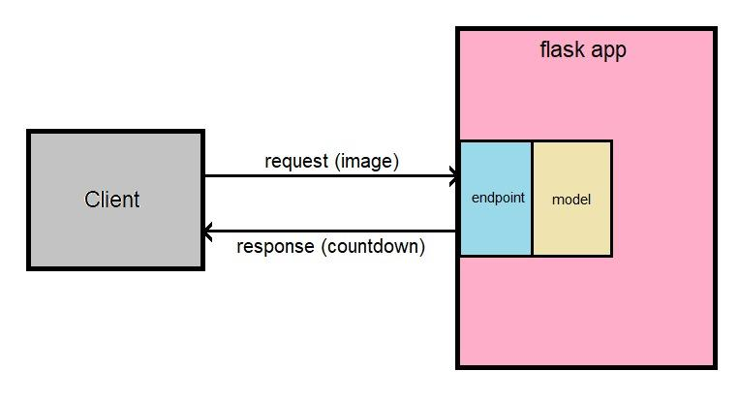
Implementation
We will provide the images to a Flask application. The image processing is done at the backend and timer is sent as response depending upon the limit of vehicles and other information gathered from the image processing.

Slide 4



Technical side
library of programming
functions Mainly aimed at real-time computer vision.
It is an end-to-end open source platform for machine learning. It has a comprehensive, flexible ecosystem of tools, libraries and community resources.
It is an API of Python that allows us to build up web-applications. It is used for the backend.

Slide 5



Technical side
Keras is an open-source software library that provides a Python interface for artificial neural networks. Keras acts as an interface for the TensorFlow library.
Algorithm that use neural networks to provide real-time object detection.
Interpreted high-level general-purpose programming language

Slide 6
Technical side(cont.)
cvlib:
A simple, high level, easy-to-use open source Computer Vision library for Python.
Matplotlib:
It is a comprehensive library for creating static, animated, and interactive visualizations in Python.

Slide 7
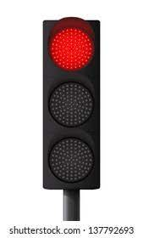
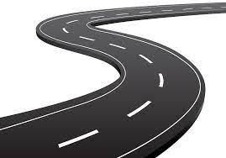
THANK YOU

