Slide 1
Data Science Capstone Project
Car Accident Severity Report
Abhilash
September 20, 2020

Slide 2
1. Introduction
The main objective of this project is to make drivers aware of the chances of a collision to reduce the number of collisions. A machine learning model which can predict the severity of the accident will be developed based on the considered dataset. This developed model will help the drivers to know the risk and be careful when the conditions are not favorable for driving.

Slide 3
2. Data Understanding
In this project I am going to deal with a data set called ‘Data-Collisions’ which is take from
https://s3.us.cloud-object-storage.appdomain.cloud/cf-courses-data/CognitiveClass/DP0701EN/version-2/Data-Collisions.csv
This data consists of ‘Car Collisions’ details for different conditions of weather, road, light conditions etc. in a community.
In this data our predictor is ‘SEVERITYCODE’ which is used to measure the severity of an accident from 0 to 4.
0 – Almost no Probability of accident
1 – Very low Probability of accident with a chance of property damage
2 – Low Probability of accident with a chance of minor injuries
3 – Mild Probability of accident with a chance of serious injuries
4 – High Probability of accident with a chance of fatality

Slide 4
3. Data Preparation
In it's original form, this data is not fit for analysis. For one, there are many columns that we will not use for this model. Also, most of the features are of type object, when they should be numerical type.
We must use label encoding to covert the features to our desired data type.
We must also clean the data wherever there is null
With the new columns, we can now use this data in our analysis and ML models

Slide 5

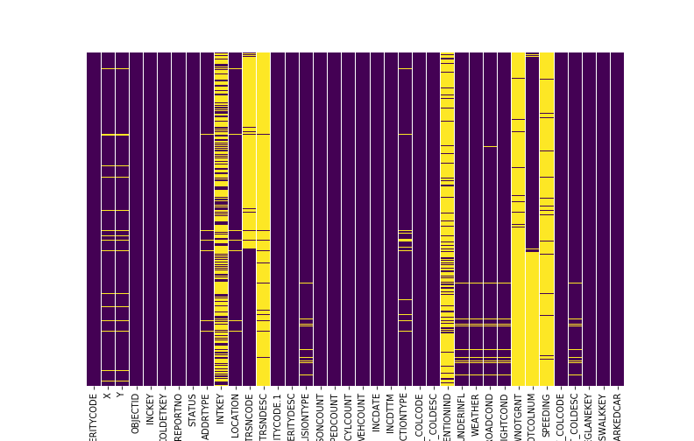

Slide 6
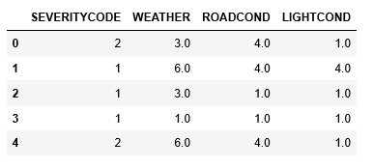

Slide 7
4. Methodology
As our data is has a categorical target value It comes under a classification problem and we will choose K-Nearest Neighbour(k-NN), Decision Tree and Logistic Regression Model.
Let us split our dataset into features and target variables and normalize the features value.

Slide 8
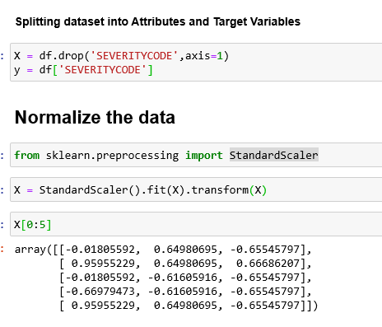
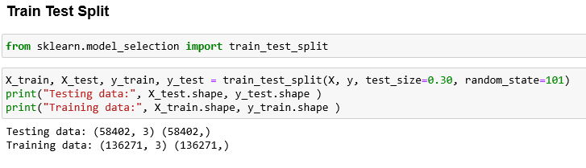

Slide 9
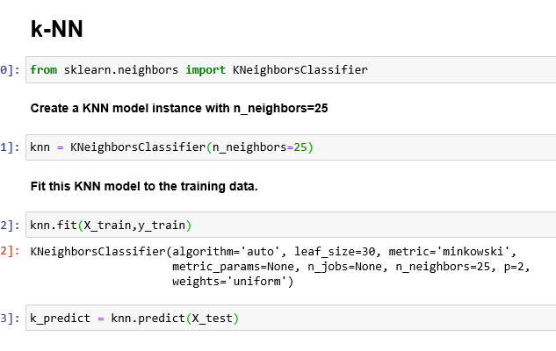

Slide 10
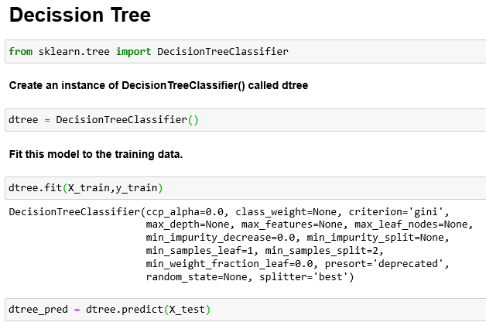

Slide 11
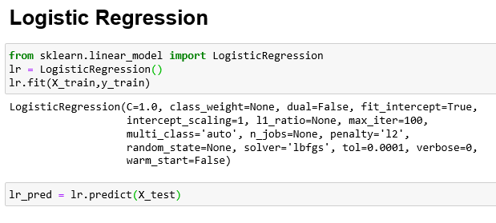

Slide 12
5. Results and Evaluation
Using all the 3 methods we have got almost same level of prediction. Below images show the f1score, jaccard_similarity_score, confusion_matrix and classification_report of the 3 models

Slide 13
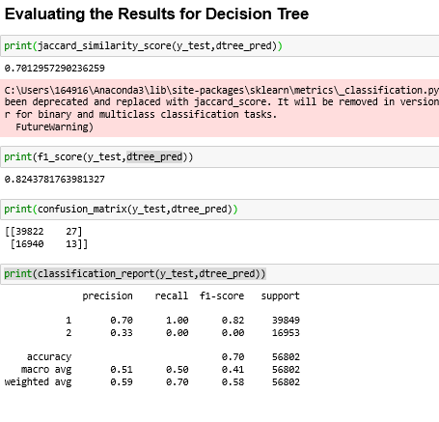
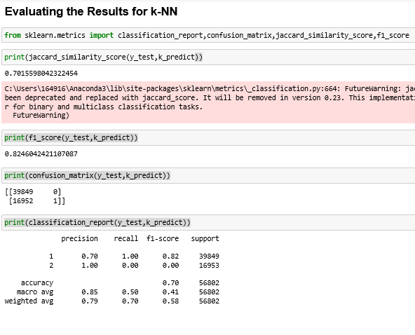
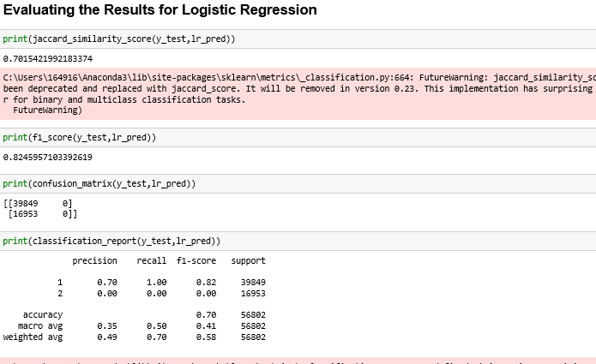

Slide 14
6. Discussion
In the beginning of this notebook, we had categorical data that was of type 'object'. This is not a data type that we could have fed through an algorithm, so label encoding was used to created new classes that were of type int8; a numerical data type.
After solving that issue we were presented with another - imbalanced data. As mentioned earlier, class 1 was nearly three times larger than class 2. The solution to this was downsampling the majority class with sklearn's resample tool. We downsampled to match the minority class exactly with 58188 values each.
Once we analyzed and cleaned the data, it was then fed through three ML models; K-Nearest Neighbor, Decision Tree and Logistic Regression. Although the first two are ideal for this project, logistic regression made most sense because of its binary nature.
Evaluation metrics used to test the accuracy of our models were jaccard index, f-1 score and logloss for logistic regression. Choosing different k, max depth and hyparameter C values helped to improve our accuracy to be the best possible.

Slide 15
7. Conclusion
Based on historical data from weather conditions pointing to certain classes, we can conclude that particular weather conditions have a somewhat impact on whether or not travel could result in property damage (class 1) or injury (class 2)

Slide 16
Thank You

