Slide 1
SE256 Project:Comparison of performance of common algorithms when using Map Reduce and
Giraph
By- Abhilash Sharma
Prateeksha Varshney

Slide 2
Introduction
Hadoop and Giraph are some of the frameworks for processing large scale graphs, so it would be interesting to get a comparative performance of Hadoop and Giraph for some algorithms that are commonly used in social networks.[1][2]
On one hand map reduce views world as key , values whereas Giraph has ”Think like a vertex” approach.
Both Hadoop map-reduce and Giraph use different approach
So it would be interesting to know what kind of leverages can we get when we use one over the other for different algorithms

Slide 3
Common graph algorithms
Pagerank
Triangle counting
Transitive closure (Using patent citation network to know the reachability between two patents)
Hashtag generation (generate hash tag for each user using epidemiological model, at each time step)
Hashtag aggregation (to find the statistical summary of a particular hashtag in the social network, such as the count of that hashtag across time)[7]
Local clustering coefficient

Slide 4
Datasets
Patent citation graph
  V=3,774,768 E=16,518,948
Live journal
  V=3,997,962 E=34,681,189
Synthetic graphs of different sizes (Using R-MAT)

Slide 5
Page rank
PageRank is used to measure the importance of website pages(vertices), it uses the idea that a page is more important if many pages have links(edges) to this page
initially it gives equal ranks to all webpages.
At iteration of page rank calculation, a particular page distributes its page rank to pages that it has links to equally
it calculates its own page rank as sum of the PageRanks that it receives from pages that has a link to this page.
This is an iterative algorithm which can be ran until convergence or predefined number of iterations
We evaluate page rank on Live Journal graph

Slide 6
Triangle counting
Triangle counting[5] is widely used for finding clustering coefficient of a graph.
Global clustering coefficient is based on number of closed triplets in the graph.
It measures degree to which graph tend to cluster together.
We evaluate triangle counting on Live Journal Graph

Slide 7
Hashtag generation
To generate hash tags tweeted by each user we use epidemiological model
Hash tags are generated for each user for 10 timesteps and for each synthetic graph as well as original graph
At any timestep, a particular user has three choices, generate a new hashtag, retweet his old hashtags or retweet hashtags from his neighbours (followees)

Slide 8
HashTag Aggregation
HashTag aggregation is widely used in data analytics, for finding subject popularity, political polarization, subject attention spikes, user interests etc
We use hashtag aggregation to find the statistical summary of a particular hashtag in the social network, such as the count of that hashtag across time (optionally for each user across time)[7]

Slide 9
Transitive Closure
Transitive closure is often used to find connectivity or reachability from source vertex.
We evaluate Transitive closure for CitPatents graph
We use transitive closure to know the reachability between two patents

Slide 10
Local clustering coefficient
Local clustering coefficient is a metric that measures how close a particular vertex and its neighbour are to form a clique or complete subgraph.
Local Clustering coefficient is calculated as ratio of number of edges between a vertex and its neighbours to Total Number of edges possible.
We evaluate Local clustering coefficient on truncated LiveJournal graph that consists of users that tweeted a particular hashtag in a timestep[4]

Slide 11
Performance metrics
MakeSpan: End to End run time of each of the algorithms.
Scalability: Using synthetic graphs of different sizes, we measured the scalability of each of the algorithms.
We ran our algorithm implementations on 7 synthetic graphs and 1 original graph.
Resource Utilization: We captured CPU utilization, Memory Utilization and Network Traffic .

Slide 12
Experimental setup and evaluation
A. Hardware configuration
SSL Cluster configuration
  ◦ Nodes: 11 nodes
  ◦ CPU Configuration: AMD Opteron(tm) Processor 3380
  ◦ RAM: 32GB, DDR3
B. Software configuration
SSL cluster is configured to run in Java 1.7 environment.
SSL cluster has Hadoop 2.6.0 installed along with Giraph 1.1.0

Slide 13
Profiling tools
We used Ganglia that is deployed on SSL cluster to collect Resource Usage data.
It is made sure that no other jobs(except daemons and other essential processes) are running so that resource usage data collected by Ganglia is as accurate as possible.

Slide 14
Synthetic graph generation
We have generated synthetic graphs of 7 different sizes corresponding to both Live Journal and Patent Citation graph to evaluate the weak scalability of the algorithms
We have retained the edge to vertex ratio in all the sizes in accordance to the original graph.
R-MAT is used for this purpose

Slide 15
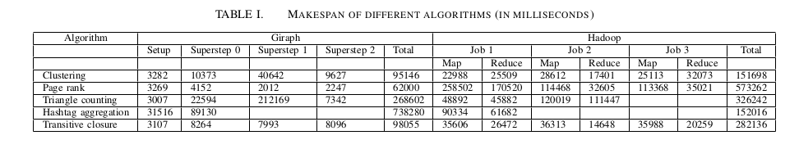
Evaluation- Makespan

Slide 16
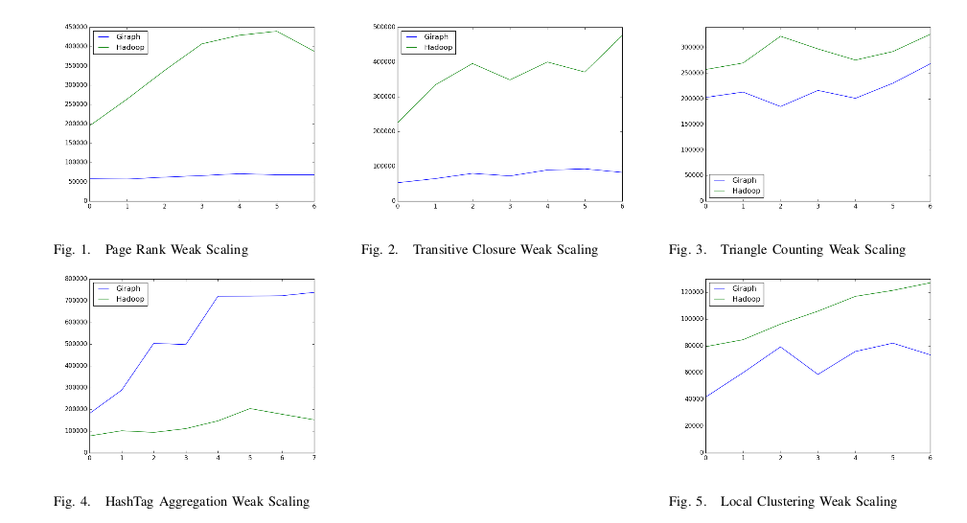
Evaluation-Scalability

Slide 17
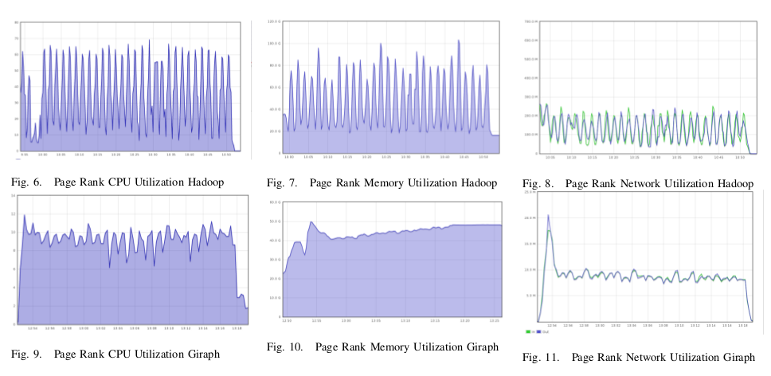
Evaluation-Resource Utilization
(Page rank)

Slide 18
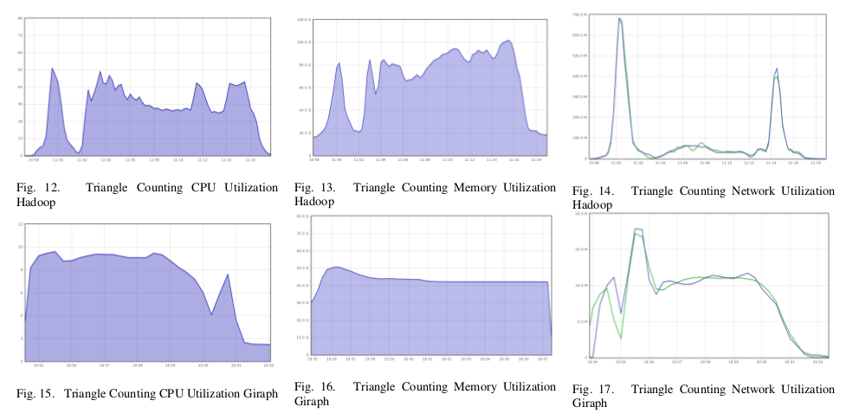
Evaluation-Resource Utilization
(Triangle counting)

Slide 19
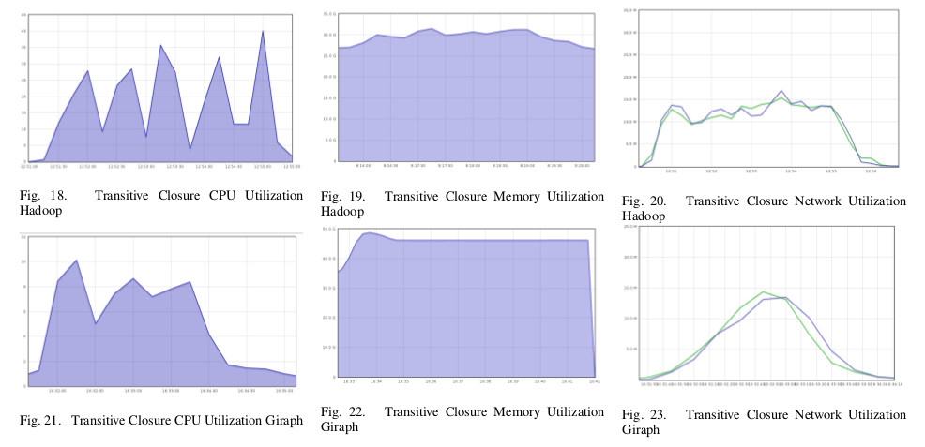
Evaluation-Resource Utilization
(Transitive closure)

Slide 20
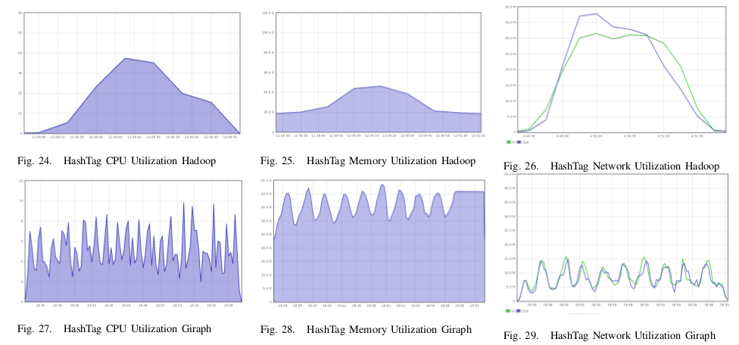
Evaluation-Resource Utilization
(Hashtag aggregation)

Slide 21
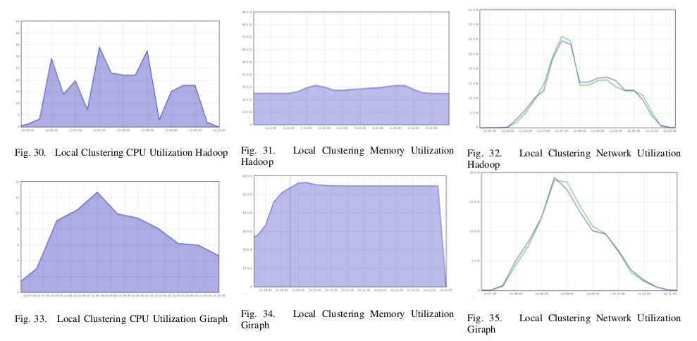
Evaluation-Resource Utilization
(Local clustering)

Slide 22
Conclusion
In this project, we analyzed common algorithms using different performance metrics such as makespan, scalability and resource utilization
Makespan of algorithms that use graph structure(iterative) is higher in hadoop while algorithms that require simple string processing like word count do not get any advantage from passing graph structure as found while running HashTag Aggregation

Slide 23
References
[1]Apache hadoop. http://hadoop.apache.org
[2]Apache giraph - http://giraph.apache.org
[3]MapReduce:Simplifed Data Processing on Large Clusters ,Jeffrey Dean and Sanjay Ghemawat
[4]Does Social Media Big Data Make the World Smaller? An Exploratory Analysis of Keyword-Hashtag Networks , Hamed, Ahmed Abdeen and Wu, Xindong
[5]Counting Triangles and the Curse of the Last Reducer ,Siddharth Suri and Sergei Vassilvitskii
[6]Clash of the Titans: MapReduce vs. Spark for Large Scale Data Analytics, Juwei Shi,Yunjie Qiu,Umar Farooq Minhas,Limei Jiao,Chen Wang,Berthold Reinwald and Fatma Ozcan
[7]Distributed Programming over Time-series Graphs ,Yogesh Simmhan, Neel Choudhury

Slide 24
Thank you! :)

