Slide 1

INTELLIGENT LOG ANALYSIS
HARNESSING INSIGHTS FROM DATA LOGS

Slide 2
Abstract
Computer logs are a rich source of information that can be analyzed to detect various issues. The large volumes of logs limit the effectiveness of manual approaches to log analysis.
Anomaly detection approaches can detect these issues. This is achieved by looking for unusual behavior in the logs utilizing machine learning (ML) models. In this project, we evaluated various ML techniques used for log anomaly detection.

Slide 3
Objective
Our goal is to build an anomaly detection system that can identify anomalies based on analysis of computer-generated logs. We focus on semi-supervised log anomaly detection, as we believe this setting to be applicable to most real-world systems, where we won’t have labeled anomaly data, but could obtain data that is considered normal or sufficiently normal from some baseline period based on the system administrator’s evaluation.

Slide 4

Our approach
Our approach is build a system that can predict attacks using our ML model.
About ML model:-
The ML model is applied to new, incoming events to detect if there’s a match.
If the new event that arrives agrees with our model’s prediction, then it is flagged as normal, otherwise it is treated as an anomaly.

Slide 5
Attacks that can be detected
DoS attacks-GoldenEye
SSH-Bruteforce
DDOS attack-HOIC
DoS attacks-SlowHTTPTest
DoS attacks-Hulk
Infilteration
Bot
FTP-BruteForce

Slide 6
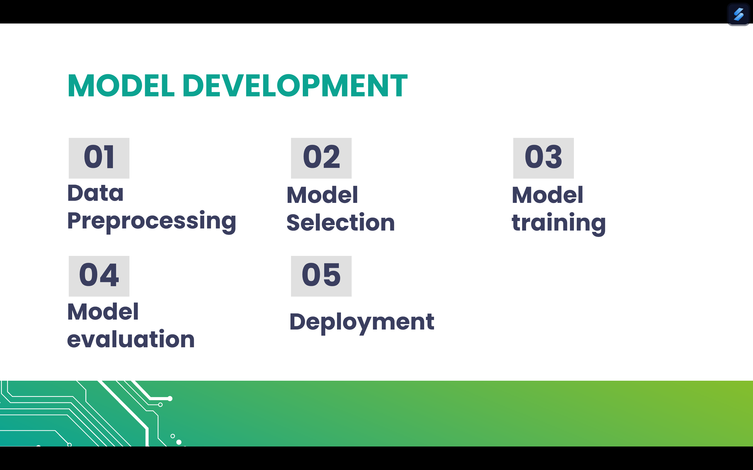

Slide 7
Data Preprocessing
Model
Selection
CICIDS2018 Dataset
LabelEncoder
MinMaxScalar
RandomForestRegressor
RandomForestClassifier

Slide 8
Model training and testing
Model
Deployment
GaussianNB
RandomForestClassifier
QuadraticDiscriminantAnalysis
MLP
WKNN
KNN
DecisionTree
Flask

Slide 9
TECHNOLOGIES AND TOOLS USED
Front End:
HTML
CSS
Backend:
Flask
Programming Language:
Python
Data Processing:
Pandas
NumPy
Seaborn
Matplotlib
ML Libraries:
Scikit-learn

Slide 10
THANKS!
PPT BY:
M.Naga Jahnavi - 245322748105
V.Lakshmi Gayatri - 245322733126
Ch.Nishitha Reddy - 245322748012
Ch.Jhansi Sai Sri - 245322748011
T.Deekshita Reddy - 245322748117

