Slide 1
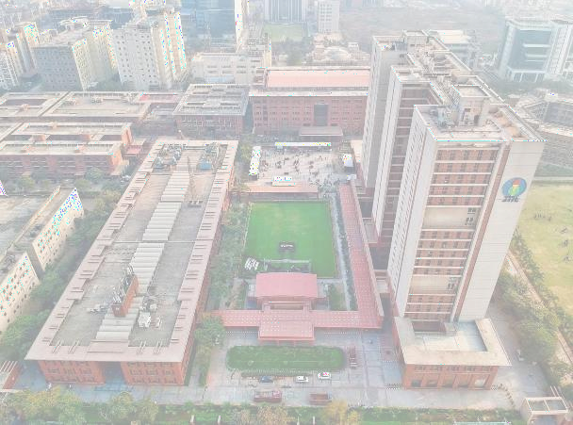


JAYPEE INSTITUTE OF INFORMATION TECHNOLOGY NOIDA
BTECH | SEMESTER-2|
SOFTWARE DEVELOPMENT LAB– II [15B17CI271]
REPORT FOR MINI GROUP PROJECT

Slide 2




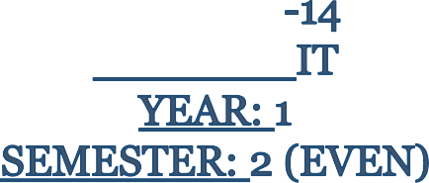
TEAM
NAME | ABHILASH TYAGI
ENROLLMENT NO. | 21104019

Slide 3

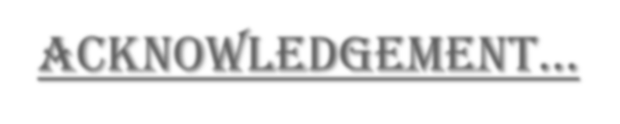



ACKNOWLEDGEMENT…
It gives us a great sense of pleasure to present the report of the B.Tech Project Undertaken during B.Tech, FirstYear. We owe a special debt of gratitude to Dr. Parul Agarwal - Assistant Professor (Senior Grade) for her constant support and guidance throughout our work. Her sincerity, thoroughness, and perseverance have been a constant source of inspiration for us. It is only her cognizant efforts that our endeavours have seen the light of the day.
At last, we would like to extend our heartfelt thanks to our parents because without their help this project would not have been successful. Finally, we would like to thank my dear friends who have been with me all the time.
~TEAM

Slide 4









INDEX
CHAPTER | CONTENT | PAGE NO.
1 | INTRODUCTION | 1
2 | FEATURES | 2
3 | C++ PROGRAMMING | 3
4 | DESIGN & IMPLEMENTATION | 4
5 | SOURCE CODE | 5-10
6 | OUTPUT SCREENS | 11-16
7 | ADVANTAGES & DISADVANTAGES | 17
8 | FUTURE IMPROVEMENTS | 18
9 | CONCLUSION | 19
10 | RFERENCES | 20

Slide 5
























CHAPTER-1: INTRODUCTION
1.
The CONTACT MANAGEMNET SYSYTEM is designed in ‘C++’ language.
This system is based on a concept to store and generate all the records of the Personal or an Organization’s Contact.
2.
A simple database of contacts in an office, an organization where the user can add Contact details safely and it’s not time-consuming.
3.
4.
Easy to store records of each.
5.
Add personal details, view a list of it, modify and remove the details.
1.
Convenient to operate and understand by the users.
6.

Slide 6
































CHAPTER-2: FEATURES
1.
The project provides file handling, data structure, functions, and pointer which makes this simple C++
mini-project.
2.
The user can add new contacts with information such as name, phone number, address, and email.
3.
List all contacts: lists all the contacts stored in a file with their respective contact details.
4.
Edit contacts: edit information given while adding the contacts
5.
Search contacts: based on name and phone number
6.
Developed using the C++ language.
7.
Delete contacts: delete contacts from a file.
2.

Slide 7



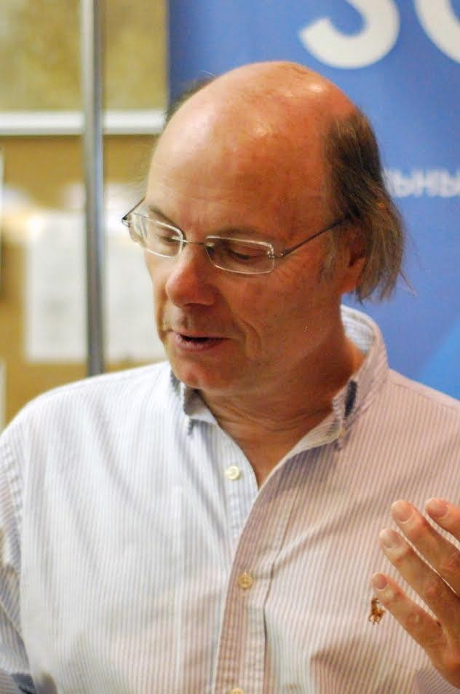
CHAPTER-3: C++ PROGRAMMING
WHY C++?…
C++ is a cross-platform language that can be used to create high-performance applications. C++ was developed by Bjarne Stroustrup, as an extension to the C language. C language is not efficient enough to tackle up the situation of data security, therefore C++ is much better option for this project.
WHY THIS PROJECT ?…
The reason for which we have chosen this project is due to its simplicity and inclination to the topic we have studied so far. Contact Management is something which requires fast execution and fast data handling which can be certainly achieved using C++.
Moreover, as a group activity it is a perfect project to learn about the important concepts of Object Oriented
Programming (OOPS) in C++ in a much more fun and creative manner.
TOPICS OF THE SDF-2 USED…
Bjarne Stroustrup
Our project has almost all fundamental aspects of C++ programming but Object Oriented Programming has been our major area of interest throughout the activity. We have been trying our best to incorporate the fundament features of the Object Oriented Philosophy.
Class and Objects
File Handling
3.

Slide 8

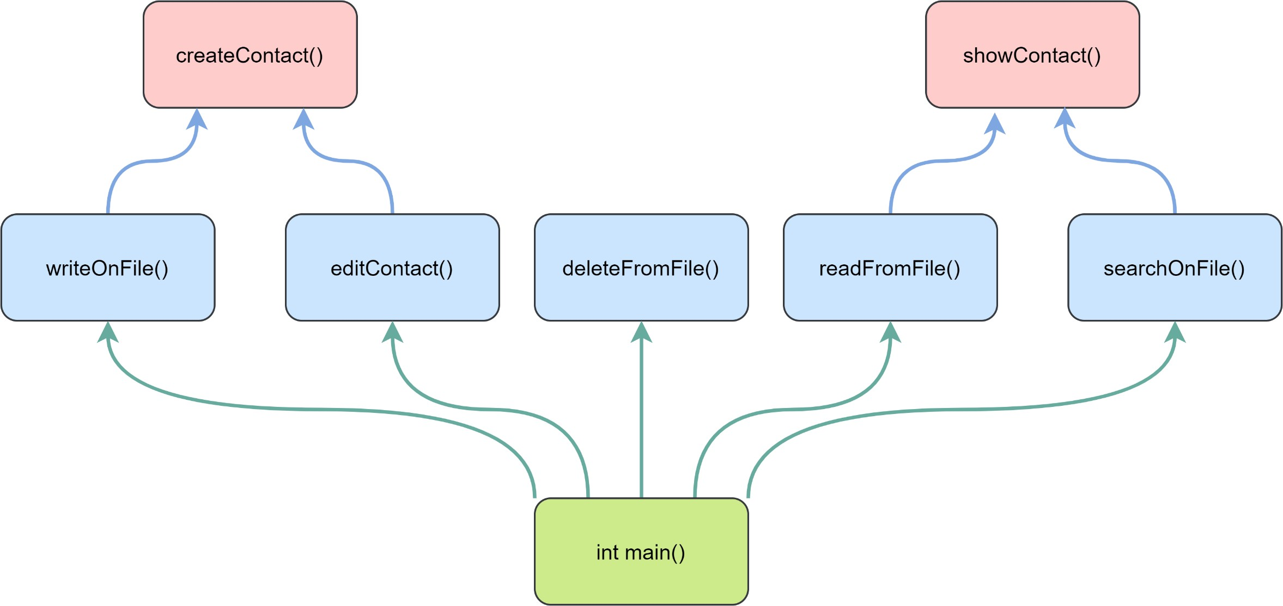
CHAPTER-4: DESIGN & IMPLEMENTATION
4.

Slide 9



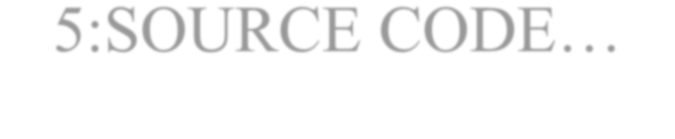
ChaPTEr-5:SOUrCE CODE…
#include<fstream>
#include<conio.h>
cout<<"Name: ";
cin.ignore();
cin>>name;
#include<string.h>
#include<iomanip>
#include<iostream>
using namespace std;
cout<<"Address: ";
cin.ignore();
class contact
cin>>add;
{
cout<<"Email address: "; cin.ignore(); cin>>email;
long ph;
char name[20],add[20],email[30];
cout<<"\n";
}
public:
void show_contact()
{
cout<<endl<<"Phone #: "<<ph; cout<<endl<<"Name: "<<name; cout<<endl<<"Address: "<<add; cout<<endl<<"Email Address : "<<email;
}
void create_contact()
{
cout<<"Phone: ";
5.
cin>>ph;

Slide 10
long getPhone()
fstream fp;
{
contact cont;
return ph;
}
void save_contact()
{
char* getName()
fp.open("contactBook.dat",ios::out|ios::app);
{
cont.create_contact();
return name;
fp.write((char*)&cont,sizeof(contact));
}
fp.close();
cout<<endl<<endl<<"Contact Has Been Sucessfully Created...";
char* getAddress()
getchar();
{
}
return add;
}
void show_all_contacts()
{
char* getEmail()
system("cls");
{
cout<<"\n\t\t================================\n\t\t\tLIST OF
CONTACTS\n\t\t================================\n";
return email;
}
fp.open("contactBook.dat",ios::in);
};
while(fp.read((char*)&cont,sizeof(contact)))
6.
{

Slide 11
cont.show_contact();
{
if(cont.getPhone()==num)
cout<<endl<<"============================================
=====\n"<<endl;
{
}
system("cls");
fp.close();
cont.show_contact();
}
found=true;
}
void display_contact(int num)
}
{
bool found;
fp.close();
int ch;
if(found == false){
cout<<"\n\nNo record found...";}
getchar();
}
found=false;
fp.open("contactBook.dat",ios::in);
while(fp.read((char*)&cont,sizeof(contact)))
void edit_contact()
7.

Slide 12
{
int num;
bool found=false; system("cls");
cout<<"..::Edit
void delete_contact()
{
int num; system("cls");
cout<<endl<<endl<<"Please Enter The contact #: "; cin>>num; fp.open("contactBook.dat",ios::in|ios::out);
fstream fp2; fp2.open("Temp.dat",ios::out); fp.seekg(0,ios::beg);
while(fp.read((char*)&cont,sizeof(contact)))
{
contact\n===============================\n\n\t..::Enter the number of contact to edit:";
cin>>num; fp.open("contactBook.dat",ios::in|ios::out);
while(fp.read((char*)&cont,sizeof(contact)) && found==false)
{
if(cont.getPhone()==num)
{
cont.show_contact(); cout<<"\nPlease Enter The New Details of Contact: "<<endl;
if(cont.getPhone()!=num)
cont.create_contact();
{
int pos=-1*sizeof(cont);
fp2.write((char*)&cont,sizeof(contact));
fp.seekp(pos,ios::cur);
}
fp.write((char*)&cont,sizeof(cont));
}
cout<<endl<<endl<<"\t Contact Successfully
Updated...";
fp2.close();
found=true;
fp.close();
}
remove("contactBook.dat");
}
rename("Temp.dat","contactBook.dat");
fp.close();
cout<<endl<<endl<<"\tContact Deleted...";
if(found==false)
cout<<endl<<endl<<"Contact Not Found...";
}
8.
}

Slide 13
int main(int argc, char *argv[])
{
system("cls"); system("color 03"); cout<<"\t\t\t\t*\t*"; cout<<"\t\t\t\t**\t**"; cout<<"\t\t\t\t***\t***"; cout<<"\t\t\t\t****\t****"; cout<<"\t\t\t\t*****\t*****";
cout<<"\t\t\t\t******\t******";
cout<<"\t\t\t\t*******\t*******"; cout<<"\t\t\t\t*******\t*******"; cout<<"\t\t\t\t******\t******"; cout<<"\t\t\t\t*****\t*****"; cout<<"\t\t\t\t****\t****"; cout<<"\t\t\t\t***\t***"; cout<<"\t\t\t\t**\t**"; cout<<"\t\t\t\t*\t*";
for(;;)
{
int ch;
cout<<"\n\t **** Welcome to Contact Management System ****";
cout<<"\n\n\n\t\t\tMAIN MENU\n\t\t=====================\n\t\t[1] Add a new Contact\n\t\t[2] List all Contacts\n\t\t[3] Search for contact\n\t\t[4] Edit a Contact\n\t\t[5] Delete a Contact\n\t\t[0] Exit\n\t\t=================\n\t\t";
cout<<"Enter the choice:";
cin>>ch;
switch(ch)
{
case 0: cout<<"\n\n\t\tThank you for using CMS..."; exit(0);
break;
break;
break;
case 1:save_contact();
break;
case 2:show_all_contacts();
break; case 3:
int num;
system("cls"); cout<<"\n\n\tPhone: "; cin>>num;
display_contact(num);
break;
case 4:edit_contact();
break; case 5:delete_contact();
break;
default:
break;
}
9.

Slide 14

int opt;
cout<<"\n\n\n..::Enter the Choice:\n\n\t[1] Main Menu\t\t[0] Exit\n";
cin>>opt;
switch (opt)
{
case 1:
system("cls");
continue;
case 0:
exit(0);
}
}
return 0;
10.
}

Slide 15




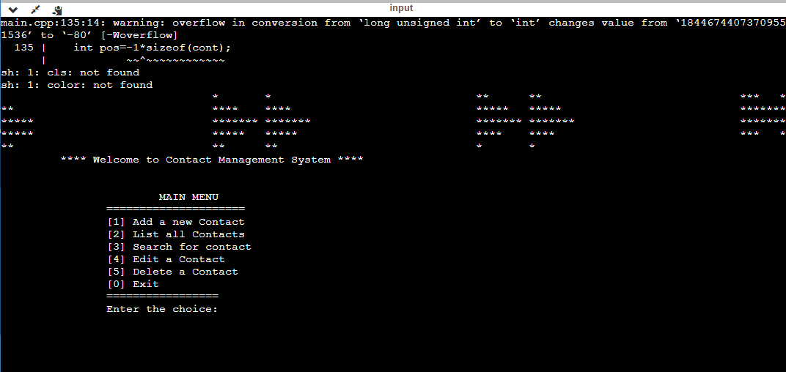
CHAPTER- 5: OUTPUT SCREEN
11.

Slide 16


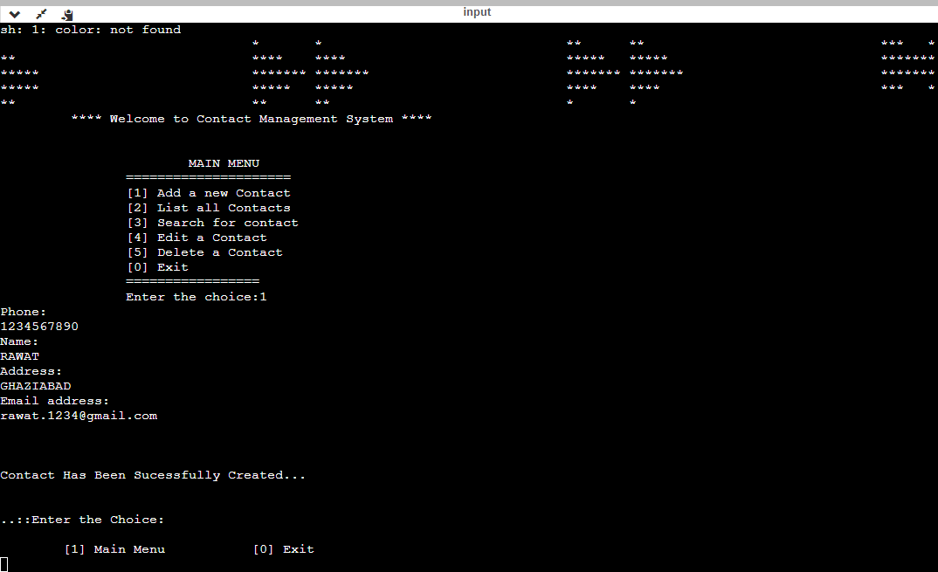
ADD A NEW CONTACT
12.

Slide 17


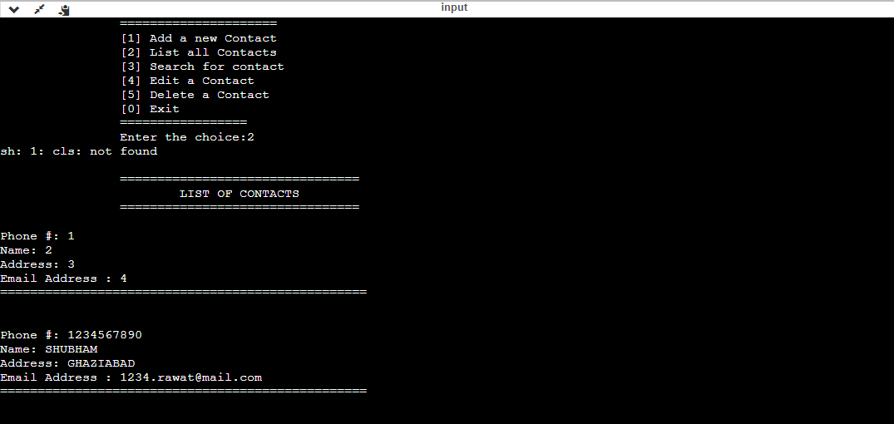
LIST ALL CONTACTS
13.

Slide 18


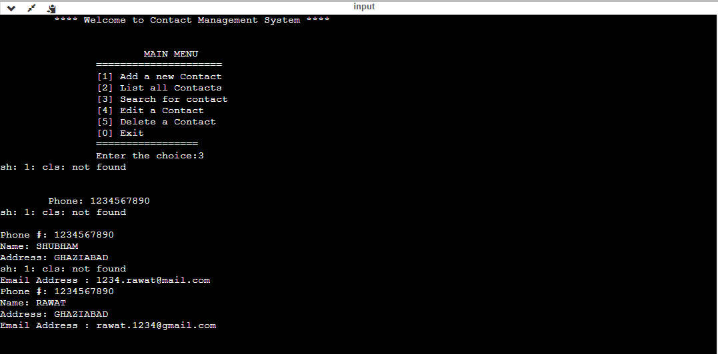
SEARCH FOR CONTACTS
14.

Slide 19


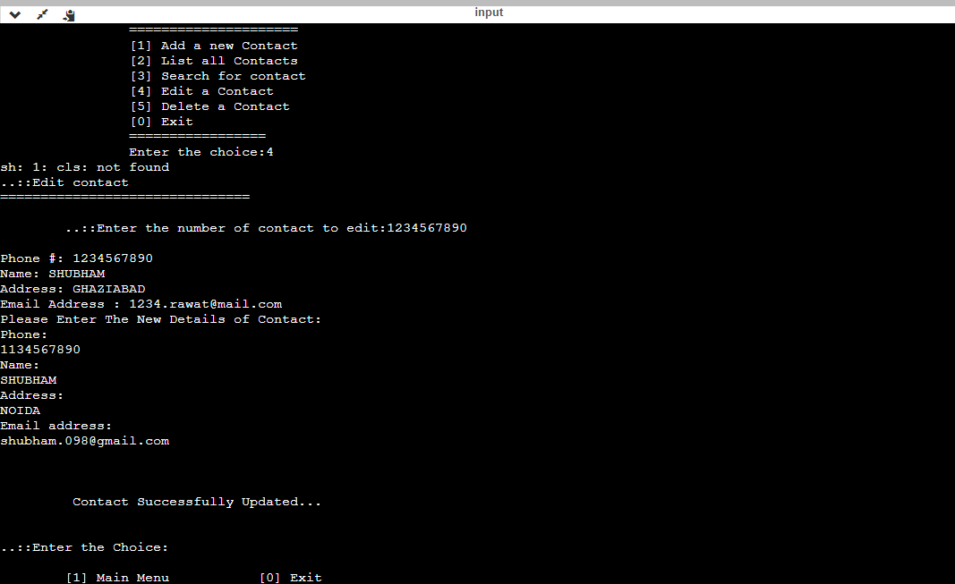
EDIT A CONTACT
15.

Slide 20


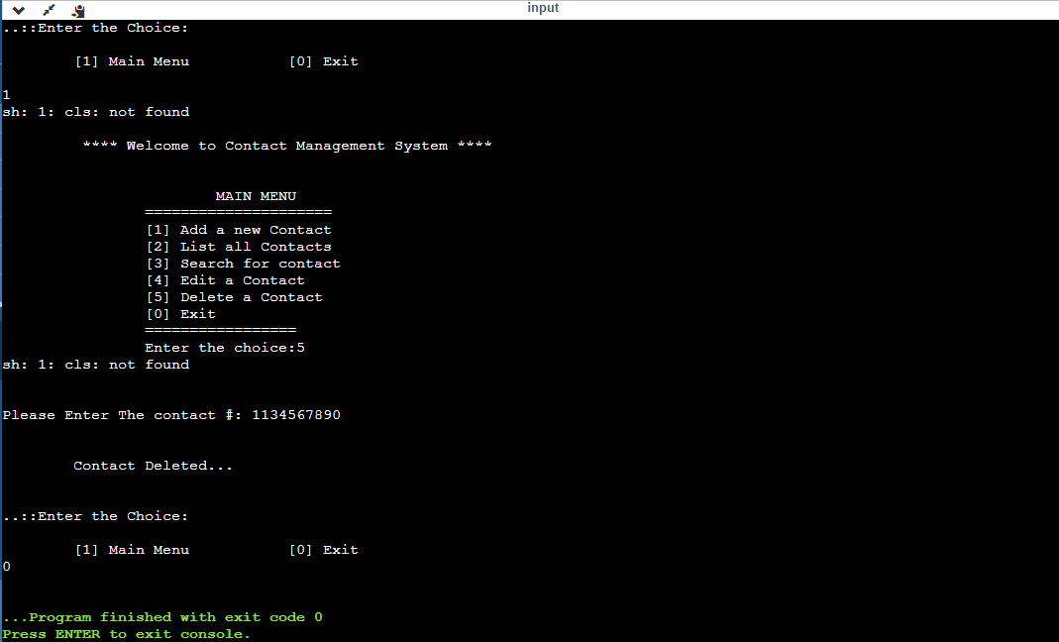
DELETE A CONTACT
16.

Slide 21







ADVANTAGES…
DISADVANTAGES…
Cannot add pictures to contacts.
Since it is written in C++, it is fast and efficient .
Convenient to operate and
understand by others.
Cannot classify contacts into different categories such as favourite, important, work etc.
Cannot add two or more numbers for the same person under same name.
Not capable of telling whether the person uses WhatsApp.
V/S
User readability | and | data | privacy
due to OOPS.
Functionalities | can | be | easily
expanded since programme is
written in object oriented language.
17.

Slide 22



FUTURE IMPROVEMENTS
To add pictures in the contacts.
To develop a mechanism to know whether the person uses
WhatsApp.
To add multiple numbers, addresses and e-mail ids to the same contact.
To classify contacts under different categories.
18.

Slide 23


CONCLUSION
The project enabled us to understand the importance of C++ programming language through OOPS and File Handling.
It also enabled us to understand that OOPS is much more powerful than structures in C language.
It helped us to understand one of the most important feature of C++ language- File Handling.
It enabled us to learn the importance of data privacy and data security through object oriented philosophy.
It enabled us to work in group and solve the problem given to us. It taught us teams spirit and time management.
Several improvements to the current programme can still be made.
19.

Slide 24


REFERENCES
https://codeprojectz.com/applications-and-web-projects/contact-management-system-in-c-with-source-code/
https://github.com/muradyf/contact-management-system#:~:text=Contact%20Management%20System-
,A%20contact%20management%20system%20written%20in%20C%2B%2B%20that%20provides%20various,and%20writing%20a%20contact% 20list.
https://www.codeproject.com/Questions/5315219/Need-help-making-a-contact-management-system-in-Cp
20.

