Slide 1
Compiler Design
Lex & Flex

Slide 2
Lexical Analyzer Generator
Lex is a program generator designed for lexical processing of character input streams.
Lex source is a table of regular expressions and corresponding program fragments.
The table is translated to a program which reads an input stream, copying it to an output stream and partitioning the input into strings which match the given expressions.
The compiler writer uses specialized tools that produce components that can easily be integrated in the compiler and help implement various phases of a compiler.
1/31/2017
ANKUR SRIVASTAVA ASSISTANT PROFESSOR JIT

Slide 3
Contd…..
The program fragments written by the user are executed in the order in which the corresponding regular expressions occur in the input stream.
Lex can generate analyzers in either “C” a language which can be translated automatically to portable Fortran.
Lex is a program designed to generate scanners, also known as tokenizers, which recognize lexical patterns in text.
Lex is an acronym that stands for "lexical analyzer generator.
It is intended primarily for Unix-based systems.
The code for Lex was originally developed by Eric Schmidt and Mike Lesk.
1/31/2017
ANKUR SRIVASTAVA ASSISTANT PROFESSOR JIT

Slide 4
Contd……
Lex can be used with a parser generator to perform lexical analysis.
It is easy, for example, to interface Lex and Yacc, an open source program that generates code for the parser in the C programming language.
Lex can perform simple transformations by itself but its main purpose is to facilitate lexical analysis.
The processing of character sequences such as source code to produce symbol sequences called tokens for use as input to other programs such as parsers.
1/31/2017
ANKUR SRIVASTAVA ASSISTANT PROFESSOR JIT

Slide 5
Contd……
Processes in lexical analyzers
  Scanning
    Pre-processing
      Strip out comments and white space
      Macro functions
  Correlating error messages from compiler with source program
    A line number can be associated with an error message
  Lexical analysis
1/31/2017
ANKUR SRIVASTAVA ASSISTANT PROFESSOR JIT

Slide 6
Contd……
Terms of the lexical analyzer
  Token
    Types of words in source program
    Keywords, operators, identifiers, constants, literal strings, punctuation symbols(such as commas, semicolons)
  Lexeme
    Actual words in source program
1/31/2017
ANKUR SRIVASTAVA ASSISTANT PROFESSOR JIT

Slide 7
Contd…..
  Pattern
    A rule describing the set of lexemes that can represent a particular token in source program
    Relation {<.<=,>,>=,==,<>}
    Lexical Errors
  Deleting an extraneous character
  Inserting a missing character
  Replacing an incorrect character by a correct character
  Pre-scanning
1/31/2017
ANKUR SRIVASTAVA ASSISTANT PROFESSOR JIT

Slide 8
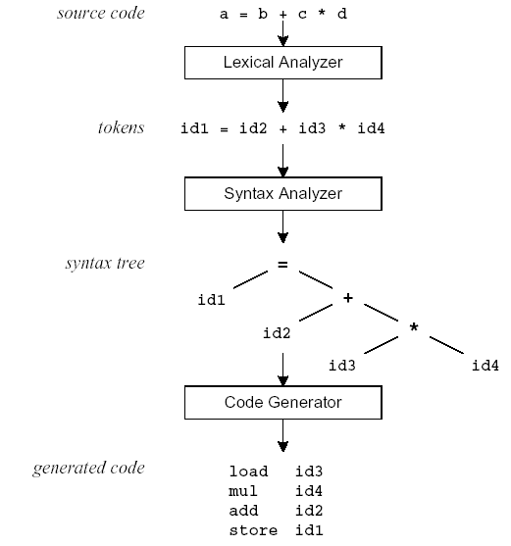
Compilation Sequence
1/31/2017
ANKUR SRIVASTAVA ASSISTANT PROFESSOR JIT

Slide 9
What is Lex?
The main job of a lexical analyzer (scanner) is to break up an input stream into more usable elements (tokens)
  a = b + c * d;
  ID ASSIGN ID PLUS ID MULT ID SEMI
Lex is an utility to help you rapidly generate your scanners
1/31/2017
ANKUR SRIVASTAVA ASSISTANT PROFESSOR JIT

Slide 10
Lex – Lexical Analyzer
Lexical analyzers tokenize input streams
Tokens are the terminals of a language
  English
    words, punctuation marks, …
  Programming language
    Identifiers, operators, keywords, …
Regular expressions define terminals/tokens
Some examples are
Flex lexical analyser
Yacc
Ragel
PLY (Python Lex-Yacc)
1/31/2017
ANKUR SRIVASTAVA ASSISTANT PROFESSOR JIT

Slide 11
Contd…..
Lex turns the user's expressions and actions (called source in this memo) into the host general-purpose language.
the generated program is named yylex.
The yylex program will recognize expressions in a stream (called input in this memo) and perform the specified actions for each expression as it is detected. See the below fig….
Source -> -> yylex
Input -> -> Output
Fig. An overview of Lex
Lex
yylex
1/31/2017
ANKUR SRIVASTAVA ASSISTANT PROFESSOR JIT

Slide 12
yylex()
It implies the main entry point for lex.
Reads the input stream generates tokens, returns 0 at the end of input stream.
It is called to invoke the lexer or scanner.
Each time yylex() is called, the scanner continues processing the input from where it last left off.
Eg:
yyout
yyin
yywrap
1/31/2017
ANKUR SRIVASTAVA ASSISTANT PROFESSOR JIT

Slide 13
Lexical Analyzer Generator - Lex
Lex Source program
lex.l
Lexical Compiler
lex.yy.c
C
compiler
lex.yy.c
a.out
a.out
Sequence of tokens
Input stream

Slide 14
Structure of a Lex file
The structure of a Lex file is intentionally similar to that of a yacc file.
files are divided into three sections, separated by lines that contain only two percent signs, as follows:
Definition section
%%
Rules section
%%
C code section
1/31/2017
ANKUR SRIVASTAVA ASSISTANT PROFESSOR JIT

Slide 15
Contd…..
The definition section defines macros and imports header files written in C. It is also possible to write any C code here, which will be copied verbatim into the generated source file.
The rules section associates regular expression patterns with C statements. When the lexer sees text in the input matching a given pattern, it will execute the associated C code.
The C code section contains C statements and functions that are copied verbatim to the generated source file. These statements presumably contain code called by the rules in the rules section. In large programs it is more convenient to place this code in a separate file linked in at compile time.
1/31/2017
ANKUR SRIVASTAVA ASSISTANT PROFESSOR JIT

Slide 16
Example
The following is an example Lex file for the flex version of Lex.
It recognizes strings of numbers (positive integers) in the input, and simply prints them out.
/*** Definition section ***/
%{
/* C code to be copied */
#include <stdio.h>
%}
/* This tells flex to read only one input file
*/
%option noyywrap
%%
1/31/2017
ANKUR SRIVASTAVA ASSISTANT PROFESSOR JIT

Slide 17
Contd……
/*** Rules section ***/
/* [0-9]+ matches a string of one or more digits */
[0-9]+ {
/* yytext is a string containing the matched text. */
printf("Saw an integer: %s\n", yytext);
}
.|\n { /* Ignore all other characters. */
}
%%
/*** C Code section ***/
1/31/2017
ANKUR SRIVASTAVA ASSISTANT PROFESSOR JIT

Slide 18
Contd…..
int main(void)
{
/* Call the lexer, then quit. */
yylex();
return 0;
}
If this input is given to flex, it will be converted into a C file, lex.yy.c.
This can be compiled into an executable which matches and outputs strings of integers. Eg.
abc123z.!&*2gj6
the program will print: Saw an integer: 123
Saw an integer: 2
Saw an integer: 6
1/31/2017
ANKUR SRIVASTAVA ASSISTANT PROFESSOR JIT

Slide 19
Flex, A fast scanner generator
flex is a tool for generating scanners:
programs which recognized lexical patterns in text.
flex reads the given input files,
or its standard input if no file names are given, for a description of a scanner to generate.
The description is in the form of pairs of regular expressions and C code, called rules.
flex generates as output a C source file, `lex.yy.c', which defines a routine `yylex()'.
This file is compiled and linked with the `-lfl' library to produce an executable.
When the executable is run, it analyzes its input for occurrences of the regular expressions.
Whenever it finds one, it executes the corresponding C code.
1/31/2017
ANKUR SRIVASTAVA ASSISTANT PROFESSOR JIT

Slide 20
Contd…
Flex (fast lexical analyzer generator) is a free and open-source software alternative to lex.
It is a computer program that generates lexical analyzers (also known as "scanners" or "lexers").
Flex was written in C by Vern Paxson around 1987.
He was translating a Ratfor generator.
It had been led by Jef Poskanzer.
The tokens recognized are: '+', '-', '*', '/', '=', '(', ')', ',', ';', '.', ':=', '<', '<=', '<>', '>', '>=';
numbers: 0-9 {0-9}; identifiers: a-zA-Z {a-zA-Z0-9} and keywords: begin, call, const, do, end, if, odd, procedure, then, var, while.
1/31/2017
ANKUR SRIVASTAVA ASSISTANT PROFESSOR JIT

Slide 21
Thanks

