Slide 1
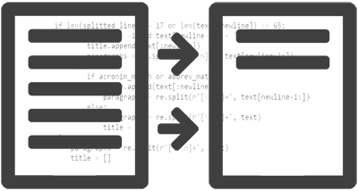
TEXT SUMMARIZATION
Name - Abhi Mahajan
Abhi Mahajan
Roll No - 101683033
101683033
Group – COE1
NLP Application
TIET

Slide 2
Goal :
To Reduce A Textual Document To A Summary That Retains The Pivotal Points Of The Original Document. Naive Summ Approach Is Developed Which Makes Use Of A Word's Frequencies For The Computation And Extraction Of Sentences That Consist Of The Most Frequent Words To Extract A Few Specific Sentences.
Applications:
Summaries Of Email Threads
Action Items From A Meeting
Simplifying Text By Compressing Sentences

Slide 3
ALGORITHM :
Term Frequency-Inverse Document Frequency
Get URL from user input
Web crawl to extract the natural language from the URL html (by paragraphs <p>).
Execute the summarize class algorithm (implemented using NLTK) on the extracted sentences stemmed to their root stems.
The algorithm ranks sentences according to the frequency of the words they contain, and the top sentences are selected for the final summary.
Return the highest ranked sentences as a final summary.

Slide 4
Web crawling - Beautiful Soup is a Python library for pulling data out of HTML and XML files. It works to provide idiomatic ways of navigating, searching, and modifying the parse tree. It commonly saves programmers hours or days of work.
Text summarization - Nltk (Natural Language Toolkit) is a leading platform for building Python programs to work with human language data. It provides easy-to-use interfaces to over 50 corpora and lexical resources such as WordNet, along with a suite of text processing libraries for classification, tokenization, stemming, tagging, parsing, and semantic reasoning, wrappers for industrial-strength NLP libraries.

Slide 5
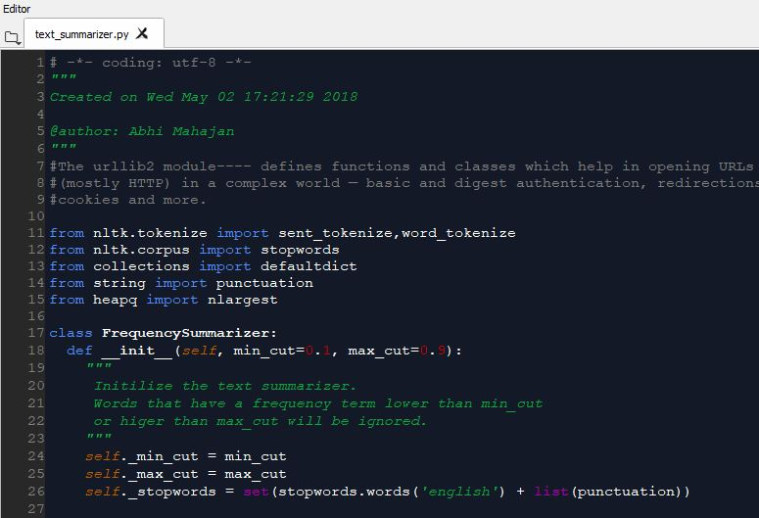
CODE :

Slide 6
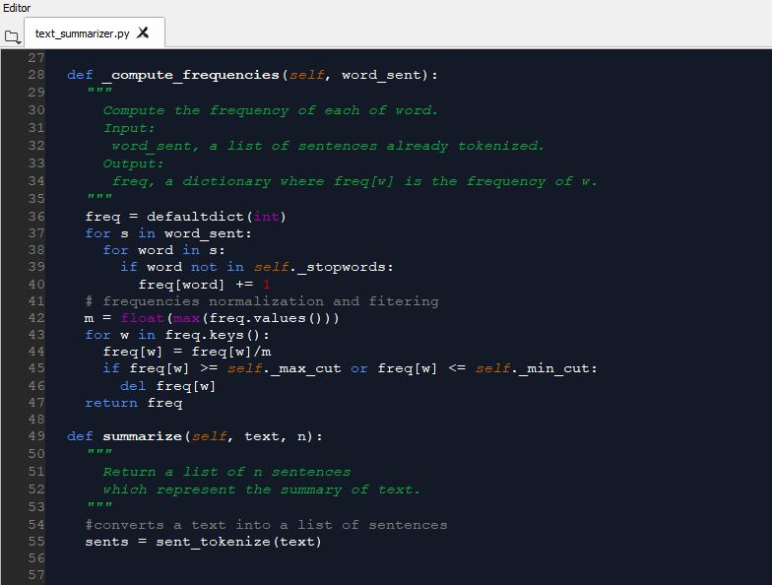

Slide 7
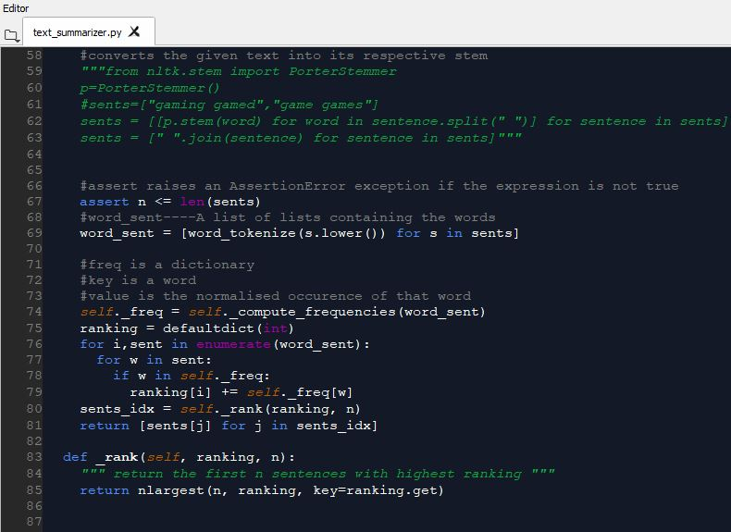

Slide 8
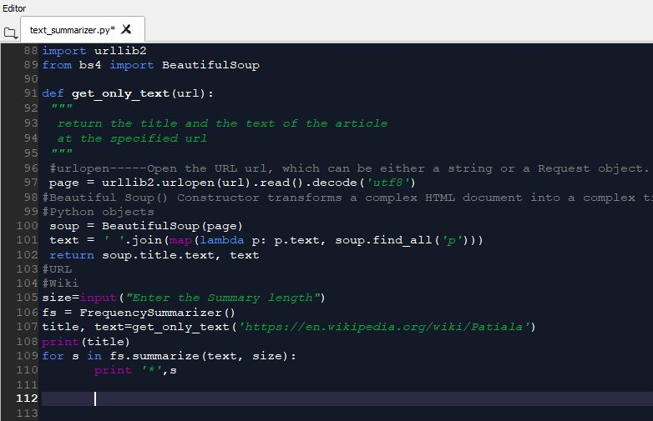

Slide 9
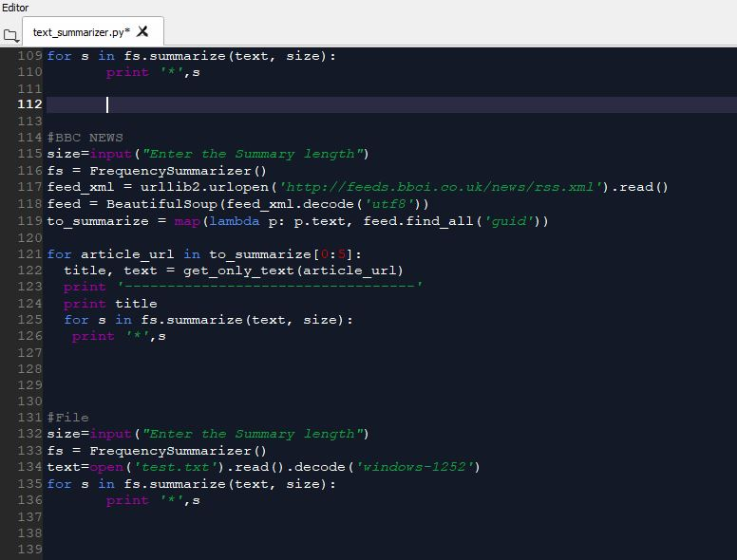

Slide 10
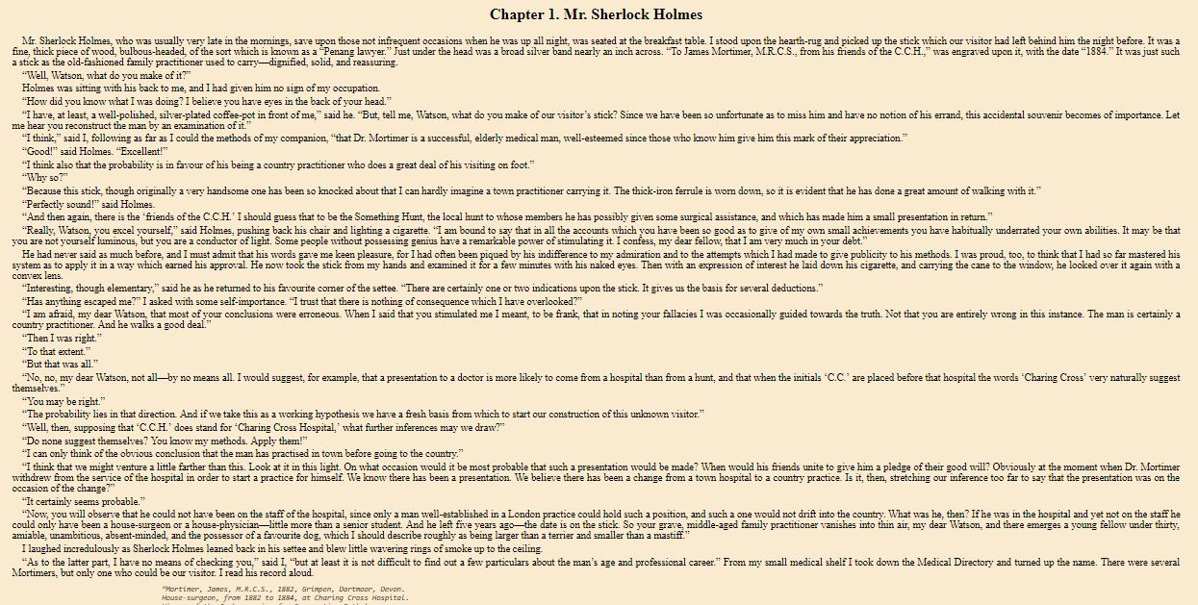
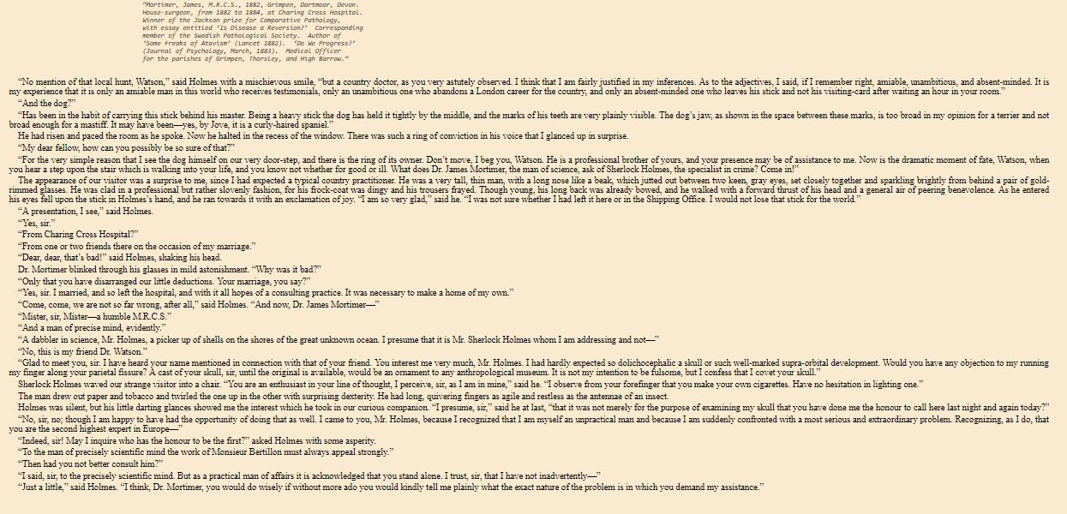
RESULT:
File to be summarized

Slide 11
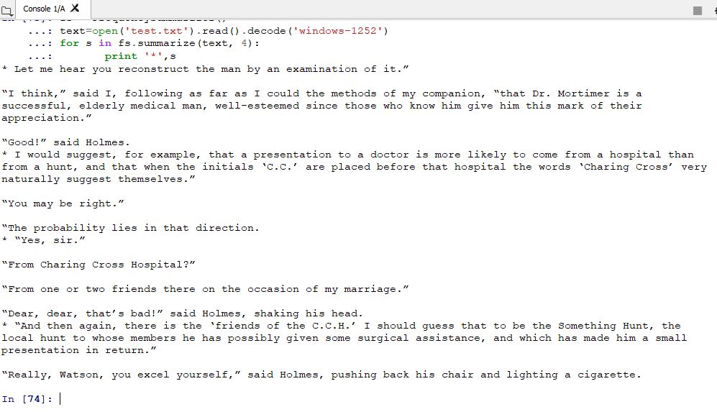
SUMMARIZED FILE

