Slide 1

LANGSPHERE
Interactive Programming Languages Directory
A clear, searchable reference for exploring language history, technical properties, syntax, ecosystems, and trade-offs.
Explore the language landscape
Website overview
Directory • Timeline • Profiles
langsphere.vercel.app
HTML
CSS
JavaScript
ABHIMANEU R NAIR
[ ARN ]

Slide 2
What LangSphere provides
A curated discovery experience for programming languages
The site turns a broad technical topic into a browsable, consistent directory. Visitors can locate a language, understand its place in history, then open a focused profile for deeper context.
01
Language directory
Search and filter languages by domain, paradigm, execution model, and use case
02
History timeline
Trace releases and creators from foundational systems languages to modern platforms
03
Language profiles
Review descriptions, core ideas, technical specifications, syntax, ecosystem, and trade-offs
LANGSPHERE / WEBSITE OVERVIEW
02

Slide 3
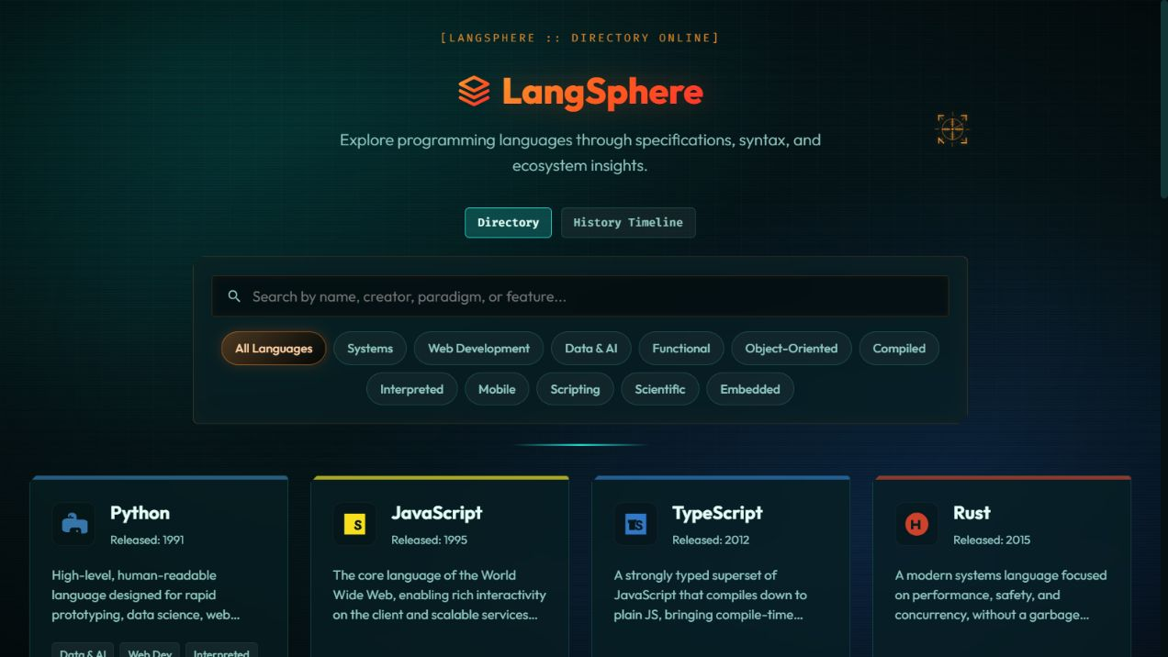
Directory discovery
A single starting point for finding the right language
Navigation cues
Search
Find a language by name, creator, paradigm, or feature
Filters
Narrow the list by Systems, Web Development, Data & AI, Functional, Mobile, and more
Cards
Scan a short description, release year, category tags, and a direct path to details
LANGSPHERE / WEBSITE OVERVIEW
03

Slide 4
User workflow
From broad exploration to practical understanding
1
2
3
4
Start in the directory
›
Refine the view
›
Open a language profile
›
Compare and learn
Browse the language set or search for a known option
Use filters to focus on a paradigm, platform, or technical characteristic
Move from the summary card into structured detail
Use specifications, syntax, ecosystem notes, and pros and cons to evaluate fit
The progression keeps the first decision lightweight and provides more technical depth only after a visitor selects a language.
LANGSPHERE / WEBSITE OVERVIEW
04

Slide 5
Language profile structure
A repeatable framework for explaining each language
Profile
Overview
Identity, creator, release year, and a concise description
Primary philosophy and notable features
Beginner guide
Syntax highlight
Accessible starting points for new learners
Recognizable code patterns and conventions
Ecosystem
Pros & cons
Tools, platforms, libraries, and community context
Useful strengths and limits for evaluation
LANGSPHERE / WEBSITE OVERVIEW
05

Slide 6
Who LangSphere serves
The directory supports learning, selection, and technical context
Developers
Quickly shortlist languages for a project, platform, or programming style
Students
Connect historical context with beginner-friendly concepts and syntax
Researchers
Use consistent language summaries to orient further technical investigation
Educators
Use profiles and the timeline as visual entry points for course discussions
The content model helps visitors move from “What is this language?” to “Where does it fit?” without needing to consult multiple sources first.
LANGSPHERE / WEBSITE OVERVIEW
06

Slide 7
Why the directory matters
Programming languages carry different histories, trade-offs, and communities
A language directory gives users a common frame for comparing options. LangSphere brings classification, history, and technical context into one interface.
+
Context before choice
A release year, creator, and category provide useful orientation before deeper research
+
Comparable profiles
A repeatable section structure makes it easier to compare languages fairly
+
Broader technical literacy
Timeline and ecosystem context help visitors connect a language to its real-world role
LANGSPHERE / WEBSITE OVERVIEW
07

Slide 8
Usability and understandability
A visual assessment of the live experience
Clear hierarchy
Fast scanning
The site opens with a name, a concise purpose statement, view selector, search, then filters
Language cards surface release year, a plain-language summary, and category labels
Progressive detail
Distinct visual identity
The directory remains broad while individual profiles provide deeper technical information
Dark teal panels, warm orange highlights, and monospaced labels reinforce a technical reference tone
LANGSPHERE / WEBSITE OVERVIEW
08

Slide 9
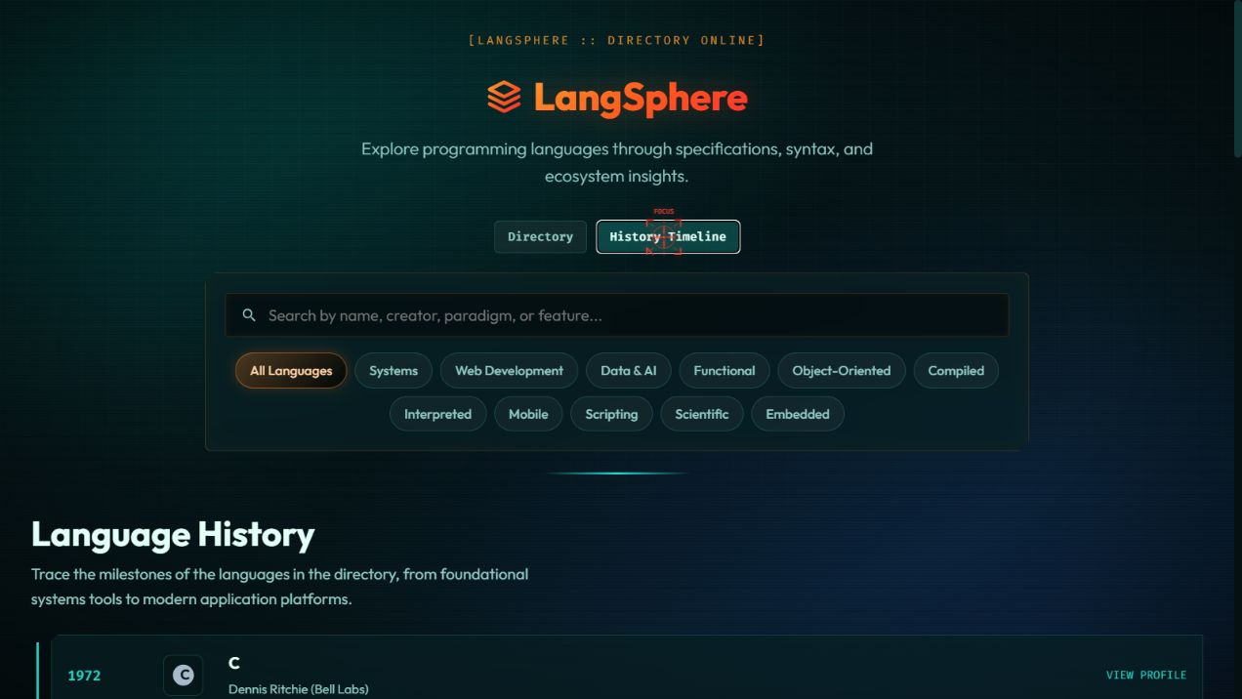
Screens from the live site
Directory cards and the history view make the information architecture visible
Directory view
History timeline
Search, category filters, and language cards.
Release dates and creator context arranged chronologically.
Back to structure
LANGSPHERE / WEBSITE OVERVIEW
09

Slide 10
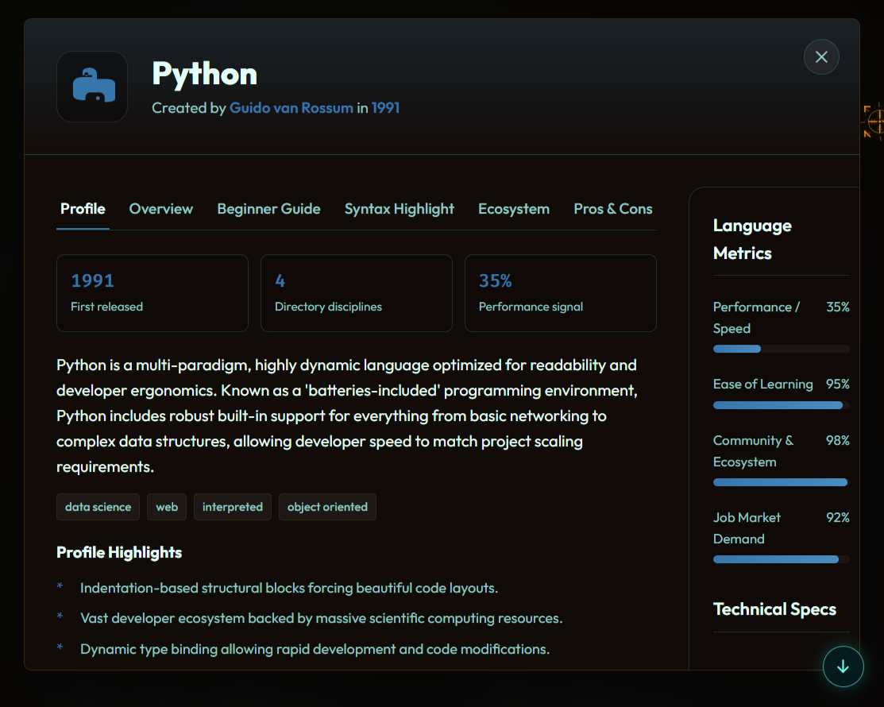

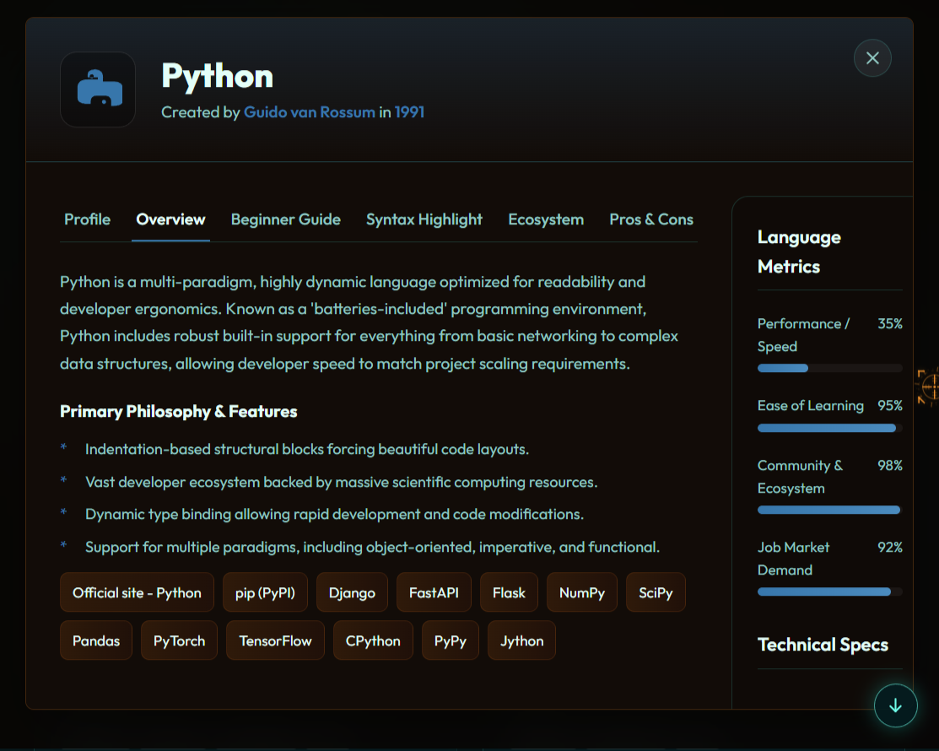
Screens from the live site
Detailed information about the language can be analysed.
Language Profile
Language Overview
Identity, creator, release year, and a concise description.
Primary philosophy and notable features.
Back to structure
LANGSPHERE / WEBSITE OVERVIEW
10

Slide 11
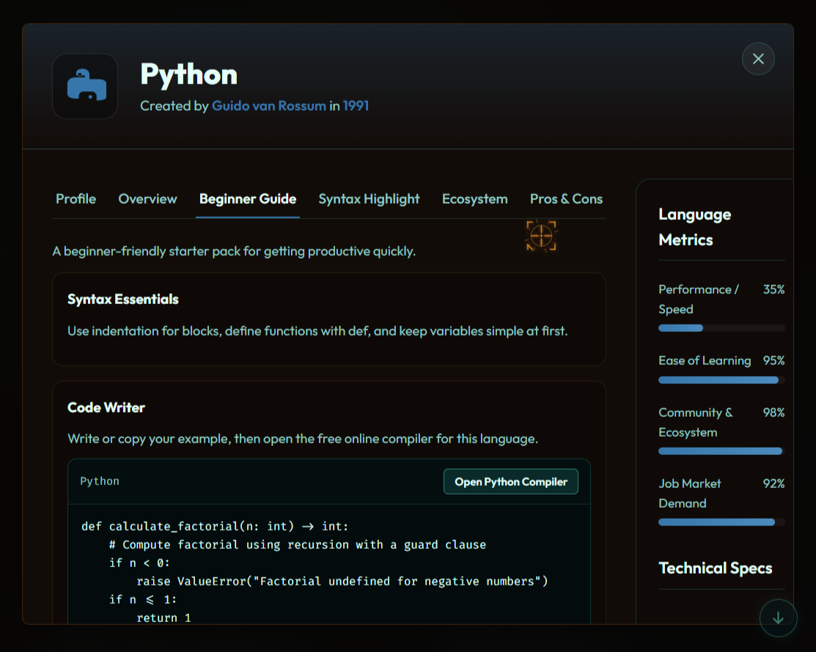
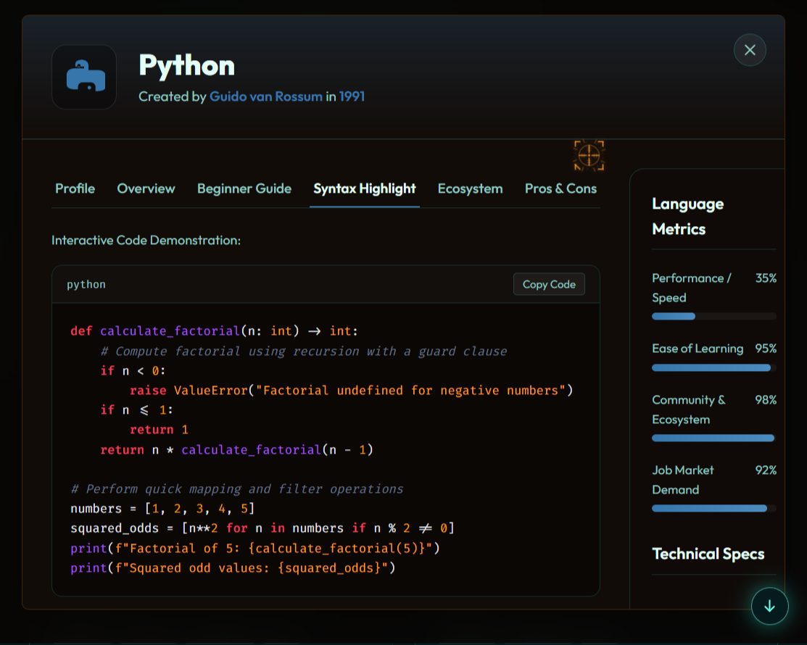
Screens from the live site
Detailed information about the language can be analysed.
Beginner Guide
Syntax Highlight
Accessible starting points for new learners.
Recognizable code patterns and conventions.
Back to structure
LANGSPHERE / WEBSITE OVERVIEW
11

Slide 12
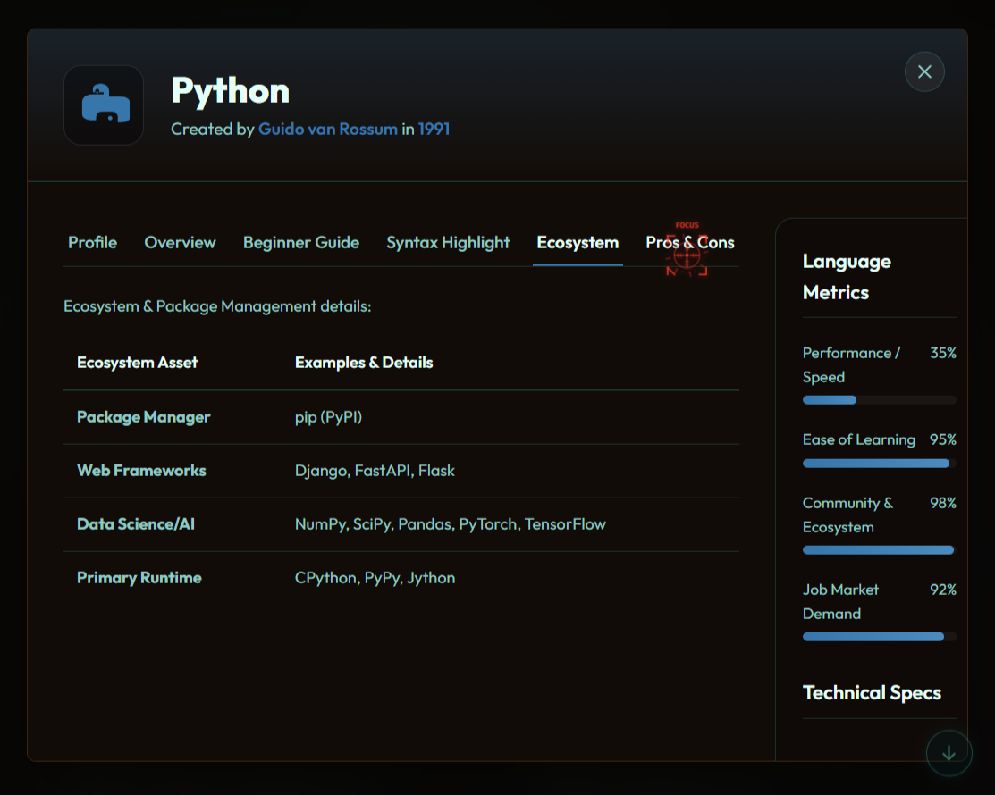
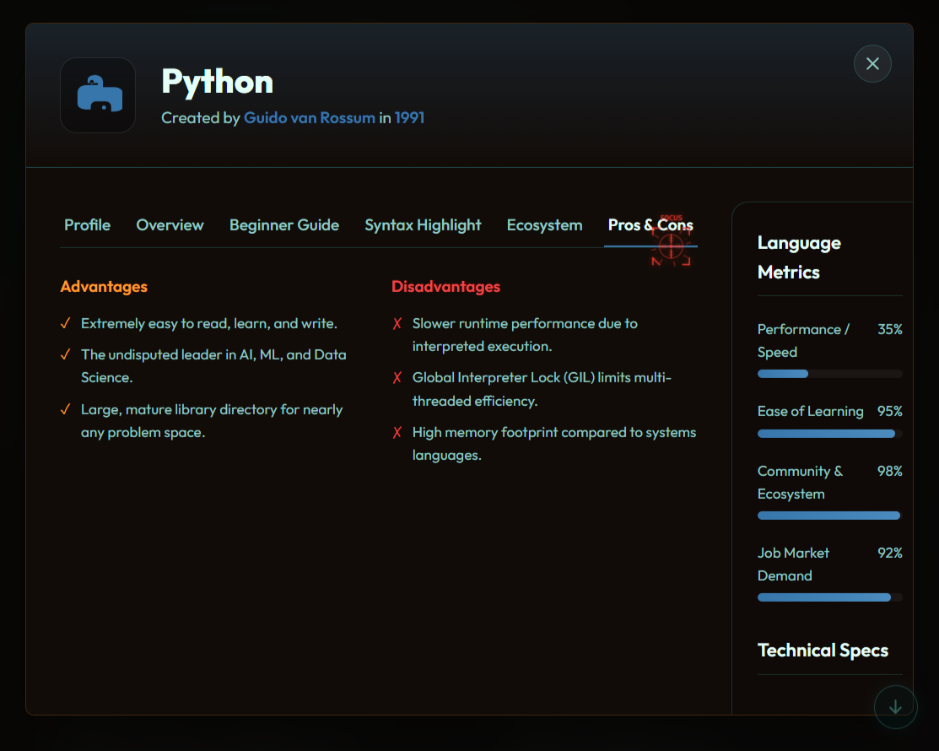
Screens from the live site
Detailed information about the language can be analysed.
Ecosystem
Pros & Cons
Tools, platforms, libraries, and community context.
Useful strengths and limits for evaluation.
Back to structure
LANGSPHERE / WEBSITE OVERVIEW
12

Slide 13
The End …
Looks like you have reached the end …!
Thankyou for your valuable time and patience !
Slide navigations
View live page on :
https://langsphere.vercel.app
langsphere.vercel.app
#Homepage
#Description
#Navigation
#Workflow
#Structure
#Users
#Accessibility
#Screenshots
LANGSPHERE / WEBSITE OVERVIEW
13

