Slide 1
AIRBNB VACATIONAL RENTAL COMPANY
Business Case Study and Report
Presented by: Abhimanyu

Slide 2
Agenda
Problem Statement:
Understand various factors influencing rental prices and occupancy rates.
Strategy to improve experiences of both guests and hosts.
Provisions if they can enter newer geographies or not.
Business Plan
Company overview
SWOT
Objectives.

Slide 3
Company Overview (AIRBNB)
Airbnb is a global online marketplace and hospitality service platform that allows people to list, discover, and book accommodations around the world. Founded in 2008, the company has revolutionized the travel and hospitality industry by providing a wide variety of lodging options, including vacation rentals, apartment rentals, homestays, hostel beds, and hotel rooms. In addition to lodging, Airbnb offers unique tourism experiences and activities hosted by locals.

Slide 4
SWOT ANALYSIS
Strengths | Weakness | Opportunities | Threats
Has a Global Reach across over 220 countries. Provides wide spectrum of facilities like room ,unique stays , swimming pools etc. Offers Flexible short-term, Long-term and business travel acomodations. | Both hosts and guests incur service fees, which can make stays more expensive. Maintaining quality condition of listings can lead to customer dissatisfaction. | Entering in new geographies with emerging markets. Enhancing more services through incorporating new services like customer support, technical side etc. | Strong competition from various vacation platforms like Vrbo, Booking.com. Increased competition in certain location Increasing regulations and legal challenges in various citites can limit growth.

Slide 5
Market Share

Slide 6
Objectives
To understand various factors influencing rental prices and occupancy rates.
What are scopes of new features which AIRBNB can add in their listings.
Provide recommendations on which steps hosts need to take in order to optimise their experience.

Slide 7
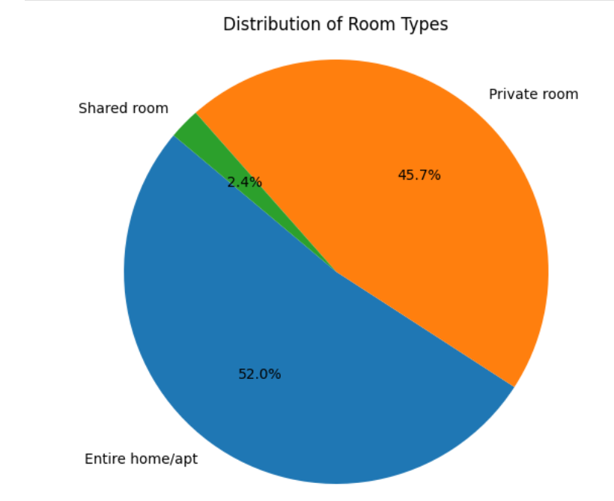
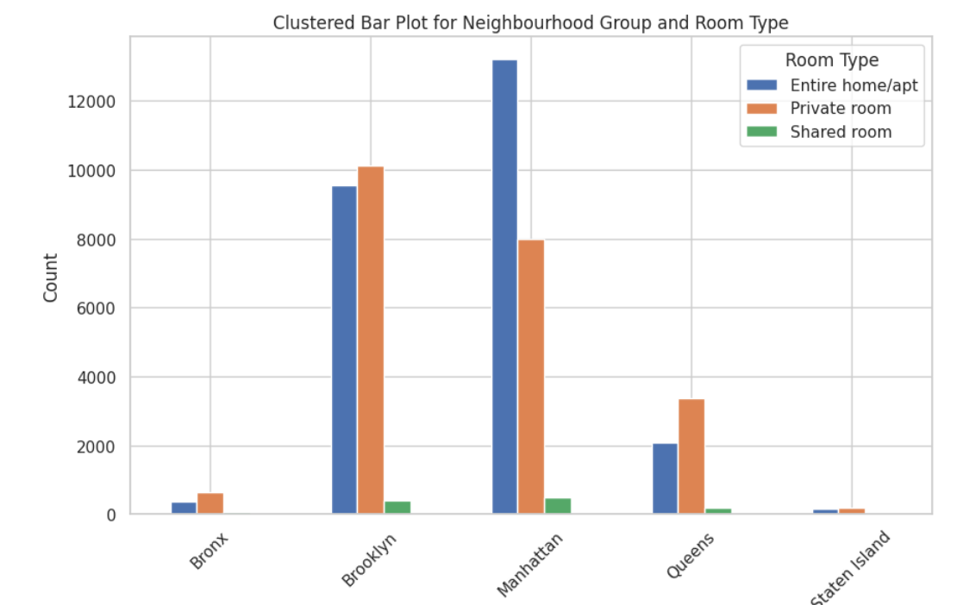
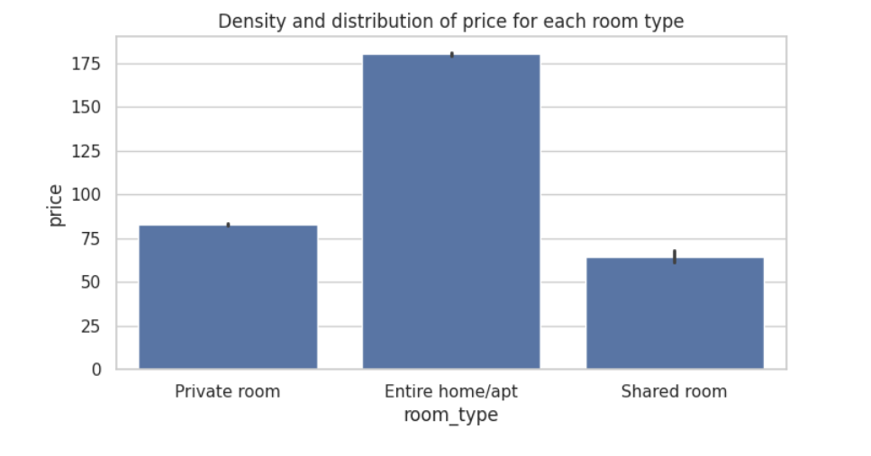
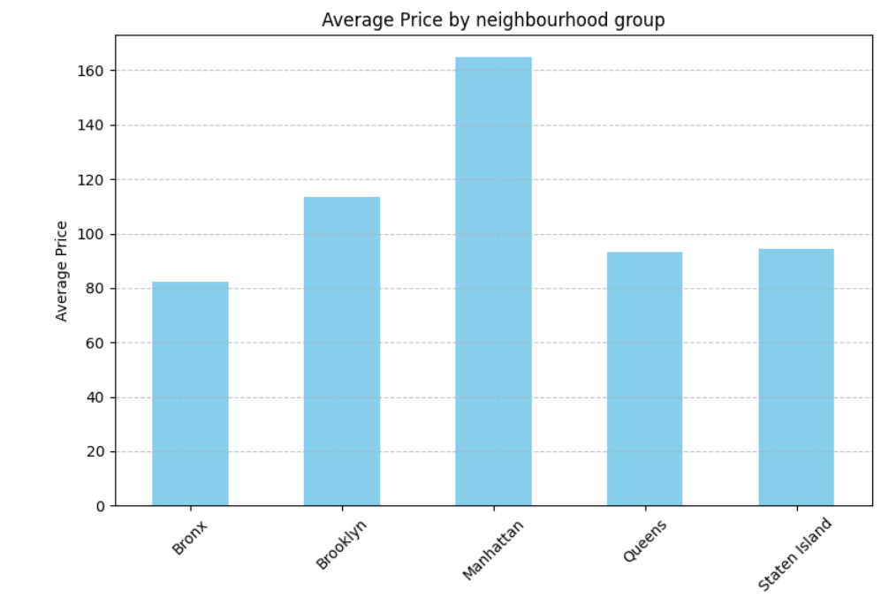
Methodology
From the above visual we can observe that most
guests are preferring entire apt/private rooms.
Manhattan is the most expensive city for rental prices
and Entire apt has its strong presence in this.

Slide 8
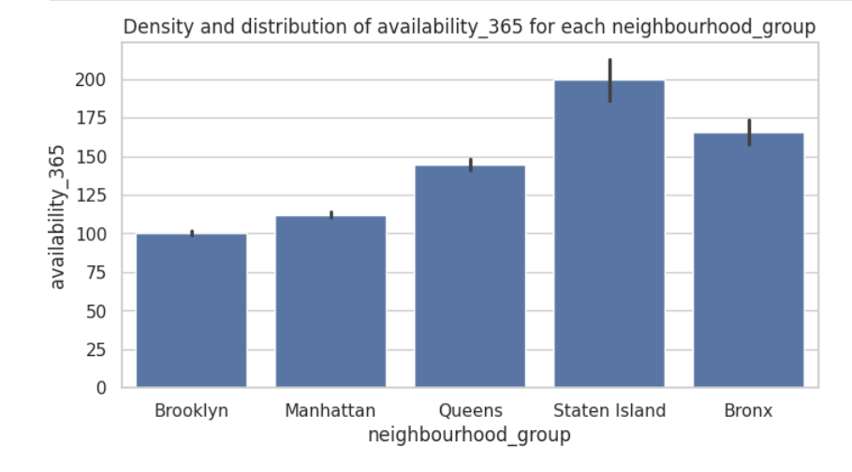
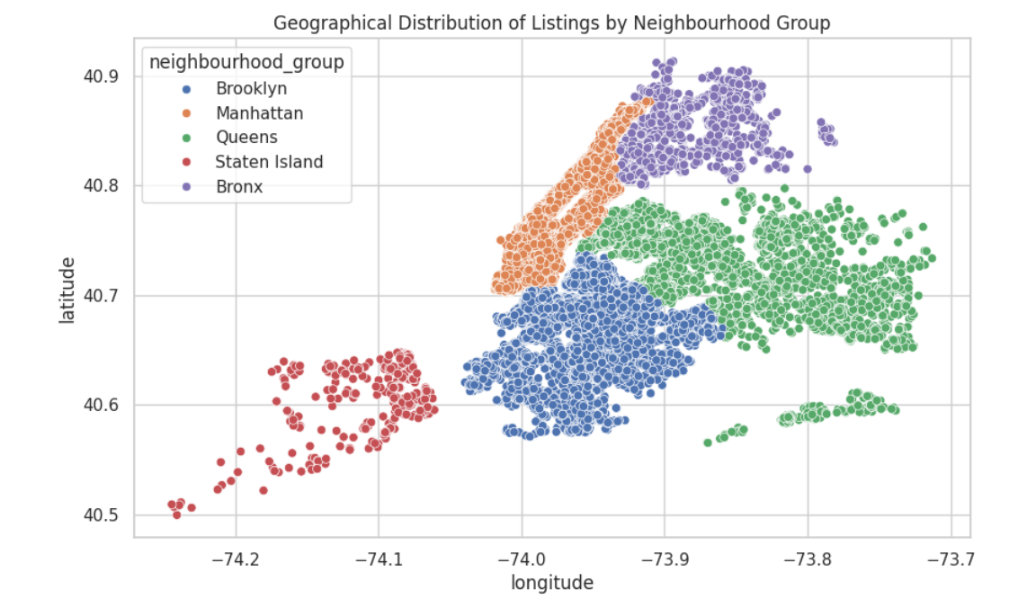
Density of availability of houses is comparatively
higher in Bronx,State Island, Queens.
which implies there is comparatively lower
demand in these locations.
Queens has larger area with lower
listings as compared to it depicting
lower market density.
Manhattan and Brooklyn has higher
number of listings but as per plot we
can see that a small area has higher
number of listings in both
Manhattan and Brooklyn which
indicates higher market density.

Slide 9
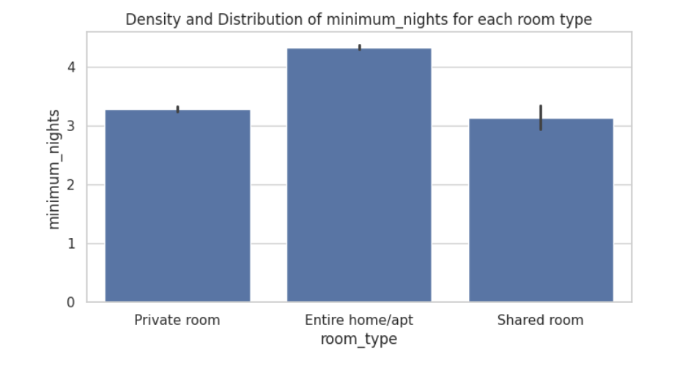
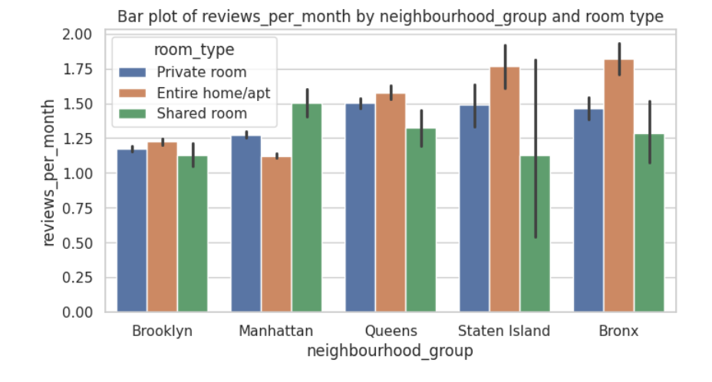
Most of the guests prefer to stay in
mostly in Entire home/apt.
Focus is much less in Shared room and
Private room.
In Manhattan private and shared
rooms needs some improvement
and in State Island and Bronx
private rooms/entire apt
needs improvement.

Slide 10
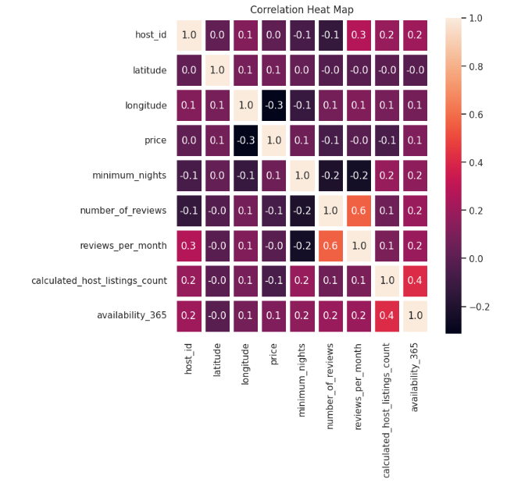
Number_of_reviews and reviews_per_month both
these columns are highly correlated indicating
Listings that receive a high number of reviews
overall are likely to maintain a relatively
consistent rate of reviews over time.
Here we observe that calculated_host_listings_count
and availability_365 have good positive coorelation
implying that hosts with a higher number of listings
tend to have their listings available for rent more often throughout the year.
Minimum_nights and review_per_month have negative relationship which may
indicate that geographies with higher review needs some improvements.

Slide 11
Execution
Factors which influence Rental Price and Occupany Rates:
Average price: Average price for manhattan is 160 and for brookly, queens and staten island is $100.
No of listings: No of listings are max for brooklyn and manhattan is approx. 20000
Review_per_month: No of reviews per month are 1.50 for staten island,bronx and queens and for brooklyn and manhattan it is 1.25.
Availability_365:State island has highest number of days available for booking i.e 200 and for queens and bronx it is 175 and for manhattan and brooklyn it is 100.
Strategy to implement in order to enhance the experience of both host and guest:
Focus on improving Additional services in region of Manhattan (for private room set) in order to retain and increase the customers.
More seats can be increase for shared room set.
In regions like Bronx, State Island and Queens we can see lower demands for rooms in general Therefore we can make effort to board-in more in-close localities of host for listings as there may be travelling issue. OR We can provide special cab facilities in these regions.

Slide 12
Shared room are in low demand in these areas so the listings can be divided in Larger and smaller listings. Larger listings -> Shared room facility.
Smaller listings -> Single room/private apt.
For private room/entire apt AIRBNB can introduce services like garden area, pool , more traditional approach which suits the location.
If the firm can successfully execute these plans and maintain outcomes , then they can look into going into more newer complex geographies.

Slide 13
Implications
Operational Implications:
Cab facilities -> Saves travelling cost of guests -> Increased pool of customers-> More revenue.
Shared room -> Divide into Larger and smaller Rooms -> Larger = Shared Room and Smaller = Private/Entire apt -> Enhanced User Experience.
Private room -> Additional facilities(traditional) -> Enhanced User Experience.
Long-term Implications:
Like TripAdvisor,Focusing on traditional roots of the geography help both hosts and guest and require less effort for the hosts.
Introducing cab-facility feature helps firm build wide network which add on to the uniqueness of it.
Implementing the plan for 6-month and if it turns out to be profitable then firm can look into entering into more challenging geographies.

