Slide 1
Customer segmentation case study
A consumer good company which specialize in wide spectrum of products has collected b2c demographic customer data of approx. 8000 customers related to their products and further this particular data is segmented into segments by data science team by using unsupervised clustering techniques (k-means). As a data analyst in product team your task is to:
i) Define key defining characteristic of each costumer segment to implement targeted marketing. ii) What are behavioral habits of each customer segment to understand their needs, preferences and motivations. iii) Define which segment is most profitable and valuable. iv) Recommend which product is most feasible for which segment according to the analysis done. v) Which is the largest pool of Segments?

Slide 2
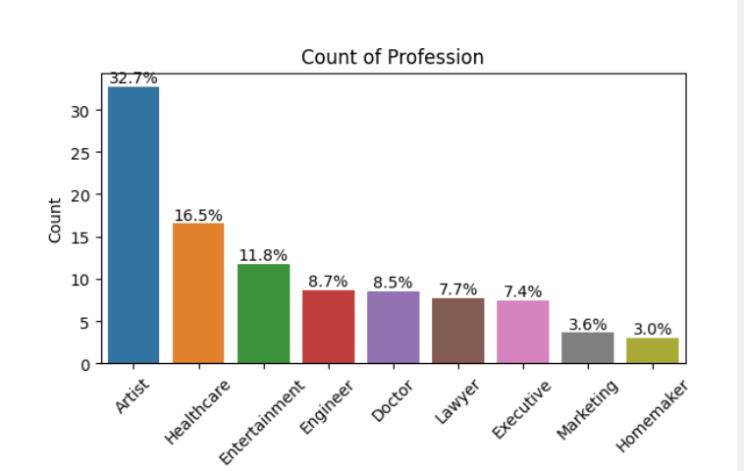
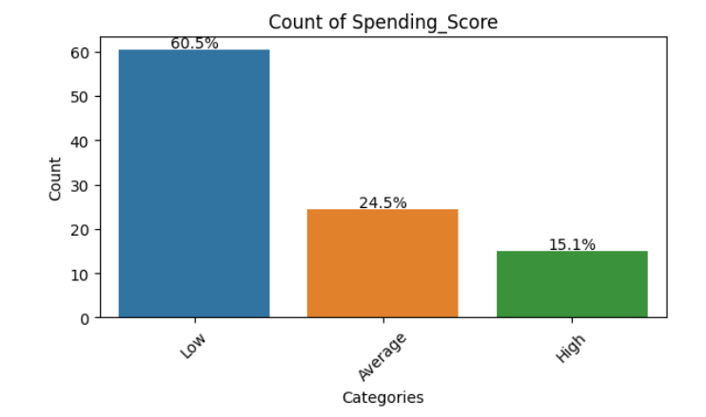
Univariate Analysis
Categorical columns:
Mostly the customers (60%) customers have Mostly artist(32.7%) are dominating the
Low spending score and (40%) customers have Purchases for goods and after that are
Average-high score. Healthcare professionals(17%).

Slide 3
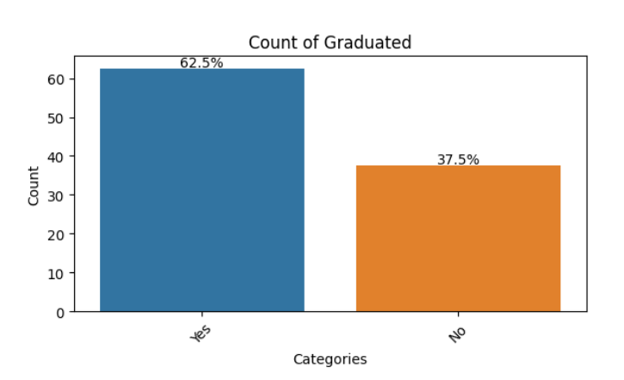
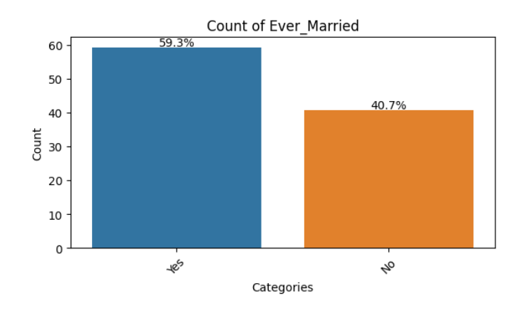
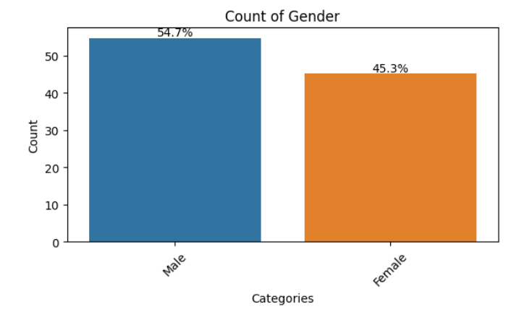
Mostly customer (60%) are graduated. Mostly customers (60%) are married.
We have approx. equal gender ratio.

Slide 4
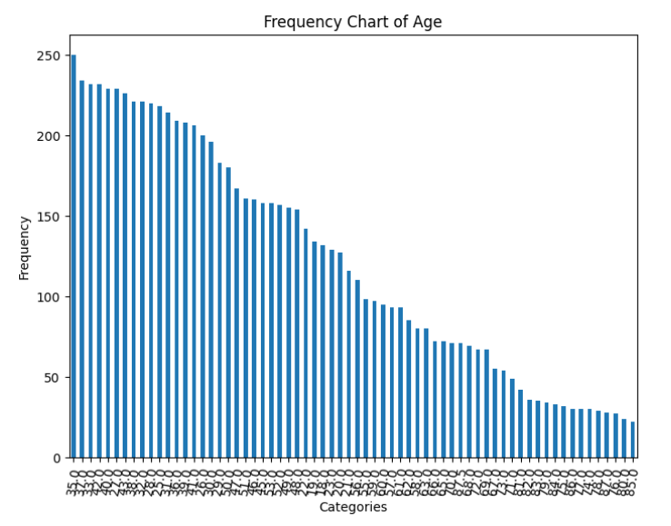
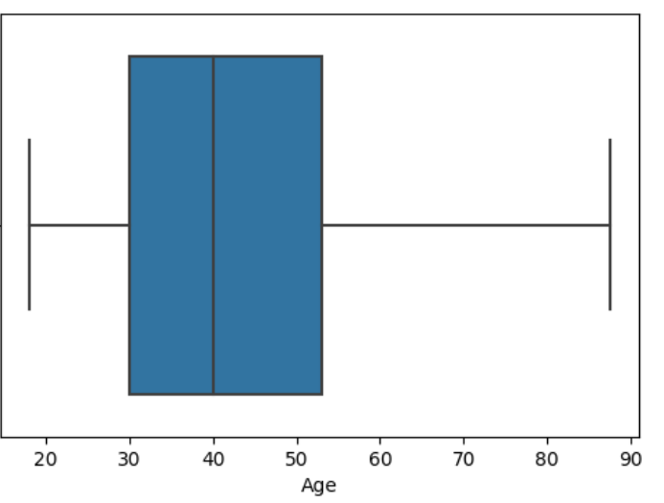
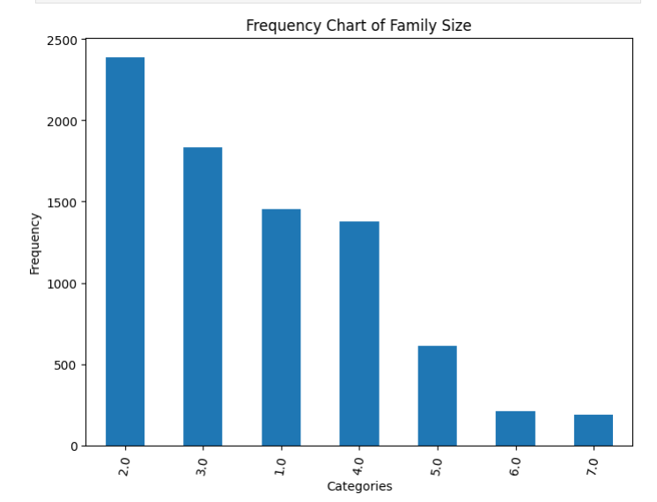
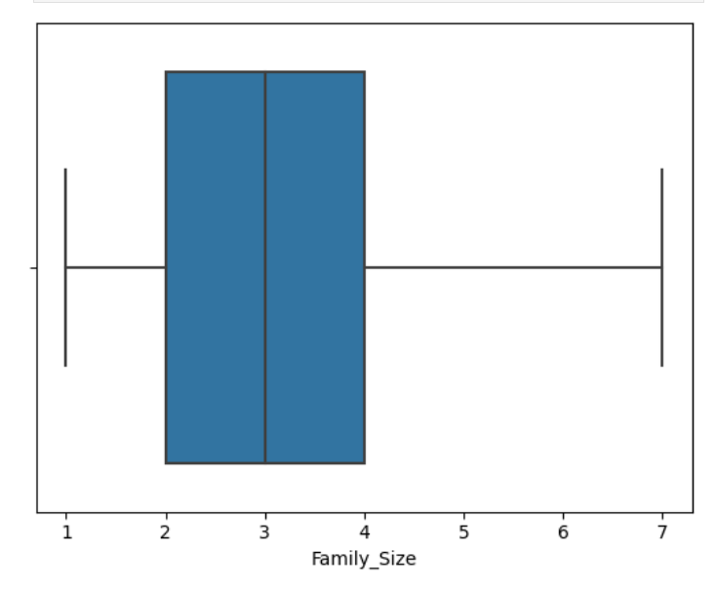
ii) Numerical variables:
Min age is 10 and max age is approx. 85 and we have max spectrum of the age group from
30-55.
Min family size if 1 and max family size is 7 and max spectrum of family size is from 2 to 5 as we can see from frequency graph as well.

Slide 5
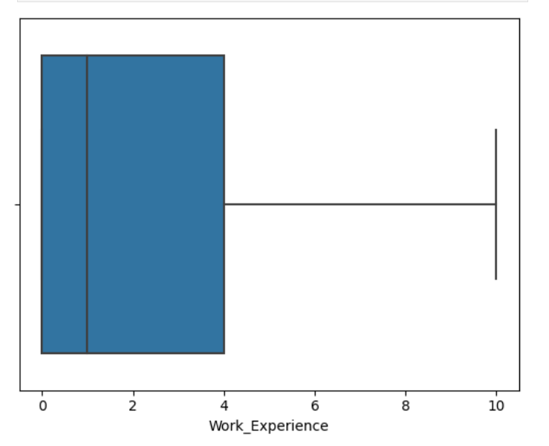
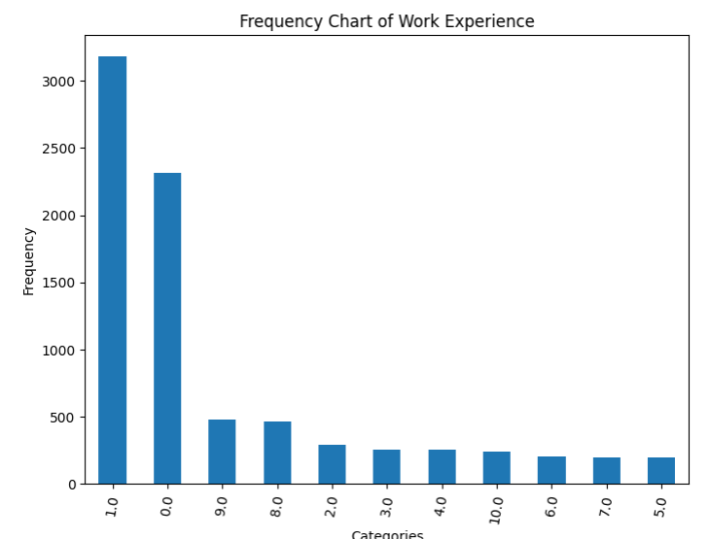
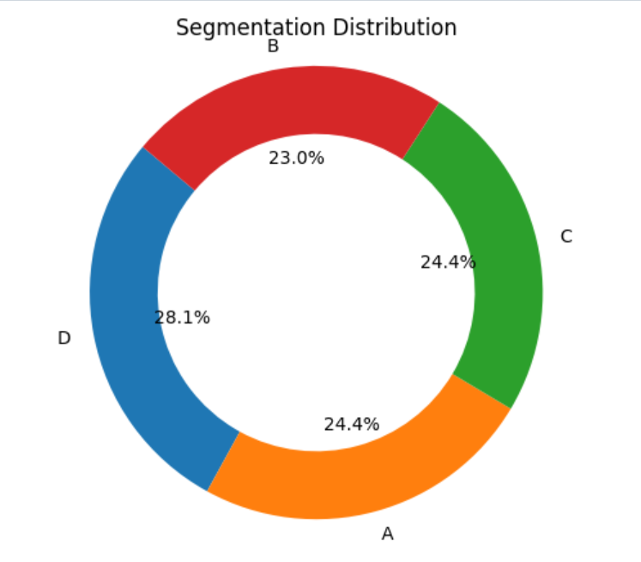
Mostly younger population is present in the cohort between the age group of 0-4 years of
Work Experience with that too 3000 customers are only a year experienced.
Which is largest pool of segments?

Slide 6
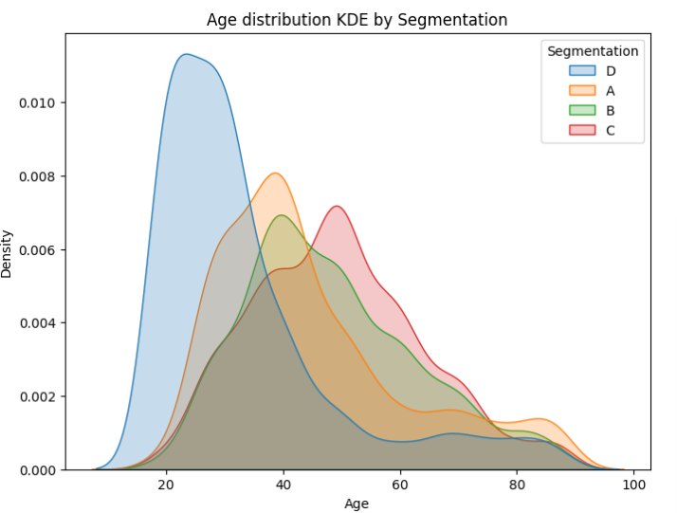
Bivariate Analysis
What is key defining characteristic of each customer segment to implement target marketing.
Analysis between age wrt to segments.
We can observe that for segment D most probable age bracket is of 20-40 years and rest for every segment there is age bracket of 40+ .Therefore age is the defining characteristic for the segment D.

Slide 7
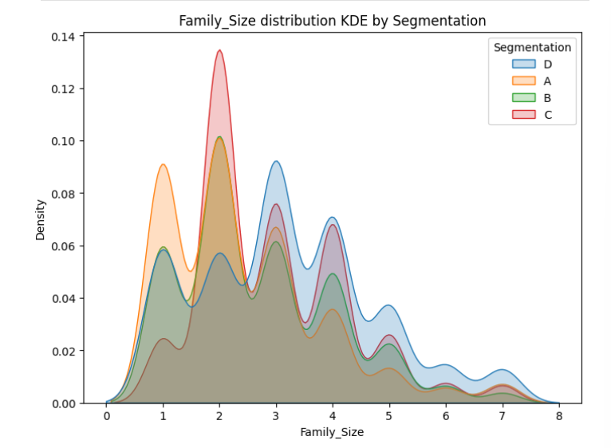
Analysis of Family size wrt to the segments.
We can see the family size of most of segments is widely spread but for the segment C we can clearly see that most of the customers are of the age bracket of
2 or more . Therefore we can conclude that family size is the defining characteristic for the segment C .

Slide 8
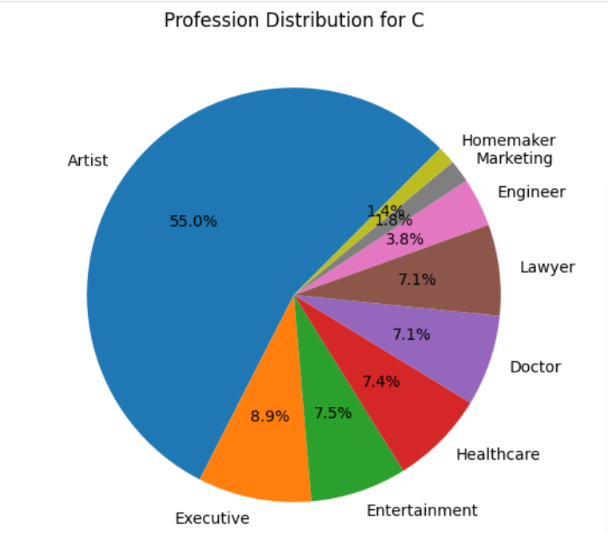
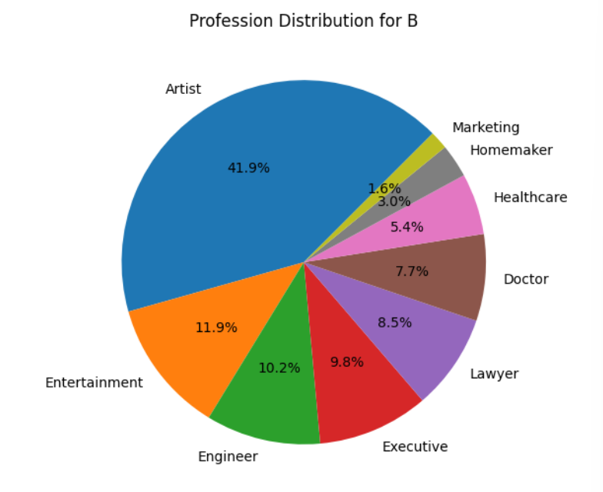
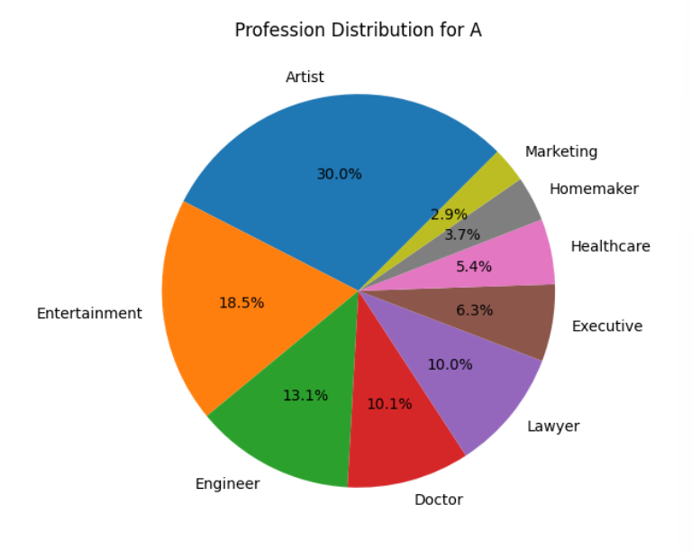
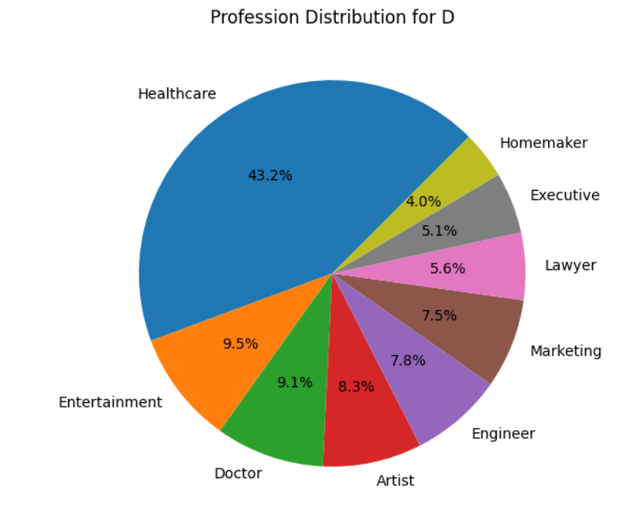
Analysis of Profession wrt segments
Segment D has highest number healthcare , doctors
homemakers and marketing professionals.
Segment C has highest number of artists.
Segment B has highest number of executive professionals.
Segment A has highest number of entertainment ,engineers
and Lawyers as the professionals.

Slide 9
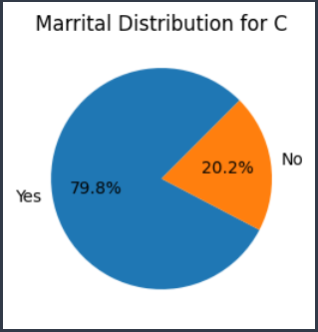
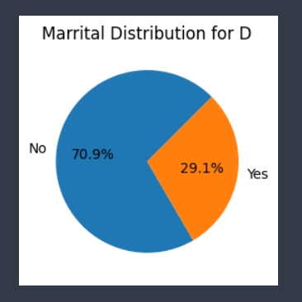
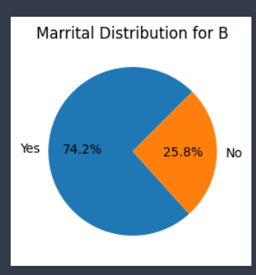
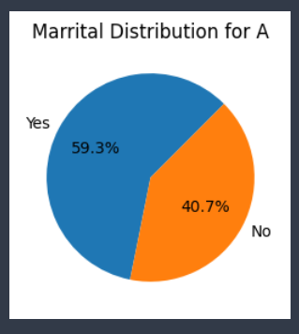
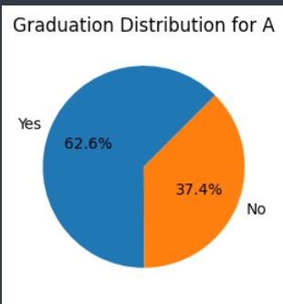
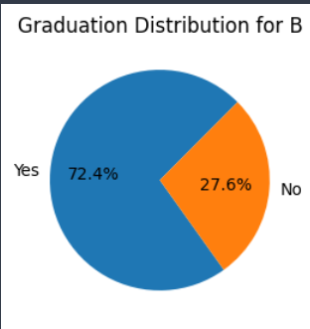
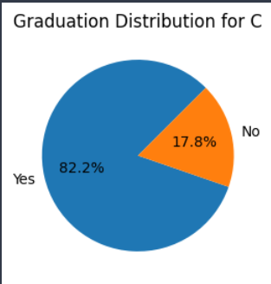
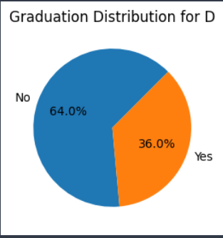
Analysis of Marital Status wrt to segments:
Segment C has highest number of married people.
Segment D has highest number of unmarried people.
Analysis of Graduation wrt to segments:

Slide 10
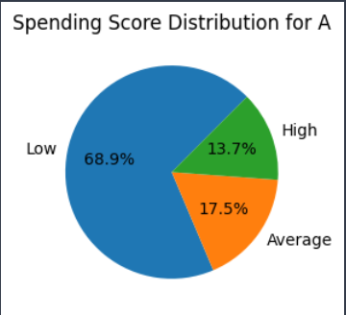
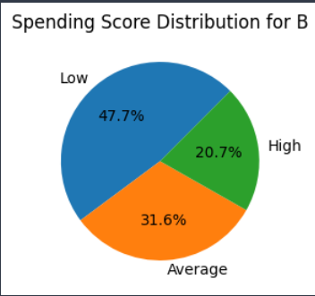
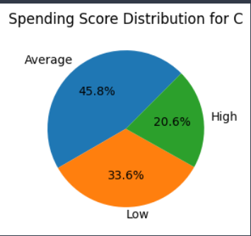
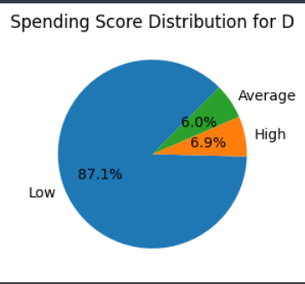
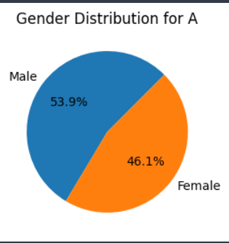
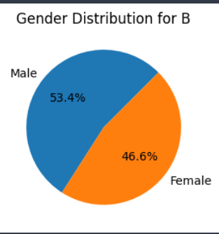
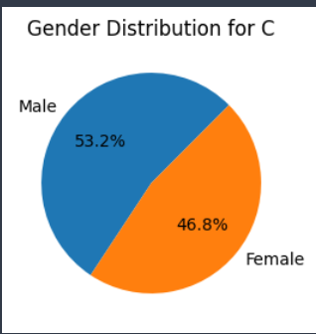
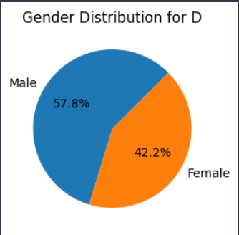
Segment C has highest number of graduated professionals. Segment A has highest number of ungraduated professionals.
Analysis of Spending Score wrt to segments:
Segment B has highest number of people having spending score from average – high.
Segment D has highest number of people having low spending score.
Analysis of Gender wrt to segments:

Slide 11
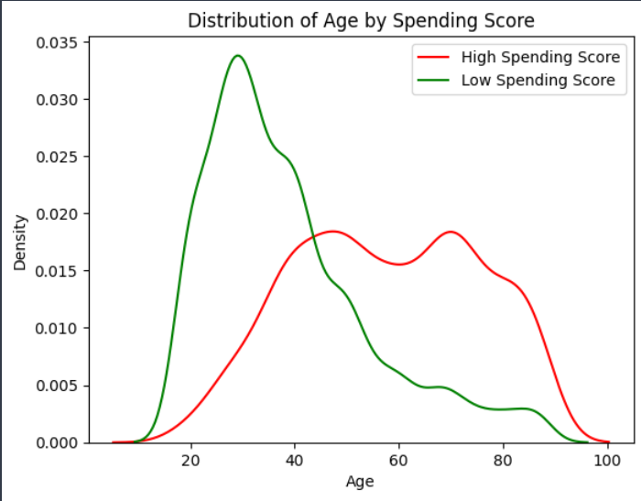
Segment D has highest number of male population. Segment C has highest number of female population.
Behavioural analysis:
Analysis of customers wrt to their behaviours like spending score ,age , Age.
What we can observe that with increasing age the
Tendency to spend more has increased and with much
younger age the people are less likely to spend more.
Segment A has mostly people from age group from 30-
50 . Therefore they tend to spend decently.
Segment B has mostly people from age group from 40-
60.Therefore they tend to spend more than Segment A.
Segment C has mostly people from age group from 45-
60. Therefore they tend to spend more than Segment B.
Segment D has youngest population tending to least
spending score.

Slide 12
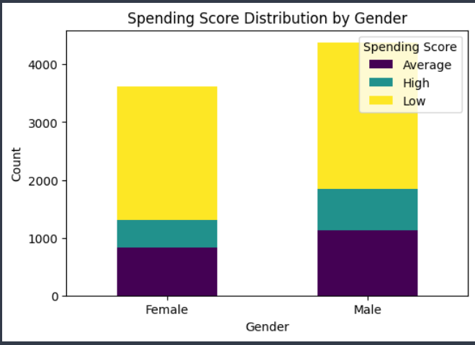
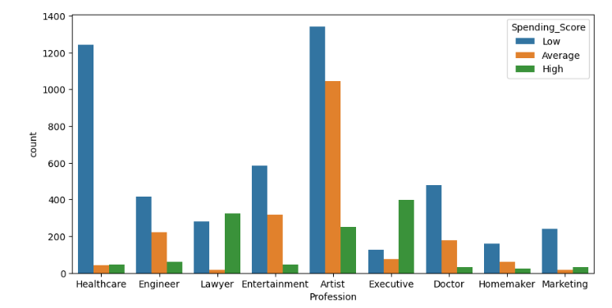
Analysis of spending score with gender:
Spending score of both male and female
equal as population of male is slightly more than
female. Both tend to spend equally.
Spending score is high for Executives ,Lawyers ,
and somewhat artist professionals.
Spending score is low for Healthcare ,Doctors
Homemaker ,Marketing ,Engineers and Artists.

Slide 13
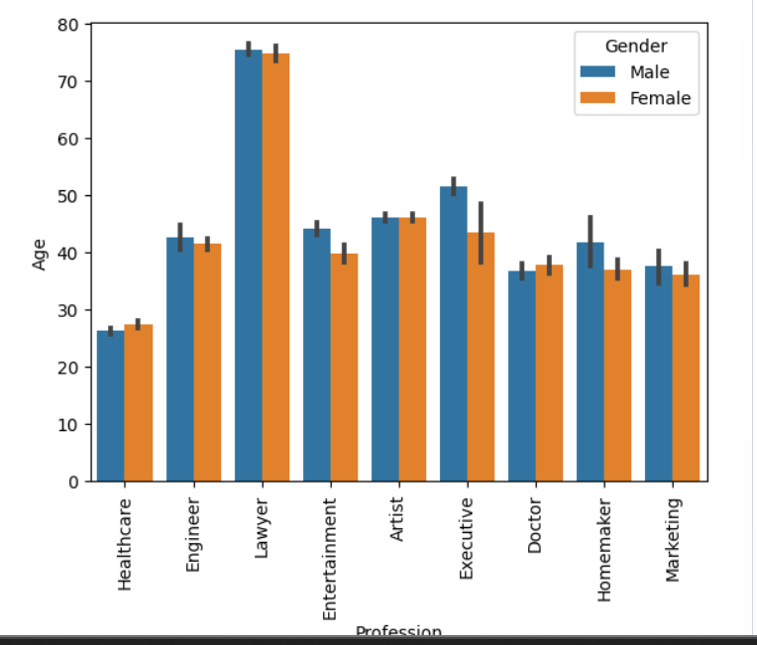
Analysis of Profession with Age and gender:
We can observe that gender ration is
maintained across professions and
youngest slot is of Healthcare
Professionals and experienced slot is of
Lawyers rest all lie on similar bracket.

Slide 14
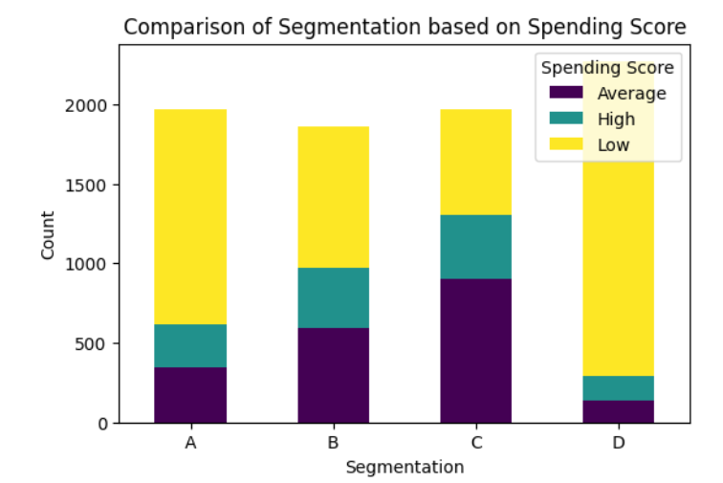
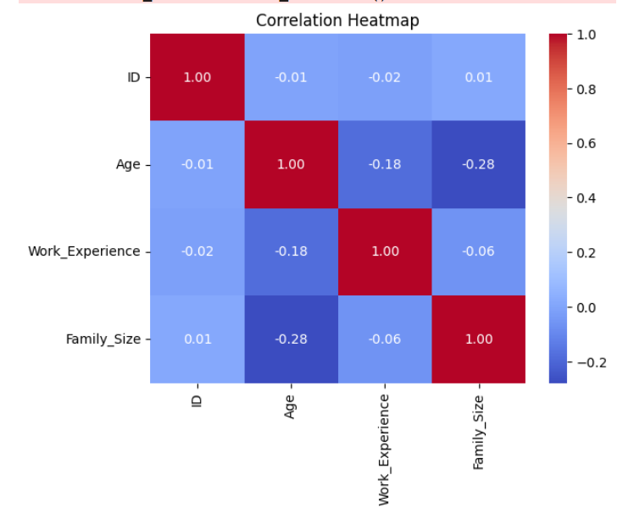
Which segment is most profitable and valuable
,knk.n.nj.bj,.bjb. Segment C has highest number of
people spending in bracket of
average-high.
Multivariate analysis:
We can see that there is negative relationship with
Every other term present in this table.
There is presence of weak relationship amongst them.

Slide 15
which product is most feasible for which segment
Segment A: Include engineers ,lawyer and entertainment professionals. Has highest number of ungraduate and 30-50 year folks and having people with decent spending capability.
Product category to be provided are as follows:
Feminine care and beauty products for females.
Grooming products for men.
Hair and skin care products .
Segment B: Include people above 40 years of age with family size of 2 and highest number of experienced executive professionals with mostly average –high spendings .
Product category to be provided are as follows:
Family care products

Slide 16
Feminine care and beauty products as there are good % of females.
Hair care products as mostly are mid-aged groups.
Home care and medicines products must be provided.
Personal Health Care products.
Segment C: Include people above of 50 and mostly old people. It has family size of approx. 2. Has highest number of Artists and highest number of married people and highest number of graduated people having average-high spenders.
Product category to be provided are as follows:
Personal Health care products.
Home care and medicines product must be provided.
Family care products as mostly there are highest number of married people present there.

Slide 17
Segment D: Include people with age 20-40 age. It includes healthcare, doctors ,homemakers and marketing professionals. Has highest number of unmarried people. Has highest number of people having low spending score. Has one of the youngest population.
Product category to be provided are as follows:
Skin and Personal Care products.
Hair care products.

