Slide 1
RV UNIVERSITY | CS3301 FULL STACK DEVELOPMENT
DevCollab
Modern Developer Teaming & Open-Source Task Marketplace
Project Phase-1 Component-2 (CIE-1 Submission)
Team Members: [Student Name 1 | USN 1] • [Student Name 2 | USN 2] • [Student Name 3 | USN 3]
Semester: 5th Semester B.Sc. (Computer Science) | Faculty: RVU School of Computer Science

Slide 2
CS3301 FULL STACK DEVELOPMENT
1. Title and Problem Definition
⚠️ THE CORE PROBLEMS IDENTIFIED
• Difficulty in Finding Project Teammates: Solo builders with strong backend skills often lack frontend/UI developers (and vice versa) for hackathons and semester capstones.
• Unstructured Task Coordination: Casual messaging groups (WhatsApp/Discord) lead to abandoned projects due to lack of defined roles, milestones, and status tracking.
• Unverified Contribution History: Recruiters and mentors cannot verify who actually built what without a transparent project contribution audit trail.
💡 THE DEVCOLLAB SOLUTION
✔ Role-Specific Project Postings: Project owners post ideas with explicit vacant positions (e.g., 'Looking for 1 React Frontend Lead & 1 MongoDB Architect').
✔ Streamlined Application & Review Workflow: Developers pitch with their verified tech badges; owners accept or reject with one click via REST API.
✔ Integrated Milestone & Task Kanban: Real-time task board (Todo / In-Progress / Done) synchronizing team efforts across the software lifecycle.
✔ Full-Stack MERN Architecture: Built strictly using React (Vite), Express.js, MongoDB Atlas, and JWT authentication.

Slide 3
CS3301 FULL STACK DEVELOPMENT
2. Introduction & Platform Vision
🌐 Full-Stack Web SPA
Built as a high-performance Single Page Application (SPA) using React 18 & Vite, ensuring instantaneous page transitions without full-page browser reloads.
🛡️ Secure REST Backend
Engineered with Node.js and Express.js, protected with Helmet, CORS, Morgan logging, and stateless JSON Web Token (JWT) authorization.
📦 Scalable Document DB
Powered by MongoDB Atlas and Mongoose ODM, utilizing normalized referencing and embedded subdocuments for high-speed query execution.
🎯 TARGET AUDIENCE & REAL-WORLD RELEVANCE
• University students forming teams for final year capstone projects and hackathons.
• Open-source creators recruiting contributors with specific JavaScript / Python skill sets.
• Developers seeking hands-on team building experience before entering the tech industry.

Slide 4
CS3301 FULL STACK DEVELOPMENT
3. Project Objectives
1. Dynamic Frontend Engineering
Develop a component-based UI in React 18 with Vite scaffolding, featuring client-side routing (React Router v6), dynamic URL params (/projects/:id), and responsive layouts with CSS Grid/Flexbox.
2. Robust RESTful API Design
Build modular Express.js routes handling complete CRUD workflows (Create project, Read listings, Update status, Delete post) adhering strictly to standard HTTP status codes (200, 201, 400, 401, 403, 404, 500).
3. End-to-End Security & RBAC
Implement salted password hashing using Bcrypt.js (10 rounds) and secure stateless JWT authentication, ensuring only Project Owners can modify posts or approve applicant requests.
4. Optimized Database Architecture
Design Mongoose schemas with data validation rules, compound indexing for fast search by tech stack, and relational population between Users, Projects, and Applications.
5. Automated Testing & Cloud CI/CD
Integrate Supertest and Jest for API unit tests, Cypress for user flows, and deploy live on Vercel (Frontend SPA) and Render (Express Web API) with MongoDB Atlas.

Slide 5
CS3301 FULL STACK DEVELOPMENT
4. Requirement Analysis
📋 FUNCTIONAL REQUIREMENTS (FR)
FR1. User Authentication: Registration, login, profile editing with bio, skill tags, and GitHub URL.
FR2. Project Discovery: Search and multi-filter projects by skills (e.g. React, Node, MongoDB), status (Open/Active), and role openings.
FR3. Project Posting (CRUD): Create new listings with role requirements, edit details, and close completed projects.
FR4. Application System: Developers submit applications with pitch messages; project creators approve/reject.
FR5. Collaborative Task Board: Accepted team members manage sprint tasks across Todo, In-Progress, and Done columns.
⚡ NON-FUNCTIONAL REQUIREMENTS (NFR)
NFR1. Security: Salted password hashing (Bcrypt 10 rounds), signed JWT tokens, CORS protection, Helmet HTTP headers, and .env secrets isolation.
NFR2. Performance & Speed: Sub-second API response times (<300ms) achieved through indexed MongoDB queries and Express gzip compression.
NFR3. Responsive UI: Mobile-first styling adapting seamlessly across smartphone (360px), tablet (768px), and desktop (1200px+) viewports.
NFR4. Scalability: Stateless server design allowing independent horizontal scaling of Express backend on Render.
NFR5. Code Maintainability: Clean MVC layering (Models, Views/React, Controllers) with ESLint adherence.

Slide 6
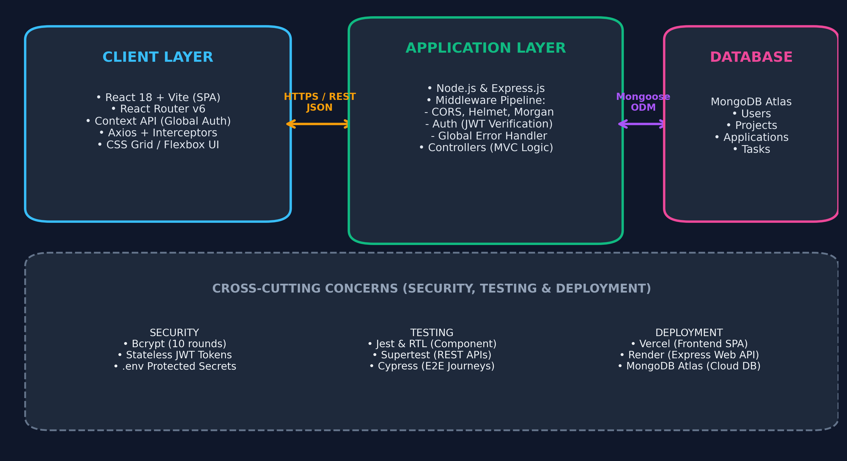
CS3301 FULL STACK DEVELOPMENT
5. System Architecture Diagram

Slide 7
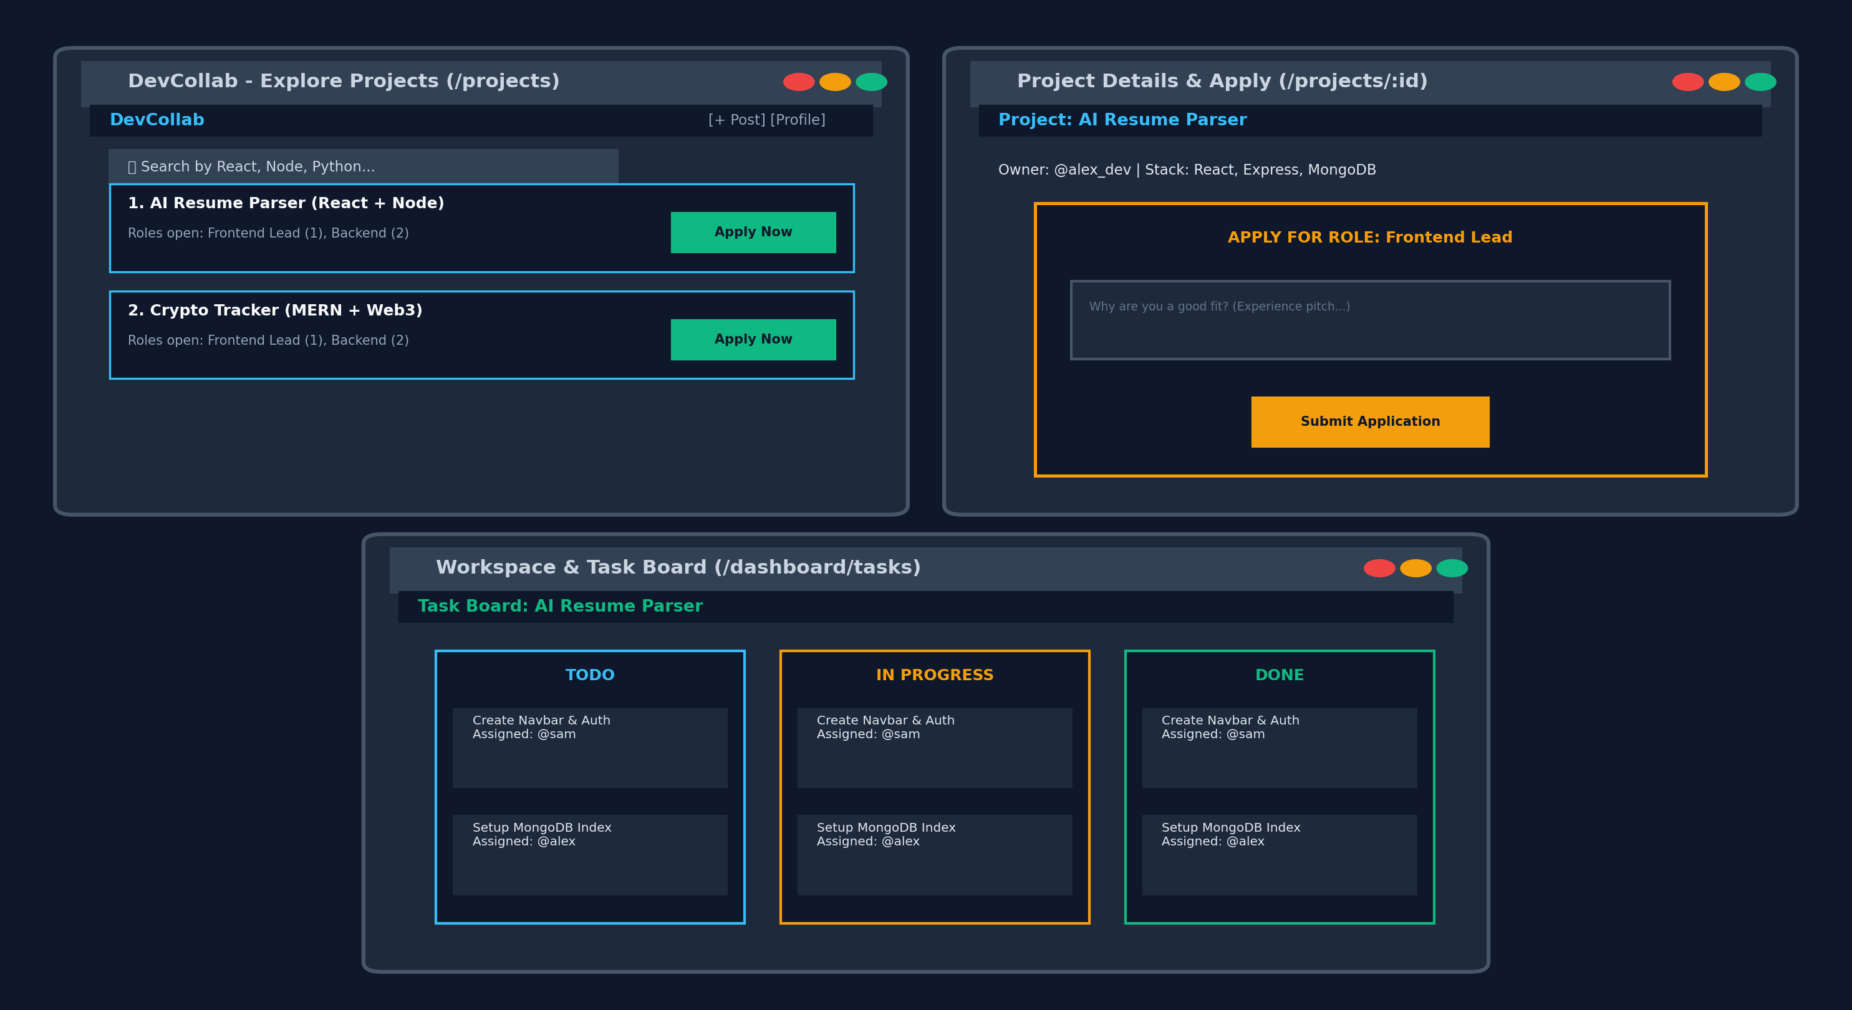
CS3301 FULL STACK DEVELOPMENT
6. UI Wireframes & Layout Planning

Slide 8
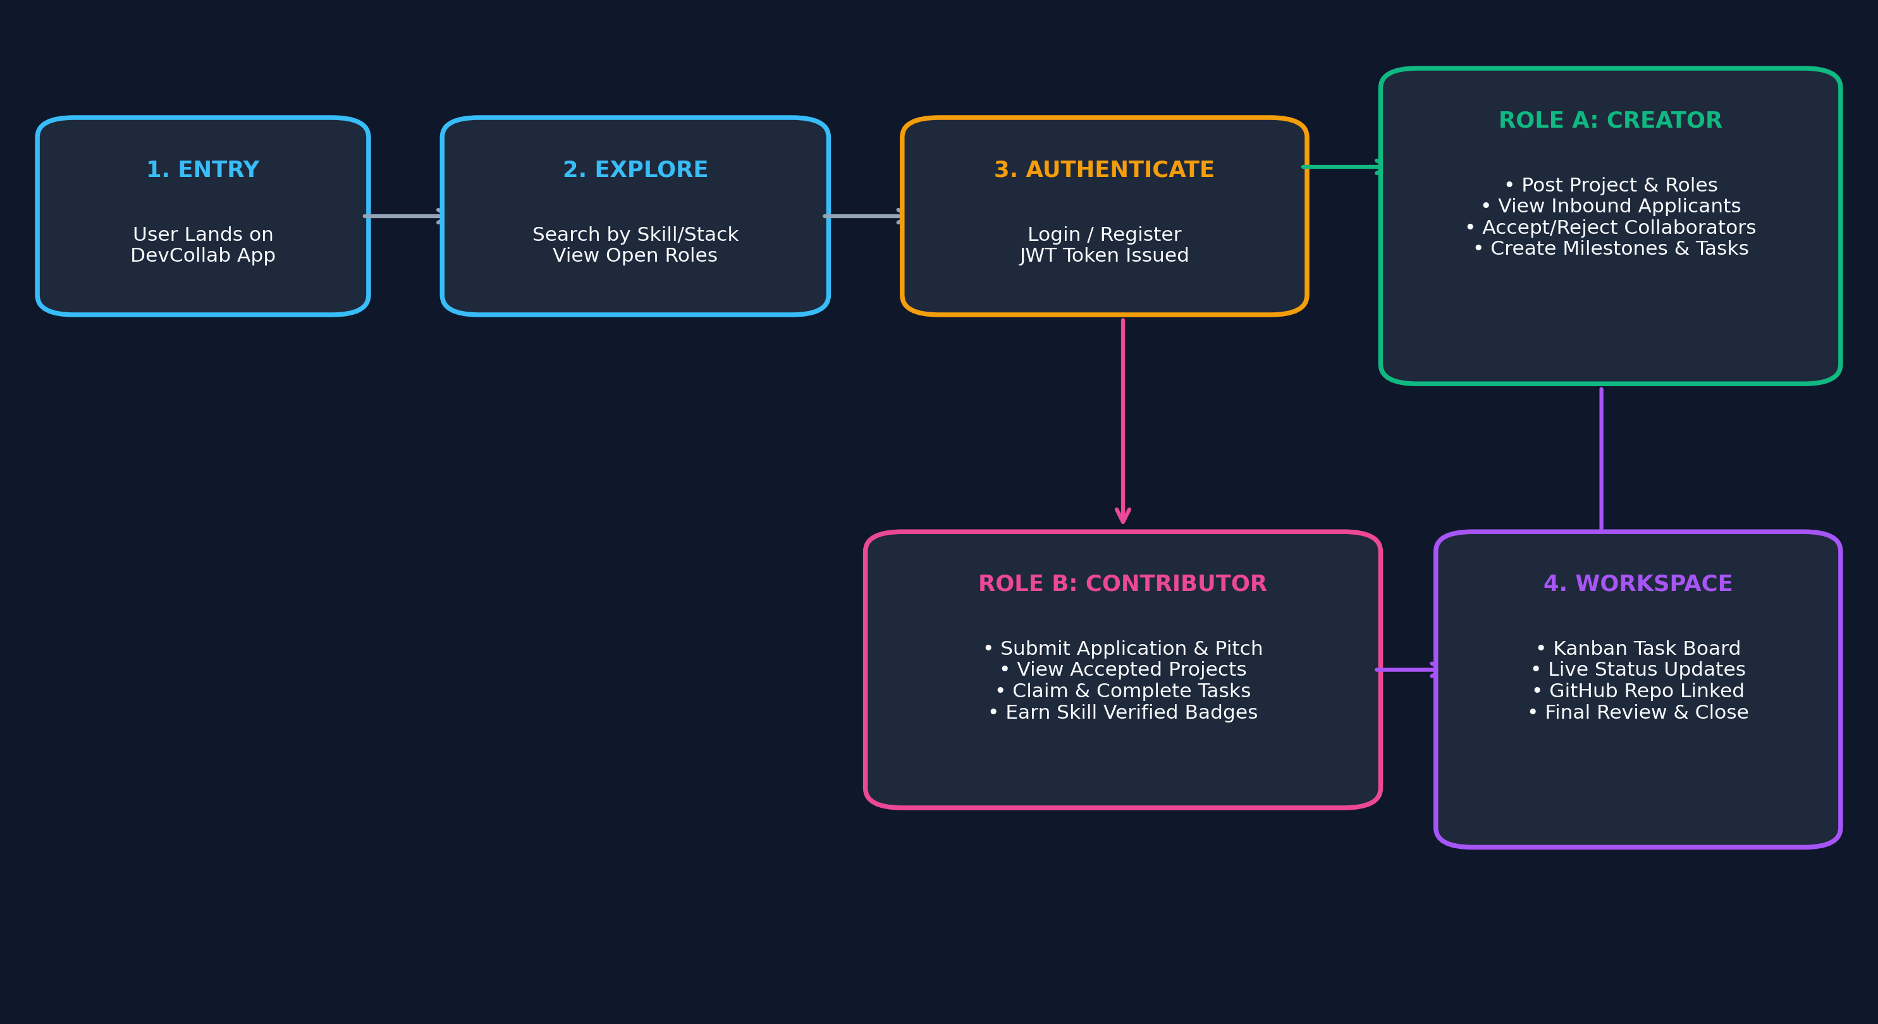
CS3301 FULL STACK DEVELOPMENT
7. User Navigation Flow & Decision Logic

Slide 9
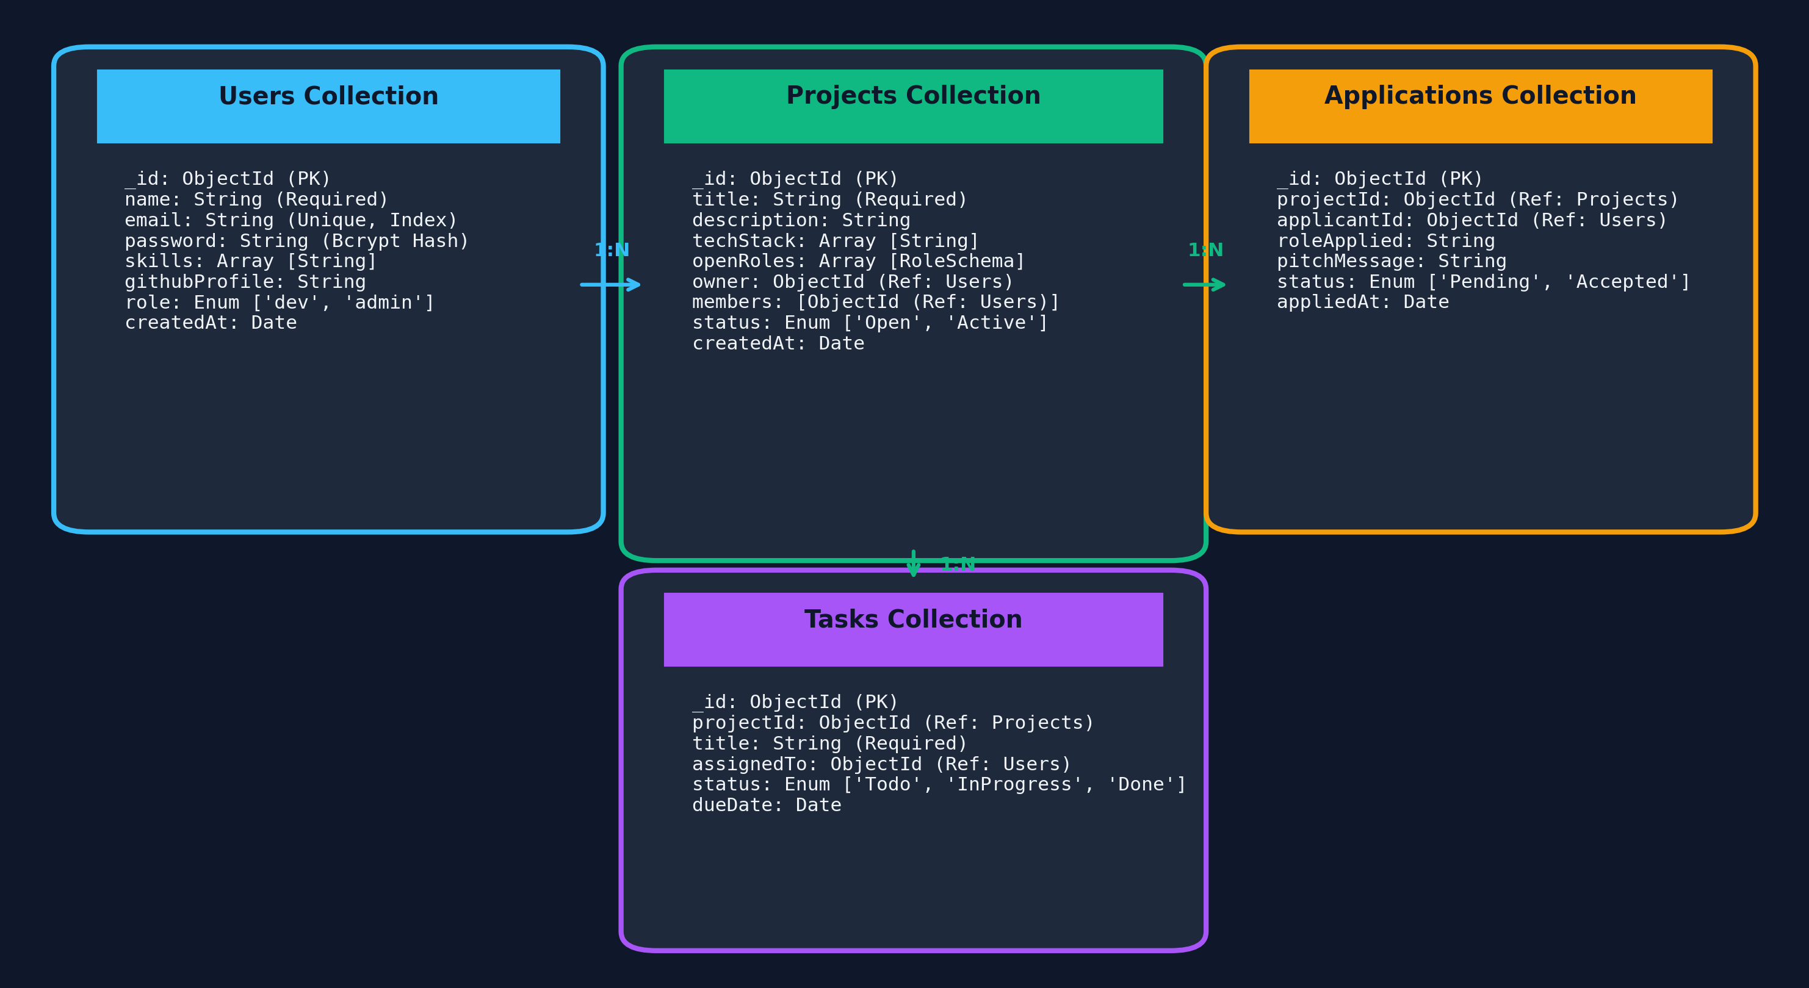
CS3301 FULL STACK DEVELOPMENT
8. Database Schema & Mongoose Models

Slide 10
CS3301 FULL STACK DEVELOPMENT
9. Technology Stack (Curriculum Modules 1 to 5)
Layer | Technology Used | Course Module | Role in DevCollab Application
Frontend Client | React.js 18 + Vite Scaffolding | Module 2 | Single Page App (SPA), dynamic component rendering, Virtual DOM.
Routing & State | React Router v6 + Context API | Module 2 & 5 | Dynamic route parameters (/projects/:id), protected routes & global auth.
Backend Web Server | Node.js & Express.js Framework | Module 3 | RESTful API pipeline, routing, custom middleware & centralized error handling.
Database & ODM | MongoDB Atlas + Mongoose ODM | Module 4 | NoSQL document storage, schema validation, indexing, and populate relations.
Security & Auth | Bcrypt.js + JSON Web Tokens (JWT) | Module 4 | Salted password hashing and stateless authorization for protected endpoints.
Testing & Cloud Deploy | Jest, Supertest, Vercel & Render | Module 5 | Automated endpoint tests, SPA hosting (Vercel), API service hosting (Render).

Slide 11
CS3301 FULL STACK DEVELOPMENT
10. Implementation Plan & Phased Milestones
Phase I (CIE-1 Current Deliverable)
Ideation, problem statement definition, system architecture diagram, user flow, Mongoose schema modeling, UI wireframes, and GitHub repository setup with milestone tracking.
Phase II (Frontend Development - Module 2)
Scaffold React app with Vite, build reusable atomic UI components (Navbar, ProjectCard, Modal), configure React Router, and implement state-managed forms.
Phase III (Backend REST APIs - Module 3)
Initialize Express server with CORS/Helmet middleware, establish MVC controllers, implement 5+ CRUD endpoints for projects/applications, and verify via Postman.
Phase IV (Database & Auth - Module 4)
Connect Express backend to MongoDB Atlas, enforce Mongoose validations, implement Bcrypt password hashing, JWT creation, and protected route middleware.
Phase V (Integration, Testing & Deployment - Module 5)
Axios frontend-backend handshake, automated unit testing with Supertest and Jest, Cypress E2E user flow tests, and live production deployment on Vercel & Render.

