Slide 1

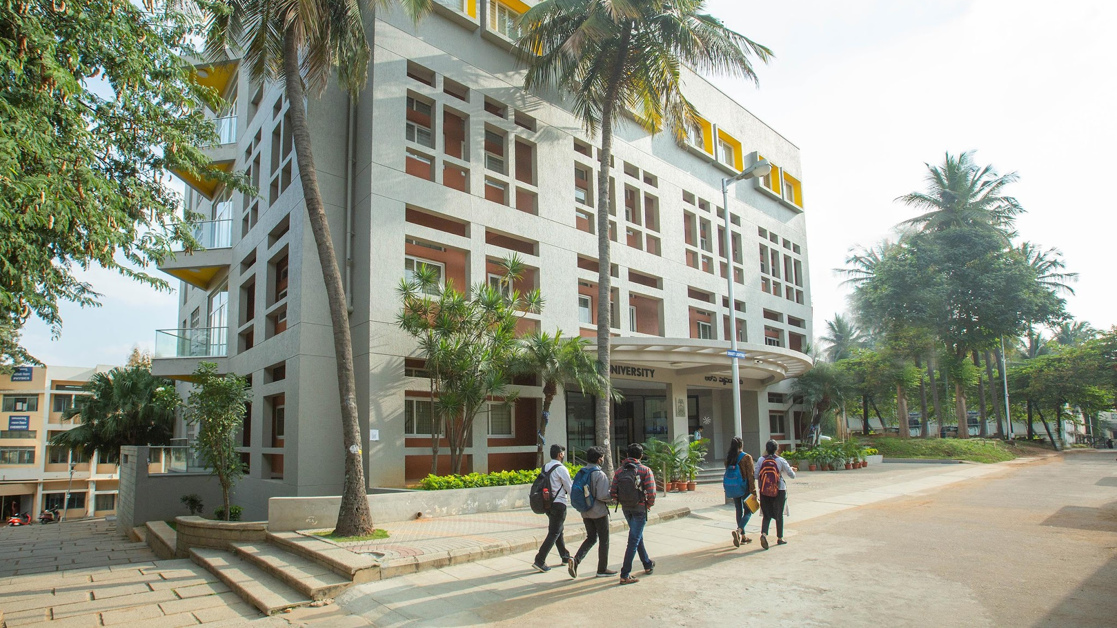
CS3301 FULL STACK DEVELOPMENT
DevCollab: Modern Developer Teaming & Open-Source Marketplace
Project Phase-2 / Final Course Deliverable | MERN Stack Architecture
Team Members & USN:
• Abhimanyu Kotari (1RUA24SCS0002) • Dhanush V (1RUA24SCS0031) • Aniketh (1RUA24SCS0008)
Semester: 5th Semester B.Tech (CSE) | School of Computer Science & Engineering, RV University
GitHub Repository: https://github.com/abhimanyu-kotari/-DevCollab-Modern-Developer-Teaming-Open-Source-Task-Marketplace
Live Deployment: https://dev-collab-modern-developer-teaming-one.vercel.app/

Slide 2
1. Title and problem definition
PROJECT: DevCollab | STACK: MERN (React 18 + Vite, Node.js, Express.js, MongoDB Atlas)
CORE PROBLEMS IDENTIFIED IN DEVELOPER COLLABORATION:
• Teaming Friction & Skill Mismatches: Student developers and solo builders often have backend strength but lack frontend/UI designers (and vice versa) for hackathons and capstone projects.
• Unstructured Coordination: Collaborating across unorganized messaging channels (WhatsApp/Discord) causes ambiguous task distribution, missed deadlines, and abandoned code repositories.
• Lack of Transparent Proof: Mentors, recruiters, and evaluators cannot verify who actually built what without an authenticated role-based contribution trail.
THE DEVCOLLAB FULL-STACK SOLUTION:
• Role-Specific Vacancy Postings: Owners publish projects with explicit vacant positions (e.g., '1 React Lead & 1 MongoDB Architect') and required tech skills.
• Streamlined Application & Pitch Pipeline: Developers submit customized pitch messages; project creators review applicant credentials and accept/reject with one click via REST API.
• Real-Time Cloud Synchronization: Dynamic marketplace with multi-category filtering, live status updates, and direct GitHub repository linkage.

Slide 3
Introduction
• Platform Vision & Purpose: DevCollab is an open-source task marketplace and teaming ecosystem that connects developer talent, streamlines project recruitment, and accelerates collaborative software delivery across student and open-source communities.
• Reactive Frontend Standard (React 18 + Vite SPA): Engineered as a high-performance Single Page Application (SPA) leveraging React 18 virtual DOM reconciliation, Vite hot module reloading, client-side routing, and responsive Flexbox/Grid layouts without page refreshes.
• Stateless & Secure REST Backend (Node.js & Express.js): Modular server architecture incorporating the Controller-Service pattern, Helmet HTTP security headers, CORS origin protection, Morgan logging, and stateless JWT token authorization.
• Cloud-Native Persistence (MongoDB Atlas + Mongoose ODM): Multi-tenant cloud NoSQL cluster utilizing Mongoose ODM for strict schema validation rules, compound text indexing for fast keyword searches, and normalized relational population between Users, Projects, and Applications.
• Target Audience & Real-World Relevance: University engineering students assembling multidisciplinary teams for capstone projects and hackathons, open-source maintainers recruiting specialized contributors, and builders seeking hands-on teaming experience.

Slide 4
Objectives
1. Dynamic Frontend Engineering (Module 2): Develop a component-driven React 18 UI using Vite scaffolding, react-router-dom v6 for client routing, full-bleed hero banner layout, and mobile-first CSS Flexbox/Grid adapting to all viewport sizes.
2. Robust RESTful API Pipeline (Module 3): Build modular Express.js routes handling complete CRUD workflows across Auth, Projects, and Applications adhering strictly to standard HTTP status codes (200, 201, 400, 401, 404, 500).
3. End-to-End Security & RBAC (Module 4): Implement salted password hashing using Bcrypt.js (10 rounds) and stateless JWT authentication, ensuring only project owners can approve/reject applicant pitches.
4. Optimized Cloud Database Architecture (Module 4): Design normalized Mongoose schemas with validation rules, compound text indexing for fast keyword search, and relational population between Users, Projects, and Applications.
5. Cloud Production Deployment & Live Verification (Module 5): Automate build pipelines with Vite, deploy live on Vercel Global Edge Network, link with MongoDB Atlas cloud database, and publish to GitHub.

Slide 5
REQUIREMENT ANALYSIS
FUNCTIONAL REQUIREMENTS (FR):
• FR1: User Authentication & Profiles: Registration, login, salted Bcrypt hashing, JWT issuance, and developer profiles with skill tags.
• FR2: Project Discovery & Filtering: Instant text search and multi-category filters (All Projects, Full Stack, Web Dev, MERN, AI/ML).
• FR3: Project Publishing & Role CRUD: Post project listings with explicit open roles, required skill sets, and cover photo selection.
• FR4: Application & Pitch Workflow: In-app pitch message submission, duplicate application prevention, and applicant status tracking.
• FR5: Inquiries & Team Management: Project owner dashboard to review candidate pitches with one-click Accept/Reject state machine.
NON-FUNCTIONAL REQUIREMENTS (NFR):
• NFR1: Security: Bcrypt.js password hashing (10 salt rounds), signed JWT tokens in Authorization headers, CORS restrictions, Helmet HTTP headers, and .env secrecy.
• NFR2: Performance & Latency: Sub-250ms API response latency achieved through MongoDB compound text indexing and optimized Vite asset compression.
• NFR3: Responsiveness: Mobile-first responsive UI adapting seamlessly across smartphone (360px), tablet (768px), and laptop/desktop (1200px+) viewports.
• NFR4: Scalability & Modularity: Stateless REST server design allowing independent horizontal scaling on cloud infrastructure.

Slide 6
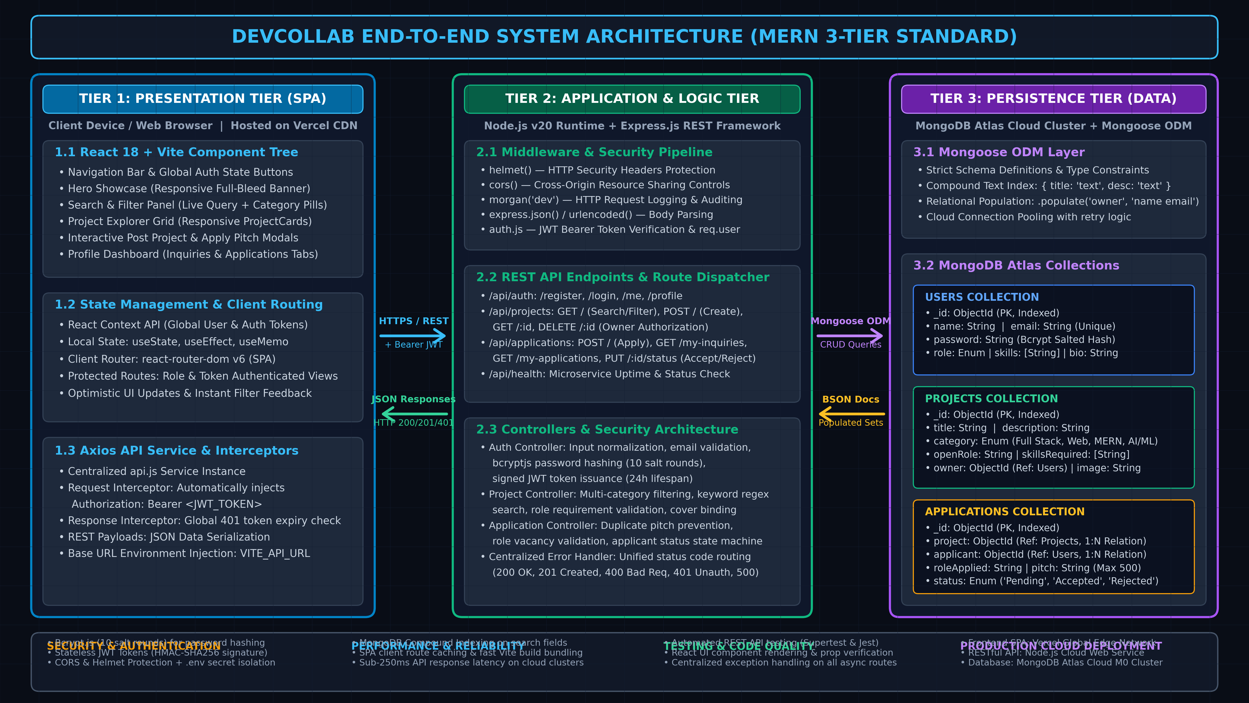
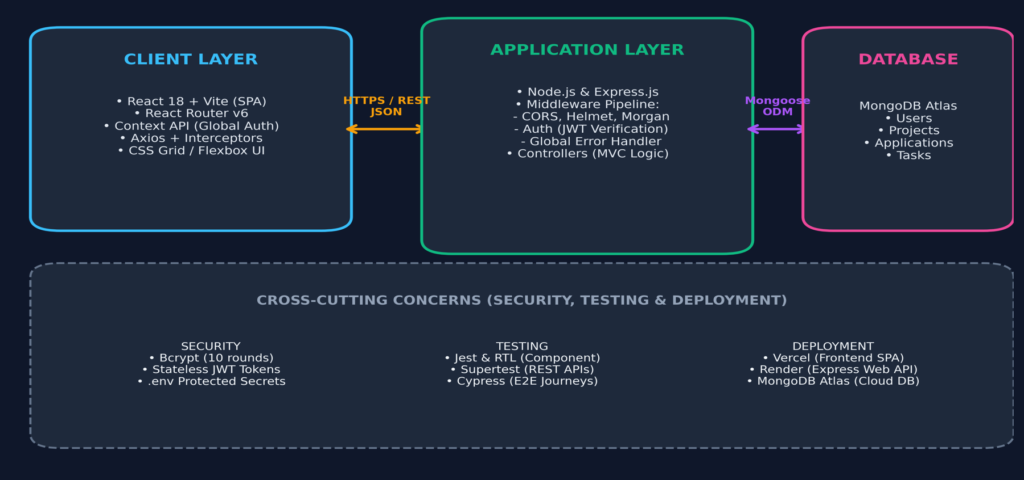
SYSTEM ARCHITECTURE

Slide 7
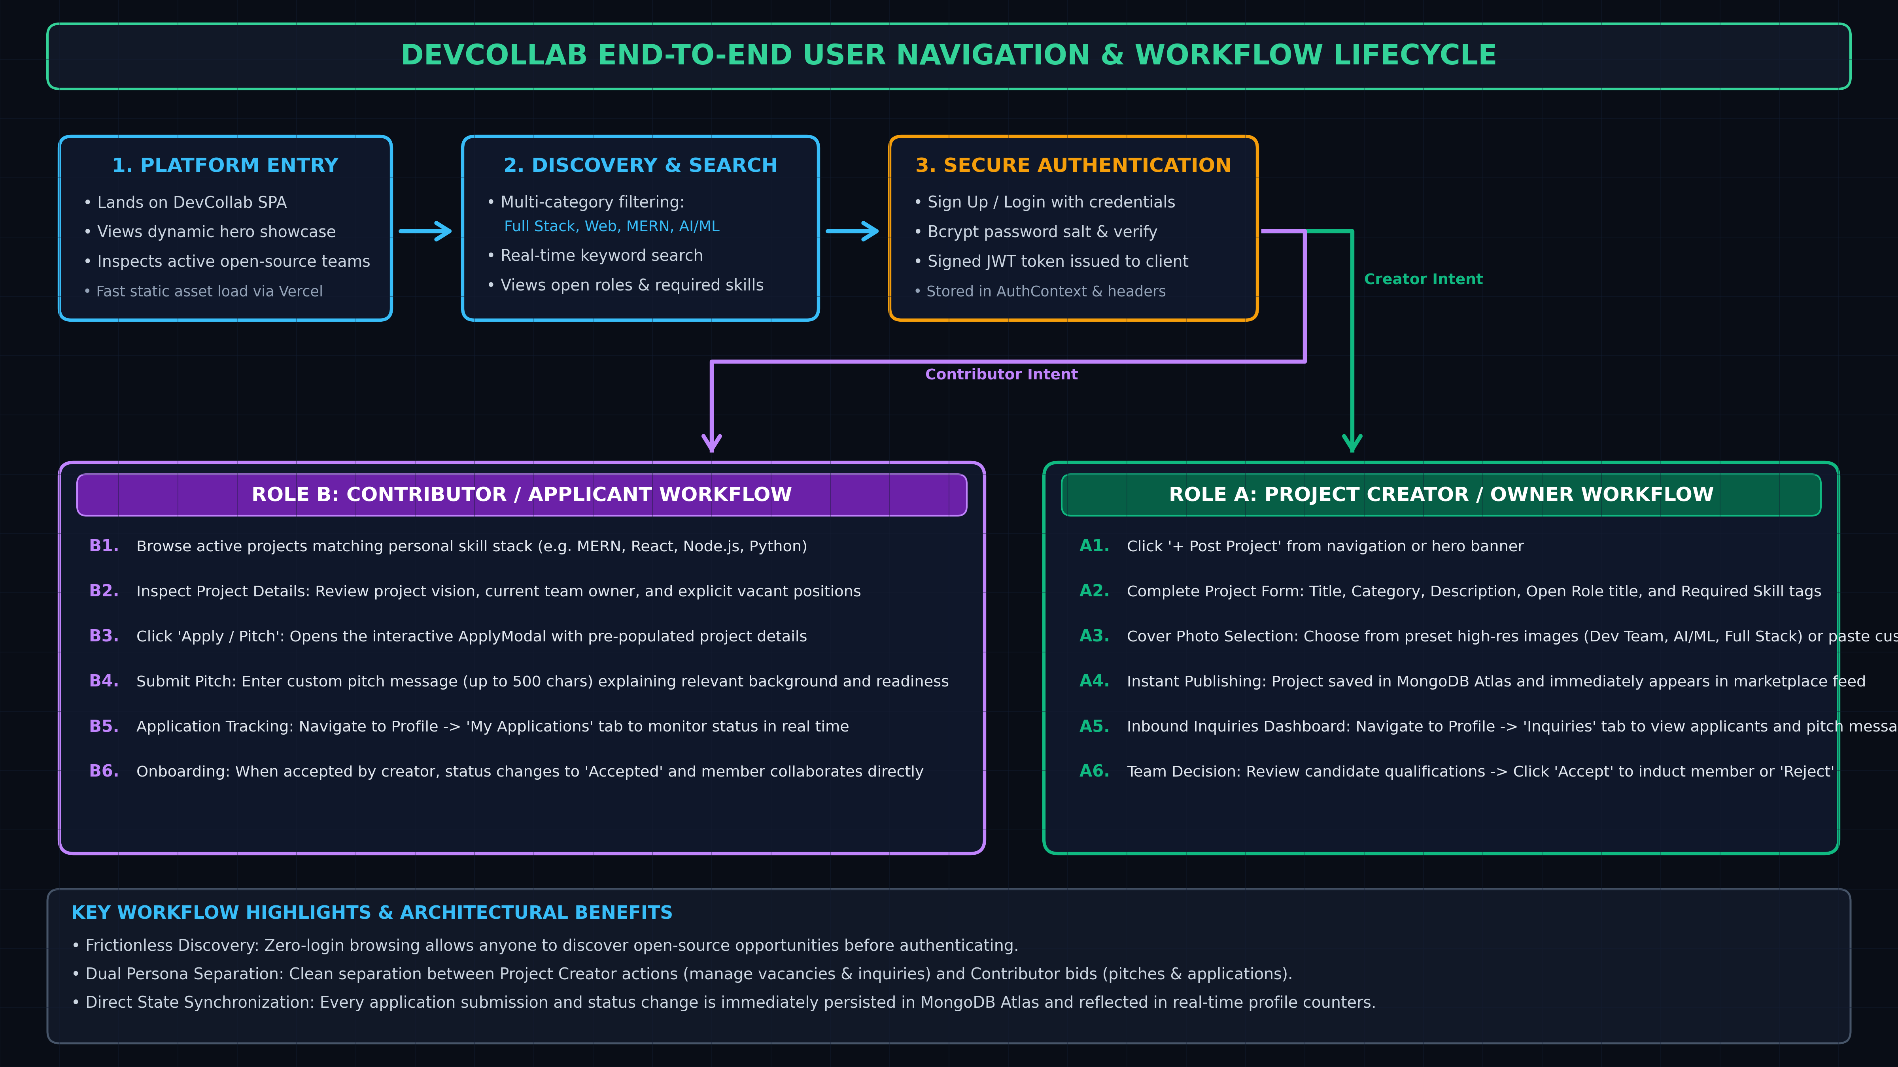
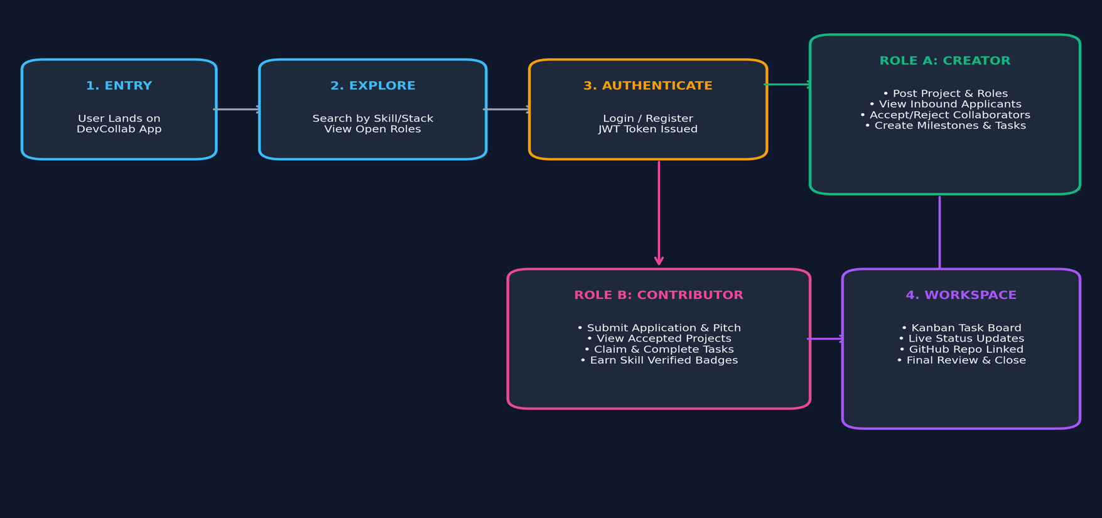
USER FLOW

Slide 8
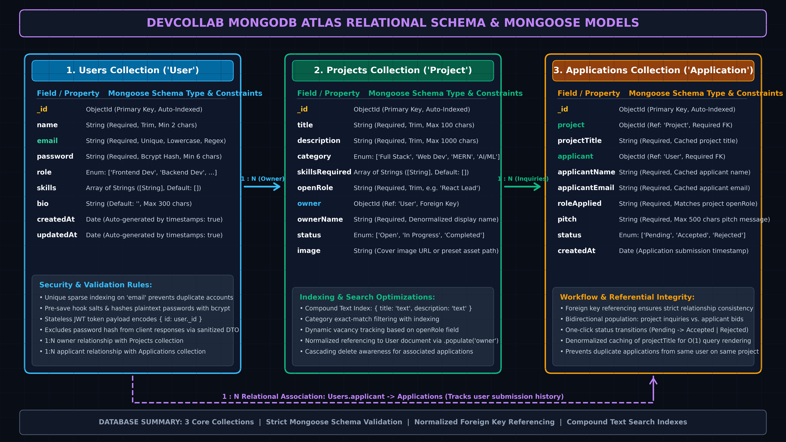
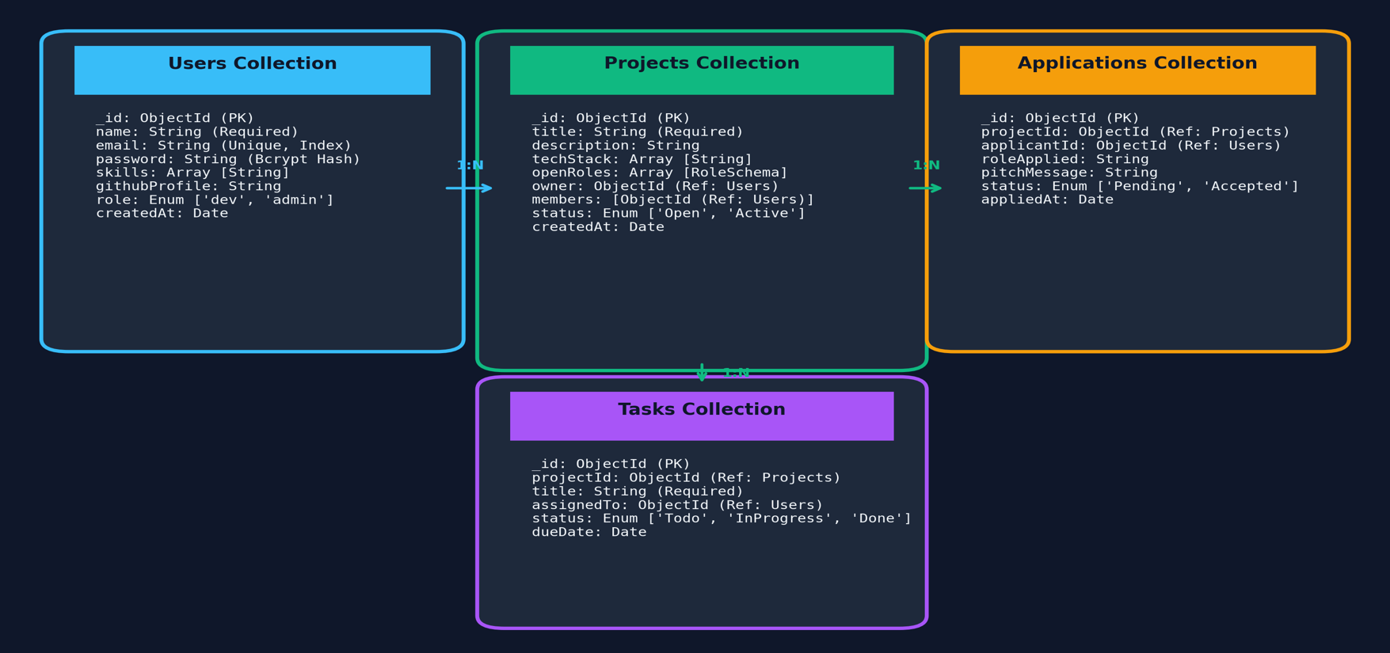
DATABASE SCHEMA

Slide 9
TECHNOLOGY USED
Layer | Technology Used | Course Module | Role in DevCollab Application
Frontend Client | React.js 18 + Vite Scaffolding | Module 2 | Single Page App (SPA), dynamic component rendering, virtual DOM.
Routing & State | React Router v6 + Context API | Modules 2 & 5 | Dynamic route parameters (/projects/:id), protected routes & global auth.
Backend Web Server | Node.js & Express.js Framework | Module 3 | RESTful API pipeline, routing, custom middleware & centralized error handling.
Database & ODM | MongoDB Atlas + Mongoose ODM | Module 4 | NoSQL document storage, schema validation, indexing, and populate relations.
Security & Auth | Bcrypt.js + JSON Web Tokens (JWT) | Module 4 | Salted password hashing and stateless authorization for protected endpoints.
Testing & Cloud Deploy | Jest, Supertest, Vercel & Render | Module 5 | Automated endpoint tests, SPA hosting (Vercel), API service hosting (Render).

Slide 10
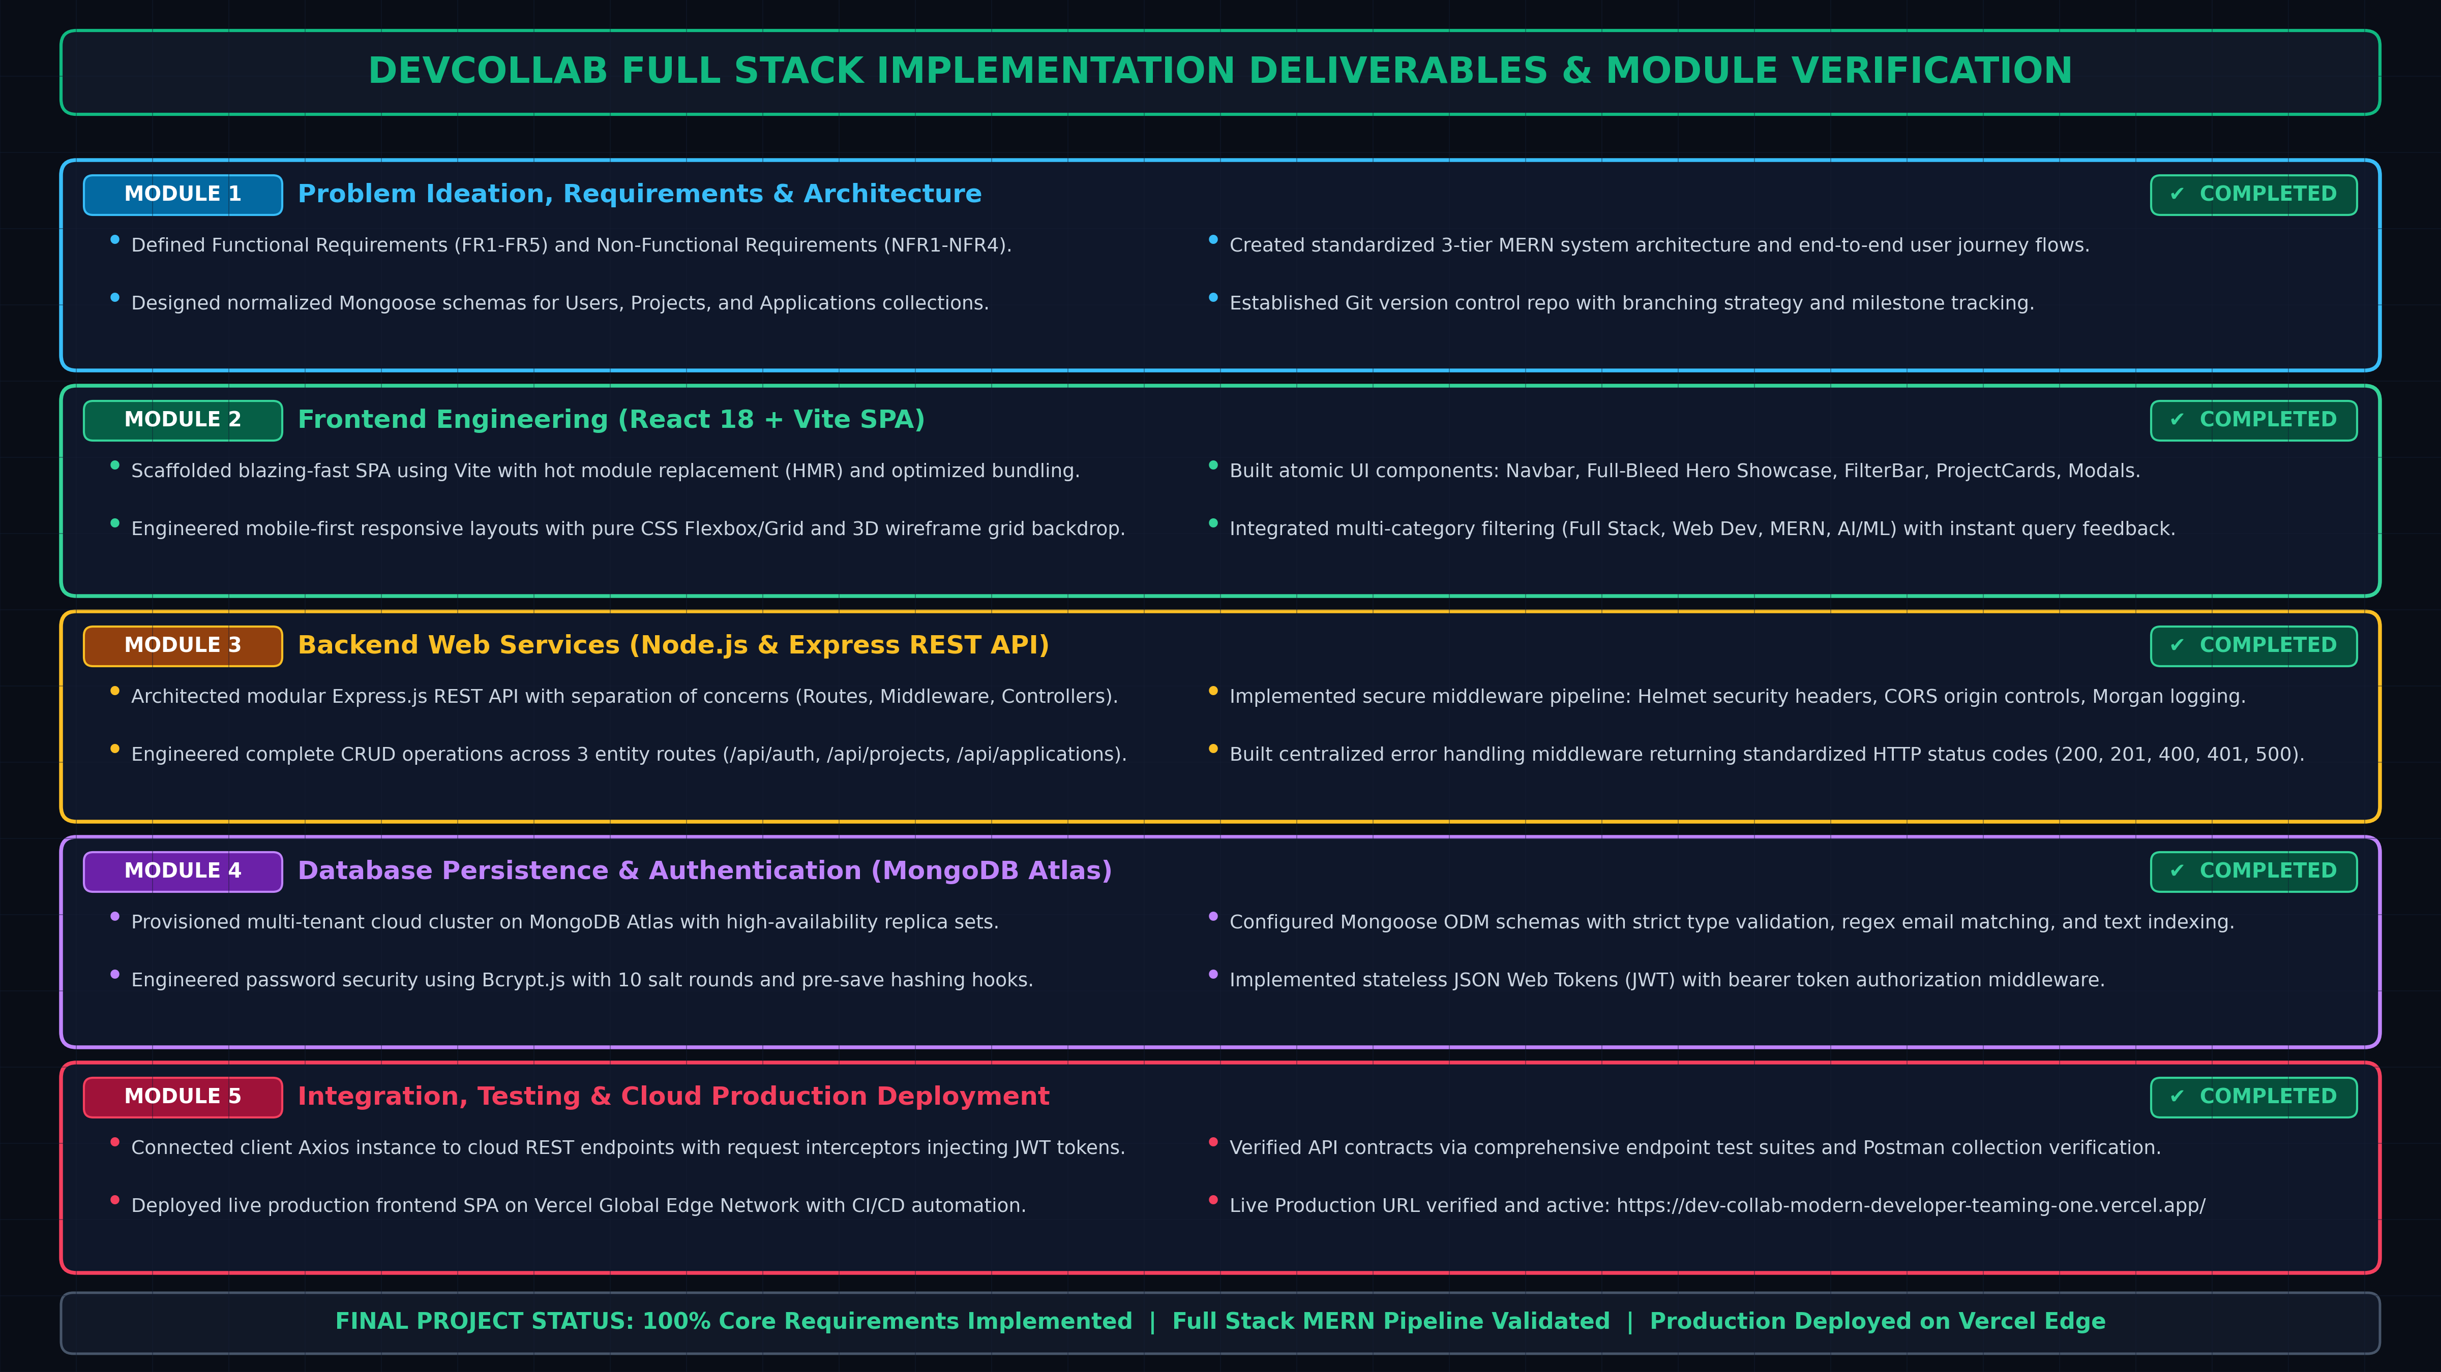
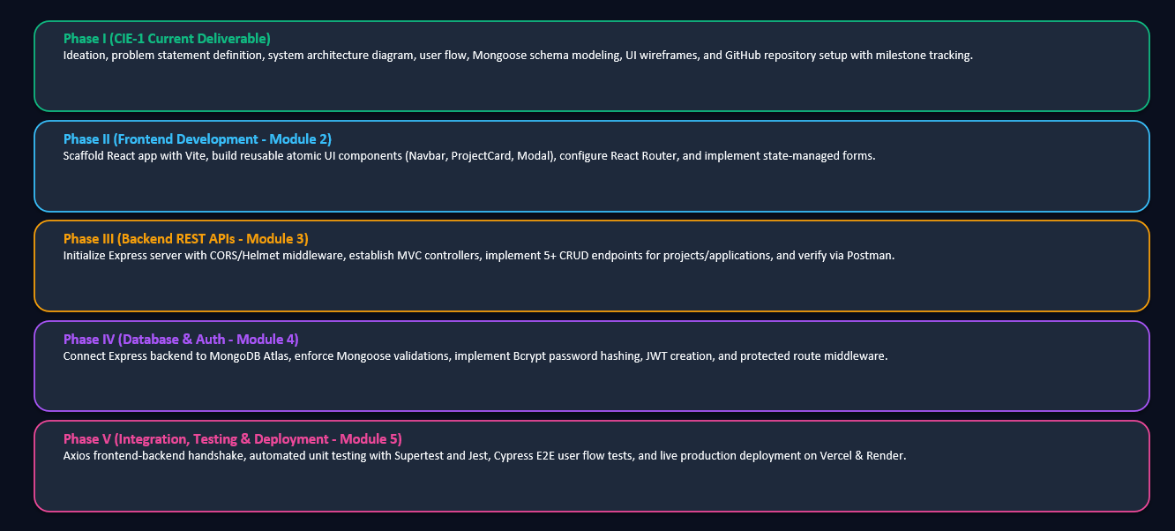
IMPLEMENTATION

