Slide 1
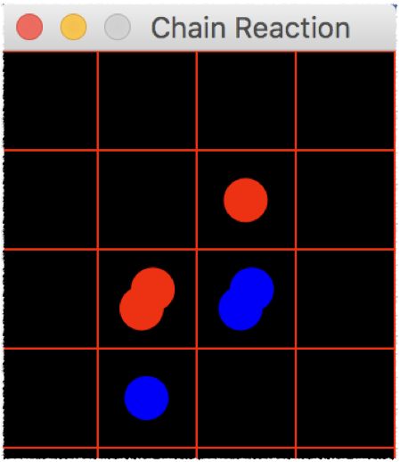

Chain Reaction
The logic of the game is handled entirely in the Board class. The makeMove function is called to progress the game, which uses a Breadth-First-Search in the background to propagate the move.
Save/Load/Undo is implemented using Serialization. The Board class is Serialized after every turn to implement Undo, as well as to have the game saved in case of unexpected exit.

Slide 2
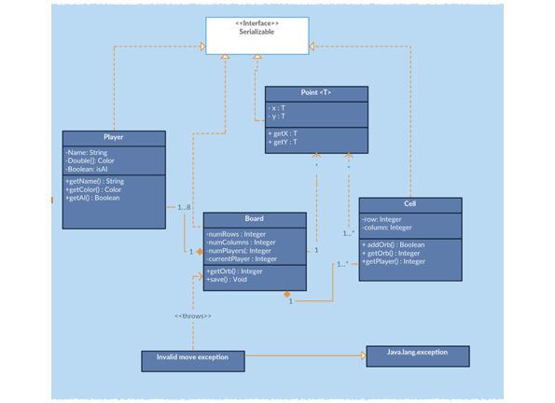
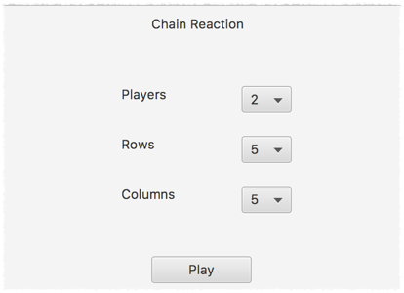
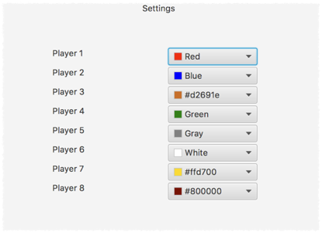
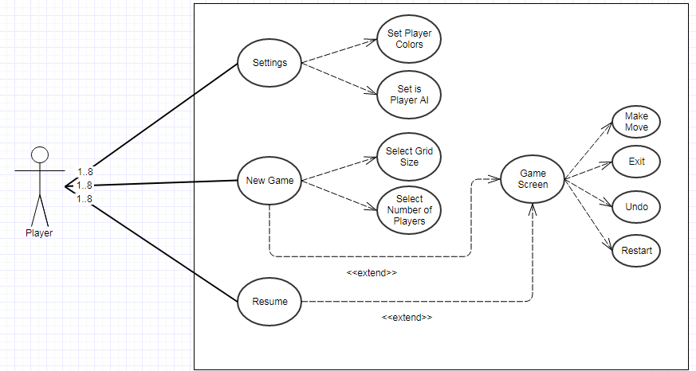

Slide 3
Work Distribution
Abhimanyu : Gui of game page, menu settings, some backend functions, some class definition
Hanit : Backend and logic, animation

Slide 4
Bonus
Arbitrary grid size
Ability to change player name
Color picker
Option to make players AI controlled

