Slide 1

Command Pattern
Abhi Gupta
1st August, 2019

Slide 2
Scenario
Design a remote control API which can control different things in the house like lights, garage, stereo, tv etc.

Slide 3
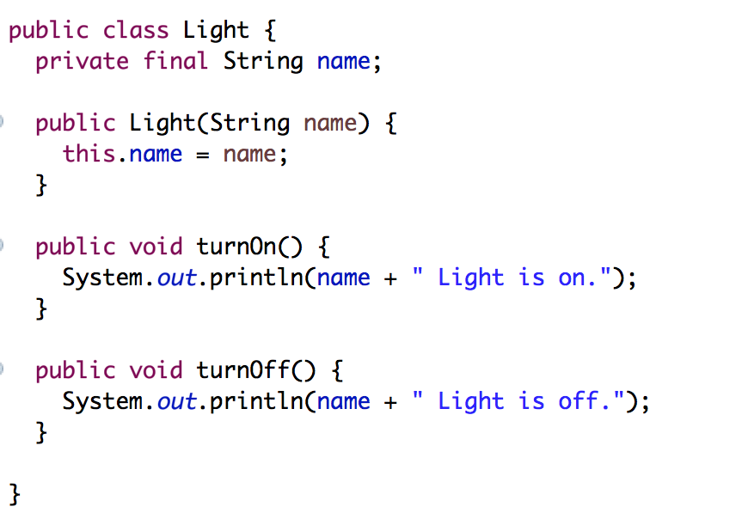
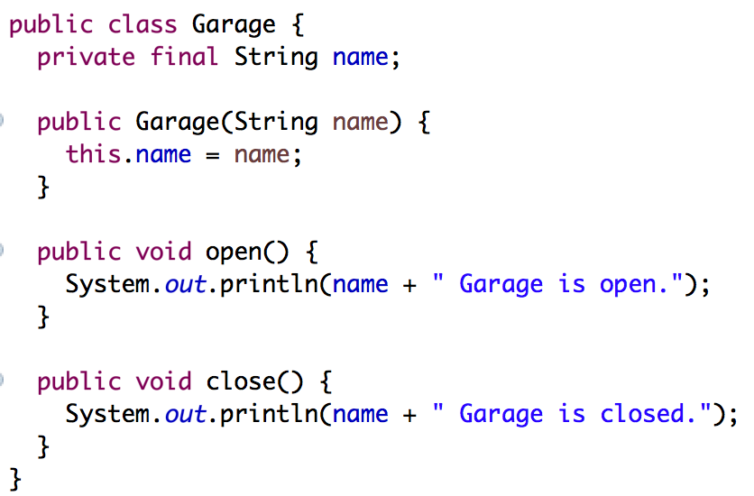
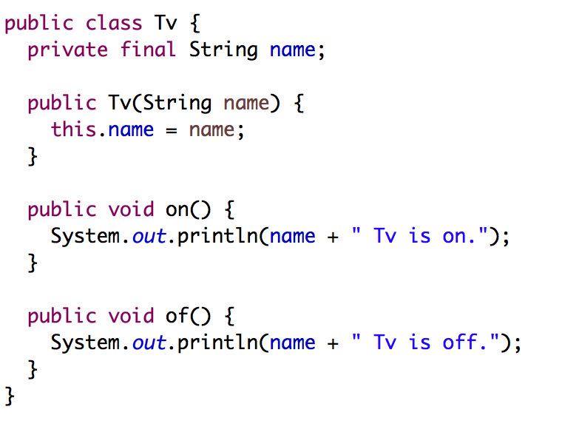
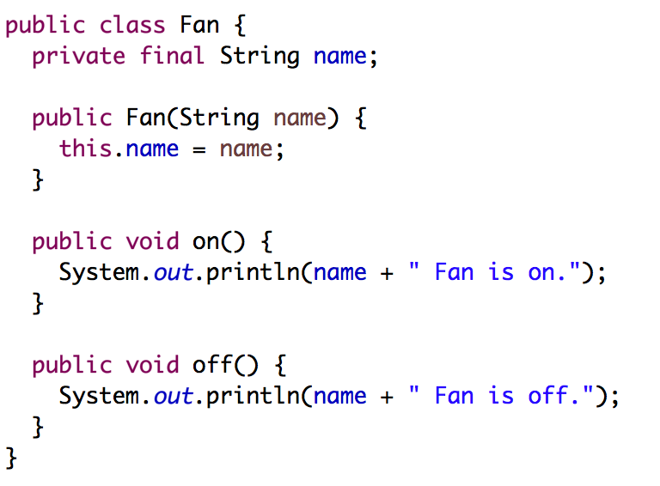
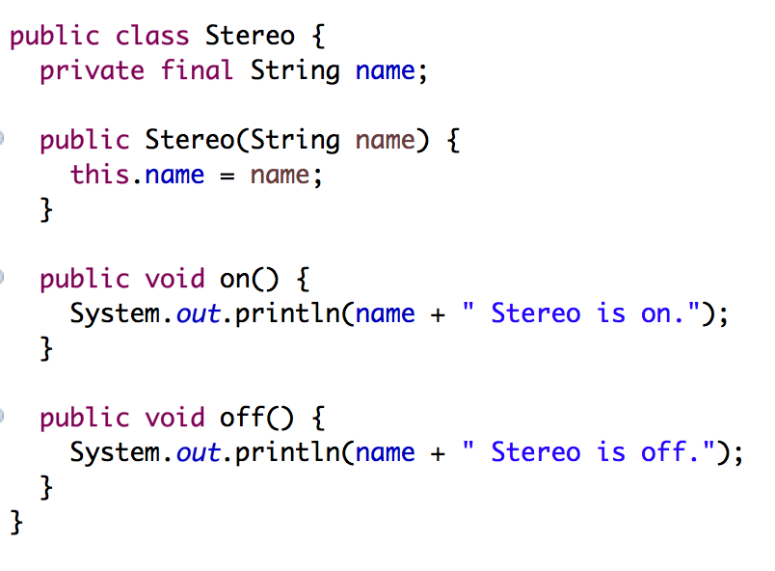
Let's represent these items in the house as Java Objects

Slide 4

How will a NOOB design this API ?

Slide 5
Noob's Demo

Slide 6
Is this a good Design ?
Violates Separation of Concern Principle.
RemoteControl Class is not only executing the operation but it is also deciding what is the type of object it needs to execute operation on.
It is also deciding whether the operation is a On or a Off.
Remote Control API is not easily extendable:
Add one more condition in Switch case everytime a new item needs to be supported.
Add one more type in the ItemType enum.
Basically, a lot of code changes are required to support a new item.

Slide 7

A Rockstar Developer's Design

Slide 8

Command Pattern
What if I have a middle layer between my Remote Control and my Items ?
This middle layer will abstract away the different execution details of each Item from the remote Control.
If I have a Middle Layer, then my Remote Control class doesn't have to worry about what object I execute my commands on.
I just call the execute function on the Middle layer and the middle Layer will take care of the execution.

Slide 9
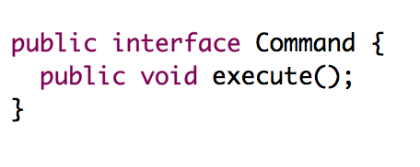
Middle Layer – Command Object

Slide 10
Rockstar's Demo

Slide 11
Benefits
RemoteControl Class only calls execute() method of commands and nothing else
Command takes care of the execution.
There is separation of concern between classes.
Code is easily extendable.
Just need to implement the execute() function and the RemoteControl class will be able to handle that command.
No code changes required in the API to support new items. Just need to register the new command with the remote.

Slide 12

Questions ?

