Slide 1
The generalised Cauchy derivative as a principle value of the Grünwald-Letnikov derivative for divergent expansions
arxiv.org/abs/1809.08051 (SUBMITTED to FRACT. CALC. APPL. ANAL.)
(Abhimanyu Pallavi Sudhir, Imperial College London)

Slide 2
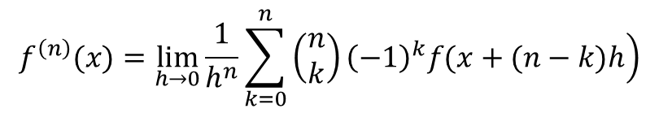
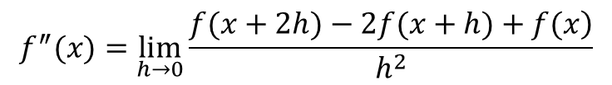

GRÜNWALD-LETNIKOV
(Resemblance to binomial theorem is suggestive)
$$f^{″}(x)=\lim_{h→0}\frac{\left.f(x+2h)−2f(x+h)+f(x\right)}{h^{2}}$$
$$⋮$$
$$f^{\left(n\right)}(x)=\lim_{h→0}\frac{1}{h^{n}}\sum_{k=0}^{n}{\left.\left(\begin{matrix}n \\ k\end{matrix}\right){\left(−1\right)}^{k}f(x+(n−k)h\right)}$$

Slide 3
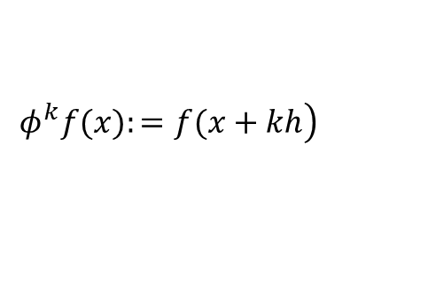

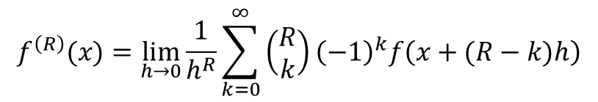
GRÜNWALD-LETNIKOV
$φ^{k}$ forms a “commutative ring” – so we have the binomial theorem
Motivation: $φ^{1}−φ^{0}=d$ (the differential operator)
Consider ${\left(φ^{1}−φ^{0}\right)}^{n}$
Like with binomial theorem, extend this to non-integer n
$$\left.φ^{k}f(x):=f(x+kh\right)$$
$$f^{\left(R\right)}(x)=\lim_{h→0}\frac{1}{h^{R}}\sum_{k=0}^{∞}{\left(\begin{matrix}R \\ k\end{matrix}\right){\left(−1\right)}^{k}f\left(x+(R−k)h\right)}$$

Slide 4
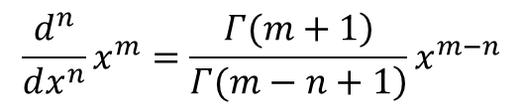
RIEMANN-LIOUVILLE
Or “Generalised Cauchy” – as it follows from Cauchy’s Repeated Integral formula
Straightforward form for power functions
Proof by Ortigueira & Coito (2004): Riemann-Liouville derivative equals the Grünwald-Letnikov derivative
$$\frac{d^{n}}{dx^{n}}x^{m}=\frac{\left.Γ(m+1\right)}{\left.Γ(m−n+1\right)}x^{m−n}$$

Slide 5
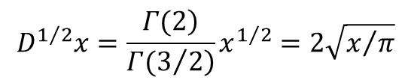
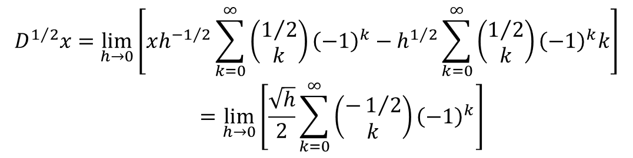
COUNTER-EXAMPLE
Grünwald-Letnikov – divergent
Riemann-Liouville
$$\begin{matrix}D^{1/2}x=\lim_{h→0}\left[xh^{−1/2}\sum_{k=0}^{∞}{\left(\begin{matrix}1/2 \\ k\end{matrix}\right){\left(−1\right)}^{k}}−h^{1/2}\sum_{k=0}^{∞}{\left(\begin{matrix}1/2 \\ k\end{matrix}\right){\left(−1\right)}^{k}k}\right] \\ =\lim_{h→0}\left[\frac{\sqrt{h}}{2}\sum_{k=0}^{∞}{\left(\begin{matrix}−1/2 \\ k\end{matrix}\right){\left(−1\right)}^{k}}\right]\end{matrix}$$
$$D^{1/2}x=\frac{\left.Γ(2\right)}{\left.Γ(3/2\right)}x^{1/2}=2\sqrt{x/π}$$

Slide 6
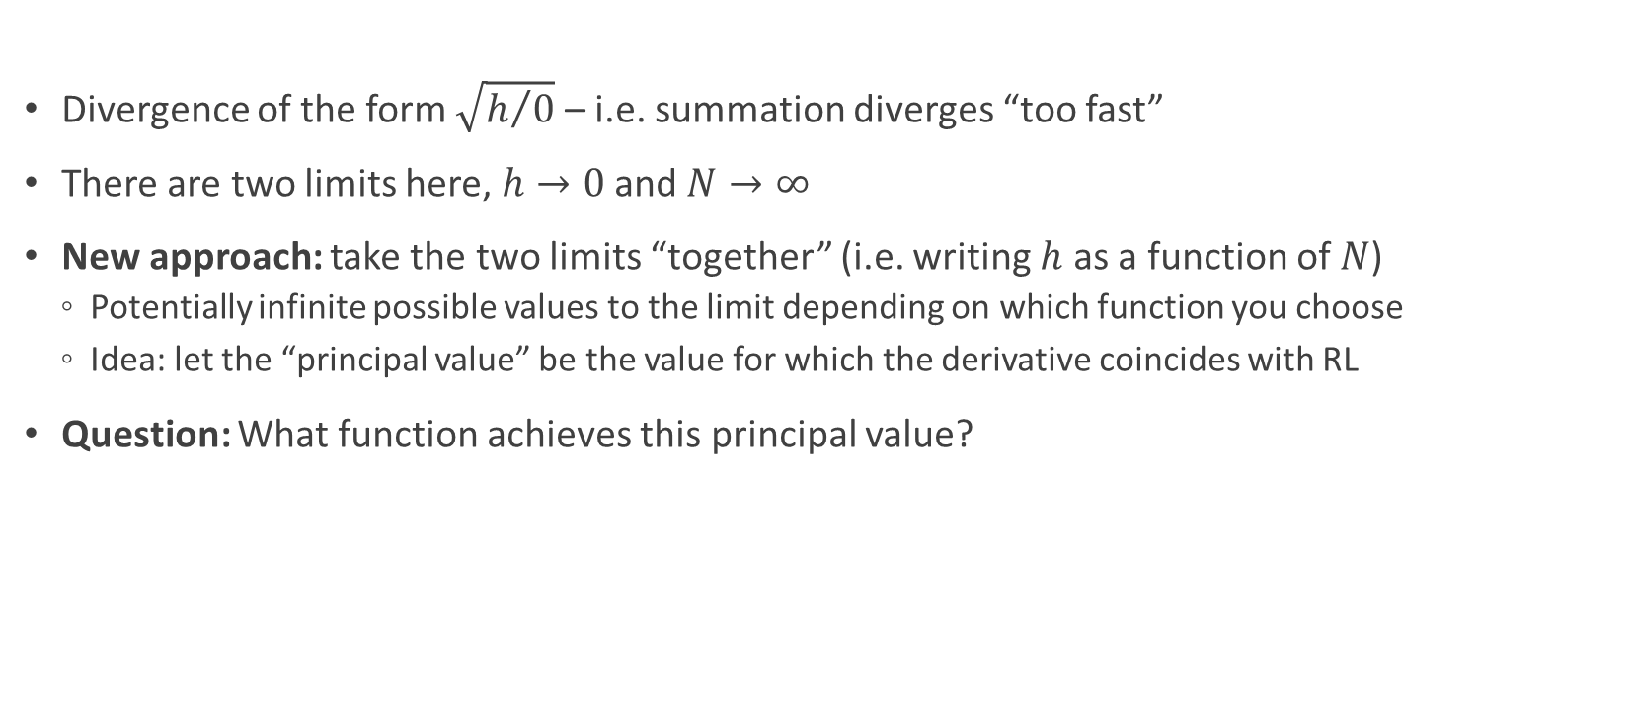
IDEA
Divergence of the form $\sqrt{h/0}$ – i.e. summation diverges “too fast”
There are two limits here, $h→0$ and $N→∞$
New approach: take the two limits “together” (i.e. writing $h$ as a function of $N$)
Potentially infinite possible values to the limit depending on which function you choose
Idea: let the “principal value” be the value for which the derivative coincides with RL
Question: What function achieves this principal value?

Slide 7
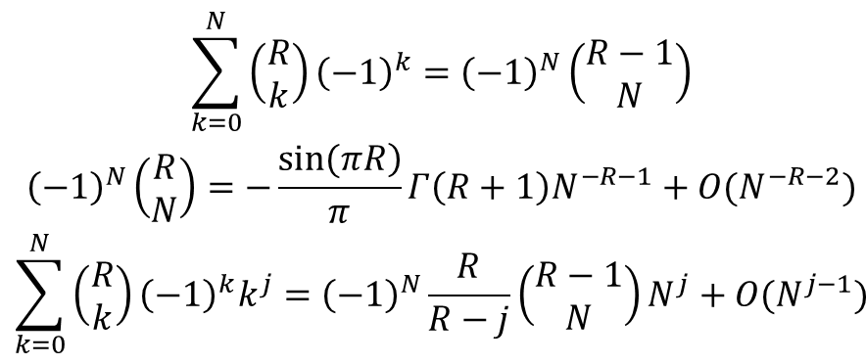
STANDARD RESULTS AND LEMMAS
(Lemma 1)
(Lemma 2)
(Lemma 3)
$$\begin{matrix}\sum_{k=0}^{N}{\left(\begin{matrix}R \\ k\end{matrix}\right){\left(−1\right)}^{k}}={\left(−1\right)}^{N}\left(\begin{matrix}R−1 \\ N\end{matrix}\right) \\ {\left(−1\right)}^{N}\left(\begin{matrix}R \\ N\end{matrix}\right)=−\frac{\left.sin⁡(πR\right)}{π}Γ\left(R+1\right)N^{−R−1}+O(N^{−R−2}) \\ \sum_{k=0}^{N}{\left(\begin{matrix}R \\ k\end{matrix}\right){\left(−1\right)}^{k}k^{j}}={\left(−1\right)}^{N}\frac{R}{R−j}\left(\begin{matrix}R−1 \\ N\end{matrix}\right)N^{j}+O(N^{j−1})\end{matrix}$$

Slide 8


EXAMPLE: $D^{1/2}x$
Lemma 1, 3:
Lemma 2:
Solve for h:
$$\begin{matrix}D^{1/2}x=\lim_{h→0, N→∞}\frac{x}{\sqrt{h}}\sum_{k=0}^{N}{\left(\begin{matrix}1/2 \\ k\end{matrix}\right){\left(−1\right)}^{k}}−\sqrt{h}\sum_{k=0}^{N}{k\left(\begin{matrix}1/2 \\ k\end{matrix}\right){\left(−1\right)}^{k}} \\ \begin{aligned}D^{1/2}x=\frac{x}{\sqrt{h}}{\left(−1\right)}^{N}\left(\begin{matrix}−1/2 \\ N\end{matrix}\right)+\frac{\sqrt{h}}{2}{\left(−1\right)}^{N}\left(\begin{matrix}−3/2 \\ N\end{matrix}\right) \\ \end{aligned} \\ \begin{aligned}{\left(−1\right)}^{N}\left(\begin{matrix}−1/2 \\ N\end{matrix}\right)\sim \frac{1}{\sqrt{π}}N^{−1/2}; {\left(−1\right)}^{N}\left(\begin{matrix}−3/2 \\ N\end{matrix}\right)\sim \frac{2}{\sqrt{π}}N^{1/2} \\ \end{aligned} \\ \\ \begin{aligned}D^{1/2}x=\frac{x}{\sqrt{h}}\frac{1}{\sqrt{π}}N^{−1/2}+\frac{\sqrt{h}}{2}\frac{2}{\sqrt{π}}N^{1/2} \\ h=x/N \end{aligned}\end{matrix}$$

Slide 9
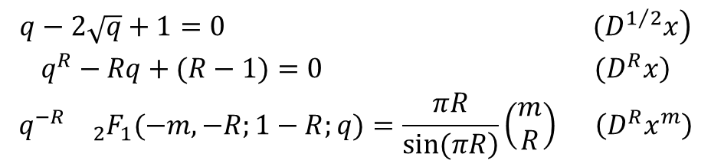
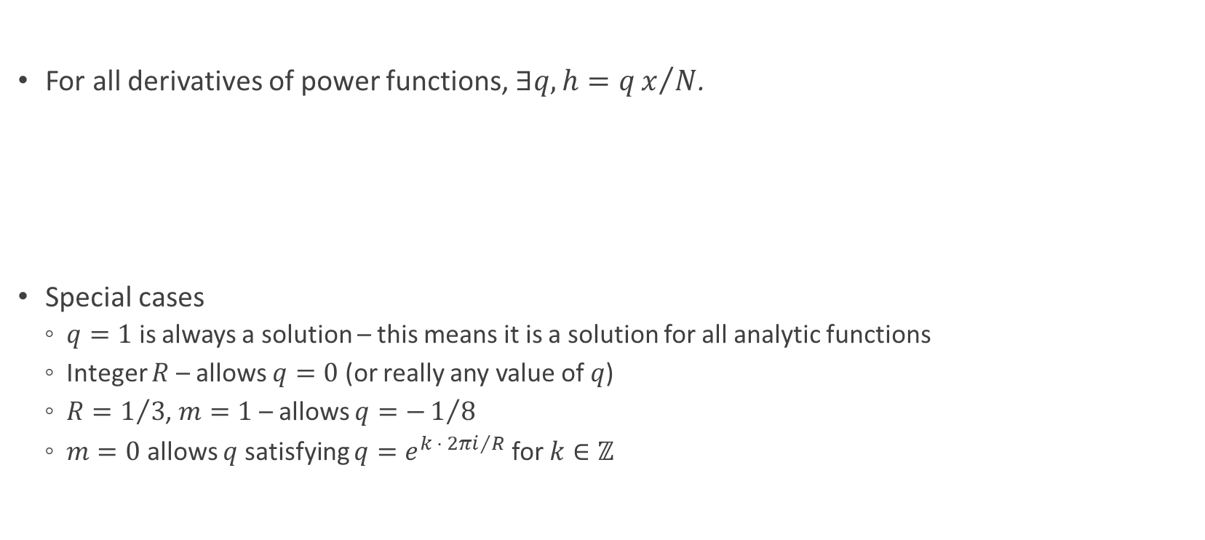
MORE Q-RELATIONS
For all derivatives of power functions, $∃q,h=qx/N$.
Special cases
$q=1$ is always a solution – this means it is a solution for all analytic functions
Integer $R$ – allows $q=0$ (or really any value of $q$)
$R=1/3$, $m=1$ – allows $q=−1/8$
$m=0$ allows $q$ satisfying $q=e^{k ⋅ 2πi/R}$ for $k∈ℤ$
$$\begin{matrix}\left.q−2\sqrt{q}+1=0 (D^{1/2}x\right) \\ \left.q^{R}−Rq+(R−1)=0 (D^{R}x\right) \\ q^{−R}{}_{2}F_{1}(−m,−R;1−R;q)=\frac{πR}{\left.sin(πR\right)}\left(\begin{matrix}m \\ R\end{matrix}\right) \left(D^{R}x^{m}\right)\end{matrix}$$

Slide 10
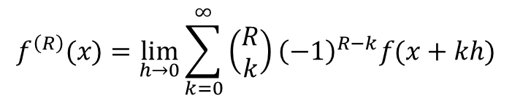
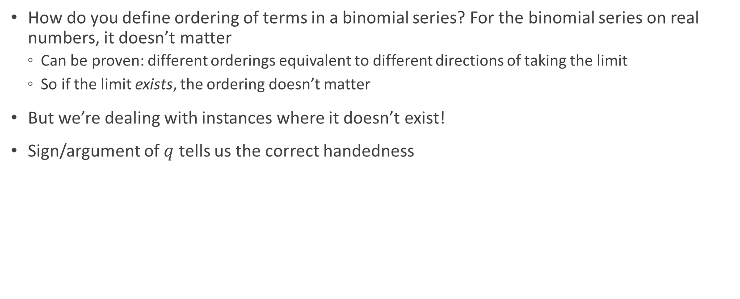
HANDEDNESS OF GL DERIVATIVE
(IMPLICATIONS)
How do you define ordering of terms in a binomial series? For the binomial series on real numbers, it doesn’t matter
Can be proven: different orderings equivalent to different directions of taking the limit
So if the limit exists, the ordering doesn’t matter
But we’re dealing with instances where it doesn’t exist!
Sign/argument of $q$ tells us the correct handedness
$$f^{\left(R\right)}(x)=\lim_{h→0}\sum_{k=0}^{∞}{\left(\begin{matrix}R \\ k\end{matrix}\right){\left(−1\right)}^{R−k}f(x+kh)}$$

Slide 11

DISCONTINUOUS FUNCTIONS
(IMPLICATIONS)
Fractional derivative inherently “non-local” – can see this from infinite summation form of GL derivative, or integral form of RL
Can the fractional derivative “sense” discontinuities/non-smoothness in the function?
Can be conclusively answered with my principal value formalism! – “Yes, to a certain extent.”
Where the “extent” equals $qx$

Slide 12

FUTURE RESEARCH
Other (than 1) values of $q$for a general power series
General theory for fractional derivatives of generally non-smooth functions
Alternative formalization of Dirac Delta function!
Instead of taking limits of functions, take limit $R→1$ for $\left.D^{R}H(x\right)$

Slide 13
REFERENCES
[1] J.B. Diaz, T.J. Osler, Differences of fractional order. Mathematics of Computation. 28, No 125 (1974), 185–202.
[2] D. Guichard, An Introduction to Combinatorics and Graph Theory. Whitman College Press, Walla Walla (2018).
[3] V. Kiryakova, A long standing conjecture failed? In: Proceedings of the 2nd Int’l Workshop “Transform Methods & Special Functions, Varna ’96”, IMI-BAS, Sofia (1996), 579-588.
[4] M.D. Ortigueira, F. Coito, From differences to derivatives. Fract. Calc. Appl. Anal. 7, No 4 (2004), 459–471.

Slide 14
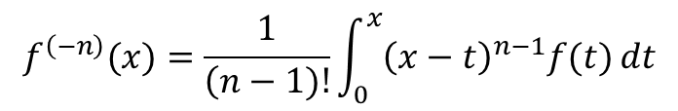

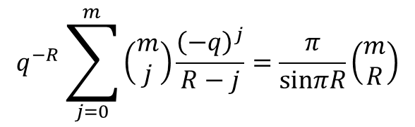
APPENDIX
Cauchy’s Repeated Integral formula
Explicit restatement of q-relation for $D^{R}x^{m}$:
$$f^{\left(−n\right)}(x)=\frac{1}{\left(n−1)!\right.}\int_{0}^{x}{{\left(x−t\right)}^{n−1}f(t) dt}$$
$$q^{−R}\sum_{j=0}^{m}{\left(\begin{matrix}m \\ j\end{matrix}\right)\frac{{\left(−q\right)}^{j}}{R−j}}=\frac{π}{sinπR}\left(\begin{matrix}m \\ R\end{matrix}\right)$$

