Slide 1
A Primer on Lie theory
Abhimanyu Pallavi Sudhir
Hand-out: abhimanyu.io/media/wu-urop.pdf
More on Lie theory: thewindingnumber.blogspot.com/p/1203.html
More on Topology: thewindingnumber.blogspot.com/p/2204.html

Slide 2
STUFF TO COVER
Motivation
Infinitesimal generators, exponential map
Lie bracket, adjoint map, Jacobi identity
Lie algebra elements as derivations
BCH formula, Lie’s theorems, covering spaces
Examples of the Lie correspondence
Killing form, simplicity
Applications: indefinite orthogonal group
Applications: control theory (parallel parking)

Slide 3
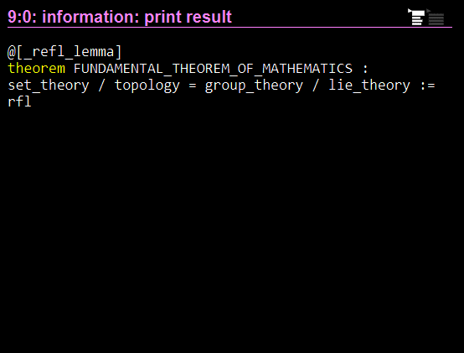
Motivation
“Set theory : Topology :: Group theory : Lie theory”

Slide 4

Motivation
Cardinality in set theory “generalizes” to “wiggle room” in topology
${\left[0,10\right]}_{ℝ}$ is “kinda” finite, it’s “like” ${\left[0,10\right]}_{ℤ}$
In group theory, we’re not just concerned with cardinality, but group structure
$\left(ℝ,+\right)$ is “like” $\left(ℤ,+\right)$
$\left.U(1\right)$ is “kinda” cyclic, “kinda” finite
$(ℝ,+)$ and $(ℝ^{2},+)$ are “different”

Slide 5





$$≈{(1+εX)}^{t/ε}$$
$$\lim_{ε→0}{{\left(1+εX\right)}^{t/ε}}$$
$$=exp tX$$
$$≈1+εX$$
$$1$$

Slide 6
Equivalently intuition for:
Euler’s formula
Compound-interest limit
Infinitesimal generators

Slide 7


Alternate form of exp
Expand ${\left(1+\frac{X}{n}\right)}^{n}$
$k$^{th} degree term is $\frac{1}{n^{k}}\left(\begin{matrix}n \\ k\end{matrix}\right)X^{k}$
$$\lim_{n→∞}\frac{1}{k!}\frac{\left.n(n−1)…(n−k+1\right)}{n^{k}}=\frac{1}{k!}$$
$$⇒expX=1+X+\frac{1}{2}X^{2}+\frac{1}{3!}X^{3}+…$$

Slide 8


EXP
In general, infinitesimal generators form a vector space $TG$
Clearly for an Abelian group, $exp\left(X+Y\right)=expX expY$ and the tangent space is homomorphic to the group
Analog of FT-FAG: every compact connected Abelian Lie group is a torus
Interesting local structure of the group comes from non-Abelian stuff
$exp$:$TG→$ $G$

Slide 9







$$e^{εX}e^{εY}e^{−εX}e^{−εY}$$
$$≈1+ε^{2}(XY−YX)$$
$$e^{−εX}$$
$$e^{εY}$$
$$e^{−εY}$$
$$e^{εX}$$
$$1$$

Slide 10



Another way to see [X,Y]
“Adjoint map” homomorphism
Induces a Lie algebra homomorphism
Preserves Lie bracket – Jacobi identity
$Ad :G→Aut \left(G\right) :=g↦λx. gxg^{−1}$
$$ad :𝔤→Der \left(𝔤\right) :=Y↦\left[Y,−\right]$$
$$\left.ad([X,Y])=[ad\left(X\right),ad(Y)\right]$$
$$⇒ ad([X,Y])(Z)=ad(X)ad(Y)Z−ad(Y)ad(X)Z$$
$$⇒ \left[[X,Y],Z]=[X,[Y,Z]]−[Y,[X,Z]\right]$$

Slide 11

TAYLOR SERIES
$$exp∇=Δ$$

Slide 12


Derivations
Cayley’s theorem: groups can be understood as the automorphism groups of some object $\left.G=\text{Aut}(M\right)$
Derivatives of automorphisms at the identity are directional derivative operators, or “derivations”
$$φp\left(fg\right)=φp(f)φp(g)$$
$$\left.fg+εdφ_{0}(fg)=(f+εdφ_{0}f)(g+εdφ_{0}g\right)$$
$$⇒dφ_{0}(fg)=\left(dφ_{0}f\right)g+f\left(dφ_{0}g\right)$$

Slide 13

Derivations
Tangent vectors $⇒$ Left-invariant vector fields $⇒$ Directional derivatives
“Linear operator that satisfies product rule” is equivalent to being a directional derivative for analytic functions

Slide 14
How Much structure is preserved locally?
Sufficiently high-order structure surely determines local structure of group: exp is a local topological isomorphism
An example of local topological isomorphism is having the same covering space: for connected groups, this is the only local Lie group isomorphism

Slide 15
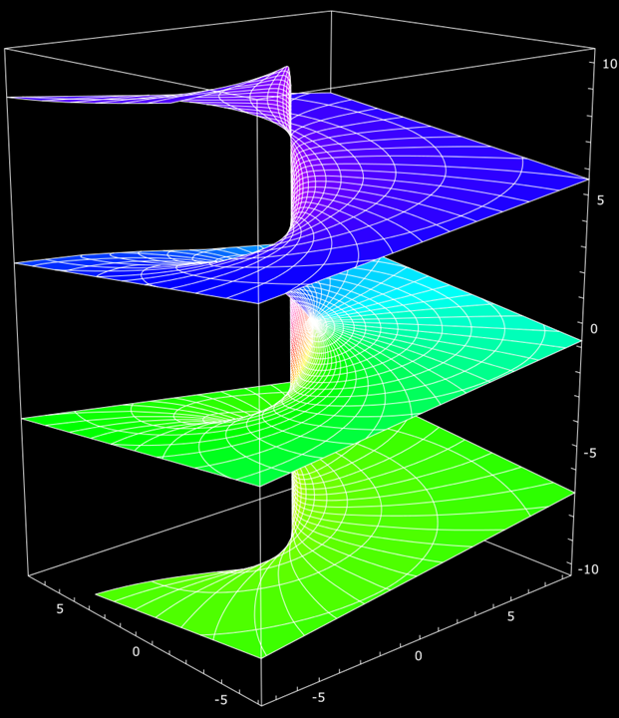
COVERING SPACE (EXAMPLE)
Source:
en.wikipedia.org/wiki/File:
Riemann_surface_log.svg

Slide 16
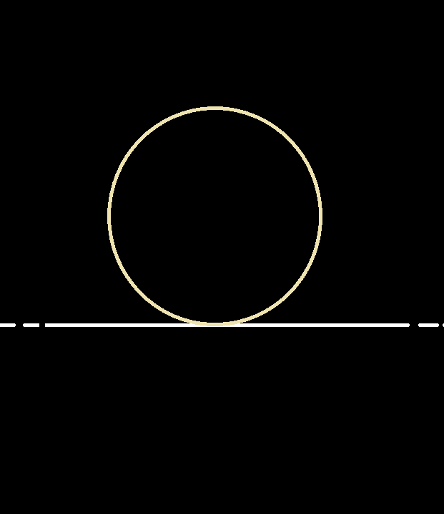
COVERING SPACE (EXAMPLE)
More generally, any plane covers a torus

Slide 17
COVERING SPACE (NON-EXAMPLE)

Slide 18
Universal cover is simply-connected
Notion of “wrapping”: must be a homeomorphism on some open neighbourhood of each point from each connected pre-image
Any “wrapping” must introduce circles, i.e. eliminate simply-connectedness
A universal cover is “unwrapping”

Slide 19
Definition of a lie algebra
Definitions (motivation in Lie’s second, third theorems)
Lie algebra – a vector space equipped with an antisymmetric, bilinear, Jacobi-satisfying product called the “Lie bracket”.
Lie algebra homomorphism – a linear, Lie bracket-preserving map.
Motivation comes from the 2nd and 3rd fundamental theorems of Lie theory.
Definition isn’t obvious nonsense: 1st fundamental theorem of Lie theory.

Slide 20

Lie Correspondence
Lie’s first theorem
Tangent space of a Lie group is a Lie algebra
Differential of a Lie group homomorphism is a Lie algebra homomorphism
Lie’s second theorem – (G simply-connected) a Lie algebra homomorphism $𝔤→𝔥$ is the differential of a unique Lie group homomorphism $G→H$
Lie’s third theorem – Every Lie algebra is the tangent space of a unique simply-connected Lie group

Slide 21

Baker-campbell-hausdorff
$\left.log(e^{X}e^{Y}\right)$ can be written purely in terms of nested commutators
of $X$ and $Y$
(proof: abhimanyu.io/media/wu-urop.pdf p. 5-6)

Slide 22
Examples of the correspondence
Lie group : Lie algebra
Subgroup : Subalgebra
Normal subgroup : Ideal
Centre : Centre

Slide 23



Killing FORM
Contours of Killing form are orbits of Adjoint map
Radius perpendicular to tangent: generalisation of $x⋅(x×y)=0$
$$[X,Y]$$
$$X$$

Slide 24
Indefinite orthogonal group

Slide 25
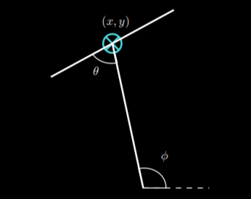

Parallel parking
$Steer=\frac{∂}{∂θ}$
$Drive=sin\left(θ+φ\right)\frac{∂}{∂x}−cos(θ+φ)\frac{∂}{∂y}−cosθ\frac{∂}{∂φ}$
$\left[\left[Steer,Drive\right],Drive\right]=sinφ\frac{∂}{∂x}−cosφ\frac{∂}{∂y}$

