Slide 1
A mathematical definition of property rights
Abhimanyu Pallavi Sudhir
Imperial College London (4th year MSci)
Read through: arxiv.org/abs/2107.09651

Slide 2
“Utility functions are coded in,
agents attempt to maximize it
through efficient heuristics.”
“Utility functions are an abstraction of agent behavior.”
Game theory/
Theoretical Economics
Artificial intelligence/
Learning theory
Agent science
Computer science/
Model theory
Information theory/
Statistics
Decision theory/
Agent foundations

Slide 3
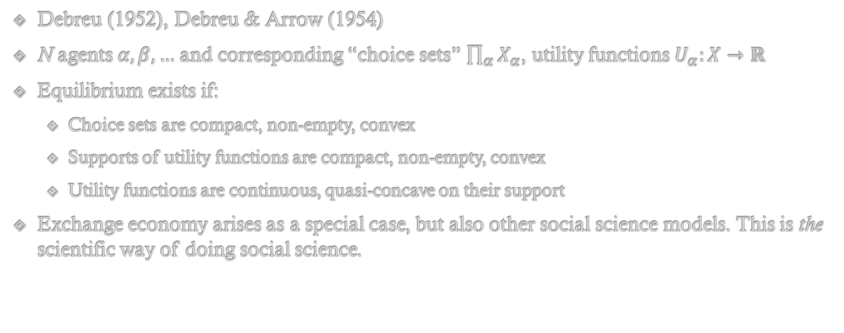
Abstract economy
Debreu (1952), Debreu & Arrow (1954)
N agents $α,β,…$ and corresponding “choice sets” $\prod_{α}{X_{α}}$, utility functions $U_{α}:X→ℝ$
Equilibrium exists if:
Choice sets are compact, non-empty, convex
Supports of utility functions are compact, non-empty, convex
Utility functions are continuous, quasi-concave on their support
Exchange economy arises as a special case, but also other social science models. This is the scientific way of doing social science.

Slide 4
Property rights theory
Coase (1960), reviewed variously e.g. Randall (1975), Furubotn (1972), Cheung (1970).
Important insights
Multiple “rights structures” are possible that lead to different, but efficient, equilibria
Efficiency results from: non-attenuated rights structure, zero transaction costs, perfect information, perfect competition
Non-attenuation and zero transaction costs are only defined in a relative sense
But no formal math

Slide 5

The mathematics of rights
Idea: exercising a right is a choice to forbid someone else’s choice
We want to say:
But this violates Cantor.
$$X_{α}=X_{α}^{0}×\prod_{β}{2^{X_{β}}}$$

Slide 6
The mathematics of rights
Idea: Think about what a “choice with rights” looks like in English, and formulize that:
Me take club from Thrak
Me (take club from Thrak AND forbid Thrak take club from me)
Me (take club from Thrak AND forbid Thrak (take club from me AND forbid me take club from Thrak))
Me (take club from Thrak AND forbid Thrak (take club from Me AND forbid Me (take club from Thrak AND forbid Thrak take club from me))
...
All sentences that make sense – but each successive sentence is more clearly defined than the previous one.
We intuitively “project” each choice into the previous one – inverse limits!

Slide 7

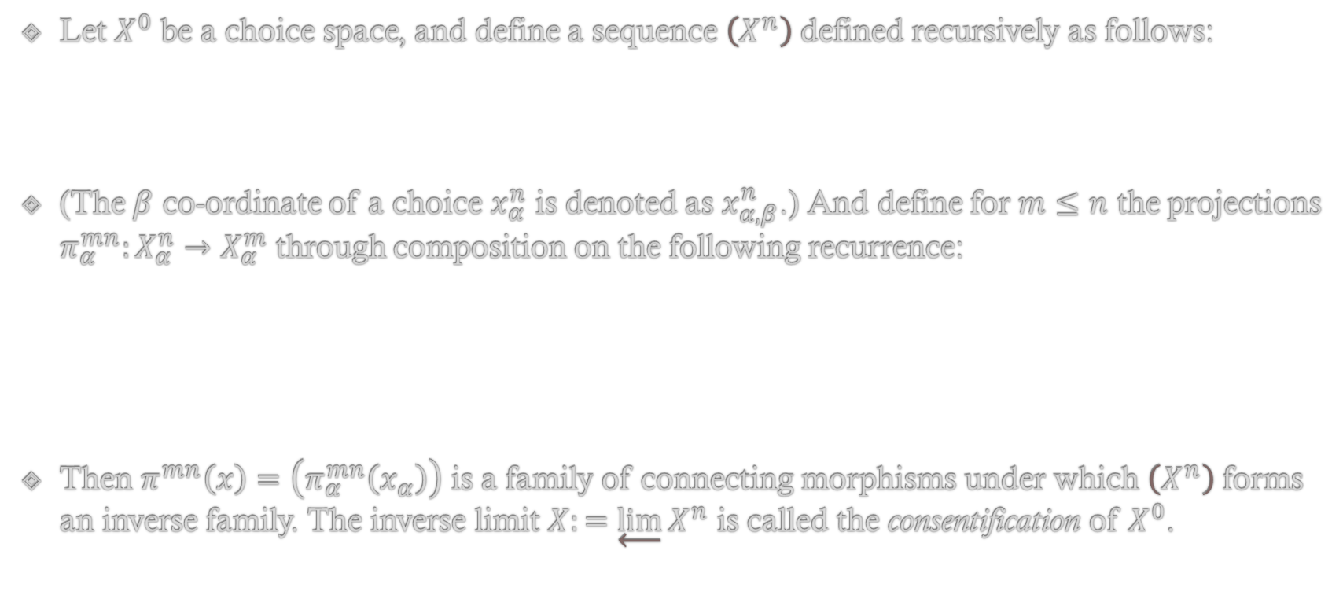

The mathematics of rights
Let $X^{0}$ be a choice space, and define a sequence $\left(X^{n}\right)$defined recursively as follows:
(The $β$ co-ordinate of a choice $x_{α}^{n}$ is denoted as $x_{α,β}^{n}$.) And define for $m≤n$ the projections $π_{α}^{mn}:X_{α}^{n}→X_{α}^{m}$ through composition on the following recurrence:
Then $π^{mn}\left(x\right)=\left(π_{α}^{mn}\left(x_{α}\right)\right)$ is a family of connecting morphisms under which $\left(X^{n}\right)$ forms an inverse family. The inverse limit $X:=\underset{←}{lim}X^{n}$ is called the consentification of $X^{0}$.
$$X_{α}^{n+1}=X_{α}^{0}×\prod_{β}{2^{X_{β}^{n}}}$$
$$\begin{matrix}π_{α}^{01}\left(x_{α}^{0} , R_{α,−α}^{0}\right)=x_{α}^{0} \\ π_{α}^{m\left(m+1\right)}\left(x_{α}^{0} , R_{α,−α}^{m}\right)=\left(x_{α}^{0},π_{−α}^{\left(m−1\right)m}\left(R_{α,−α}^{m}\right)\right)\end{matrix}$$

Slide 8
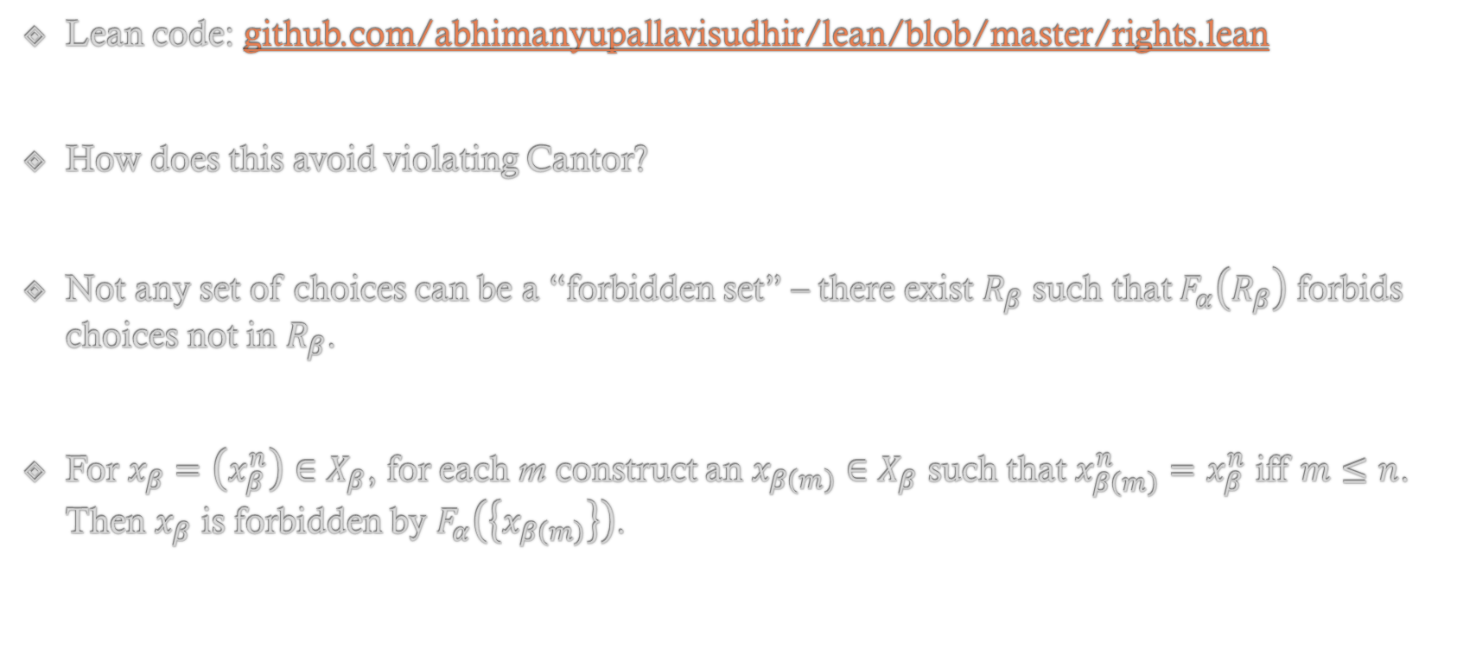
The mathematics of rights
Lean code: github.com/abhimanyupallavisudhir/lean/blob/master/rights.lean
How does this avoid violating Cantor?
Not any set of choices can be a “forbidden set” – there exist $R_{β}$ such that $F_{α}\left(R_{β}\right)$ forbids choices not in $R_{β}$.
For $x_{β}=\left(x_{β}^{n}\right)∈X_{β}$, for each m construct an $x_{β\left(m\right)}∈X_{β}$ such that $x_{β\left(m\right)}^{n}=x_{β}^{n}$ iff $m≤n$. Then $x_{β}$ is forbidden by $F_{α}\left(\left\{x_{β\left(m\right)}\right\}\right)$.

Slide 9
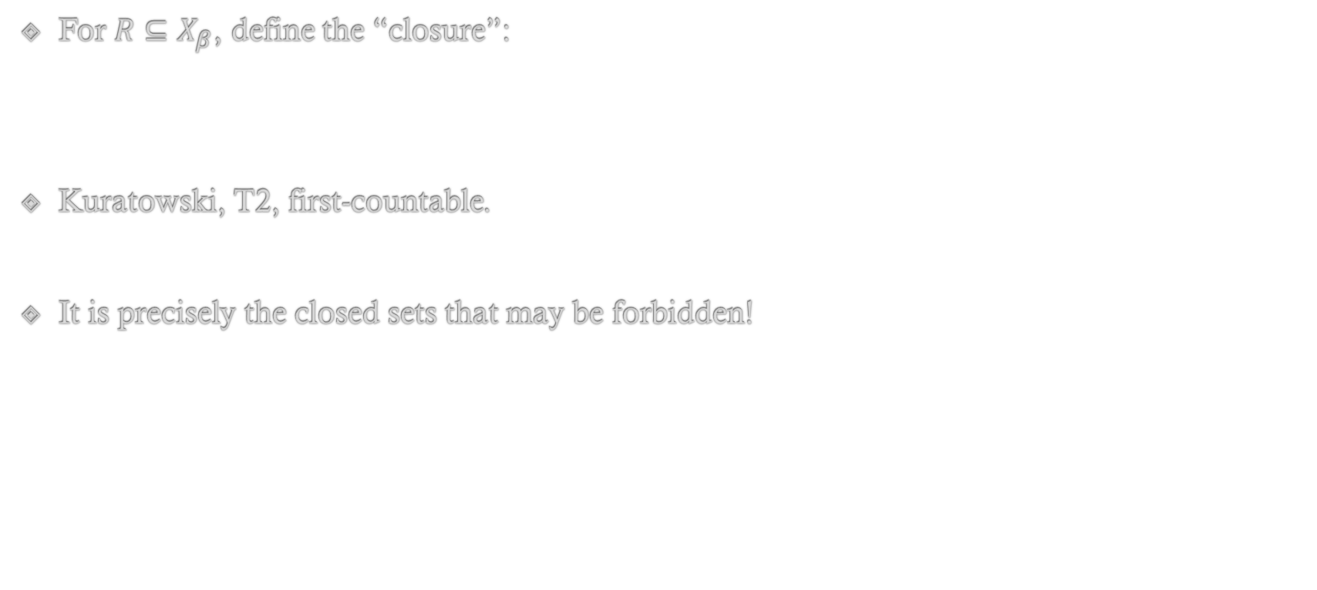

The mathematics of rights
For $R⊆X_{β}$, define the “closure”:
Kuratowski, T2, first-countable.
It is precisely the closed sets that may be forbidden!
$$cl\left(R\right)=\left\{y∈X_{β}∣∀n,∃y^{′}∈R,{y^{′}}_{n}=y_{n}\right\}$$
$$X_{α}=X_{α}^{0}×\prod_{β}{φ_{β}}$$

Slide 10

Economics from rights
Rights structure, non-attenuated rights structure.
Exchange economy as a consentified economy
$$X_{α}^{0}:=\left\{x_{α}:A→{\overline{X}}_{α}\right\}$$
$$U_{α}^{0}\left(x\right):={\overline{U}}_{α}\left(\sum_{β∈A}{x_{α}\left(β\right)}\right)$$

Slide 11
Future work
Equilibrium and dynamical properties, price theory
Production economy and transferable rights
Welfare economics from rights theory

Slide 12
References
Ronald Coase. “The Problem of Social Cost”. In: Journal of Law and Economics 3 (1960), pp. 1–44.
Alan Randall. “Property Rights and Social Microeconomics”. In: Natural Resources Journal 15.4 (1975), pp. 729–747.
Eirik G. Furubotn and Svetozar Pejovich. “Property Rights and Economic Theory: A Survey of Recent Literature”. In: Journal of Economic Literature 10.4 (1972), pp. 1137–1162.
Jongwook Kim and Joseph T. Mahoney. “Property Rights Theory, Trans-action Costs Theory, and Agency Theory: An Organizational Economics Approach”. In: Managerial and Decision Economics26.4 (2005), pp. 223–242. doi: https://doi.org/10.1002/mde.1218.
Joseph T. Mahoney. “Property Rights Theory”. In: Economic Foundationsof Strategy. SAGE, 2005. Chap. 3, pp. 109–138 .isbn: 9781412905435. doi: https://dx.doi.org/10.4135/9781452229850.
Pol Antras. “The Property Rights Approach”. In: Global Production: Firms, Contracts, and Trade Structure. Princeton University Press, 2015. Chap. 7, pp. 197–222. isbn: 9780691168272.
Anthony Downs. An Economic Theory of Democracy. New York: Harper,1957. isbn: 9780060417505.
James M. Buchanan and Gordon Tullock. The Calculus of Consent. Ann Arbor: University of Michigan Press, 1962. isbn: 9780472061006.
Mancur Olson.The Logic of Collective Action. Cambridge, MA: Harvard University Press, 1965.isbn: 9780674537514.
Sanford J. Grossman and Oliver D. Hart. “The Costs and Benefits of Ownership: A Theory of Vertical and Lateral Integration”. In: Journal of Political Economy 94.4 (1986), pp. 691–719.doi :https://doi.org/10.1086/261404.
Gerard Debreu. “A Social Equilibrium Existence Theorem”. In: Proceedings of the National Academy of Sciences38.10 (1952), pp. 886–993. doi: https://doi.org/10.1073/pnas.38.10.886.
Steven N. S. Cheung. “The Structure of a Contract and the Theory of a Non-Exclusive Resource”. In: The Journal of Law & Economics 13.1 (1970), pp. 49–70.
Harold Demsetz. “The Exchange and Enforcement of Property Rights”. In: The Journal of Law & Economics 7 (1964), pp. 11–26.
Kenneth Arrow and Gerard Debreu. “Existence of an Equilibrium for a Competitive Economy”. In: Econometrica 22.10 (1954), pp. 265–290. doi: https://doi.org/10.2307/1907353.

