Slide 1

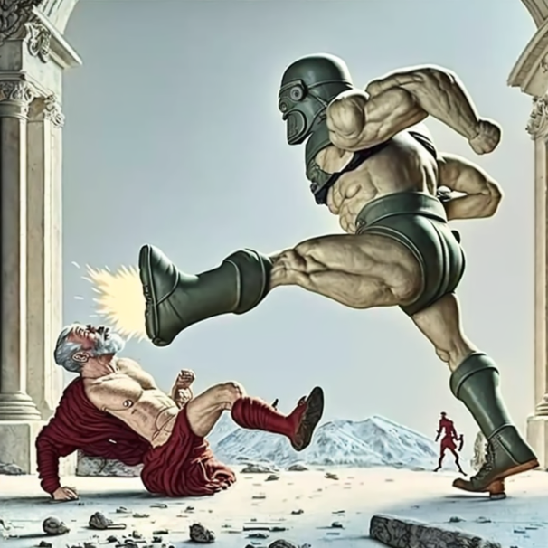
ALGORITHMIC INFORMATION and firing philosophers (FOR REAL THIS TIME)
ALGORITHMIC INFORMATION IS THE ROOT OF ALL OUR PROBLEMS

Slide 2
Efficient market hypothesis
Economist: “If the market weren’t efficient, someone would exploit it and make it efficient. Thus the market must be efficient.”
CSist: “That’s physically impossible.”
The market is efficient “when accounting for imperfect logical knowledge”

Slide 3
Bounded rationality
“Optimal when you account for imperfect logical knowledge” – where else have we heard that before?
We assign a probability of 10% to the trillionth digit of pi, because that’s the best algorithm we have (subject to some constraints)
… or not necessarily the best algorithm. After all, we might not know the best algorithm (or that it is the best algorithm)

Slide 4
GAME dynamics
Assuming perfect rationality is OK for equilibrium applications
What if we want a fundamentally dynamical theory of games and markets?

Slide 5
Market failure
EMH
Decision theory
Game/market dynamics
Algorithmic information
Game/market dynamics
AI alignment
Thermo-dynamics
Bounded rationality
Extrapolated volition

Slide 6
Embedded agency/ Decision theory
Newcomb problem: Box A has $1M iff you reject Box B (which has $10)
Newcomb soda: You drink a soda blindly, which gives you a strong urge to choose either Box A or Box B, and independently gives you $1M or $10
Causal dependence: A = f(B) or B = f(A)
Common cause: A = f(C), B = f(C)
Algorithmic dependence: A = f(C), B = f(D)

Slide 7
Market failure
EMH
Decision theory
Game/market dynamics
Algorithmic information
Game/market dynamics
AI alignment
Thermo-dynamics
Bounded rationality
Extrapolated volition

Slide 8
Extrapolated volition
What are is program’s “utility function”?
Cannot just fit an as-if theory: it is lacking in (algorithmic) information
What would you want if you had all relevant algorithmic information?
Relevant to AI alignment

Slide 9
Market failure
EMH
Decision theory
Game/market dynamics
Algorithmic information
Game/market dynamics
AI alignment
Thermo-dynamics
Bounded rationality
Extrapolated volition

Slide 10
This is the most important thing in the world
The fundamental problem of philosophy
Relevant to AI Notkilleveryoneism
Lots of low-hanging fruit in the adjacent areas
We can finally fire all the philosophers

Slide 11
Idea: agents are markets!
Garrabrant et al (2016) – Logical Induction

