Slide 1


BETTING ON WHAT IS NEITHER VERIFIABLE NOR FALSIFIABLE
You might be willing to bet your life on it, but how?

Slide 2
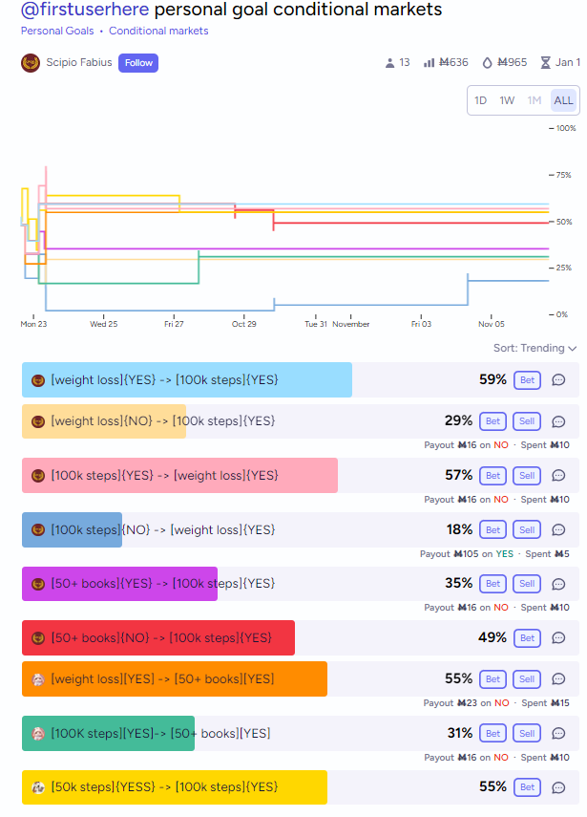
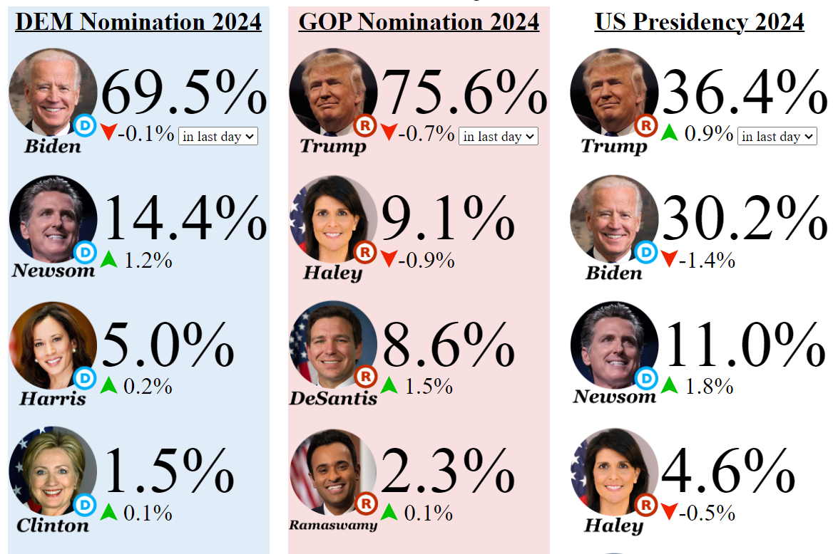
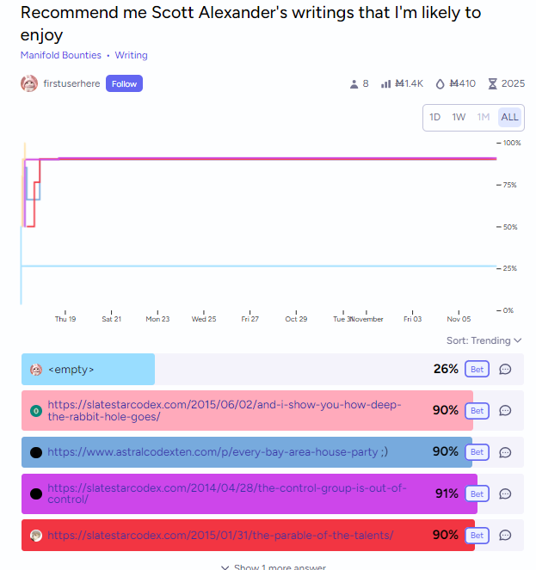
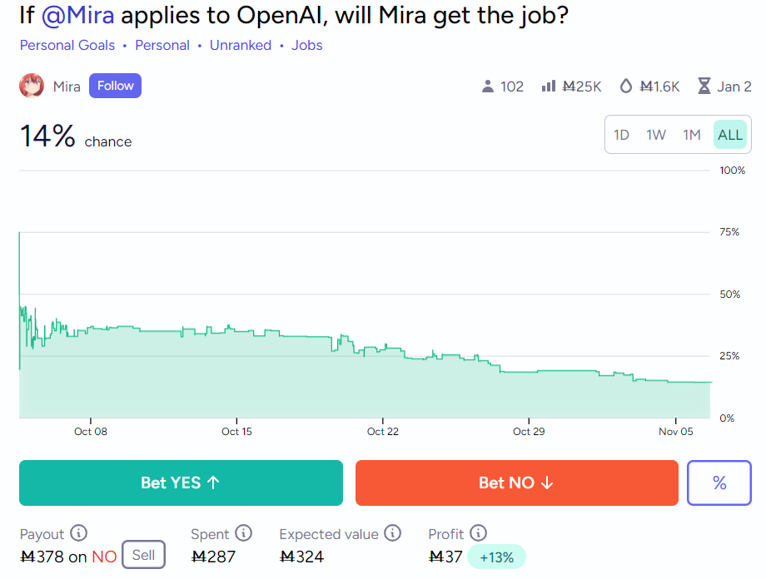
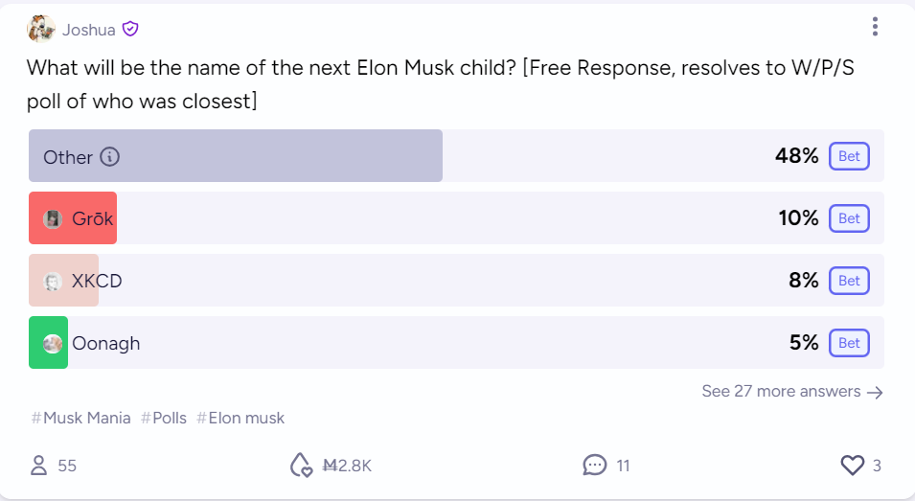
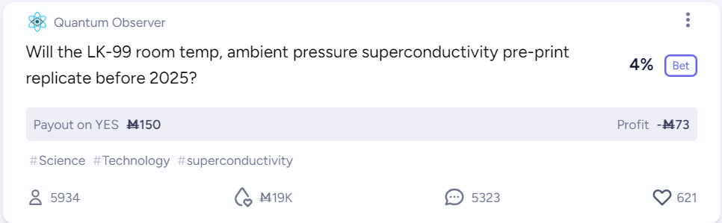
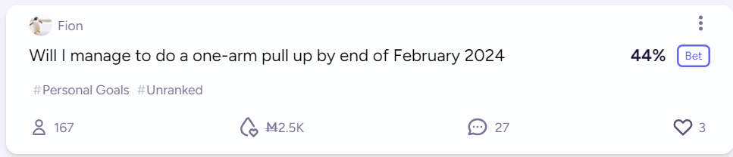

Slide 4
VERIFIABLE, FALSIFIABLE
Δ₀: Questions whose answers we will find out at a definite point in time.
Verifiable: Statements that will be confirmed (if true)
“There is at least one white swan”
“An asteroid will hit the Earth”
“You are mortal”
“P halts”
Falsifiable: Statements that will be refuted (if false)
“All swans are white”
“An asteroid will never hit the Earth”
“You are immortal”
“P doesn’t halt”

Slide 5
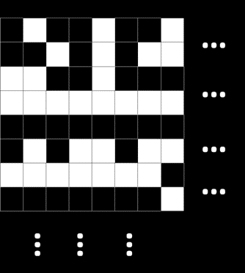
NI
“All men are mortal”
“Every swan will grow a white feather”
“This infinite checkerboard has a completely shaded horizontal row”
“There are an infinite number of primes”
“The limit of this sequence is L”
This feels like it should be meaningful!

Slide 6
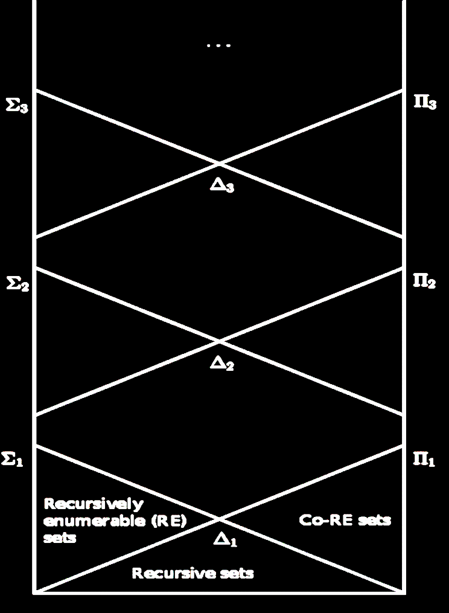
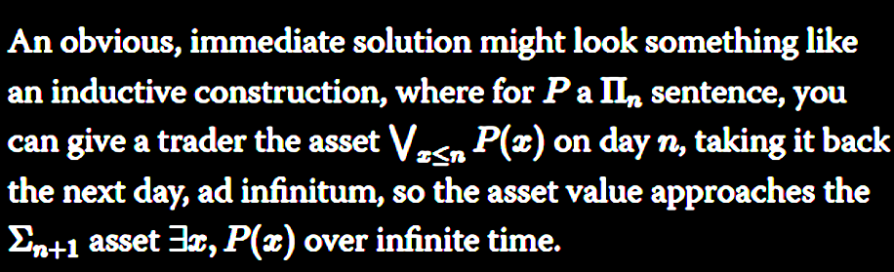
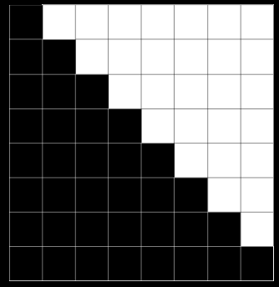
ARITHMETICAL HIERARCHY

Slide 7
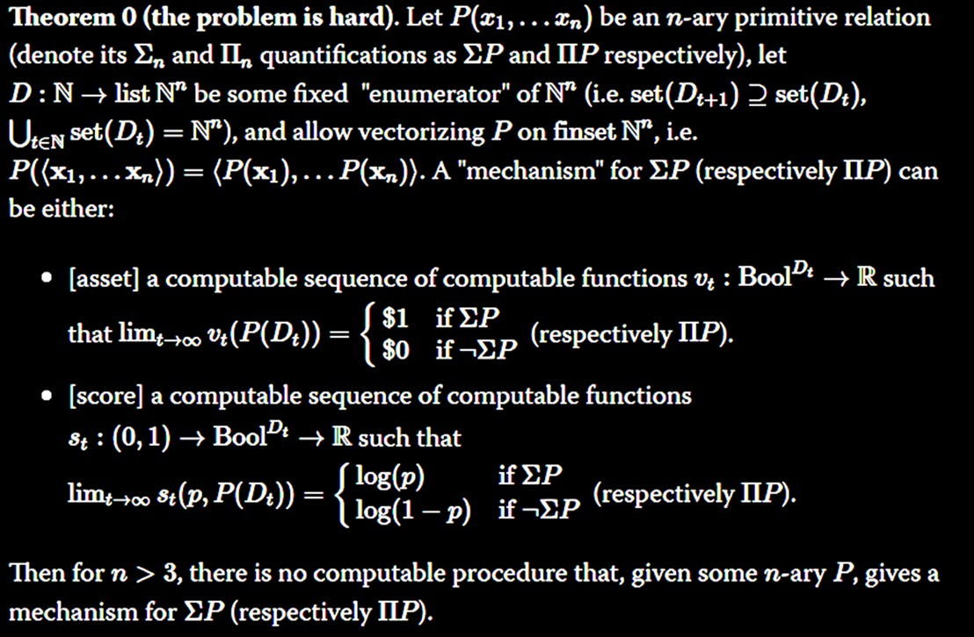
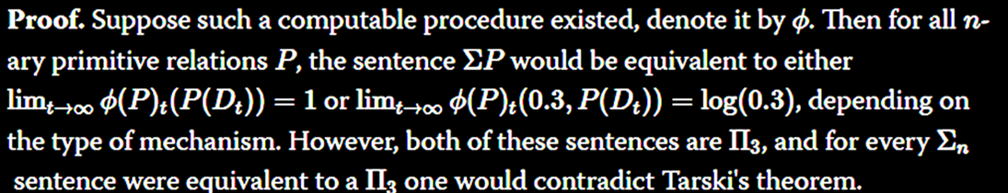
aaaahhh

Slide 8
LET’S PLAY A GAME.
GAME SEMANTICS

Slide 9
fbafakjdjfnsf
Wait
How about this game
“∀x, ∃(y,z), BB(z) = y ∧ y > x”

Slide 10
CONSTRUCTIVISM
“ The Probability that WE WILL CONSTRUCT an x such that for all y WE WILL CONSTRUCT, P(x, y)

Slide 11
SOFT NON-CONSTRUCTIVISM
An event I that gives no information on A or on B, but gives information on A ∪ B.
I have two children; A is “my eldest is a boy”; B is “my youngest is a boy”; I is “I have a boy and a girl”.

Slide 12

HARD NON-CONSTRUCTIVISM
An event I that is independent of every finite union $\underset{i∈S}{∪}A_{i}$ but informs
the countable union $\underset{i∈ℕ}{∪}A_{i}$
(Not really possible in probability theory)

Slide 13
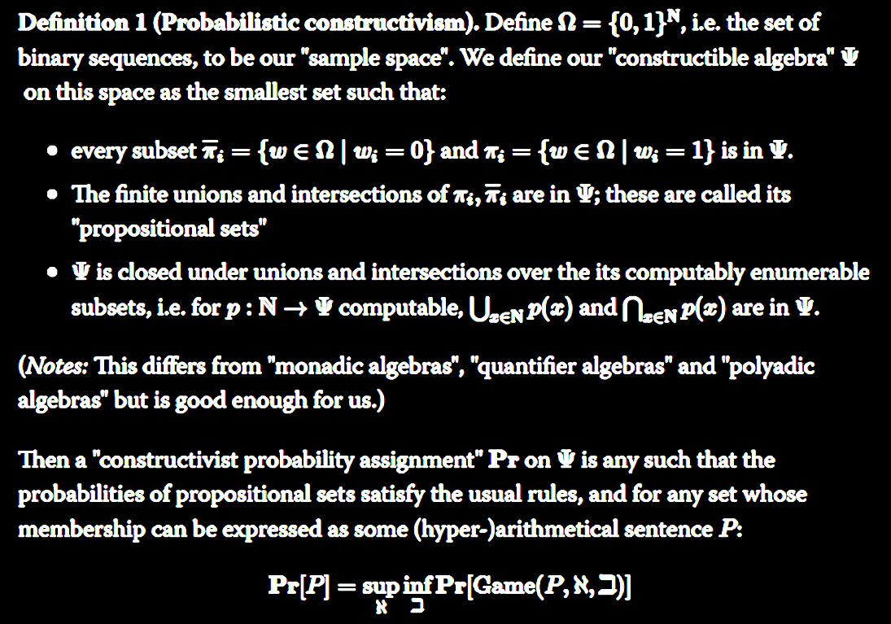
PROBABILISTIC CONSTRUCTIVISM

Slide 14
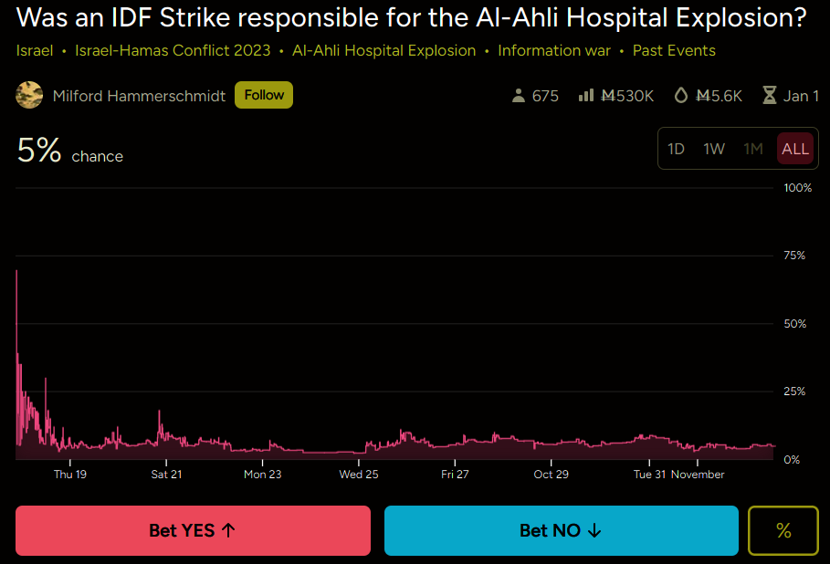
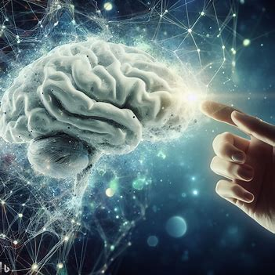
The real reason this is important
“If a tree falls down in the forest, and no one’s there to bet on it … does it make a sound?”
What caused the Late Bronze Age Collapse?

