Slide 1
Landsat Soil Classification
AI For Engineers(S-22) Project
Group Members:-
1. Abhishek Mhamane (BT18CIV057)
2. Darshan Dhote (BT18CME070)
3. Nerella Akhil (BT18MEC076)
4. Chilagani Chaitanya Chandra (BT18MEC132)
5. Jillella Sai Charan Reddy (BT18ECE123)

Slide 2
Contents
Introduction
Dataset
Expletory Data Analysis
Data Pre-Processing
Methodology
Model Architecture
Training Info
Results

Slide 3
Introduction
Machine Learning as a technique has revolutionized many fields. One such field is that of Remote Sensing.
Remote Sensing data is huge, 1 scene covering 30x30 km area would be several Gb’s in size.
Analysing such huge data requires automated methods – thus machine learning and deep learning methods are widely utilised for image classification, feature extraction, image segmentation.
In this project we are going to take a smaller example and will attempt technology demonstration on the Statlog (Landsat Satellite) Data Set from UCI ML Repository

Slide 4
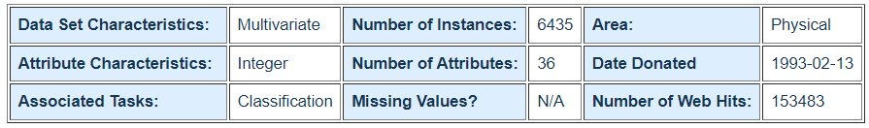
About the Dataset
Dataset Name - Statlog (Landsat Satellite) Data Set
Dataset hosted at - https://archive.ics.uci.edu/ml/datasets/Statlog+%28Landsat+Satellite%29
Source: Ashwin Srinivasan, Department of Statistics and Data Modeling,
University of Strathclyde, Glasgow, Scotland, UK
ross@uk.ac.turing
Dataset Information
The database consists of the multi-spectral values of pixels in 3x3 neighborhood's in a satellite image, and the classification is associated with the central pixel in each neighbourhood.
The aim is to predict this classification, given the multi-spectral values. In the sample database, the class of a pixel is coded as a number.

Slide 5
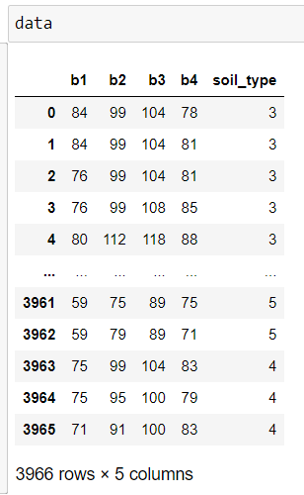
Continued..
The number is a code for the following classes: 1 - red soil 2 - cotton crop 3 - grey soil 4 - damp grey soil 5 - soil with vegetation stubble 6 - mixture class (all types present) - There are no examples with class 6 in this dataset. 7 - very damp grey soil
The four spectral values for the central pixel are given by attributes 17,18,19 and 20. If you like you can use only these four attributes, while ignoring the others.

Slide 6
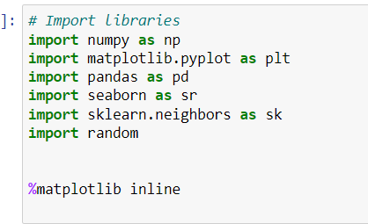
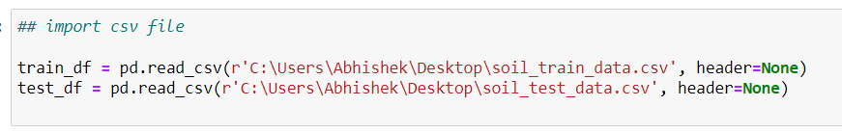
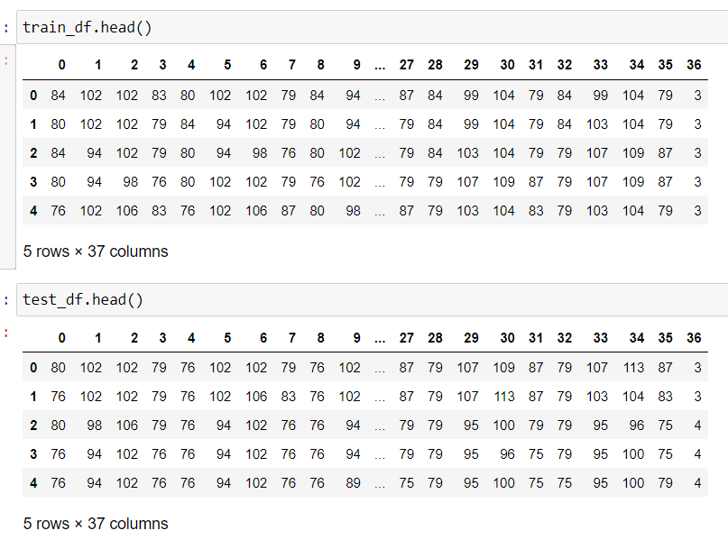
Exploratory Data Analysis and Data Processing
Importing required Libraries
Importing data files
Exploring data
As mentioned in Dataset information we need to isolate the central pixels.

Slide 7
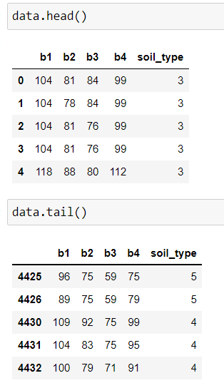

The given data is reduced to just the central px spectral values.
A new pandas DataFrame was created for clipped data.
We are avoiding any kind of normalization or standardization to a scale of 0-1 as these sensors are independent and sensor calibration data is not available.
Generally DN values need to be converted to Surface Reflectance values by using specified gain and multiplication factor.

Slide 8
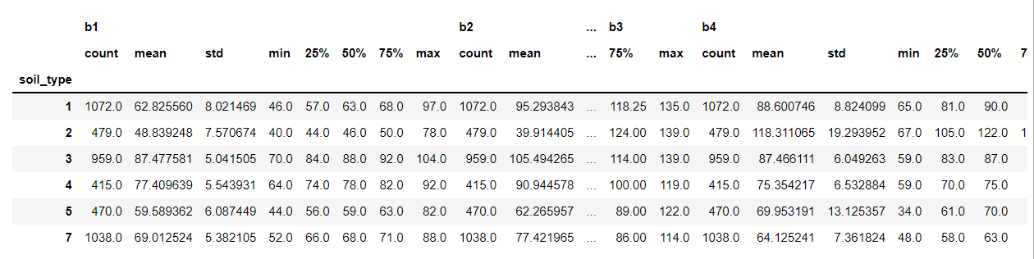
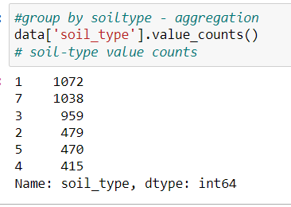
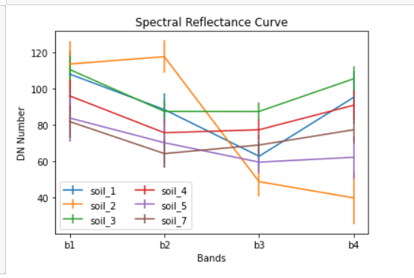
Data skew

Slide 9
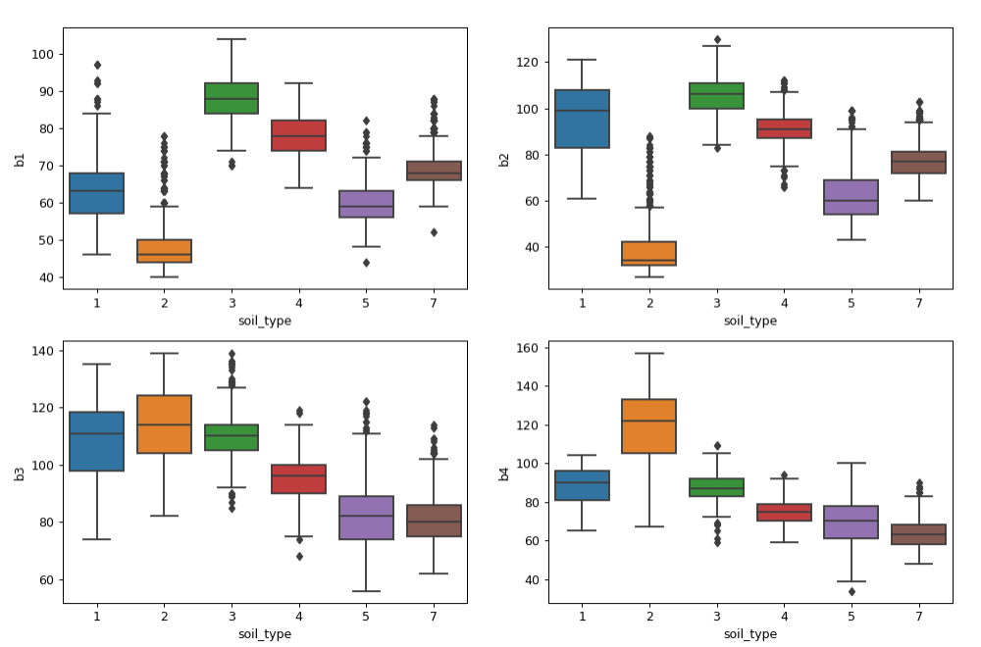
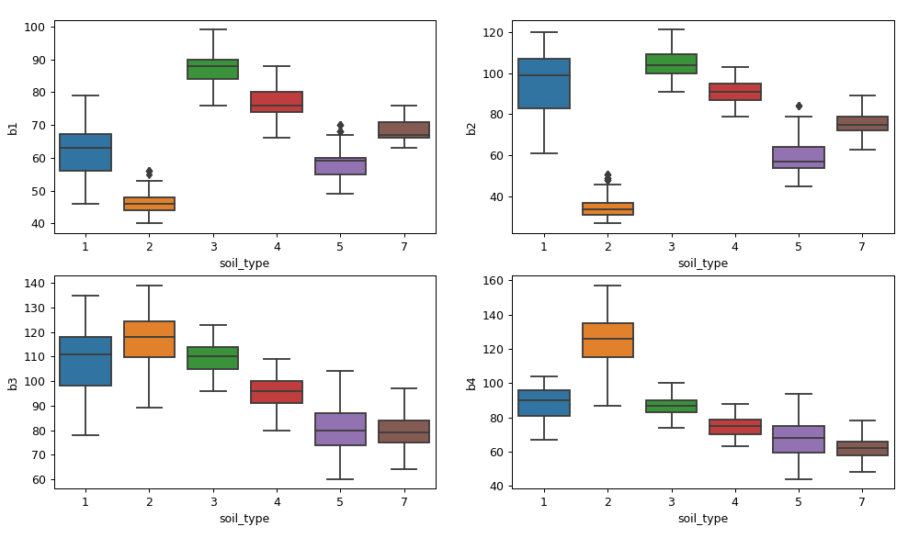
Box Plot Raw Train Data
Box Plot Clean Train Data

Slide 10
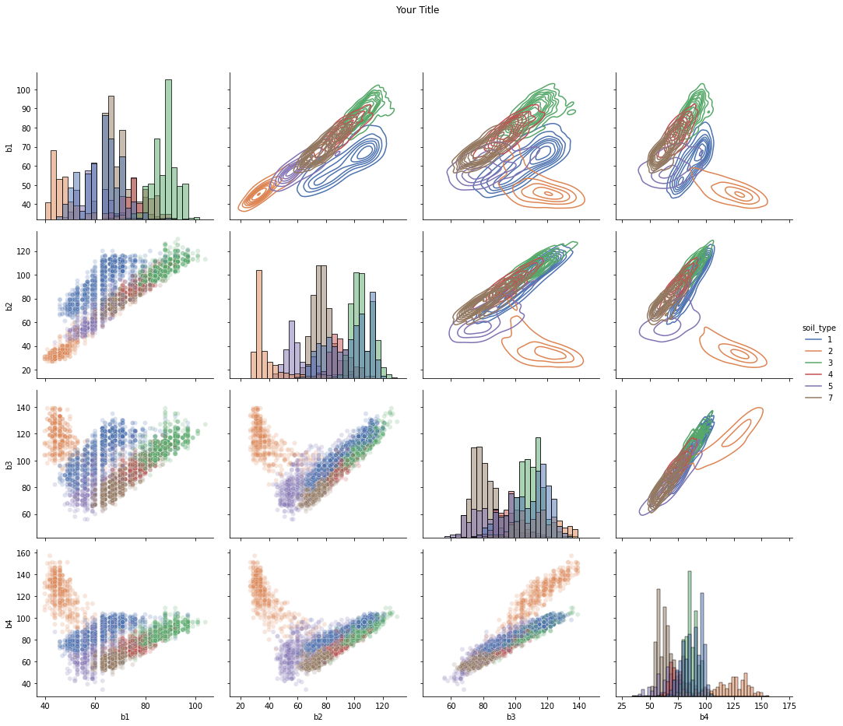
Pair Plot – Scatter and KDE of Raw Train Data

Slide 11
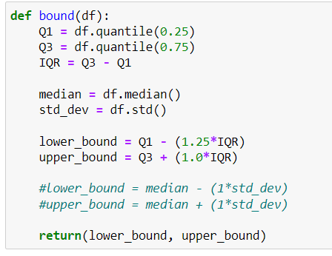
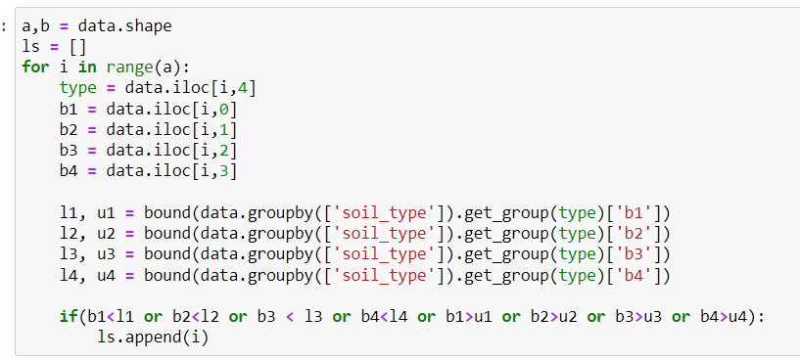
From Spectral Reflectance Curves and group statistics it can be observed that there is large std deviation in the data.
From Box Plot chart it is observed that there are large number of outliers.
Outliers have bad influence on overall classification, thus need to be removed.

Slide 12
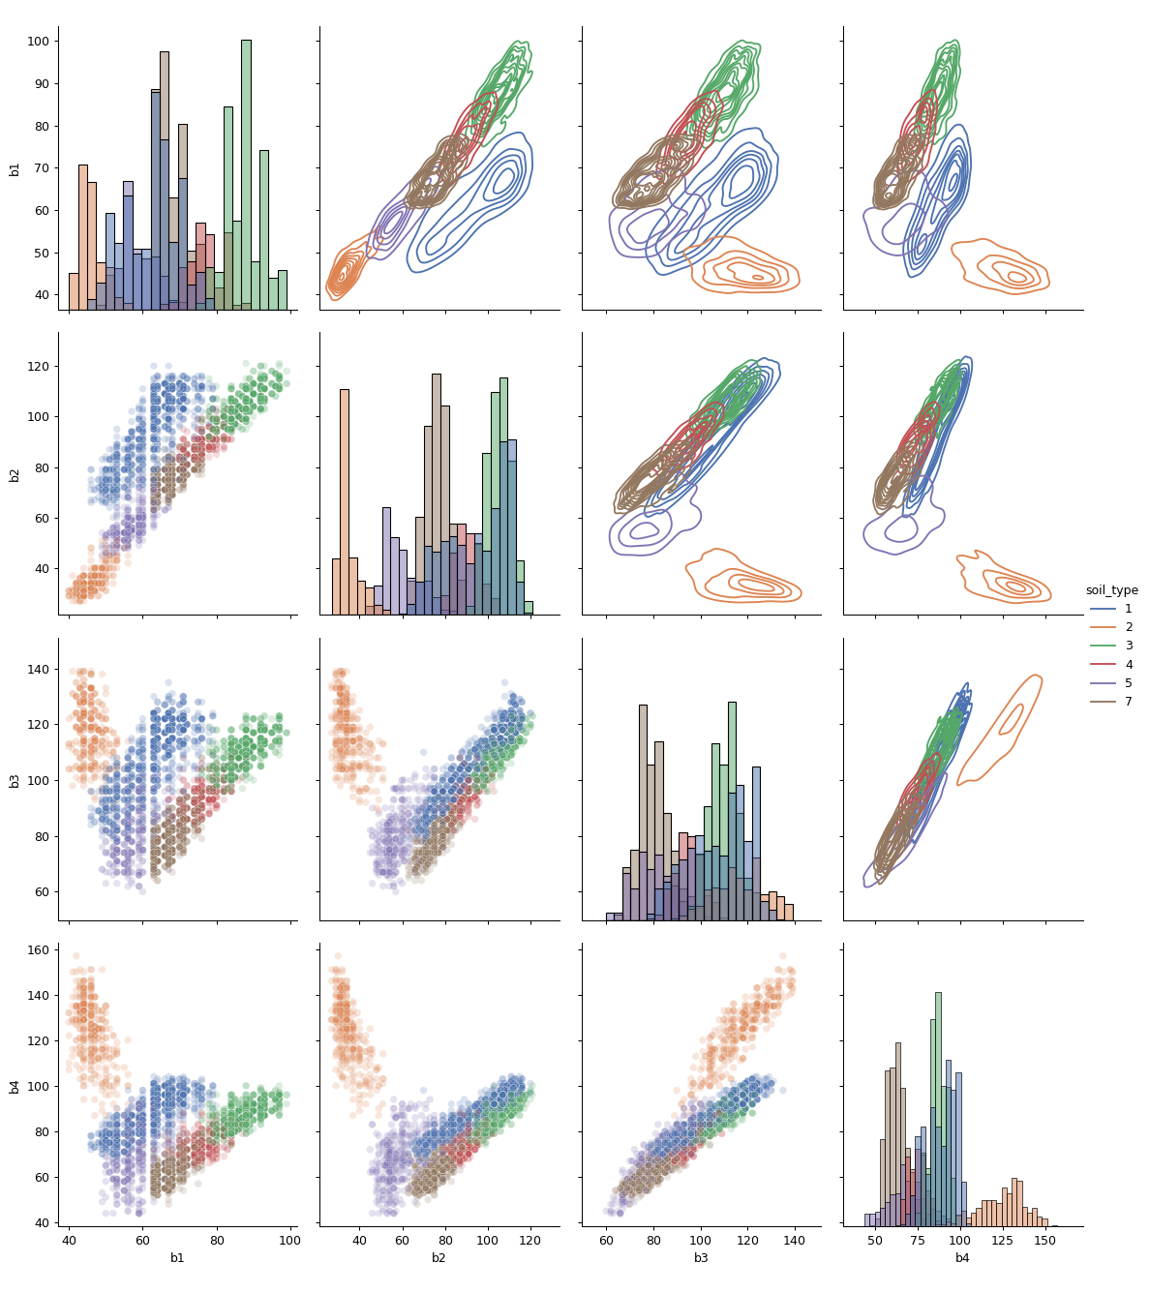
Pair Plot – Scatter and KDE of Clean Train Data

Slide 13
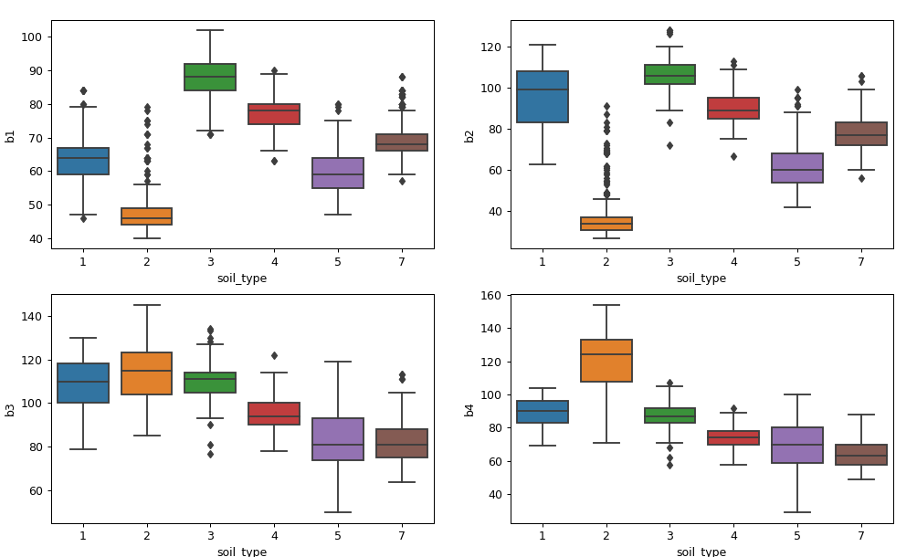
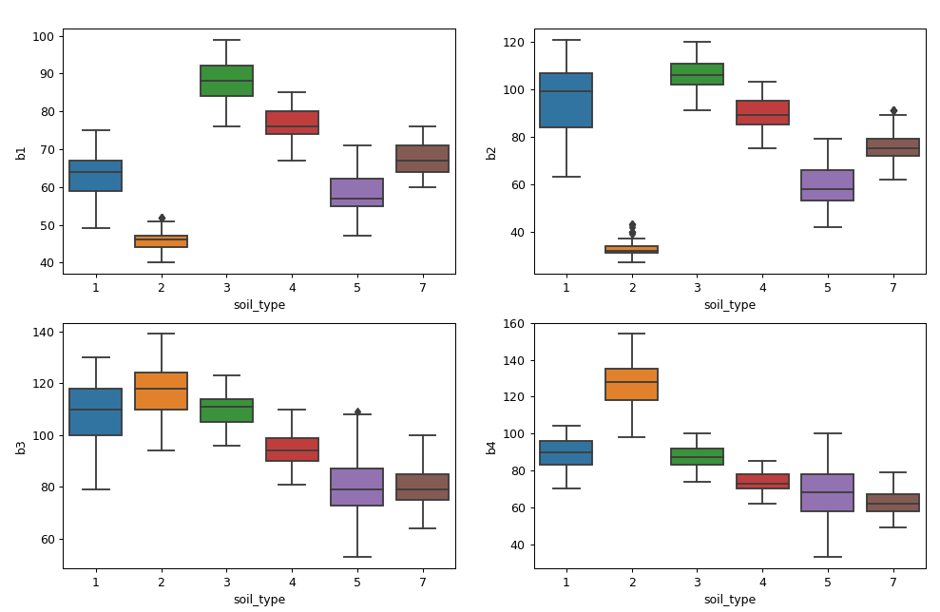
Box Plot Raw Test Data
Box Plot Clean Test Data

Slide 14
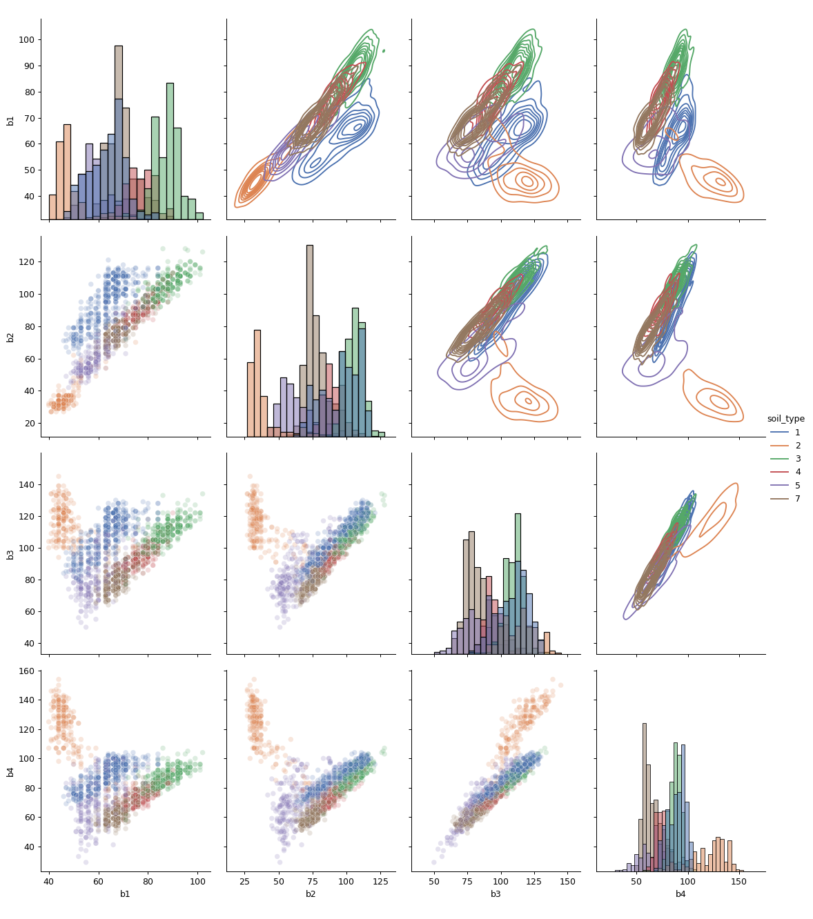
Pair Plot – Scatter and KDE of Raw Test Data

Slide 15
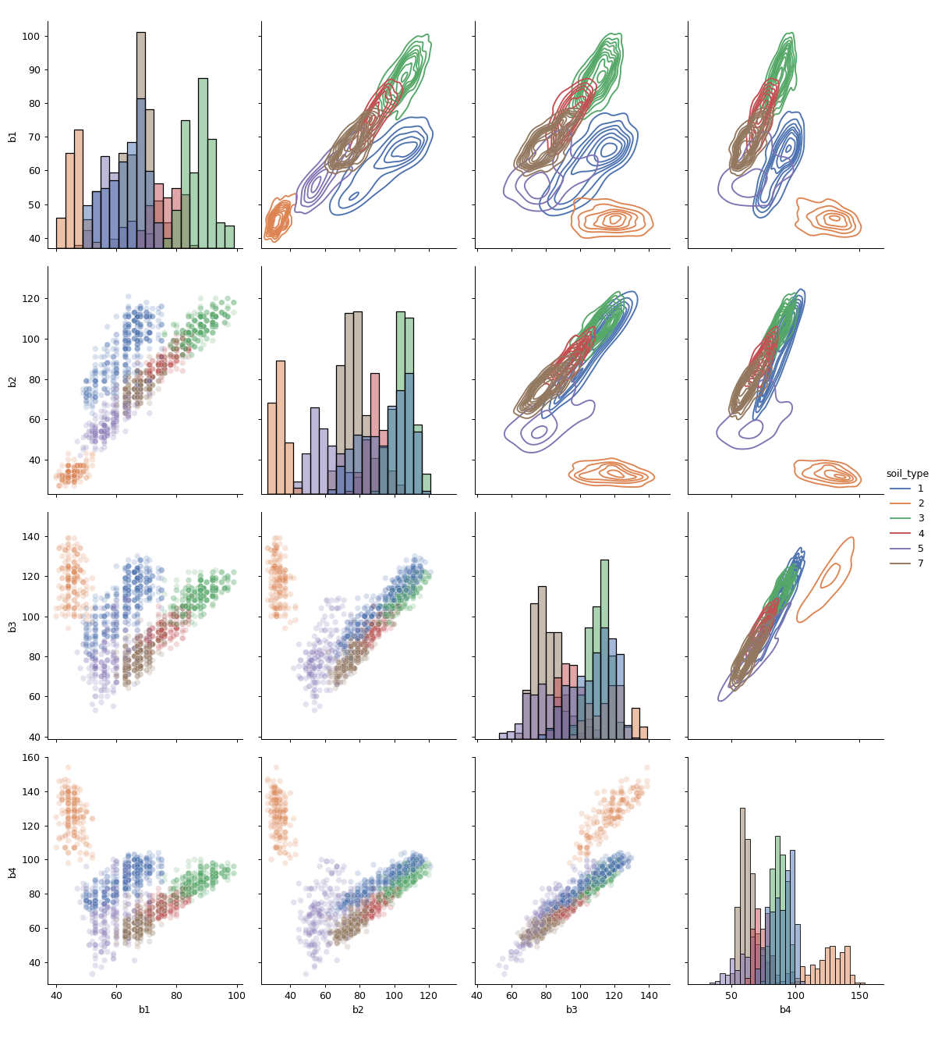
Pair Plot – Scatter and KDE of Clean Test Data

Slide 16
Multi-Class Classification using Sklearn and Visualization
We utilized pre implemented models in the SK Learn module
This was done to access the data and feasibility of developing an ANN from fist principle for this dataset.
Different statistical and ANN based models were prepared, keeping in mind the scatter plot distributions of training data.
We have tried to further develop understand the “Black-Box” ANN and ML models by visualizing decision boundries.
As the data has 4 features/Bands, a 4D visualization is “Not possible”.
Thus we considered any 2 best fit features for visualizations using
Matplotlib.pyplot.contour() and
Matplotlib.pyplot.contour() methods
Visualizations of K Nearest Neighbour, Nearest Centroid and ANN model are presented.

Slide 17
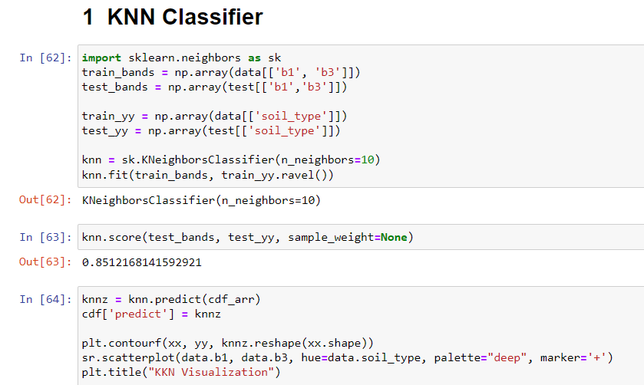
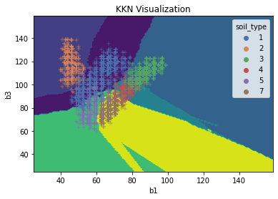
K-Nearest Neighbours is a statistical Classification Algorithm.

Slide 18
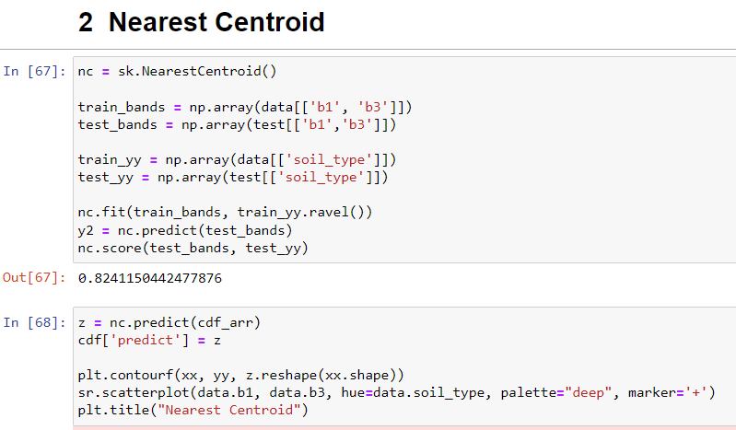
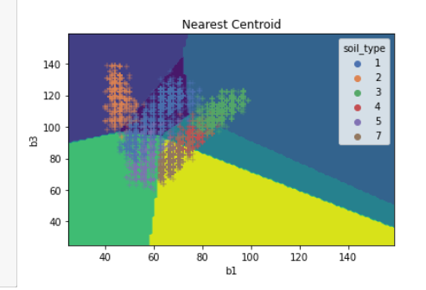
Decision boundaries are quite linear as compared to K Nearest Neighbour.
Nearest Centroid is also a Statistical Classification Algorithm.

Slide 19
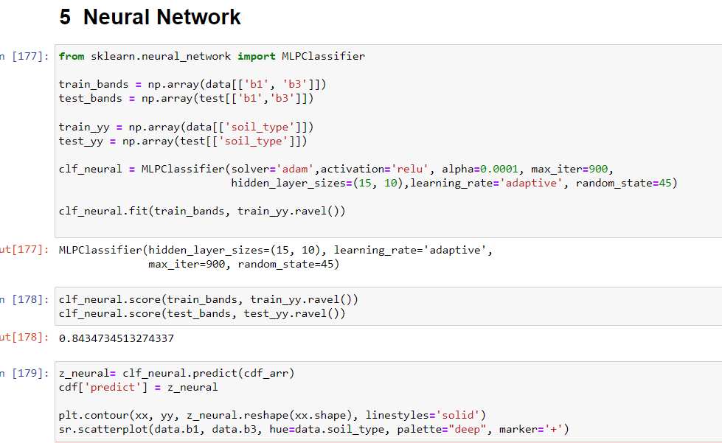
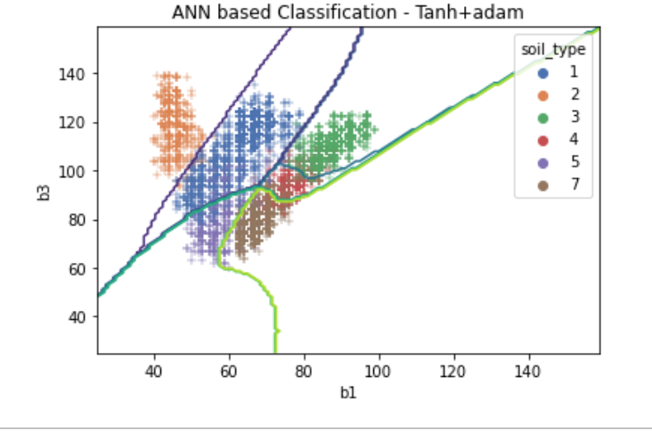
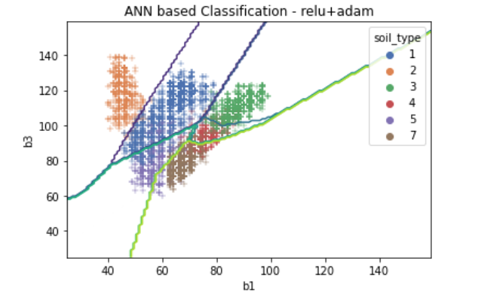
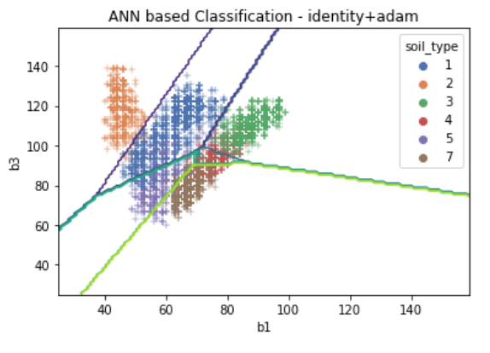
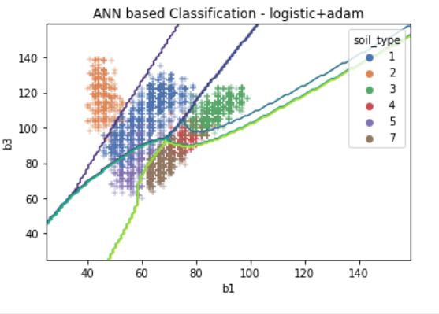
Same Architecture but different activation functions lead to different levels on non-linearity in decision boundary.
Accuracy was more or less similar ~ 82% - 84%

Slide 20
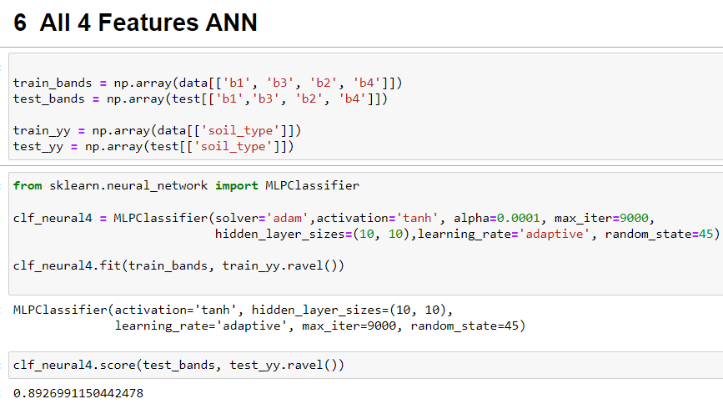
The decision boundary cannot be visualized for a 4 feature vector model as the hyperplane will be 4 dimensional.

Slide 21
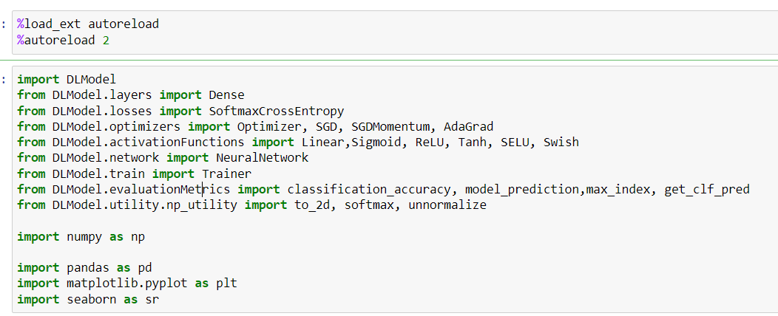
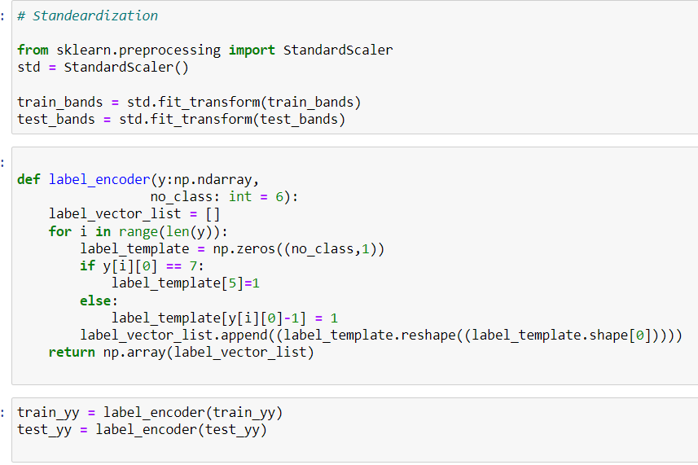
Using First Principles

Slide 22
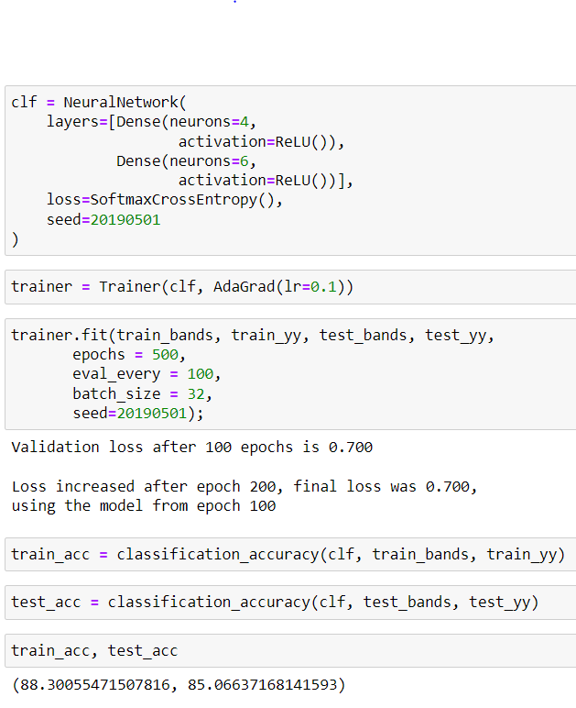

Slide 23
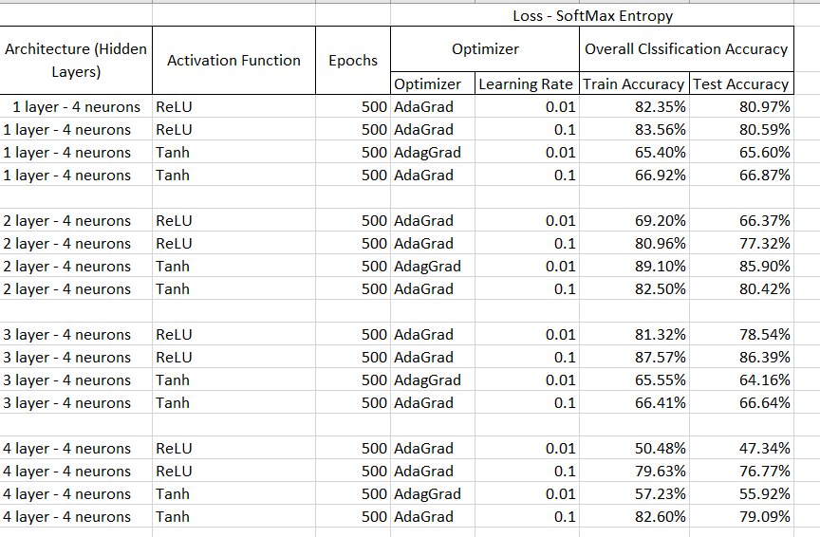
Different Architecture and their performances

Slide 24
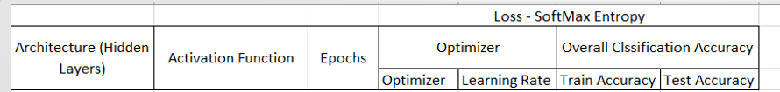
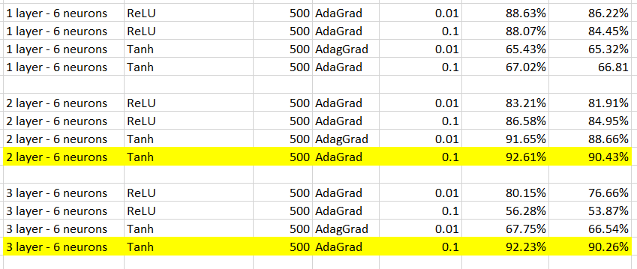

Slide 25
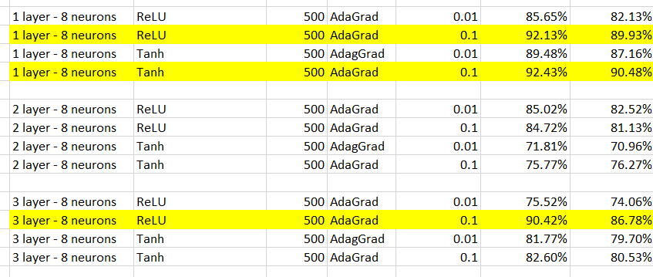
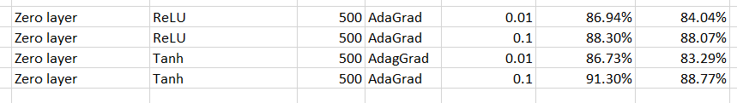

Slide 26
Results and Conclusion
Raw data was processed and cleaned to remove Outliers.
Soil Classification was achieved with ~90% accuracy.
Different ANN Architectures were compared to achieve optimal design.
“Black Box” Nature of ANN Classifiers was understood by visualizing decision boundaries.

Slide 27
Thank You

