Slide 1
ASSET MANAGEMENT SYSTEM
Team Members:
Abhishek Mishra
Samiran Kosambe
Amarsinh Dhepe
Mentor :Vaishali Shrivastava
Notes:
Add instructor notes here.

Slide 2
OBJECTIVES
Project Understanding
Approach used
Project Execution
Modules
Learning
Best Practices
Opportunity for improvement
Notes:
Add instructor notes here.

Slide 3
PROJECT UNDERSTANDING
The main objective of this project is to design and develop an Asset Management System for an organization.
Asset Management System is used to search for an asset based on search condition, assign a hardware asset to/from an employee based on request, insert new asset details, modify an existing asset details and display all asset allocation request details.
The Asset Management System is an integrated system that contains both the Manager and Admin.

Slide 4
High Level Design Diagram
Controller
Microservice
User Interface
Controller
Service
Dao
Database

Slide 5
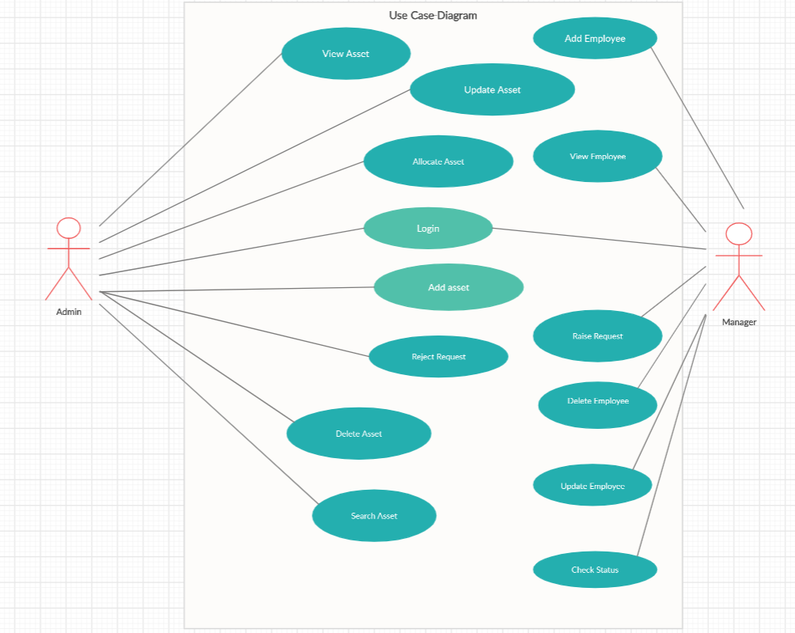
USE CASE DIAGRAM

Slide 6
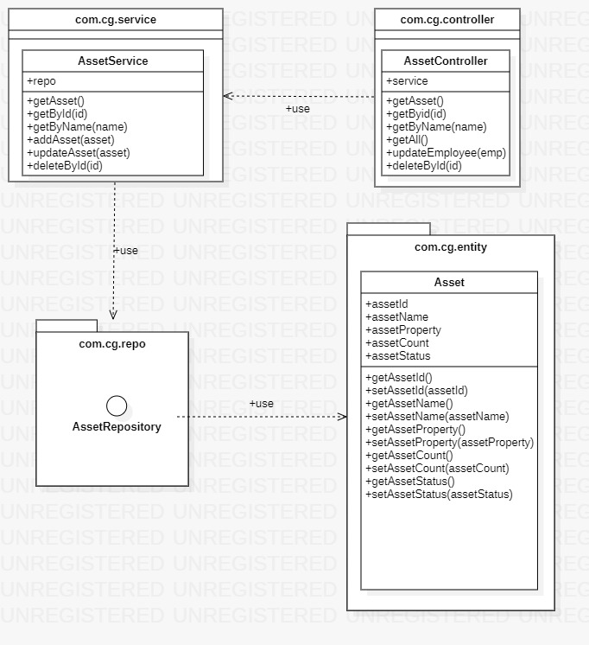
CLASS DIAGRAM FOR ASSET

Slide 7
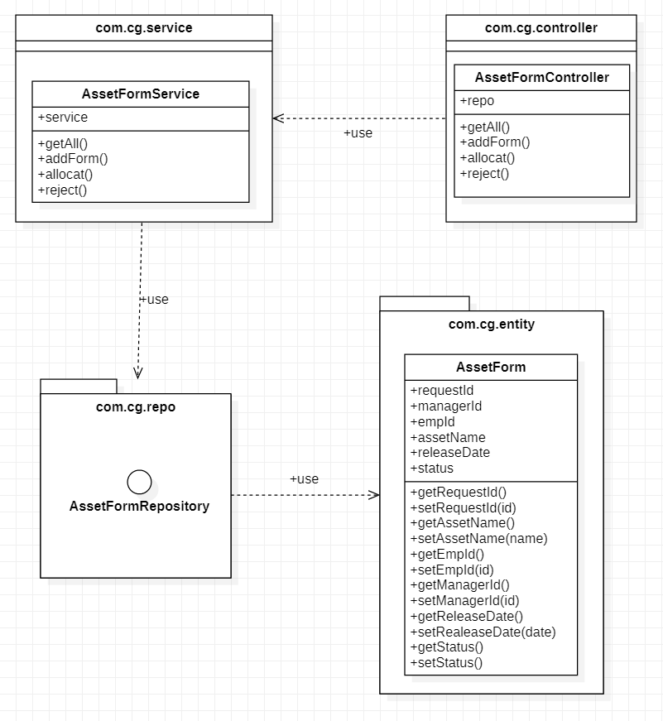
CLASS DIAGRAM FOR ASSET FORM

Slide 8
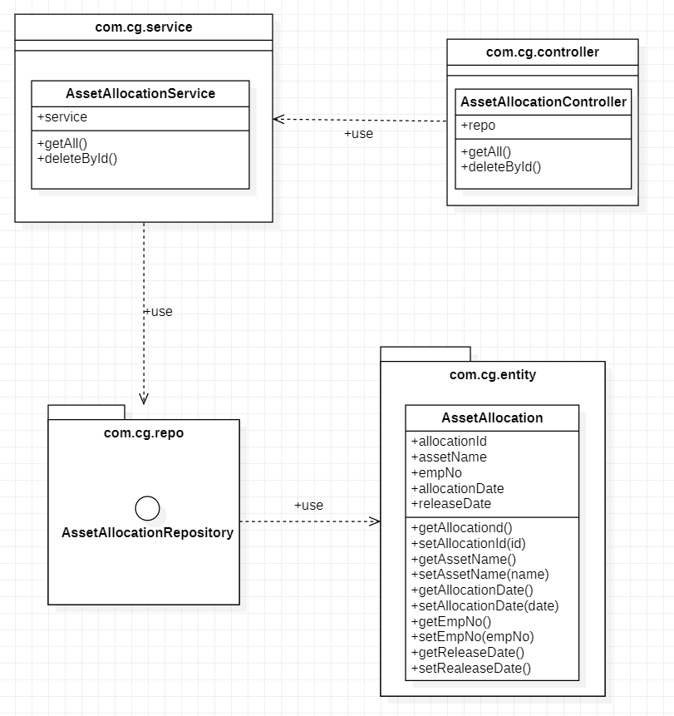
CLASS DIAGRAM FOR ASSET ALLOCATION

Slide 9
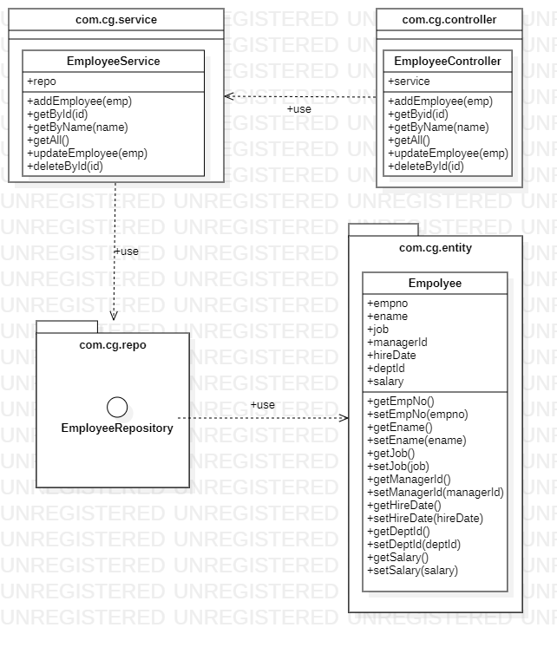
CLASS DIAGRAM FOR EMPLOYEE

Slide 10
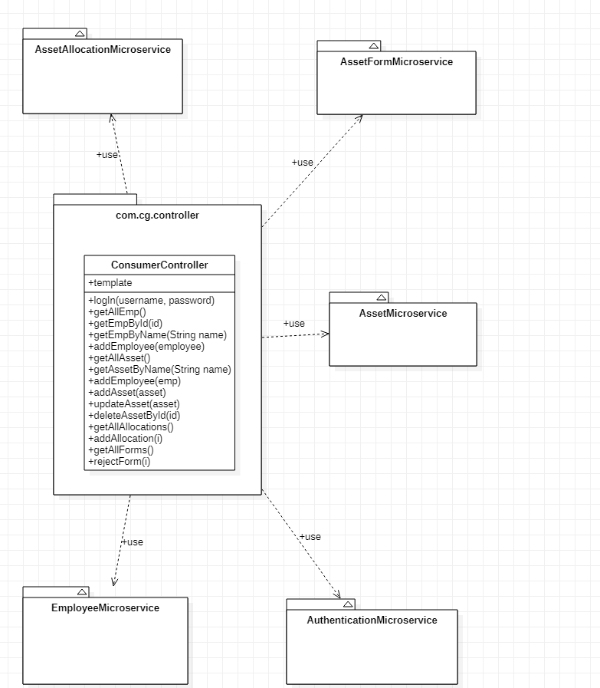
AssetManagementSystemConsumer Class Diagram

Slide 11
APPROACH USED
Business Logic Components and Services :-
-Spring Boot
-Microservices
Databases:-
-H2 Database

Slide 12
PROJECT EXECUTION
Login Module
Manager Module
Admin Module

Slide 13
LOGIN MODULE
Login:
Manager can login into the portal through his/her login credentials.
Admin can also login into the portal.

Slide 14
MANAGER MODULE
Manager:
Login
Raise request for his/her employee
View status of the raised request

Slide 15
ADMIN MODULE
Admin Module:
Login
Add new asset/ modify asset details from the inventory.
Approve/Reject an asset request raised by Manager

Slide 16
LOGIN MODULE
Manager Module:
Login module is common for both manager and admin.
Take login credentials from the manager.
If login credentials are wrong, will give error message .
If login is successful, will navigate to manager portal.

Slide 17
LOGIN MODULE
Admin Module:
Take login credentials from the admin.
If login credentials are wrong, will give error message .
If login is successful, will navigate to admin portal.

Slide 18
MANAGER MODULE
Manager can raise a request for allocation of asset to an employee.
Manager have to fill up the asset requisition form while raising a request for an asset.
Manager can view the status of raised request.

Slide 19
ADMIN MODULES
Admin can add new asset.
Admin can modify details of an existing asset.
Admin can Approve/Reject a request for asset.

Slide 20
LEARNING
We have implemented the Asset Management System project, using Spring boot framework with JPA, Microservice.
We have learned to work as a team.
Time Management and division of work.
Supporting team members in the work.

Slide 21
BEST PRACTICES
Followed placing comments in appropriate places
Followed naming conventions.
Followed proper indentation.

Slide 22
OPPORTUNITY FOR IMPROVEMENT
The following features can be further implemented to improve the project:-
-Notification of document status to employee through messages.

Slide 23
MVP PLAN
MVP | Product | Start Date | End Date | Remarks
1 | Employee Service | 6/6/2020 | 10/6/2020
2 | Asset Service | 6/6/2020 | 10/6/2020
3 | AssetForm Service | 6/6/2020 | 10/6/2020
4 | AssetAllocation Service | 8/6/2020 | 10/6/2020
5 | Authentication Service | 8/6/2020 | 10/6/2020
6 | AssetManagementSystemConsumer Service | 9/6/2020 | 10/6/2020

Slide 24
THANK YOU

