Slide 1
MEAN SQUARE ERROR
Probability and Statistics for Data Science

Slide 2
DEFINITION
Mean squared error (MSE) of a statistical model is the mean of the squared difference of the expected values predicted by the model and the actual observed values of the experiment.
Mean squared error (MSE) measures the amount of error in statistical models.
It assesses the average squared difference between the observed and predicted values.
The mean squared error is also known as the mean squared deviation (MSD).
Analogous to variance of data set.

Slide 3
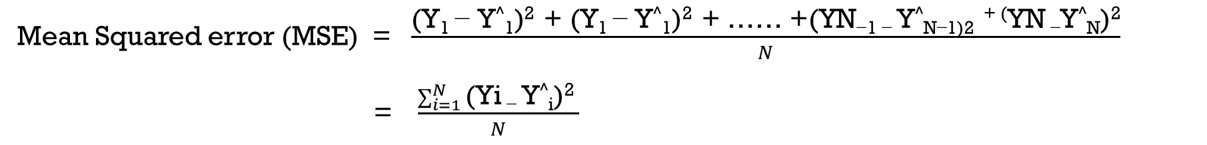
formula
ACTUAL VALUE | EXPECTED VALUE | DIFFERENCE | SQUARED DIFFERENCE
Y₁ | Y^₁ | Y₁ - Y^₁ | (Y₁ - Y^₁)²
Y₂ | Y^₂ | Y₂ - Y^₂ | (Y₂ - Y^₂)²
. . . | . . . | . . . | . . .
Y_{N-1} | Y^_{N-1} | Y_{N-1} - Y^_{N-1} | (Y_{N-1} - Y^_{N-1})²
Y_{N} | Y^_{N} | Y_{N} - Y^_{N} | (Y_{N} - Y^_{N})²
Mean Squared error (MSE) = $\frac{\text{(}\text{Y}\text{1 }\text{− }\text{Y}\text{^}\text{1}\text{)}\text{2 }\text{+ (}\text{Y}\text{1 }\text{− }\text{Y}\text{^}\text{1}\text{)}\text{2 }\text{+ …… +(}\text{YN}\text{−1 − }\text{Y}\text{^}\text{N}\text{−1)2 + }\text{(}\text{YN}\text{ −}\text{Y}\text{^}\text{N}\text{)}\text{2}}{N}$
= $\frac{\sum_{i=1}^{N}{\text{(}\text{Yi}\text{ − }\text{Y}\text{^}\text{i}\text{)}\text{2 }}}{N}$

Slide 4
Key features
When a model has no error, the mean squared error equals zero. As error in the model increases, its value also increases.
Squaring the differences eliminates negative values for the differences and ensures that the mean squared error is always greater than or equal to zero.
Squaring increases the impact of larger errors. These calculations disproportionately penalize larger errors more than smaller errors. This property is useful to have only smaller errors.
Square root of the MSE, gives root mean square error (RMSE), RMSE is analogous to the standard deviation.
RMSE is given as square root of MSE and gives the average value by which each value is deviated from the actual value.

Slide 5
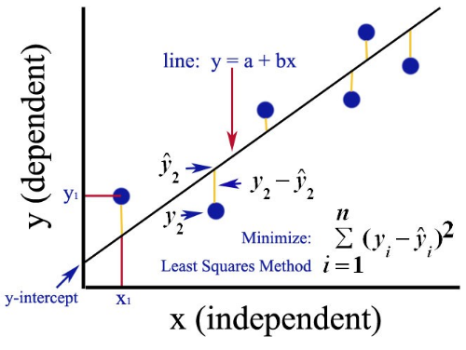
Example : linear regression

Slide 6
Worked out EXAMPLE
INDEPENDENT VARIABLE (x) | DEPENDENT VARIABLE (y)
2 | 3
4 | 7
6 | 5
8 | 10
The given data describes two variables one dependent variable y and another independent variable x. The relationship between them is unknown that is for f(x) = y, function f() is unknown, we are assuming that they have a linear relationship and applying linear regression which gives the value of m and c such that y = mx + c.
Linear regression use the concept of mean square error , the idea is to minimise the mean square error. By applying linear regression on the above data we get m = 0.95 and c = 1.5

Slide 7
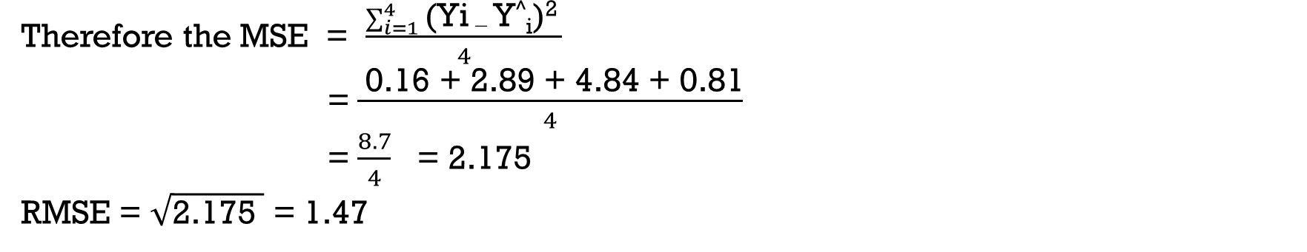
ACTUAL VALUE ( from given data ) | EXPECTED VALUE ( y = 0.95x + 1.5 ) | DIFFERENCE | SQUARED DIFFERENCE
3 | 3.4 | -0.4 | 0.16
7 | 5.3 | 1.7 | 2.89
5 | 7.2 | -2.2 | 4.84
10 | 9.1 | 0.9 | 0.81
Therefore the MSE = $\frac{\sum_{i=1}^{4}{\text{(}\text{Yi}\text{ − }\text{Y}\text{^}\text{i}\text{)}\text{2 }}}{4}$
= $\frac{ \text{0.16 + 2.89 + 4.84 + 0.81}}{4}$
= $\frac{8.7}{4}$ = 2.175
RMSE = $\sqrt{\text{2.175 }}$ = 1.47

Slide 8
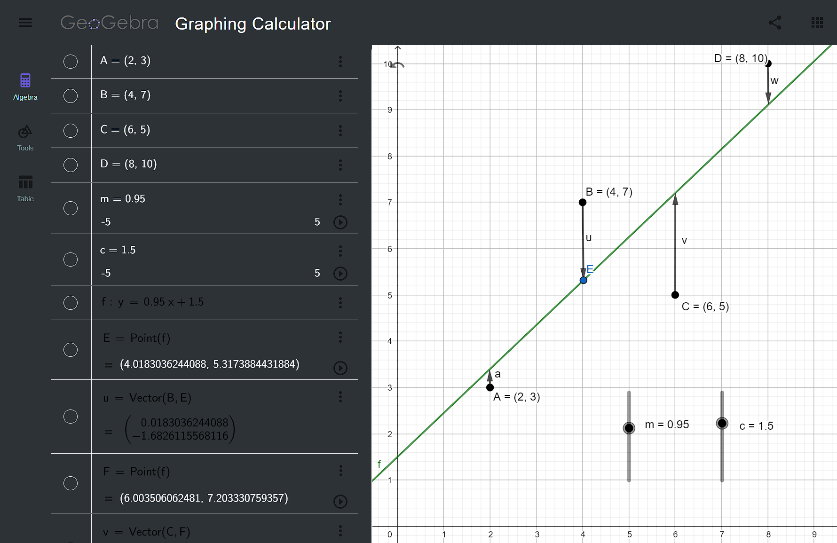
https://www.geogebra.org/graphing/rdzaxs95

Slide 9
THANK YOU

