Slide 1
Committee meeting
April 12, 2021
Abhinab Kadel
M.Sc. Student Atmospheric sciences
Weather forecast research team (wfrt),
Department of earth, ocean and atmospheric sciences (Eoas)

Slide 2
Contents
RECAP
ACTIVITIES SINCE LAST MEETING
Courses and new skills learnt
THESIS:
Changes, new research questions, current work,
Future work and timeline
WATERSHED PRECIP PROJECT
QUESTIONS AND SUGGESTIONS

Slide 3
RECAP

Slide 4
Summary of previous meeting
Thesis interest:
probabilistic precipitation forecasts
specific watersheds containing run-of-river in BC and Nepal
evaluate economic value
Suggestions:
Narrow down thesis topic
Present a timeline
Program Start: Sept 2019
Coursework completed: 14/18 CP

Slide 5
Activities since last meeting

Slide 6
New courses
STAT 545A: Data Analysis I (1.5 CP)
Introduction to R and R concepts:
data frames, functions and data visualisation
Version control using Git
STAT 545B: Data Analysis II (1.5 CP)
Advanced concepts:
data and string manipulation (regex)
interactive apps using Shiny
create R packages
functional programming using purr package

Slide 7
courses
Completed Courses:
ATSC 448A: Directed Studies (3 CP)
ATSC 201 + Research Proposal
CEEN 525: Energy Policy (2 CP)
ATSC 507: Numerical Weather Prediction (3 CP)
EOSC 511: Numerical Techniques for EOAS (3 CP)
ECON 471: Economics of Non-Renewable Resources (3 CP)
Grades: >80% for all the courses
Missing 1 CP of coursework

Slide 8
content creation
Prepare contents for ATSC 313
New course by Doug and Roland
Renewable Energy Meteorology
Topics related to solar energy:
Solar energy technologies
Energy yield calculation
Position of sun
Pollution effects

Slide 9
new tools
QGIS
Spatial Data Analysis
working with shapefiles using Python and QGIS

Slide 10
thesis

Slide 11
Proposed changes
Area:
Focus entirely in Nepal
Forecast variable:
Streamflow and Energy yield
Research Questions:
How reliable are the streamflow forecasts for a hydropower operator?
How useful are these forecasts for different operational scenarios faced by a run-of-river hydropower?

Slide 12
Motivation
streamflow information is preferred
both plant owner and utility
used in initial hydropower design
streamflow model present for flood forecasting
covers major rivers and segments
familiarity of the market and regulations
easy to reach out to stakeholders and acquire resources.
physical presence
access to contacts

Slide 13
Streamflow forecast
10 day ensemble forecast
uses ECMWF forecast
Forecast chain:
Precipitation Forecast
Runoff
Streamflow

Slide 14
Gridded runoff
Precipitation + runoff:
output from a NWP model
global ECMWF Integrated Forecast System
1 control + 50 perturbed + 1 high res
runoff using Land Surface Model (LSM)
LSM used: HTESSEL
LSM provide lower boundary condition for a NWP model
output is gridded surface and subsurface runoff
also obtained through WRF

Slide 15
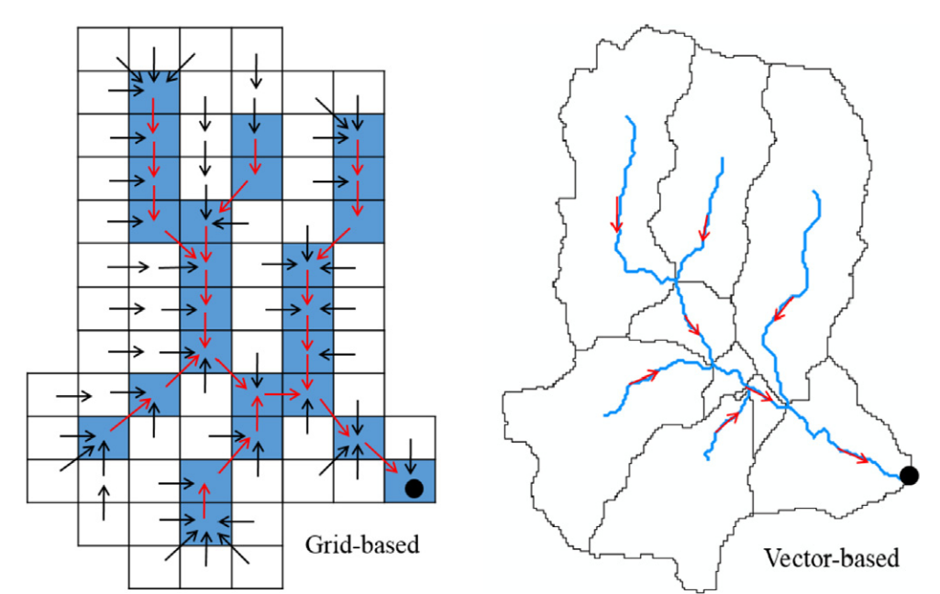
routing
estimate flow downstream based on upstream flow
Grid-based:
river segments are discretized into grids
LISFLOOD (GloFAS)
Vector-based
1 river segment = 1 line
RAPID (Streamfow Prediction – Nepal)
Source: Qiao et. al., 2019
Notes:
Grid-based issues: computational demand + a grid could cover more than 1 river.

Slide 16
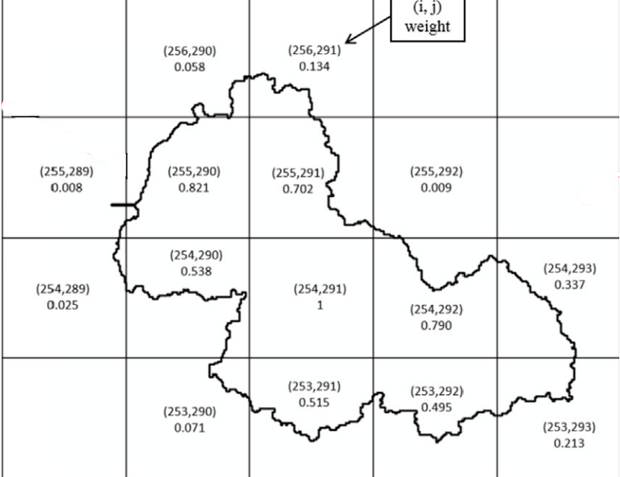
grid → vector
distribution of gridded runoff to line segments
area-weighted approach
routing
using Muskingum method
assumes constant flow throughout river segment
Area weighted approach illustration. The irregular polygon is catchment of a river segment. Values are weights. Source: Qiao et. al., 2019
Notes:
Muskingum method is a simplified form of the St. Vallant equations, which in turn is simplification of the Navier-Stokes equation

Slide 17
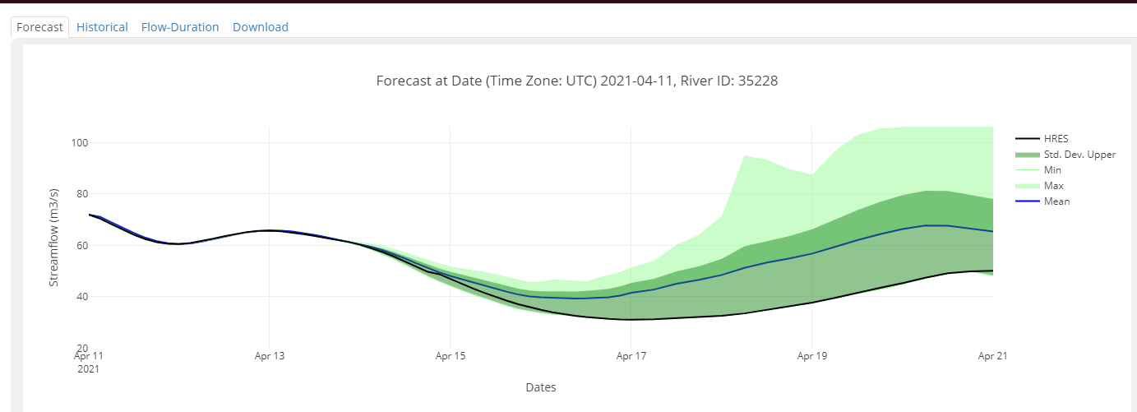
streamflow prediction tool (SPT)
Forecasts made by Brigham Young University (BYU)
Currently maintained by ICIMOD
Forecasts accessible through website
http://tethys.icimod.org/apps/streamflownepal/
Archives available starting March 2020
Notes:
Muskingum method is a simplified form of the St. Vallant equations, which in turn is simplification of the Navier-Stokes equation

Slide 18
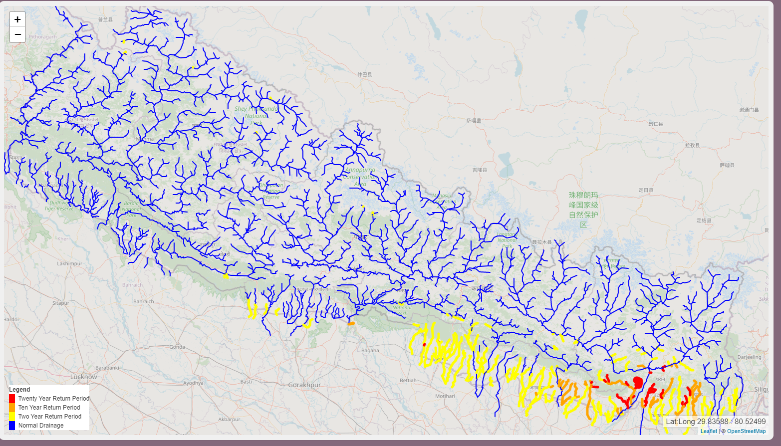
SPT coverage
Covers major stream networks in Nepal
Source: http://tethys.icimod.org/apps/streamflownepal/

Slide 19
spt forecast data
acquired data for March 2020
1 netcdf file per member per initialization date.
yet to play around with it.

Slide 20
scenarios for application
Flood damage mitigation
Monthly energy yield estimation
Pooling optimization for Peaking Run-of-River projects

Slide 21
flood damage mitigation
operational plants have safeguards
shut the plant completely during high flooding
under construction have highest risks
Evaluate if the streamflow forecast could have identified the flooding event in advance and if damage could be mitigated
Identified 1 flooding event

Slide 22
monthly energy yield estimation
Current market structure:
30 years Power Purchase Agreement (PPA)
pricing determined by fixed feed-in tariff at times of PPA
operators provide their estimated monthly yield before the month starts
penalty if they do not meet the target
Current trend:
use previous year’s flow information
Possible approach:
Would 10 day forecasts + climatology provide better results?

Slide 23
Peaking run of river (PROR)
PROR:
Run of river projects with some pooling capacity
Usually around 2-6 hours
Pool water to provide maximum production during peak hours
Pricing:
Tiered pricing for the dry season
Tiers based on number of hours the plant can run in full capacity.
Peak hours based on season and usually evening hours.

Slide 24
PROR - 2
Explain a method to use the forecasts for efficient operation of the PROR projects
Identified 2 PROR projects

Slide 25
site identification strategies
Project Capacity:
> 5 MW to narrow down selection
smaller projects are in smaller streams
some were not covered by the SPT
River origin:
Himalayas vs mid hill
River size:
Major river vs smaller segment
Precipitation trends
Winter vs summer precipitation
winter precip is predominant in the western half of the country

Slide 26
Identified projects
Kaligandaki A – 144 MW and Marsyangdi – 69 MW:
Himalayan origin major river located in central region.
Peaking ROR project
Ankhu Khola – 8 MW:
Himalayan origin smaller segment in central region
Naugad Khola – 8.5 MW:
Mid hills origin smaller segment in western region
negotiating with 2 more projects focusing in eastern region.

Slide 27
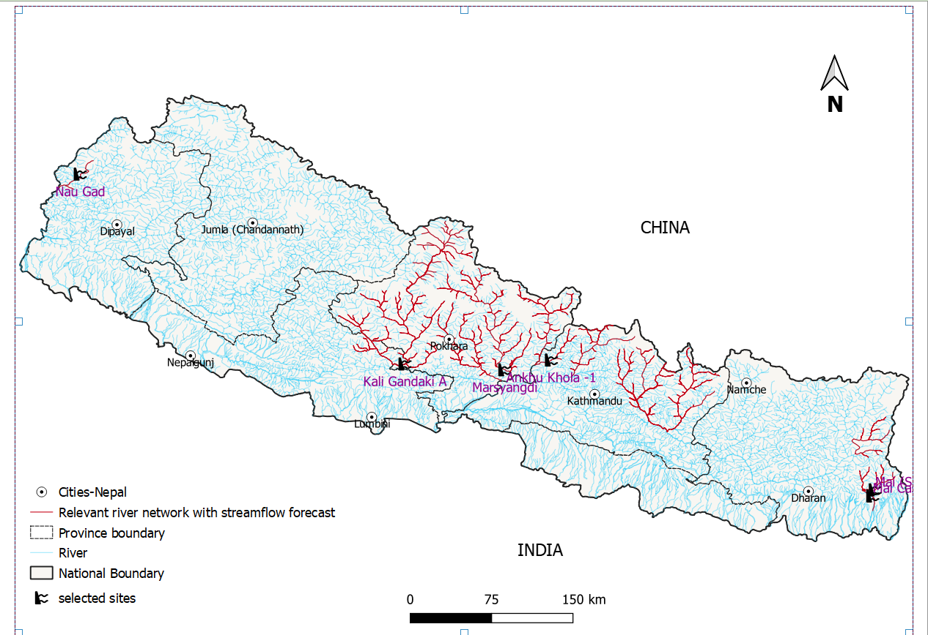

Slide 28
Future work

Slide 29
further steps – forecast data
Retrieve further forecast data
Call ICIMOD
Contact BYU for archives before 2020
Convert the forecast to probabilistic
individual ensemble members already available
Accuracy check
read through verification reports
check with river gauge readings (local met office/projects)

Slide 30
further steps – Application
Data about flood damage
Contact the projects
Extension to seasonal forecasts.
more reading needed.
optimized operation for PROR
further literature review needed.
noted a few publications on reservoir operation

Slide 31
Watershed precipitation
Notes:
I started work on it last year June. I will continue working on it because I am mainly funded through BC Hydro.

Slide 32
watershed precipitation
Watershed wide precipitation
use UBC ensemble members
currently implemented using 12 km, 4 km and 1.3 km WRF forecast outputs
Watershed selection based on IPP projects in BC
pilot project based on 3 sites:
Box Canyon
Lamont Creek
Ashlu Creek
Useful for BC Hydro to monitor the IPP possible production

Slide 33
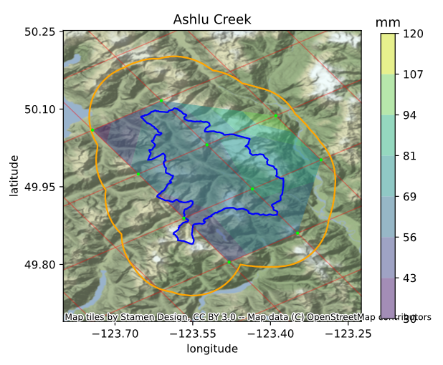
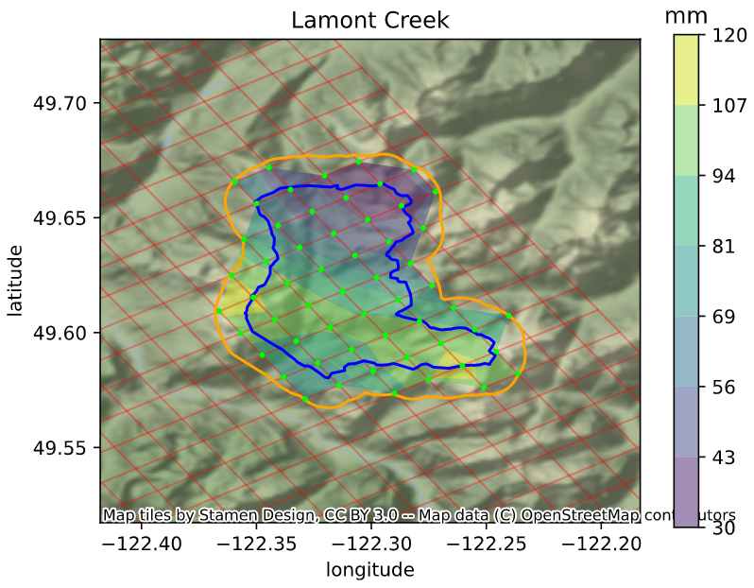
current status
used a buffer to identify the forecast points that lie within the watershed
works for a single NWP model-initial condition combination
e.g. WRF-GFS

Slide 34
FUTURE work
adapt a consistent method of identifying points within a watershed
automating the scripts

Slide 35
TIMELINE

Slide 36
suggested timeline
Name | Aimed Date | Comments
Data collection | April - May 2021 | Forecasts + hydroelectric power production
Data analysis | April – Sep 2021 | Probabilistic forecast creation + extension to monthly forecasts + accuracy tests
Further literature review | April – Aug 2021
Watershed Precip project | Sep 2021 | roughly 1 week of ~4 hr daily work.
Write thesis + remaining analysis | Fall 2021 | Already started writing bits and pieces
Complete remaining CP | Fall 2021 | Look for 1.5 CP course
Hand in thesis | Nov – Dec 2021 | 2 months time to account for feedback processes

Slide 37
questions and suggestions
Notes:
1. Talk about looking for more scholarships

