Slide 1
GloFAS - Introduction
Forecasts accessible at: https://www.globalfloods.eu/glofas-forecasting/#

Slide 2
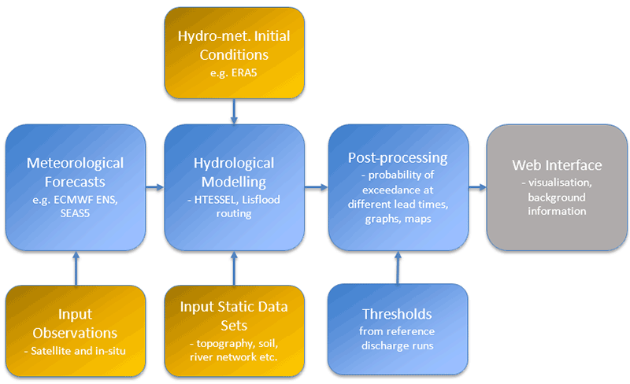
GloFAS 30 day forecast
operational since April 2018
coupled land-surface and hydrological model
meteorological ensemble created using ECMWF Integrated Forecast Systems (IFS)
hydrological models to extract runoff and another model for routing
produce 51 streamflow scenarios at 0.1 deg resolution (~ 10 km)
compare the streamflow values with flood thresholds
selected thresholds: 2 yr, 5 yr, 10 yr, 20 yr return periods
detailed evolution of streamflow forecasts provided for 2000 static reporting points
GloFAS workflow. ICIMOD streamflow forecasts use the data output from HTESSEL runs.

Slide 3
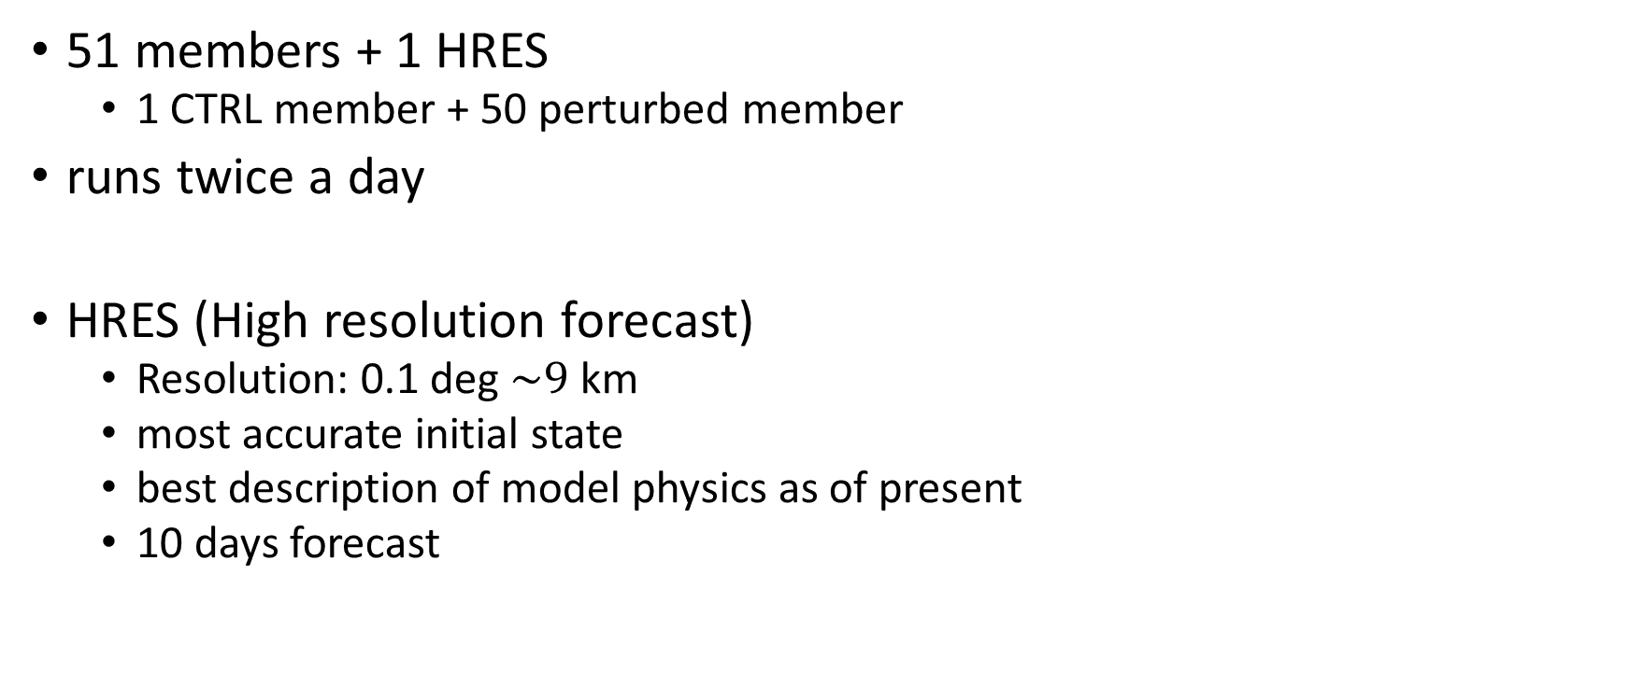
Meteorological ensemble
51 members + 1 HRES
1 CTRL member + 50 perturbed member
runs twice a day
HRES (High resolution forecast)
Resolution: 0.1 deg $\sim$9 km
most accurate initial state
best description of model physics as of present
10 days forecast

Slide 4
Meteorological Ensemble
1 CNTL (control) forecast
lower resolution than HRES
0.2 deg ~18 km
most accurate initial state and model physics (like a HRES member)
the parent unperturbed member
50 perturbed members
different initial states
different model physics
on average lower skill than HRES and CNTL

Slide 5
Initial conditions
real time hydro-meteorological observations
uses ECMWF-C3S ERA5-T reanalysis as observations until the real time observations are available.
ERA5T is the early release of the ERA5 data.
data no more than 3 months behind real time. t-3 mos.
ERA 5 is released 2-3 months later. This is different from ERA 5T if there are flaws in the original ERA 5 data.
ERA5 resolution 0.25 x 0.25
first day of the CTRL member
Notes:
Reanalysis: combination of model data (forecast outputs) with observations across the world through data assimilation
latest observation + latest forecast output = analysis
historical observations spanning longer time span + latest forecast output = reanalysis

Slide 6
Hydrological Models
Two hydrological models used:
HTESSEL
(Hydrology Tiled ECMWF Scheme for Surface Exchanges over Land)
Land surface model
Precipitaiton -> Runoff
Lisflood global
Routing model
calculates how the streamflow progresses through a river stretch.

Slide 7
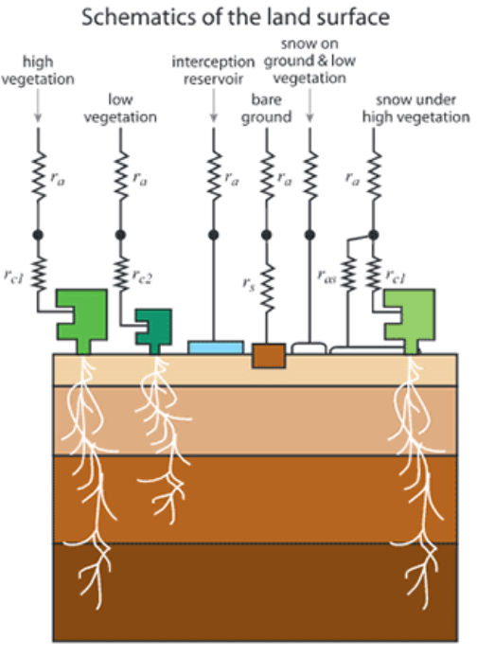
HTESSEL
A Land Surface Model
conventionally used to provide lower boundary condition while running an NWP model.
Includes:
1 layer snowpack model
4 layer soil
vegetation root uptake
Estimates surface water and energy fluxes
Estimates temporal evolution of:
soil temperature
moisture content
snowpack conditions
a part of the ensemble forecasts returns surface runoff.
Aspects covered in a Land Surface Model (LSM)
https://confluence.ecmwf.int/display/COPSRV/HTESSEL

Slide 8
Lisflood
a river routing model
runoff -> discharge
Notes:
routing: how does a runoff translate to river discharge as we follow the river path?

Slide 9
Flood Thresholds
defined through:
ECMWF-C35 ERA5 reanalysis
treated as “observed climatology”
because it is impossible to have data measured in every portion of each of the rivers
range of hydrological observational records
also used for calibration of model

