Slide 2
Progress
Need of hydro industry
streamflow > precip
Streamflow forecasting tool in Nepal
used for flood forecasting
covers rivers that have major hydro projects
Contact with projects about energy production data

Slide 3
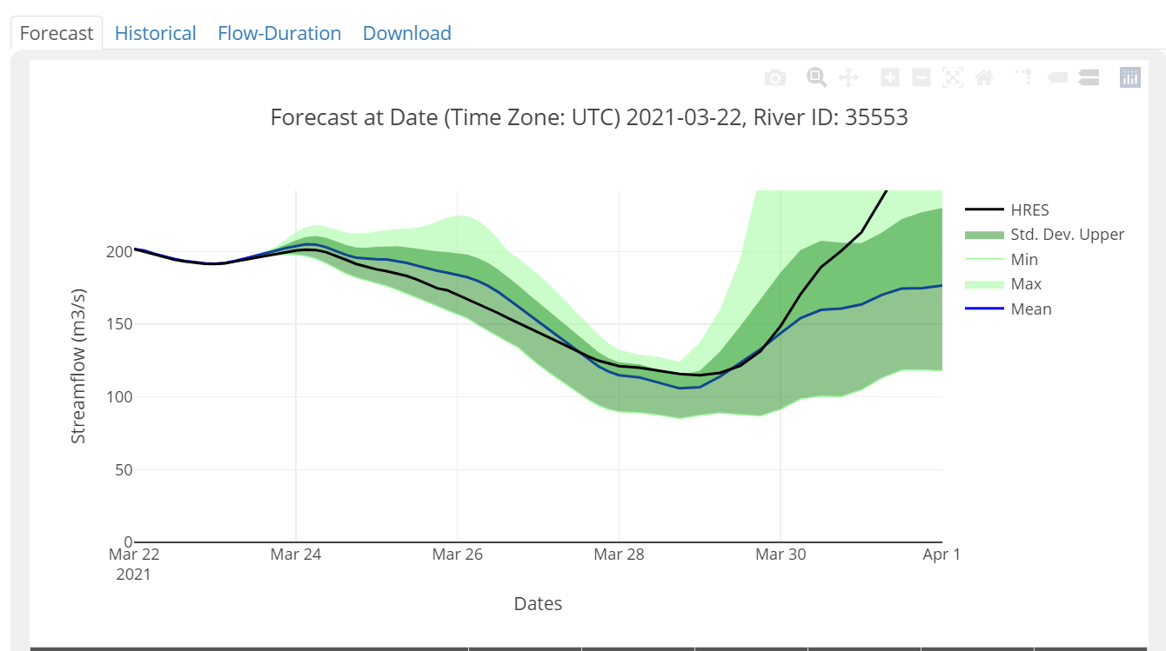
Streamflow forecast
A pilot project in multiple countries
Structure:
ECMWF precip + runoff
RAPID model for flow routing
ECMWF 30 yr reanalysis for calibration
The good:
can focus on applications of the forecast
Notes:
Learnt about the streamflow forecasting service in late December. Contacted them early Jan/Feb. Was told they are working on verification studies.

Slide 4
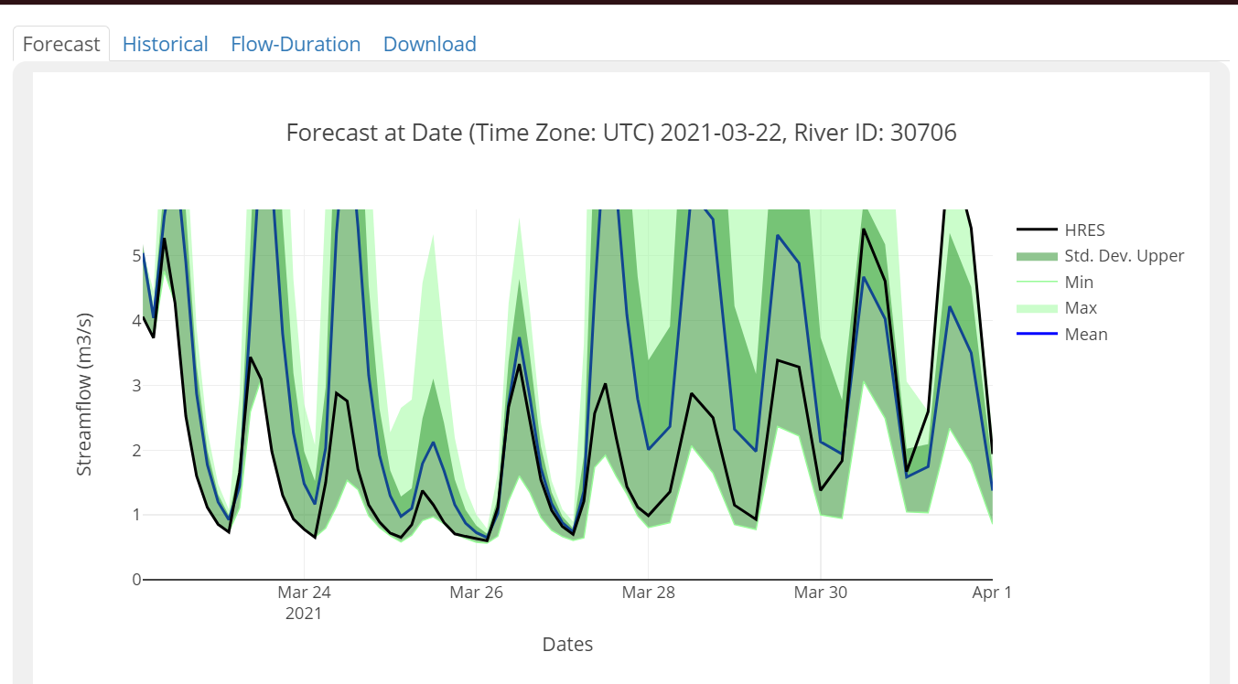
Streamflow forecast (issues)
Archive and data access
currently viewing and attempting access through ICIMOD (Nepal)
poor web interface
data downloads are sometimes not working
quality issues for higher upstream regions.
Alternative:
Get data from BYU, who initiated the service
Notes:
Backstory: BYU started it and ICIMOD used to get data from BYU’s API. I have contact information of the professor who leads the group there. I just need to contact him. I will CC you. Archive access: They mentioned that they are working on the how to give access to archives.

Slide 5
Contact with power projects
Two projects agreed to provide daily energy yield + streamflow data.
Talking with government authority on Monday about other two projects
Requirement:
A letter from the university/research team asking what data are required, and the purpose of the study.
A letter promising we won’t spill secrets.

Slide 6
Other task
Committee meeting for 2nd week of April
will send out an email today
contact BYU
extending the 10 day forecast to 30 day

