Slide 2
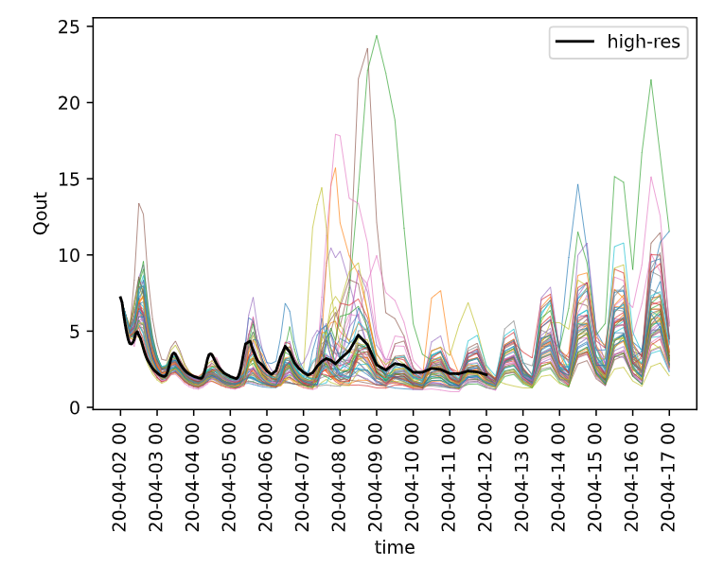
Plot showing 52 members streamflow forecast in m³/s
forecast archive
Apr 2020 -> Mar 2021
reforecast (hindcast?)
2014 to 2019

Slide 3
Questions
Bias correction is needed before creating prob. forecasts
Forecasted – observations ?
weighted bias correction
some use reanalysis data
resources to learn
Waiting for observations
preparing scripts for verifications that could be used once observations arrive
Verification
verification post bias correction

Slide 4
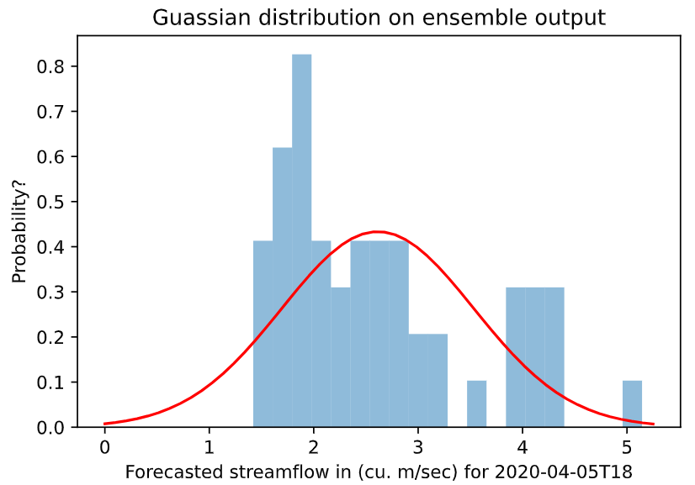
Prob. forecasts
fitting data might not make sense
all possible events are not incorporated
other choice of distributions?

Slide 5
Bayesian Model Averaging
Many literature propose it
haven’t understood how to implement
is COMPS still used in WFRT?
Meeting with Georg (BC Hydro)
50 tracers can predict 1 in 20 exceedance prob
not 1 in 50 as expected
Why?
2nd recommendation: perform bias correction on met. frcsts if possible

Slide 6
Possible access to ECMWF runoff outputs
2 reasons:
Doug’s advice: where is the error causing weight high? meteorology or routing
Georg’s advice: if the bias corrected forecasts have NS coefficient <0.7, two options:
bias correct the runoff output
rerun the routing with different parameters
contacted ECMWF and BYU
ECMWF says could waive costs based on decision by management
requires project name, description, duration, outputs and URLs
for long duration projects only?
arranged meeting with BYU grad student
ran the reforecasts

